Slide 1
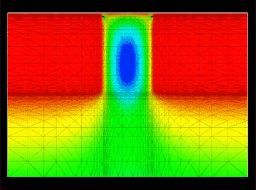
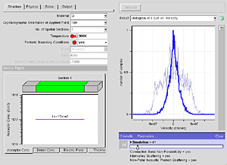







Supercharge your simulation tools with nanoHUB.org
Derrick Kearney
HUBzero® Platform for Scientific Collaboration
Purdue University
This work licensed under
Creative Commons
See license online:
by-nc-sa/3.0
Notes:
Hi, my name is Derrick Kearney, from Purdue University and I work for HUBzero and nanohub.org.
* we build websites that support science and research communities
* one of the primary goals of nanohub.org is to enable the use of simulation and modeling
A lot of times grants require that funded work be made available for the public, so people just end up putting the code up on a website.

Slide 2



Why not just downloads?
1
Source code bundles
Hello,
I'm a grad student. Your tool does not compile for me. I get errors.
Hey, can you help me?
2
Pre-compiled binaries
It doesn’t work on my machine!
New version… Reinstall
32-bit
64-bit
Notes:
Sooner or later people start sending you emails about trouble they are having downloading the source code, or compiling the source code.
Sometimes people put up pre-compiled binaries, but there are still problems related to that. You always have one or two rebels running Linux or some obscure operating system where the binaries don't work properly.
Or my favorite is when you ask someone for a copy and they change some hard coded variables, update the version number, recompile, and email it to you,

Slide 3

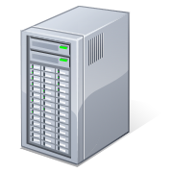
Big problems need big computers
my_super_awesome_program_to_cure_cancer.exe
Grid
Grid
100,000
Idle CPUs
Notes:
Any one run code on one of the grid infrastructures around?
Here is a common experience:
You have your super cool program that you want to run on the grid, cloud computing...

Slide 4
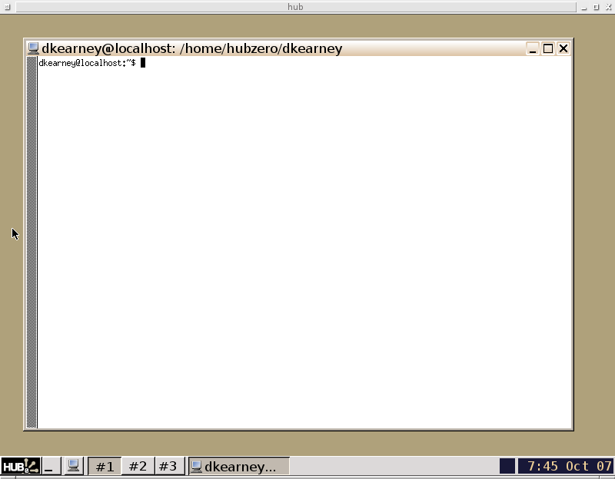
Big problems need big computers
my_super_awesome_program_to_cure_cancer.exe
$ ssh me@the-grid.com
me@the-grid.com's password:
password rejected
Error #9: Your not cool enough
Grid
Grid
100,000
Idle CPUs
Notes:
First you run into password issues because you need a certificate

Slide 5
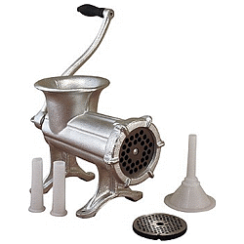
Big problems need big computers
my_super_awesome_program_to_cure_cancer.exe
$ ssh me@the-grid.com
me@the-grid.com's password:
$ make all install
Library Version Errors...
Grid
Grid
100,000
Idle CPUs
Notes:
Next you run into the usual compiling errors

Slide 6
Big problems need big computers
my_super_awesome_program_to_cure_cancer.exe
$ ssh me@the-grid.com
me@the-grid.com's password:
$ ./my_super_awesome_program_to_cure_cancer.exe \
datafile1 datafile2
Grid
Grid
100,000
Idle CPUs
Notes:
Finally you get your code to run

Slide 7
Big problems need big computers
my_super_awesome_program_to_cure_cancer.exe
$ ssh myfriend@the-grid.com
myfriend@the-grid.com's password:
password rejected
Error #9: Your friend isn't cool enough either!
Grid
Grid
100,000
Idle CPUs
Notes:
But when you try to let a friend run the code, they have trouble getting things setup.

Slide 8
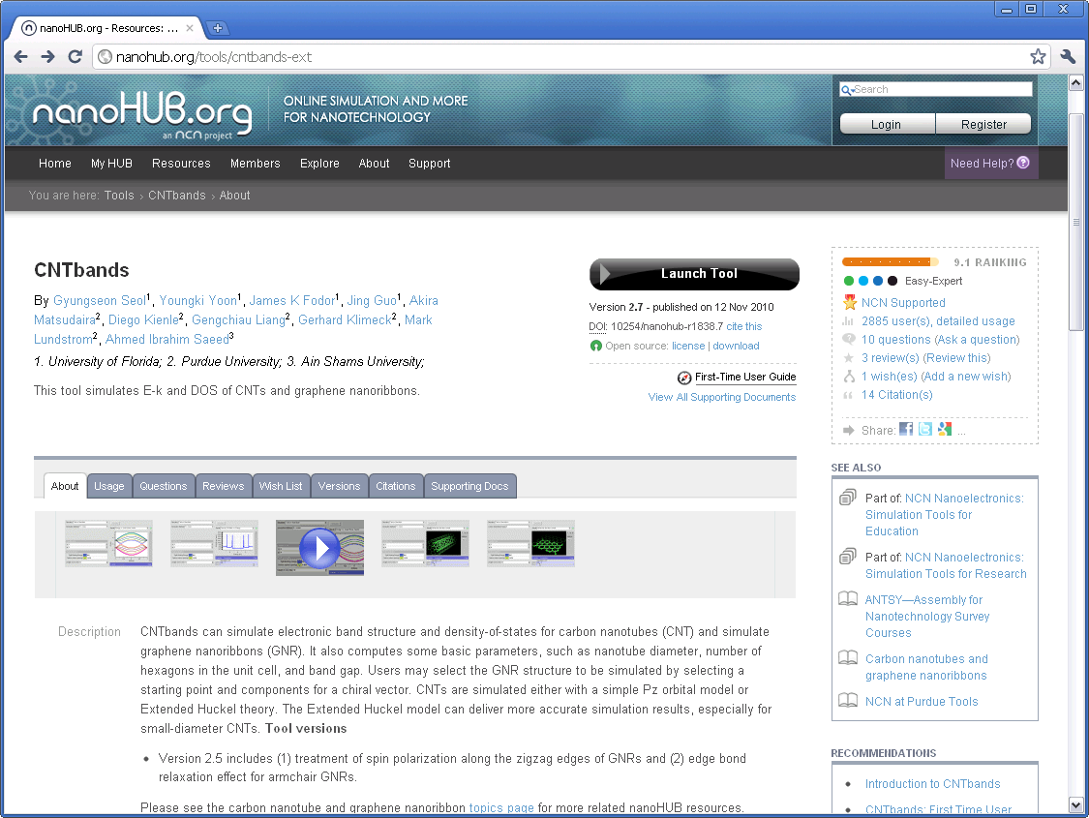
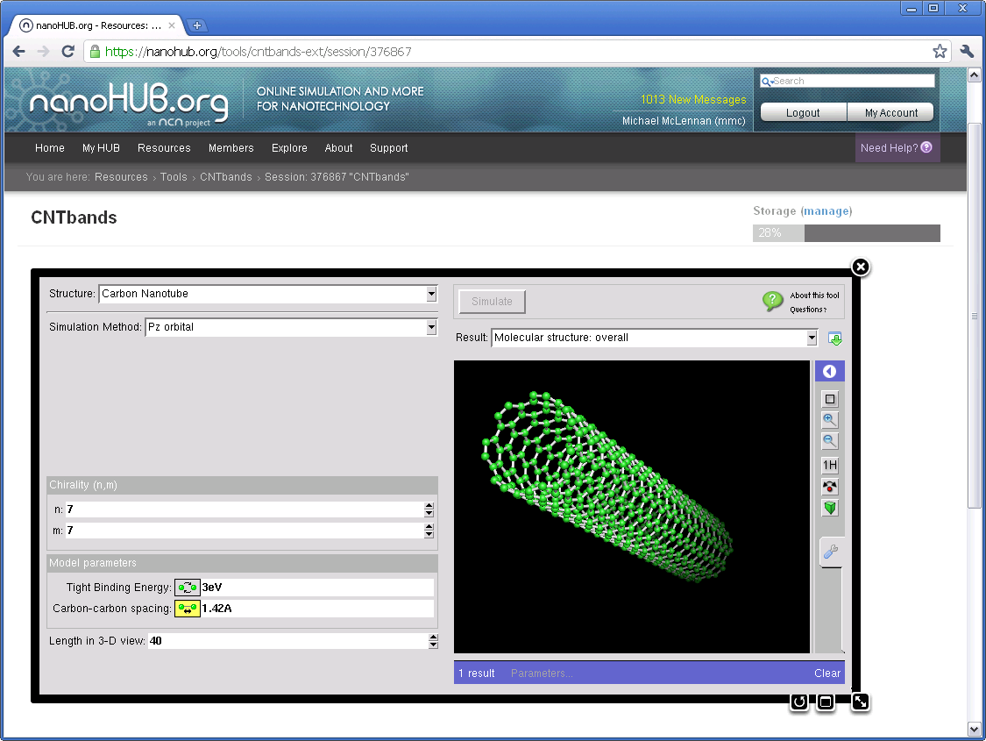
Access tools online
Notes:
Instead, you should consider installing your simulations tools on nanohub, so others can run them right in their web browser.
No downloading code
Tools with real graphical user interfaces that you can interact with from your web browser.

Slide 9
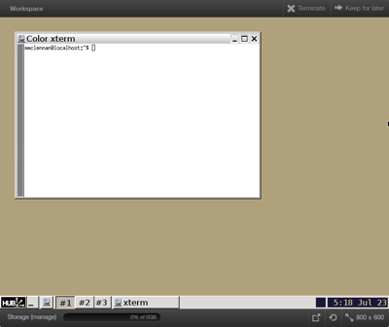
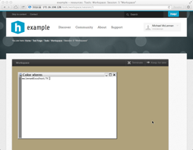


Rich Development Environments
Full-featured Linux desktop
For tool developers
For researchers
Accessible from any web browser
Still running after you close your browser
Access to computational clusters
File storage provided by the hub
local
clusters
File server
Notes:
On nanohub.org, tools run in Debian Linux 7 based development environments, called workspaces.
Same environment is available for developers to use to build, test, and deploy your software simulation tool.

Slide 10
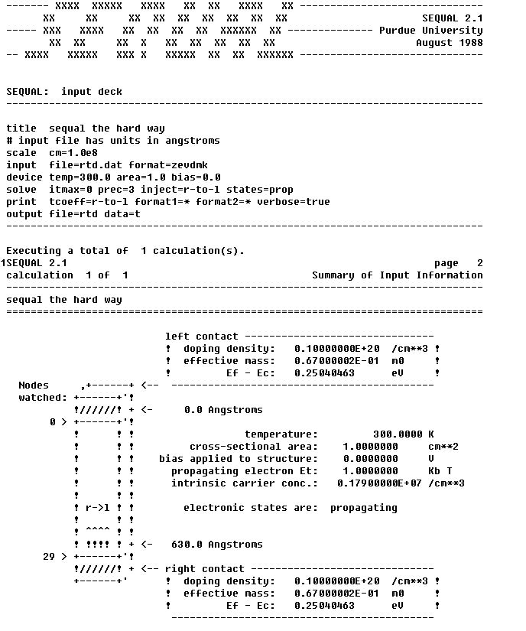
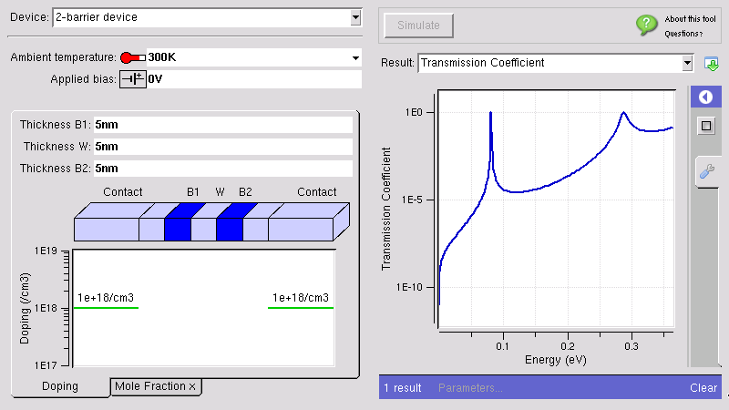








The Rappture Toolkit
inputs
outputs
Rappture
Rapid Application Infrastructure
Released in May 2005
Open Source (rappture.org)
Create standard desktop apps
Works with your favorite
programming language
Notes:
Workspaces have the Rappture Toolkit, which is a Tcl/Tk based toolkit for quickly building graphical user interfaces.
It is open source and works with your favorite programming language.

Slide 11

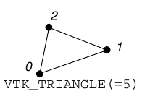
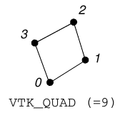

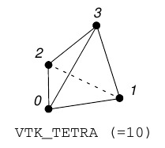
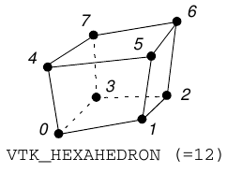
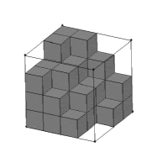
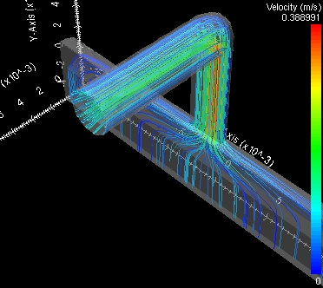
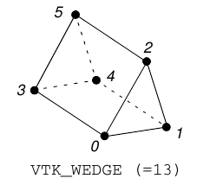
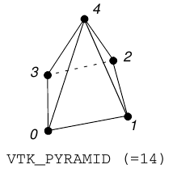
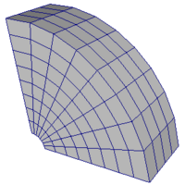
Data Visualization
fields
meshes
Isosurfaces
Streamlines
http://nanohub.org/infrastructure/rappture/wiki/rp_xml_ele_mesh
http://nanohub.org/infrastructure/rappture/wiki/rp_xml_ele_field
Notes:
The Workspaces also have access to visualization servers. Through Rappture, users can visualize the structures or results of simulations, instead of having to download the data and figure out how to load it into a data visualization tool.

Slide 12

Running locally in a Workspace
User's Workspace Terminal
HUBzero Infrastructure
$ submit --local echo hi
Tool Session
Containers
Submit
Proxy
Grid
Grid
Grid
Grid
Grid
Grid
Notes:
Tools also have the ability to run locally, in the workspace (for smaller tools)...

Slide 13
Submitting from a Workspace
User's Workspace Terminal
HUBzero Infrastructure
$ submit echo hi
Tool Session
Containers
Submit
Proxy
Grid
Grid
Grid
Grid
Grid
Grid
Notes:
Or send jobs off to the grid to be run on one of the super computers nanoHUB is connected to including Open Science Grid, Diagrid, and XCEDE resources.

Slide 14
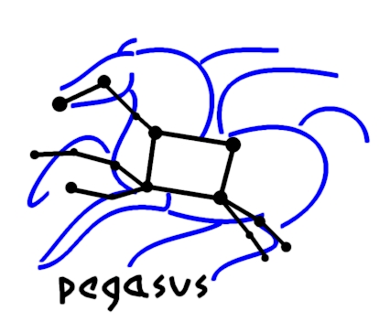
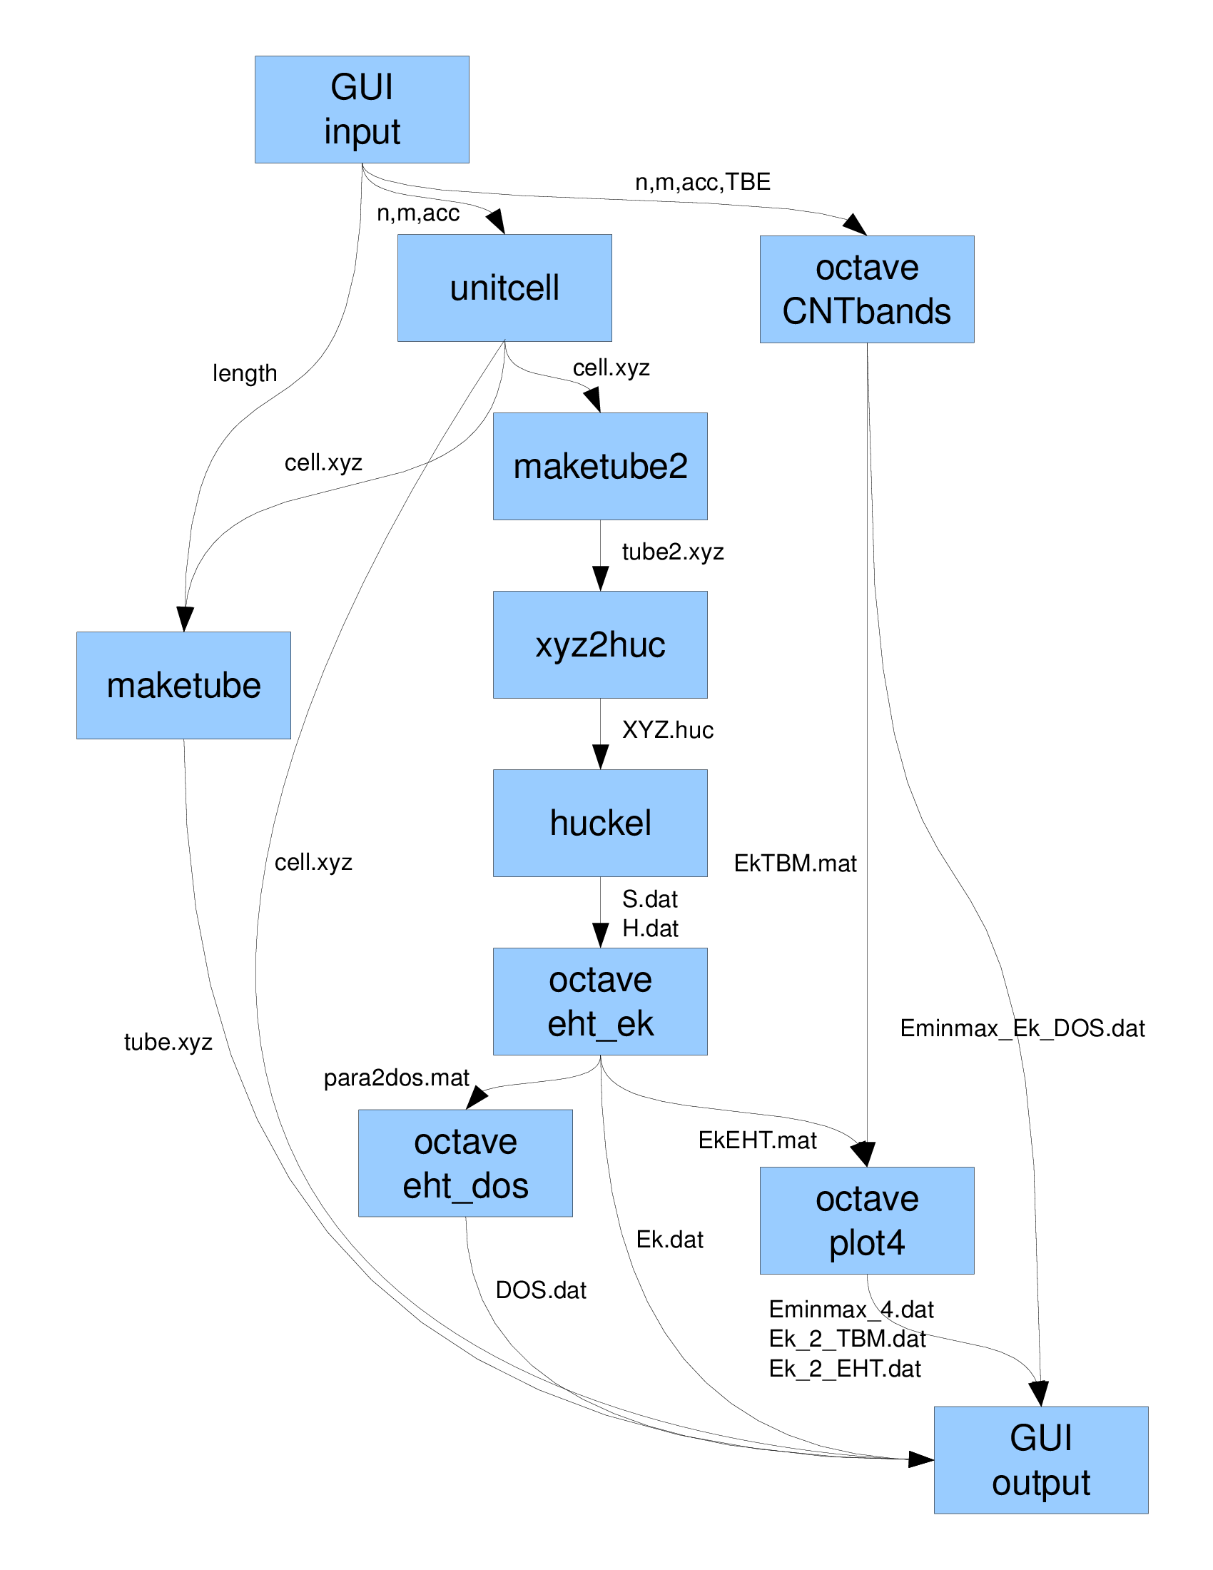
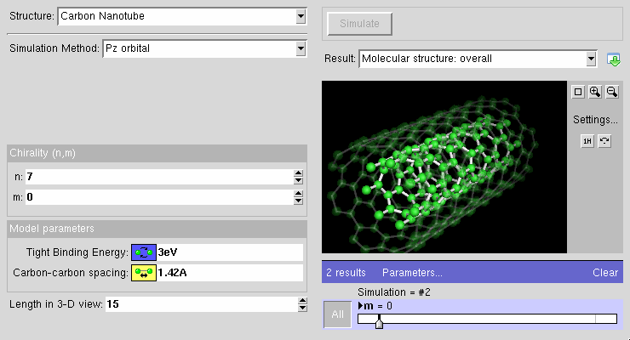
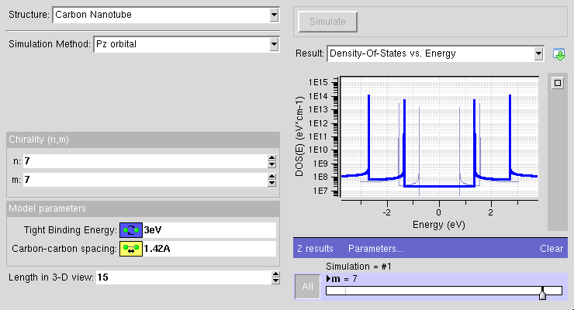
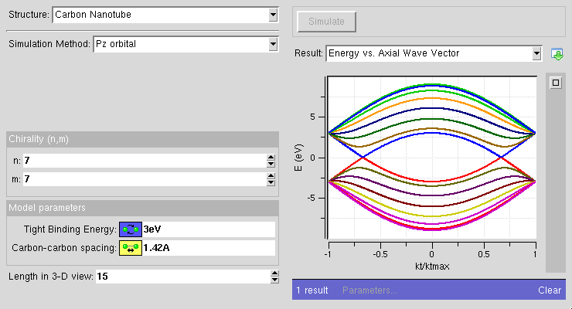
Pegasus Workflows
Ewa Deelman et al.
Developed at USC
Open Source
(pegasus.isi.edu)
Language bindings for:
Notes:
You can also build workflows using Pegasus. With workflows, you can chain together a bunch of smaller tools to make a larger tool. Pegasus was developed by Ewa Deelman's team out at USC.
Performance
Portability
Provenance
Data Management
Error Recovery
We can run pegasus jobs on the grid

Slide 15
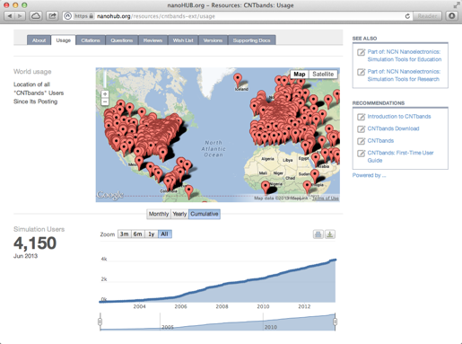
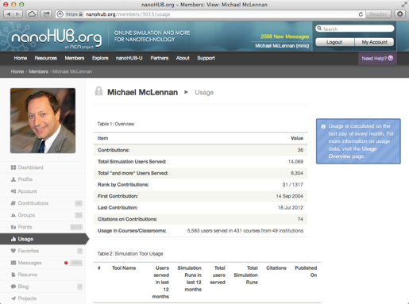
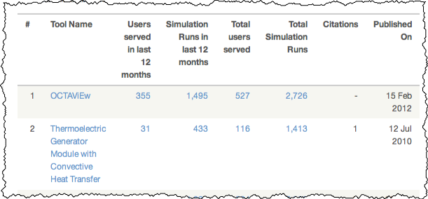
Your Own Impact Story
Contributor impact
Resource usage metrics
Notes:
Probably the best reason to deploy your code on nanohub.org is because you can build your own impact story.
This is a case where having the data really does make a difference. Users have access to the usage metrics of resources available on the website. These metrics tell the real story. This is the kind of information you want to put in a site visit report or grant proposal to show that the work you are doing is making real impact on the science.

Slide 16
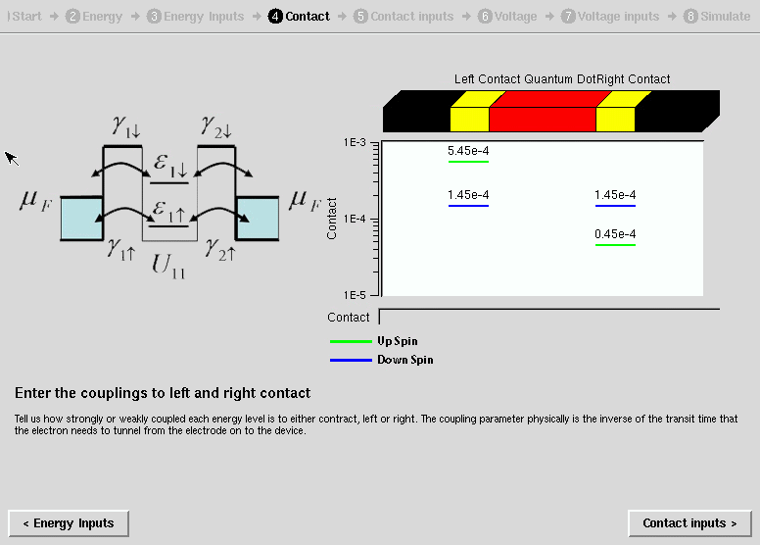

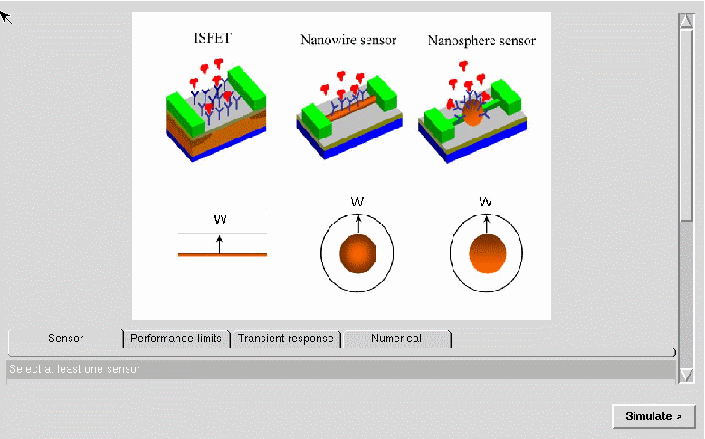
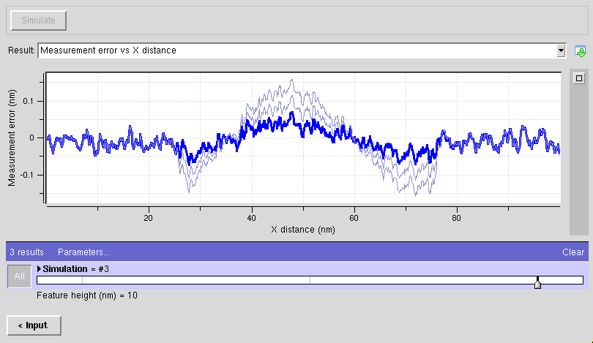
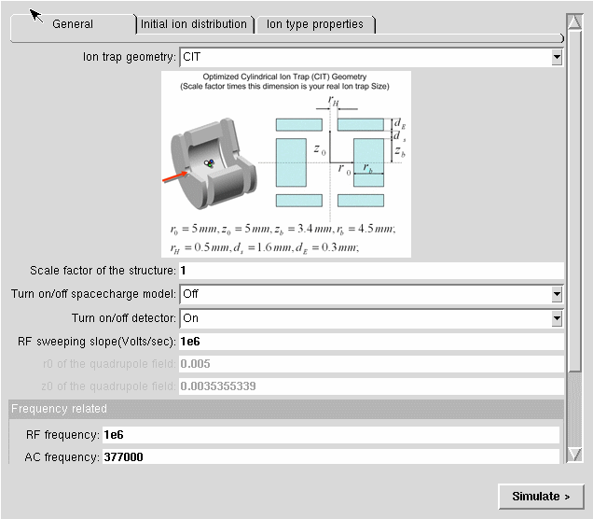
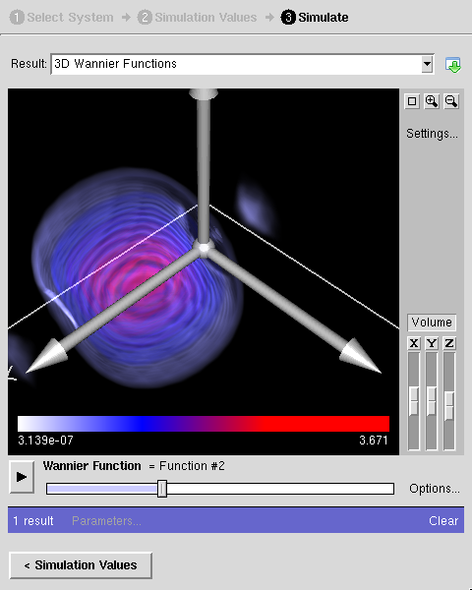
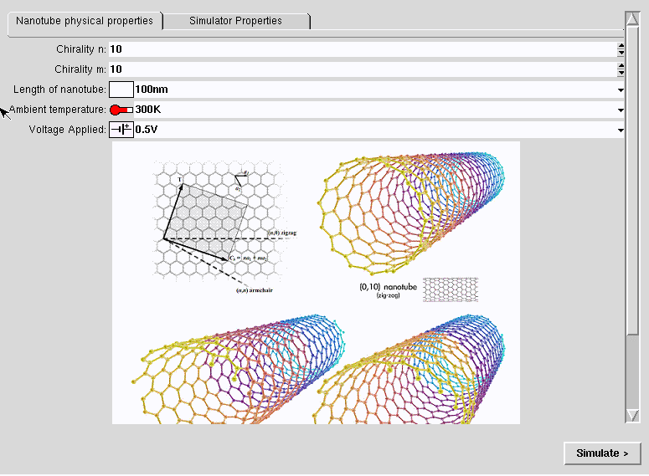
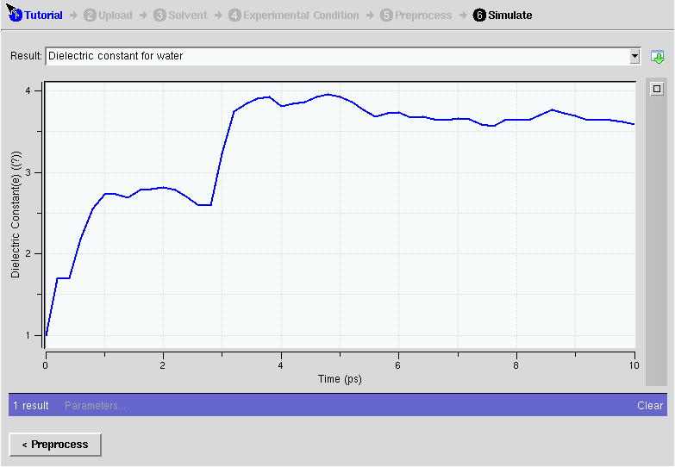
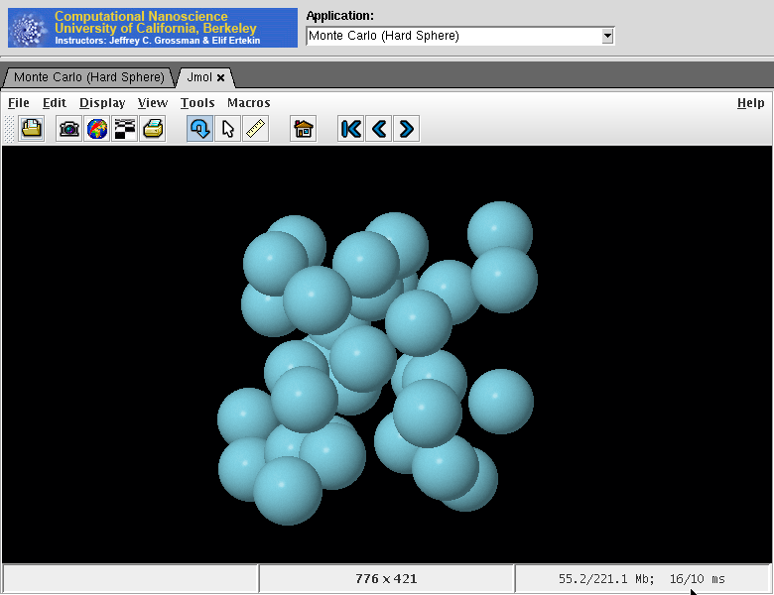
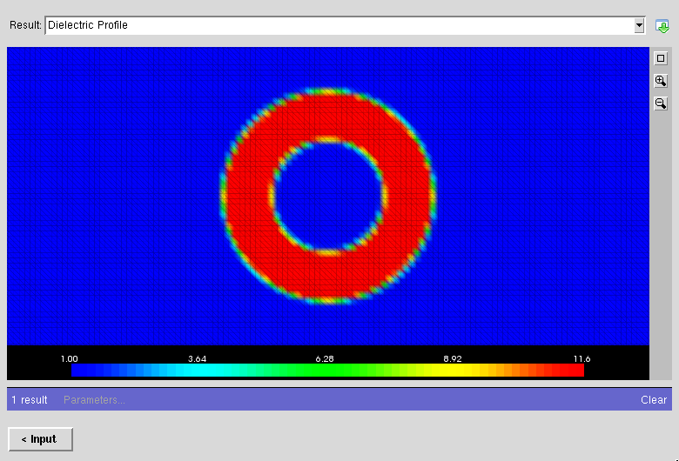
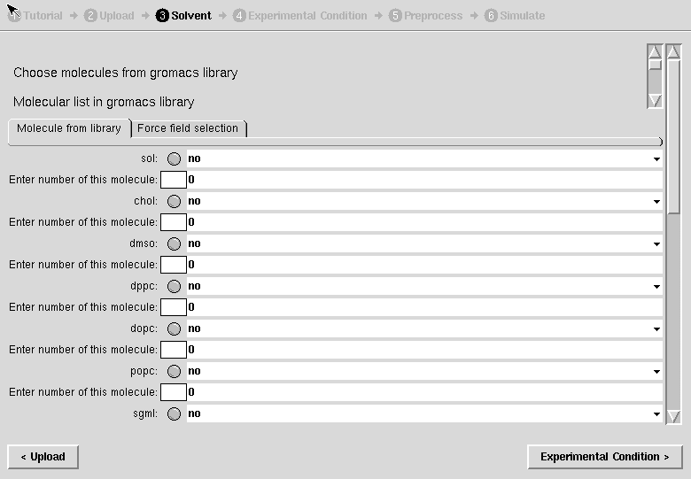
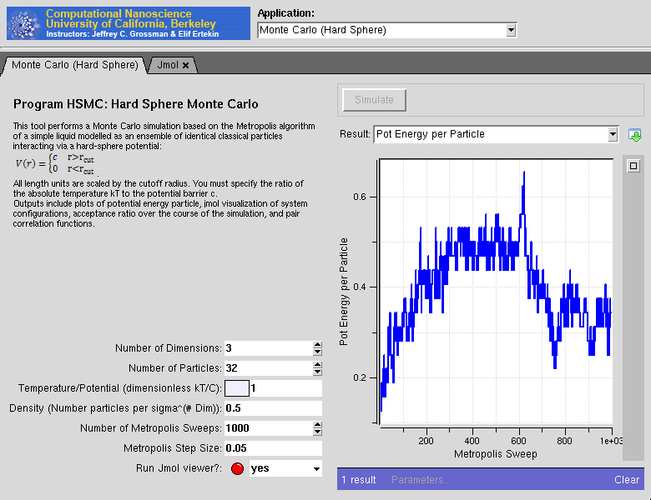
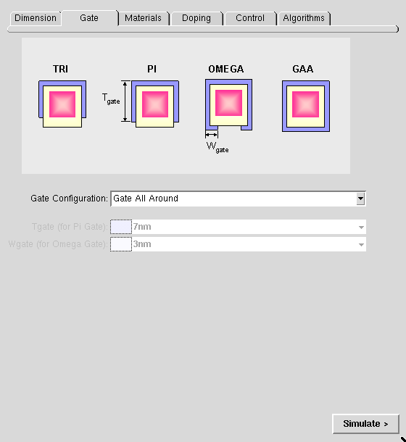
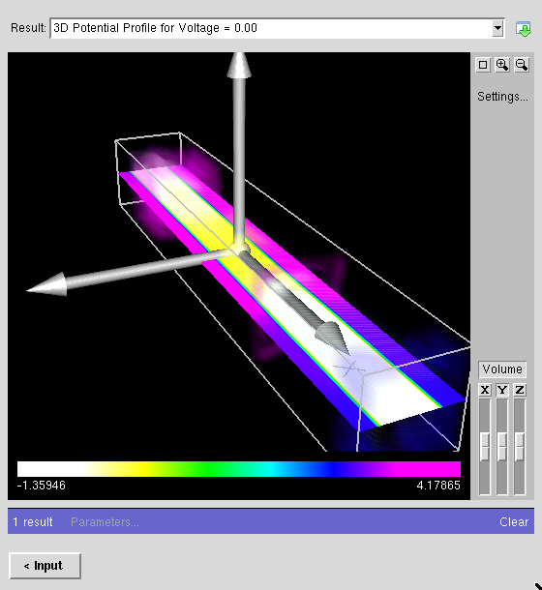
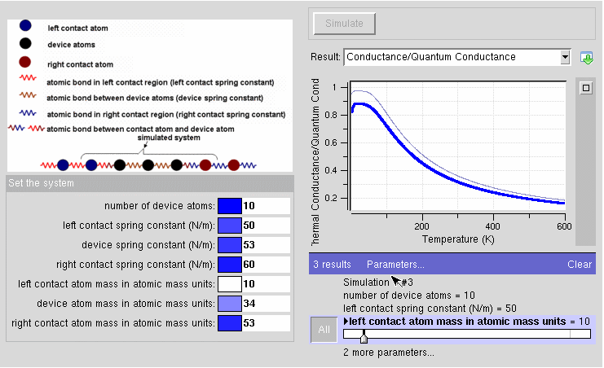
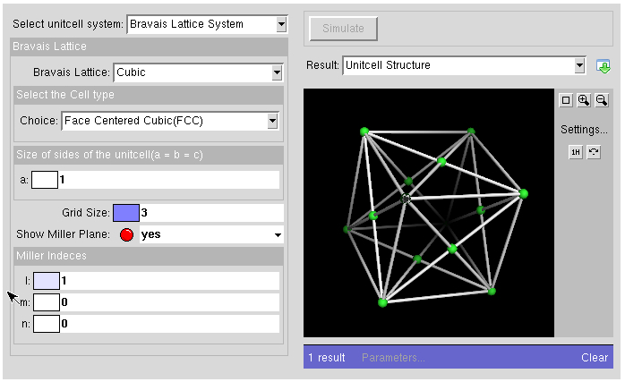
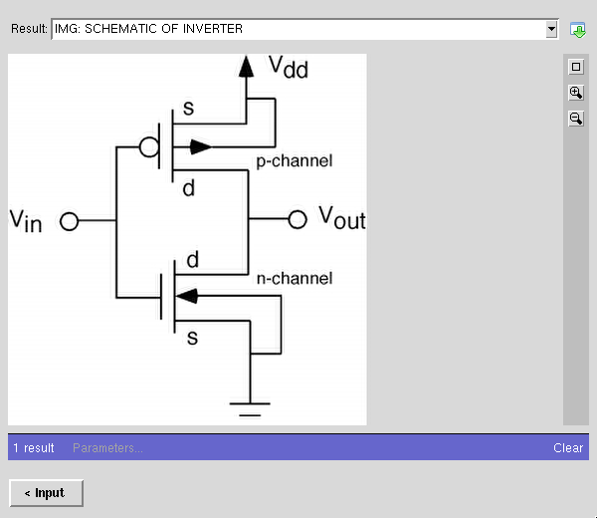
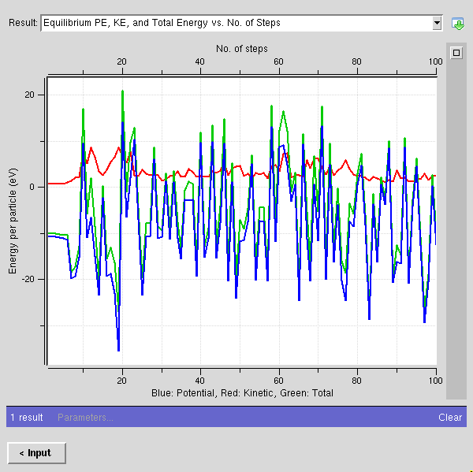
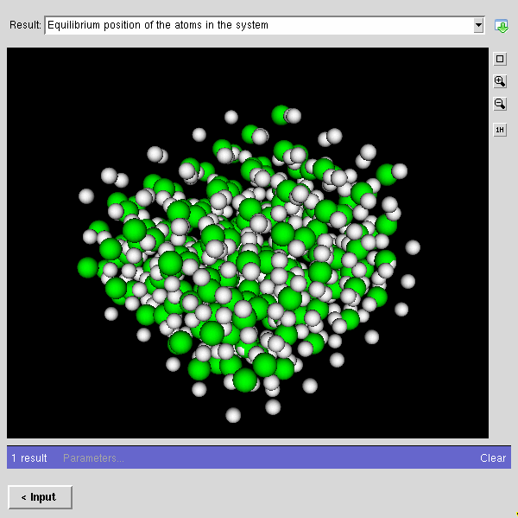
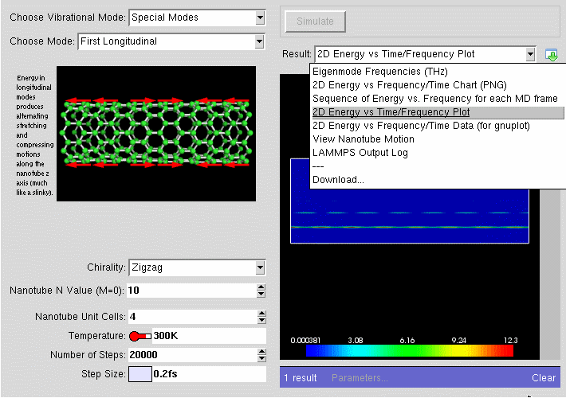
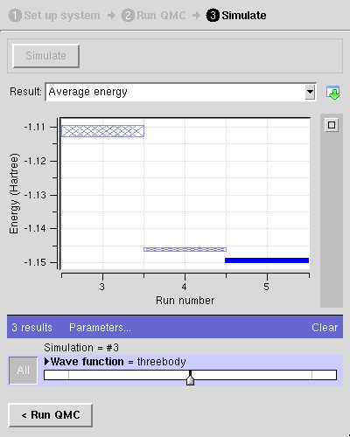
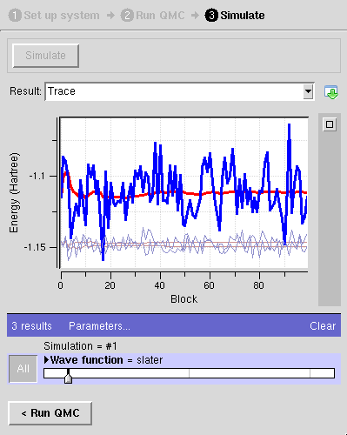
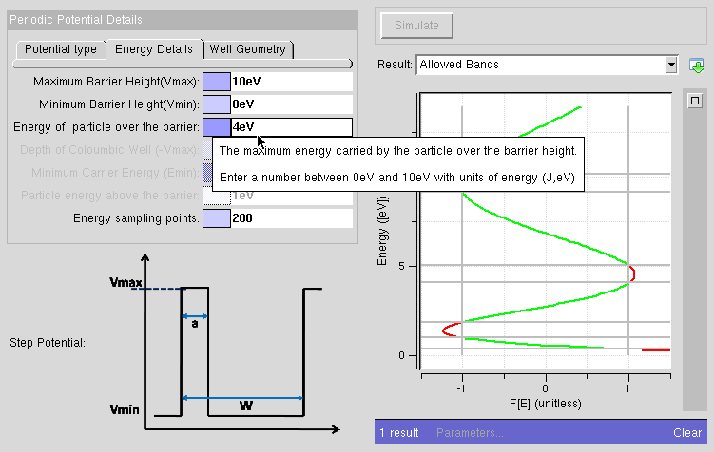



















Used to deploy hundreds of tools
Notes:
Nanohub.org has over 300 tools published for people to use for free. And adding your code is easy!

Slide 17



Start the upload process
Notes:
To get started, the first step is to click on the upload link on nanohub.org and choose the “Get Started” link

Slide 18


Tool registration form
alpha123
Nice Tool Name
1.2.3a
It does this…
Who can run it
Who can access code
Who can access wiki
Team members
Notes:
Next, from the list of resources that you can upload, choose Simulation Tool.
To setup an area on the website for your simulation tool, we need a little information. You'll be presented with a web form to fill out with some basic information about the tool.

Slide 19

Tool development process
waiting for…
User
Hub managers
https://yourhub.org/tools
Contribution form
Registered
Created
Uploaded
Installed
Updated
Hub managers create a project area for your tool
Wiki for project documentaton
Subversion source code control
Code change history
Approved
Published
Retired
Notes:
From there, the development process starts. It is kind of like a tennis match in that there are things you need to do, and things our team needs to do.
By filling out the form, you are registering the tool on the website. After the tool has been registered, we will create a subversion source code repository an wiki area.

Slide 20


Your project area
Buttons to access project functions:
Wiki documentation
Source code
Timeline of changes
NOTE: You may have to log in to see some buttons
Notes:
The Wiki area is integrated with the source code repository, so when new code gets added, or updated, you can see what changed. One of my favorite features is the timeline, because it quickly updates me on what has been going on, what files have been changed.
If you made your project area closed, you may have to login.

Slide 21


What’s happening?
Notes:
After we create the source code repository and wiki area, we will change the status of the tool to “Created”. You can see the status of the tool from the user dashboard, after you login to the website.
If you click on the tool name link,

Slide 22


Know where you stand
Notes:
It will take you to the tool status page, which lets you know where your tool stands in the process. It tells you if we are waiting on you, or if you are waiting on us to do something. It also gives you a list of things that still need to be done before the tool can be published on the website for others to use.

Slide 23


Edit your tool information page
This is the page that people see when they find your tool on the hub
Notes:
One of those things is creating the Tool information page, which is the web page that introduces the tool to users. It lists information like who developed the tool, who funded the development, and how to cite the tool in papers.

Slide 24
Edit your tool settings
Notes:
The tool status page also allows you to edit some of the details of your tool

Slide 25



Edit your tool settings
Notes:
For example, you can add new members to the development team so others can contribute code. And you can adjust the access restrictions on your source code
We try to promote open source software, so

Slide 26


Putting out Open Source
/*
* =====================================
* AUTHOR: Michael McLennan
* Copyright (c) 2011 Purdue University
*
* See the file "license.terms" for information on
* usage and redistribution of this file, and for a
* DISCLAIMER OF ALL WARRANTIES.
* =====================================
*/
…
www.opensource.org
your code
license.terms
Notes:
If you do decide to make your project open source, it is a pretty simple process. At the top of all of your source files, you include a few lines stating your name and organization, and then list a file with your license terms.
You can get a number of open source licenses from opensource.org.
Include the license in with your code
And when you go to publish your tool, the license and source code will be available to others to download.

Slide 27

Uploading your code
waiting for…
User
Hub managers
Contribution form
Registered
Created
Uploaded
Upload your code into a hub workspace. Compile, test, and commit changes back to your Subversion repository.
Installed
Updated
Approved
Published
Retired
Notes:
The next step is to upload your code. Your code needs to be uploaded into your tool's subversion source code repository.
Inside of the workspace, you can checkout a local copy of the subversion source code repository, then add your code, and commit the changes back to your repository server.

Slide 28

Uploading your code
waiting for…
User
Hub managers
Contribution form
Tool status page:
http://yourhub.org/contribtool
Registered
Created
Uploaded
Installed
Updated
Approved
Published
Retired
Notes:
Once you have your code uploaded, you click the link on the tool status page stating “my code has been uploaded”.

Slide 29


Testing your tool
waiting for…
User
Hub managers
Contribution form
Registered
Created
Uploaded
Installed
Updated
Approved
Published
Retired
Notes:
That alerts our team that the tool is ready to be installed on the system for you to test out. We'll install the code, and from there, you will be able to click the “Launch Tool” button on the tool status page to start up a testing version of the tool and see what it will look like once it has been published.

Slide 30
Testing your tool
waiting for…
User
Hub managers
Contribution form
Registered
Created
Uploaded
Installed
Updated
Approved
Published
Retired
Notes:
If you have further updates to make, you can make your fixes, then click the link that asks us to install the newest version
The process usually takes a few iterations to get the tool working properly,

Slide 31

Need help?
waiting for…
User
Hub managers
Contribution form
Registered
Don’t send email!
Created
Uploaded
I need help!
Installed
Updated
Approved
Published
Retired
Notes:
And if you have questions,
Dont send us email!

Slide 32


Use the web interface to communicate
Message goes
to the whole team,
and is stored in
the history
Notes:
Instead, use the messaging box on the tool status page. That way the email doesnt get lost and the question can get answered sooner if someone is out of town, or someone else knows the answer.
Plus we can keep the history of problem so others know what is going on.

Slide 33

Testing your tool—again
waiting for…
User
Hub managers
Contribution form
Registered
Created
Uploaded
Installed
Updated
Approved
Published
Retired
Notes:
Once you have your tool working properly in the installed state, push the link saying that you approve the tool.

Slide 34

Last step…
waiting for…
User
Hub managers
Contribution form
Registered
Created
Uploaded
Installed
Updated
Approved
Hub managers…
Take one last look
Make sure that the tool works
Check the tool information page
Then, publish your tool
Published
Retired
Notes:
We'll take one more look to make sure things are setup properly. Then push the button to publish the tool, making it available to all users of nanohub.org.

Slide 35



Your tool is published
waiting for…
User
Hub managers
Contribution form
Registered
Created
Uploaded
Installed
Updated
If you want to make changes…
Approved
Published
Retired
Notes:
Once the tool has been published, it will show up on the front page, listed as a new resource
And if you want to update it, or put out a new version, its easy, just go back to the workspace, develop new code, upload it to the repository, and click the link to have it installed again

Slide 36
Updating your tool
waiting for…
User
Hub managers
Contribution form
Registered
Created
Uploaded
Installed
Updated
Re-install your tool
You approve it
One last look
Your changes are published
Approved
Published
Retired

Slide 37

Become a Contributor
Don’t let your code gather dust on the shelf.
Get it out there!
Upload your own:
Tools
Tutorials
Promote your work by uploading/sharing
Notes:
So if you have simulation tools that you have built, I encourage you to upload it to nanohub, and start sharing it with others.
You'll be amazed at how many other people will find your work useful.

