Slide 1
Selenium Webdriver Primer
Spensa Technologies, Inc
Sept. 22, 2016
Derrick Kearney github.com/codedsk telldsk@gmail.com

Slide 2
Testing vs Checking
Testing is...
Checking is...
* Exploring & Learning
* Experimenting
* Judgement & Values
* Answers the question
“Is there a problem?”
* Confirming
* Pass / Fail
* “It Works” vs “It Operates”
Notes:
There is an ongoing conversation within Testing communities that questions whether testing can be automated. Some people say that testing cannot be automated, but checking can. And that the automation scripts people write and call tests are really just checks.
As you are exploring, you may see these terms being used. It took me a while to understand the difference. Here is what I think is going on.
When people talk about Testing, they say it is the use of tools to gain knowledge about how the system works. It involves exploring and learning. They say you can't automate testing because testing involves having values and using judgement to decide what should happen next. It answers the question “Is there a problem?”
Checking on the other hand is comparing one value with another and confirming that they are the same. It is a pass / fail operation, either the values are the same or not. This comparison can be automated. Checking can't tell us if something works, but it can tell us if something operates within the scope of our expectations (Michael Bolton, developsense.com)

Slide 3
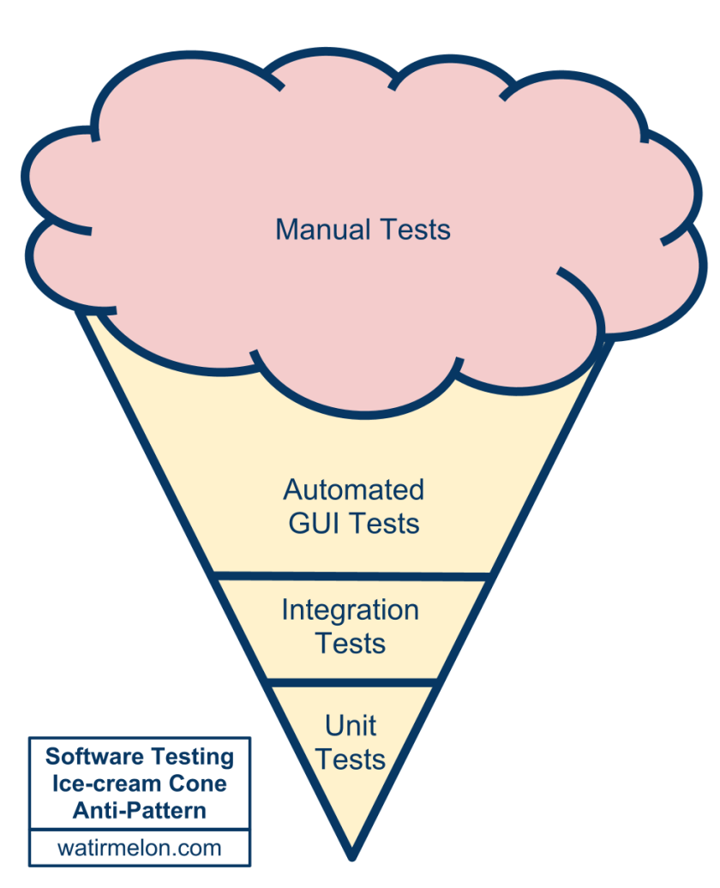
Typical Testing Pyramid
}
Too many GUI & Manual Tests
}
Very few Unit &
Integration Tests
Ideal Automated Testing Pyramid & Ice-cream Cone Antipattern - http://watirmelon.com/2012/01/31/introducing-the-software-testing-ice-cream-cone/
Notes:
Another thing you may run into is the Testing Pyramid. It is important to consider what kind of testing you want to be doing and how much time, effort, or resources you want to spend at each level.
There are always things to test. This pattern gives us an idea of the resource allocation that seems to have worked for other people.
The testing pyramid splits resources in checking the business logic, which include the graphical user interface and public facing api, and checking the technology logic, which includes your core functions and libraries that get called by the business logic.
Here, we see the dreaded Ice-cream Cone Antipattern.
A lot of resources are focused on building automated checks for the graphical user interface and manually testing the business level, while too few resources are allocated toward making sure the technology layer works.
In the end, organizations may find themselves spending more time trying to debug problems in the technology layer that manifest themselves in the business layer. This can be avoided by making sure the technology layer works in the first place.

Slide 4
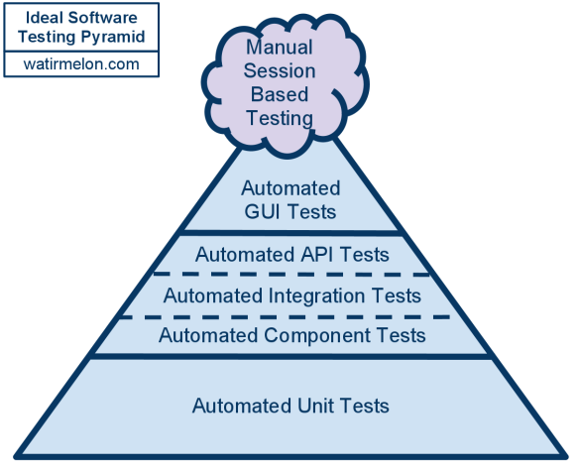
Ideal Testing Pyramid
} User Interface Tests
} Service Layer Tests
} Unit Tests
Ideal Automated Testing Pyramid & Ice-cream Cone Antipattern - http://watirmelon.com/2012/01/31/introducing-the-software-testing-ice-cream-cone/
Notes:
Ideally, your organization's testing pyramid would look like this.
Right away we notice that the bottom layer of the Pyramid, the most broad layer and the largest by area, is unit testing, followed slightly above it by component and integration testing. These show that you should spend the majority of your testing effort building a broad base of unit and component tests that check that the pieces of your program operate as you expect them to. This follows along with the pieces of your software you expect to use the most. Many of the hard errors you'll find are going to be deep in the software and these functions will be used the most, in the technology layer.
Above the unit and component tests are what are called the business facing tests. The business layer portion of the pyramid is smaller. The idea is that if you do the legwork of making sure the lowest level pieces of your software work properly, you don't need to spend as many resources checking if the pieces above work properly because you are not rechecking the technology level software in the business level.

Slide 5
Ideal Testing Pyramid
} User Interface Tests
} Service Layer Tests
} Unit Tests
Ideal Automated Testing Pyramid & Ice-cream Cone Antipattern - http://watirmelon.com/2012/01/31/introducing-the-software-testing-ice-cream-cone/
Notes:
Today we are going to be focusing on building tests for the business layer and in particular, the graphical user interface.
There are many tools that are available to perform testing at the graphical user interface level and they usually fall within two categories.

Slide 6
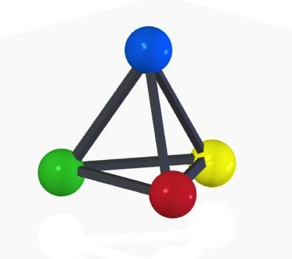

Automated Testing Tools
Web Crawlers
Pros:
- Little Developer Coordination
- Semi directed exploration
- Web App is a black box
Cons:
- Time consuming to run
- No authority to judge results
CrawlJax
IBM AppScan
Notes:
The first category of tools are web crawlers. These include tools like Crawljax and IBM AppScan. Web Crawlers need little developer coordination. This allows people to quickly get started running the programs.
Because these tools are crawling a website, they can get into a bit of trouble navigating to places they shouldn't be. These tools usually allow the user to set a blacklist of urls not to visit.
The best thing is that they treat the web application as a black box. The user doesn't have to do much work to get them up and running. Unfortunately, because they need to traverse and exhaust the whole website graph, they can take a really long time to run. Additionally there is no authority to tell if a behavior that is experienced while navigating it correct or incorrect for the web application.

Slide 7



Automated Testing Tools
Test Recorders
Pros:
- Very customizable
- Produces specific targeted tests
- Programmable in a script
Cons:
- Time consuming to build tests
- Allows for brittle test designs
Selenium
QuickTest Pro
Sahi Pro
Notes:
On the other hand there are other tools that fall into the category of test recorders. These include applications like Selenium Webdriver, QuickTest Pro, and Sahi Pro. Test recorders allow the user to provide explicit web application navigation based on actions that were previously recorded. This makes them very customizable and able to produce targeted tests. With some, you can incorporate them in a script.

Slide 8
Automated Testing Tools
Test Recorders
Developed By Jason Huggins and Simon Stewart at ThoughtWorks
Browser vendor support through W3C spec
Automation written in “your favorite language”...
Worldwide support Community
Selenium
QuickTest Pro
Sahi Pro
Notes:
Of these tools, I only have experience with Selenium Webdriver and that is the one we will be talking about today.
It was developed by Jason Huggins and later combined with another tool by Simon Stewart at ThoughtWorks.
It works with many of the major browsers by using the browser's own internal automation. There is a team of people working on a W3C specification, that includes browser vendors. Once that is completed it will help standardize the protocols and capabilities that some vendors may provide that others do not.
Selenium officially supports a hand full of programming languages like Python, Java, C#, and Ruby. Other language bindings are provided by 3rd parties.
There is a huge community to provide support for the library. They hold conferences around the world, there are mailing lists and google hangouts, and the documentation is pretty good now.

Slide 9
Automated Testing Tools
Test Recorders
What can it do?
Open web browser
Locate elements on page
Type in or click elements
Wait for triggered events
Simulate moving the mouse
Selenium
QuickTest Pro
Sahi Pro
Notes:
Most of the stuff you'll end up doing with Selenium will be pretty simple. Much of the automation will be Opening a web browser, navigating to a URL, locating an element on the web page, interacting with the element by typing into it or clicking it or reading it, waiting for an event to be triggered, or moving the mouse over objects and evaluating the result.

Slide 10
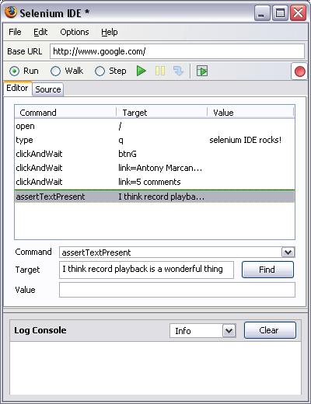
A brief word about Selenium IDE...
What can it do?
Record actions, replay as tests
Works in Firefox only
Selenium 1.0 style tests
Tests can be brittle
Try it out, then move on
Notes:
Let me take some time here to mention Selenium IDE. So far I've been talking about Selenium WebDriver, otherwise known as Selenium 2.0.
A long time ago there was a Selenium 1.0. People don't speak about it now a days unless they have to. It worked by running a little server in the background and your script would send JSON command to the server, and the server would then talk to the browser. I think this caused some problems like CSRF. But now there is version 2.0 (and soon version 3.0?)
Newer versions of the Selenium binaries have been backwards compatible but I think I heard that will be ending with the newest releases. Selenium 1.0 is dying. So if you are getting started with it, try it out, get to understand how to locate element on the webpage, but then move on to using WebDriver.

Slide 11
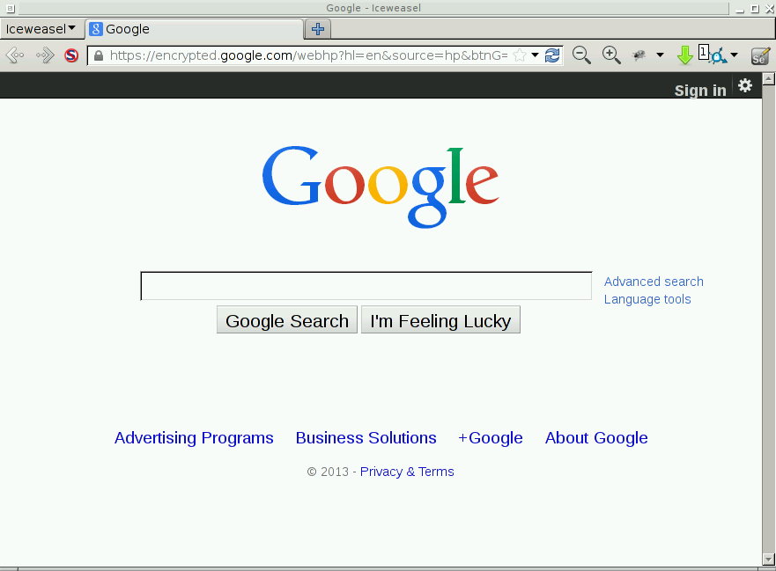

How Selenium Works
script.py
Notes:
The general way Selenium works is that you write a script or a program that interacts with the Selenium library, and that launches a web browser that has an open port listening for automation commands. Automation commands are accepted by the browser, the browser performs actions and then sends some results back to your program.

Slide 12
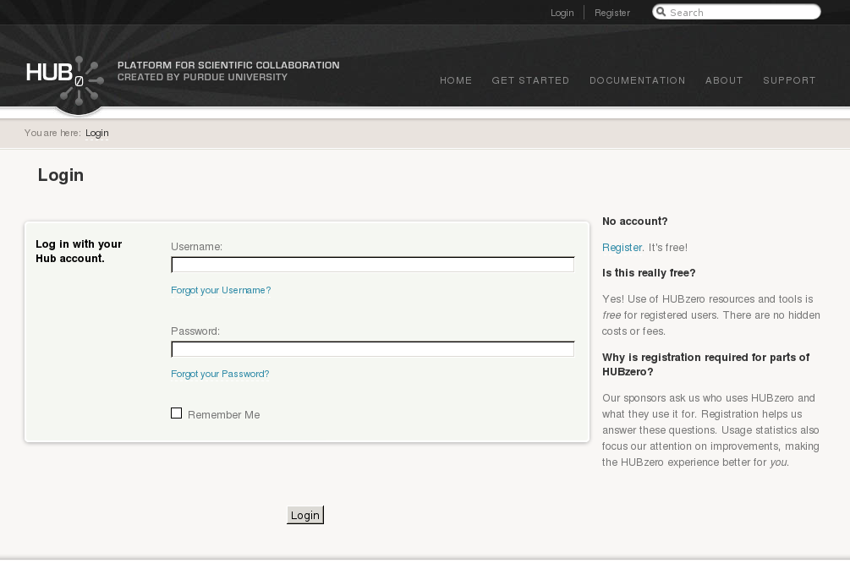
Notes:
Lets start off by writing a script that will login to a website. Login pages are quite common. This is the page for an older version of HUBzero.org.

Slide 13
hctest
Notes:
If we were to login manually, we would first, locate the username field and type our username into the field.

Slide 14
hctest
*******
Notes:
Then we would locate the password field and type our password into it

Slide 15
hctest
*******
Notes:
And lastly locate the button labeled login and click it.

Slide 16
Loading the Selenium Webdriver module:
from selenium import webdriver
Notes:
These steps can also be done in Selenium. Our first step is to import the Selenium WebDriver libraries into our script.

Slide 17
Start a web browser:
from selenium import webdriver
url = 'http://hubzero.org'
browser = webdriver.Firefox()
Notes:
Next we launch a browser by instantiating the webdriver dot browser name class.

Slide 18
Navigating to a web page:
from selenium import webdriver
url = 'http://hubzero.org'
browser = webdriver.Firefox()
browser.get(url)
Notes:
Next we navigate to our destined url using the get() method of our browser object

Slide 19
Closing a web browser:
from selenium import webdriver
url = 'http://hubzero.org'
browser = webdriver.Firefox()
browser.get(url)
...
browser.quit()
Notes:
And when we are all done, we'll need to close the browser, so we add a call to the browser.quit() method here.

Slide 20
Finding elements on a web page:
from selenium import webdriver
url = 'http://hubzero.org'
browser = webdriver.Firefox()
browser.get(url)
browser.find_element(...)
browser.find_element_by_*(...)
browser.quit()
Notes:
Opening and immediately closing a browser isn't fun. Remember, our original goal was to login to the website.
After we open the browser and navigate to the login web page, we need to look for the username and password fields on the web page. The browser object provides a few functions to help us out. There are the find_element and find_element_by functions.

Slide 21
Notes:
Recall that this is what our login page looks like

Slide 22

Locator Types:
Id
Name
Link
Xpath
CSS
<label>
Username:
<input id=”username” class=”inputbox”
type=”text” name=”username”>
</label>
Notes:
And we are interested in finding the username field. There are a number of ways to locate elements on the web page. They all deal with figuring out a way to name the element.
This naming of elements is often referred to as locator strategies.
The HTML for our username field looks like this. It is an input field with an id of username, a class attribute of inputbox, a type of text, and a name of username.

Slide 23
Locator Types:
Id
Name
Link
Xpath
CSS
Locator Type: Id
Examples:
id='username'
<label>
Username:
<input id=”username” class=”inputbox”
type=”text” name=”username”>
</label>
e = browser.find_element_by_id(id)
Notes:
We could use the input element's id to identify the element. Id's on a web page are supposed to be unique so they tend to be good locators to use.
To use the element's id, you can hand the id to the find_element_by_id method. And it would find and return an object that represents the username element.

Slide 24
Locator Types:
Id
Name
Link
Xpath
CSS
Locator Type: Name
Examples:
name='username'
<label>
Username:
<input id=”username” class=”inputbox”
type=”text” name=”username”>
</label>
e = browser.find_element_by_name(name)
Notes:
Similarly, we could use the name attribute and hand that to the find_element_by_name method. If there is only one element on the web page with that name attribute, it will return the element we want.

Slide 25
Locator Types:
Id
Name
Link
Xpath
CSS
Locator Type: Name
Examples:
loc = “//input[@id='username']”
loc = “//input[contains(@class,'inputbox')]”
<label>
Username:
<input id=”username” class=”inputbox”
type=”text” name=”username”>
</label>
e = browser.find_element_by_xpath(loc)
Notes:
Selenium also understands XPATH locators. We could use the XPATH language to build a locator that uses one of the input field's attributes to identify it, and then hand the locator to the find_element_by_xpath method.

Slide 26
Locator Types:
Id
Name
Link
Xpath
CSS
Locator Type: Name
Examples:
loc = ”input[id='username']”
loc = “#username”
loc = “.inputbox”
<label>
Username:
<input id=”username” class=”inputbox”
type=”text” name=”username”>
</label>
e = browser.find_element_by_css_selector(loc)
Notes:
Selenium also understand CSS selectors. So we could use a CSS selector and hand that to the find_element_by_css_selector to get an object representing our element on the web page.

Slide 27
Locator Types:
Id
Name
Link
Xpath
CSS
Locator Type: Link
Examples:
text = 'Register'
<p>
<a href=”/register”> Register </a>
. It's free!
</p>
e = browser.find_element_by_link_text(text)
Notes:
Now, there is also a find_element_by_link_text method. You can include the text of a link and ask it to give you back an element, but using link text is a bad idea. It tends to make brittle locators. As soon as someone changes the text of the link, your automation will fail.

Slide 28
<li id=”register”>
<a title=”Sign up for a free account” href=”/register”>Register</a>
</li>
Locator Type: Link
Examples:
link=Register
<p>
<a href=”/register”> Register </a>
. It's free!
</p>
Notes:
Also, what happens if your web page has two links with the same text, like in this example. There is a “Register” link at the top of the page, and another one in the middle. Which do you get back?

Slide 29
<li id=”register”>
<a title=”Sign up for a free account” href=”/register”>Register</a>
</li>
css=”li[id='register'] > a”
css=”a[title='Sign up for a free account']”
<p>
<a href=”/register”> Register </a>
. It's free!
</p>
Notes:
It is better to choose a different, more flexible locator like an id or class, something that won't change often.
This example shows why it is important to instrument your code for automation. If you don't build in the hooks for automation, but using good id and class names, locating elements becomes difficult.

Slide 30
Locator Types:
Id
Name
Link
Xpath
CSS
...
e = browser.find_element(by='locator_type',value='locator')
e.clear()
e.send_keys(“hctest”)
...
Notes:
One more function I'll tell you about is the find_element() method. It is the generic method that all of the previous methods are probably calling behind the scenes. It accepts a locator type and a locator to look up.

Slide 31
...
e = browser.find_element_by_css_selector(“input[id='username']”)
e.clear()
e.send_keys(“hctest”)
...
Notes:
Let's get back to our example. We are going to use a css selector to locate our element

Slide 32
<label>
Username:
<input id=”username” class=”inputbox”
type=”text” name=”username”>
</label>
...
e = browser.find_element_by_css_selector(“input[id='username']”)
e.clear()
e.send_keys(“hctest”)
...
Notes:
Our first step is to locate the element

Slide 33
...
e = browser.find_element_by_css_selector(“input[id='username']”)
e.clear()
e.send_keys(“hctest”)
...
Notes:
Next we clear it out, remove any text that may have been in the field.

Slide 34
hctest
...
e = browser.find_element_by_css_selector(“input[id='username']”)
e.clear()
e.send_keys(“hctest”)
...
Notes:
And lastly, we use the send_keys() method to type text into the field.

Slide 35
<label>
Password:
<input id=”passwd” type=”password”
name=”passwd”>
</label>
hctest
*******
...
e = browser.find_element_by_css_selector(“input[id='passwd']”)
e.clear()
e.send_keys(“pass123”)
...
Notes:
We do the same thing with the password field. First we locate the element representing the input field, then we clear it out, and last we send keys to it.

Slide 36
<p class=”submit”>
<input class=”button” type=”submit”
value=”Login” name=”Submit”>
</p>
hctest
*******
...
e = browser.find_element_by_css_selector(“input[name='Submit']”)
e.click()
...
Notes:
Our last step is to locate the “Login” button on the page. From the HTML for the widget, we see we can use the field's name attribute as a locator. Once we find the element, we can call the click method to press it.

Slide 37

...
e = browser.find_element_by_css_selector(“input[id='username']”)
e.clear()
e.send_keys(“hctest”)
e = browser.find_element_by_css_selector(“input[id='passwd']”)
e.clear()
e.send_keys(“pass123”)
e = browser.find_element_by_css_selector(“input[name='Submit']”)
e.click()
...
Notes:
So all together, our automation for the page looks like this.
Locate, clear, and type into the username field
Locate, clear, and type into the password field
Then locate and click the login button.
After you have logged in, you can check that login was successful by locating an element that is only on the web page when you have successfully logged in is present on the page.
Alternatively, you would check for a login failure message, but this may slow down all of your successful logins.

Slide 38
Login automation script
from selenium import webdriver
url = 'http://hubzero.org'
browser = webdriver.Firefox()
browser.get(url)
e = browser.find_element_by_css_selector(“input[id='username']”)
e.clear()
e.send_keys(“hctest”)
e = browser.find_element_by_css_selector(“input[id='passwd']”)
e.clear()
e.send_keys(“pass123”)
e = browser.find_element_by_css_selector(“input[name='Submit']”)
e.click()
assert(...)
browser.quit()
Notes:
Here is a look at the whole login automation script.

Slide 39
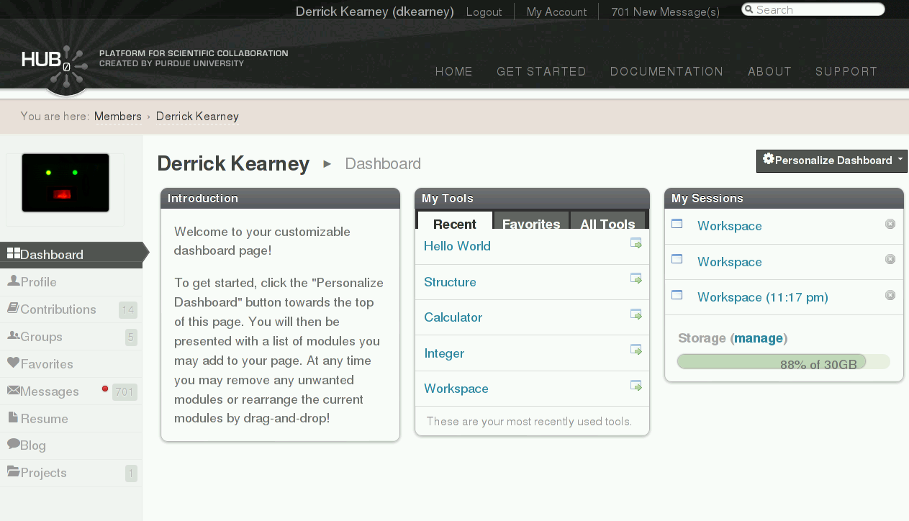
Notes:
Here is another example of using locators to find elements. After logging into the website, I get a menu on the left side of the web page. How could
I read the link names and cycle through the links until I found one I was interested in?

Slide 40
<ul id="page_menu">
<li class="active">
<a class="dashboard"
href="/members/1000/dashboard"
title="My Dashboard"> Dashboard </a>
</li>
…
<li class="">
<a class="groups"
href="/members/1000/groups"
title="My Groups"> Groups </a>
</li>
…
</ul>
css=”ul[id='page_menu'] > li:nth-child(4) > a”
css=”ul[id='page_menu'] a[class='groups']”
css=”#page_menu .groups”
Notes:
The HTML for the side menu looks like this. And if I wanted to access the 4th link in the menu, the Groups link, I would need to write a locator to identify it.
The first locator I may try is ul > li 4th child > a
This is a brittle locator, if the website is redesigned and another element is placed in the list, the Groups link may move to 5th position or 3rd position.
The next locator fixes these problem by using the class attribute.
We can rewrite the second locator to make it shorter as seen in the third locator.

Slide 41
Traversing tables and lists:
# Printing the text of the first link, from all list items:
...
elist = browser.find_elements_by_css_selector('#page_menu li')
for e in elist:
link = e.find_element_by_css_selector('a')
print 'link text = %s' % (link.text())
...
<ul id="page_menu">
<li class="active">
<a class="dashboard"
href="/members/1000/dashboard"
title="My Dashboard"> Dashboard </a>
</li>
…
<li class="">
<a class="groups"
href="/members/1000/groups"
title="My Groups"> Groups </a>
</li>
…
</ul>
Notes:
If we wanted to print the text of each link in the list, we could use the find_elements_by_css_selector method to return all elements that match our locator, not just the first. There are a whole host of complimentary methods that return a list of element objects instead of a single element object.
In a for loop, we can loop through our list of element objects, and for each object, call the text method to get the text of the widget.

Slide 42
Traversing tables and lists:
# Printing the title attribute of the first link, from all list items:
...
elist = browser.find_elements_by_css_selector('#page_menu li')
for e in elist:
link = e.find_element_by_css_selector('a')
print 'link text = %s' % (link.get_attribute('title'))
...
<ul id="page_menu">
<li class="active">
<a class="dashboard"
href="/members/1000/dashboard"
title="My Dashboard"> Dashboard </a>
</li>
…
<li class="">
<a class="groups"
href="/members/1000/groups"
title="My Groups"> Groups </a>
</li>
…
</ul>
Notes:
Similarly, if we wanted to print the title attribute of the first link for all list items, we could use the find_elements_by_css_selector to get the list of matching element objects. Next, in our for loop, iterate over each element object, calling the get_attribute() method.
This pretty much concludes the basics of using the Selenium WebDriver library. There are a few more topics that I think are helpful to know about.

Slide 43
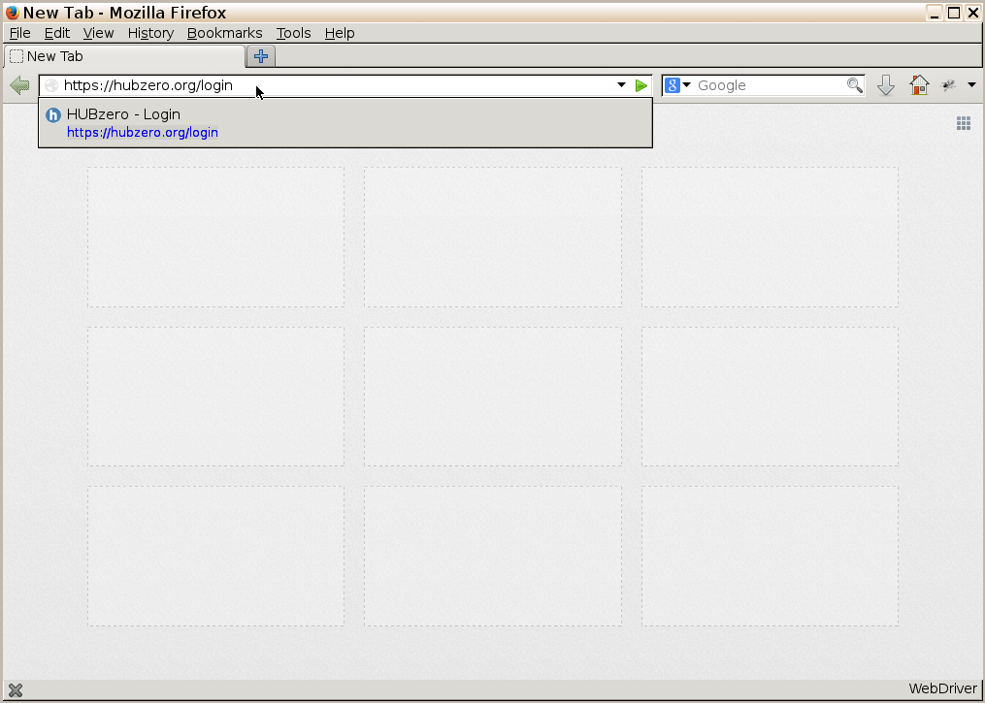
Implicit waits:
from selenium import webdriver
url = 'https://hubzero.org/login'
browser = webdriver.Firefox()
browser.get(url)
e = browser.find_element_by_css_selector(“input[id='username']”)
e.clear()
e.send_keys('hctest')
browser.quit()
Notes:
The first being waiting strategies.
If you run enough scripts, you'll eventually see errors like this happening.
You open your browser, navigate to a url

Slide 44
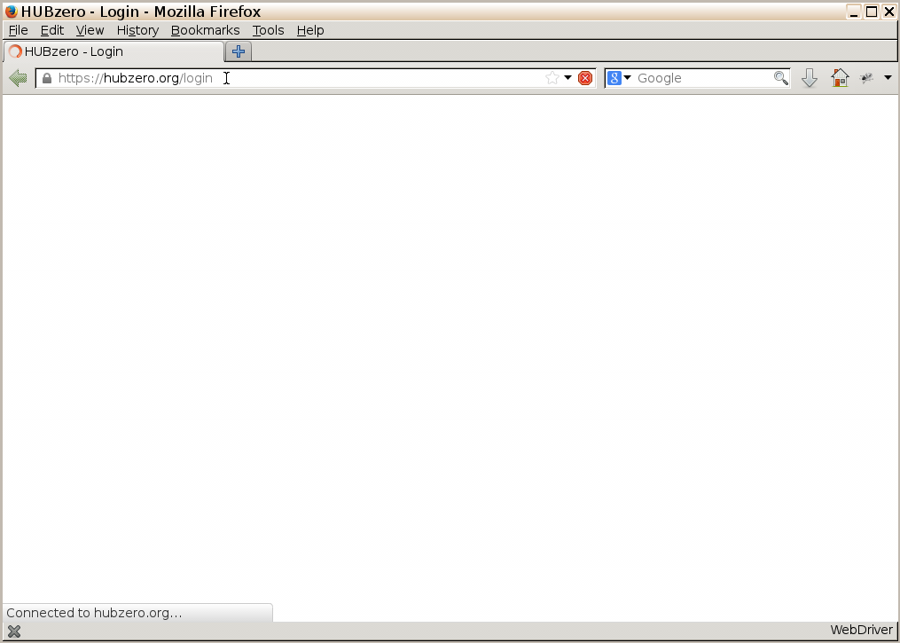
Implicit waits:
from selenium import webdriver
url = 'https://hubzero.org/login'
browser = webdriver.Firefox()
browser.get(url)
e = browser.find_element_by_css_selector(“input[id='username']”)
e.clear()
e.send_keys('hctest')
browser.quit()
Notes:
And before the web page finishes loading, your script is looking for an element on the page.

Slide 45
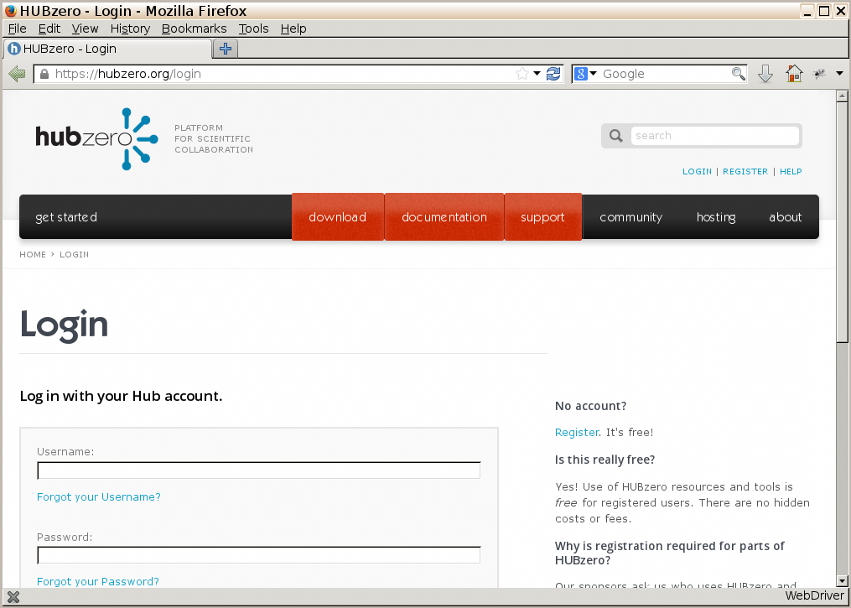
Implicit waits:
from selenium import webdriver
url = 'https://hubzero.org/login'
browser = webdriver.Firefox()
browser.get(url)
e = browser.find_element_by_css_selector(“input[id='username']”)
e.clear()
e.send_keys('hctest')
browser.quit()
Notes:
It fails to find the element and your automation dies. Just as it dies, the web page finishes loading.
With modern web pages and ajax, it is really hard to tell when a web page has “finished” loading. There is no “finished” tag that you can look for.

Slide 46
Implicit waits:
from selenium import webdriver
url = 'https://hubzero.org/login'
browser = webdriver.Firefox()
browser.implicitly_wait(30)
browser.get(url)
e = browser.find_element_by_css_selector(“input[id='username']”)
e.clear()
e.send_keys('hctest')
browser.quit()
Notes:
To help give your automation a little flexibility, you can add what is called an implicit wait to your element lookup. You only need to call the implicit wait method once for the browser object. It add a polling strategy to the lookup methods. So if the find_element method doesn't find the element on the first try, it will sleep and try again every half second or so until it reaches the timeout you set.
Here the wait is implicit because you did not have to set it explicitly for each find_element call. The wait is implied.

Slide 47
Explicit waits:
from selenium import webdriver
from selenium.webdriver.common.by import By
from selenium.webdriver.support.ui import WebDriverWait
from selenium.webdriver.support import expected_conditions as EC
url = 'https://hubzero.org/login'
browser = webdriver.Firefox()
browser.get(url)
wait = WebDriverWait(browser, 10)
wait.until(CONDITION)
e = browser.find_element_by_css_selector(“input[id='username']”)
e.clear()
e.send_keys('hctest')
browser.quit()
Notes:
Alternatively, there are explicit wait as well. To use an explicit wait, you ned to include the WebDriverWait class and you can also include the expected_condition class. The WebDriverWait class creates the explicit wait object that will wait until either some condition is met, or the timeout is passed.

Slide 48
Explicit waits:
from selenium import webdriver
from selenium.webdriver.common.by import By
from selenium.webdriver.support.ui import WebDriverWait
from selenium.webdriver.support import expected_conditions as EC
url = 'https://hubzero.org/login'
browser = webdriver.Firefox()
browser.get(url)
wait = WebDriverWait(browser, 10)
wait.until(EC.visibility_of_element_located(
(By.CSS_SELECTOR,'#username')))
e = browser.find_element_by_css_selector(“input[id='username']”)
e.clear()
e.send_keys('hctest')
browser.quit()
Notes:
In this case, we can use one of the provided conditions from the expected condition class to check for the visibility of an element. If the element is visible on the page, we are ready to move on and locate the element.
Note there are some conditions that check visibility vs existence of an element. An element can exist on the web page without being visible.

Slide 49
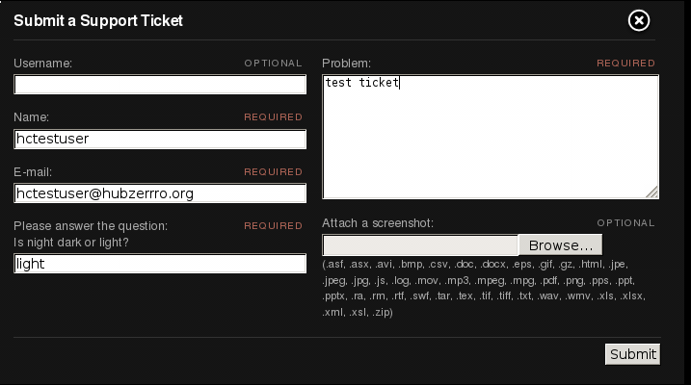
Dealing with AJAX:
Notes:
One place I've used explicit waits is when dealing with dynamic Javascript from our website's support ticket mechanism.
After you fill out a support ticket,

Slide 50
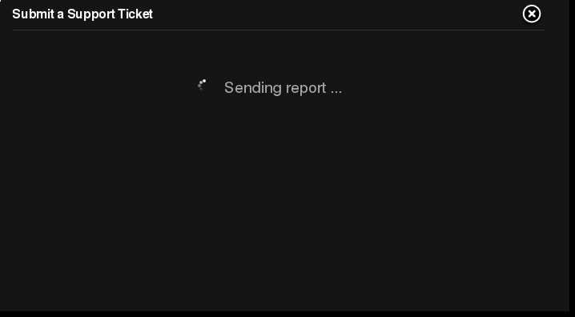
Dealing with AJAX:
Notes:
You get a spinner like this while the web site stores your support ticket and generates a ticket number for you.

Slide 51
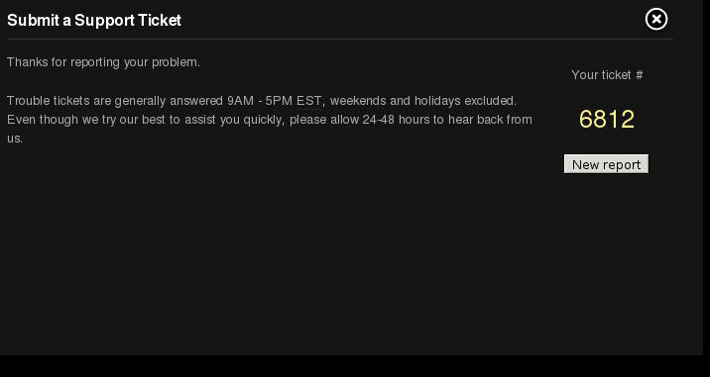
Dealing with AJAX:
<div id="trSuccess">
<div>
<p>Your ticket #
<span>
<a title=”View ticket” href="/support/ticket/6812">6812</a>
</span>
</p>
</div>
</div>
Notes:
Then you get a web page like this, where the support ticket number is inside this trSuccess div. Without some kind of waiting, this can be a hard problem to solve.

Slide 52
Dealing with AJAX:
…
submit_ticket()
# wait for the page to refresh
wait = WebDriverWait(browser, 60)
e = wait.until(lambda browser :
browser.find_element_by_id("trSuccess").is_displayed())
ticket_number = e.find_element_by_css_selector('a').text()
...
<div id="trSuccess">
<div>
<p>Your ticket #
<span>
<a title=”View ticket” href="/support/ticket/6812">6812</a>
</span>
</p>
</div>
</div>
Notes:
With explicit waits, I don't need to increase my implicit wait, which affects all failing element lookups. I can keep my implicit wait timeout low and use the explicit wait with a longer timeout here.
For my condition, I write my own lambda function which returns true or false as to whether the trSuccess div is displayed in the web page.
Once it is displayed, I jump out of my explicit wait, and grab the ticket number.

Slide 53
QUESTIONS?
MOVIES?
MORE?

Slide 54
THE
PAGE OBJECT
DESIGN PATTERN

Slide 55


Slide 56
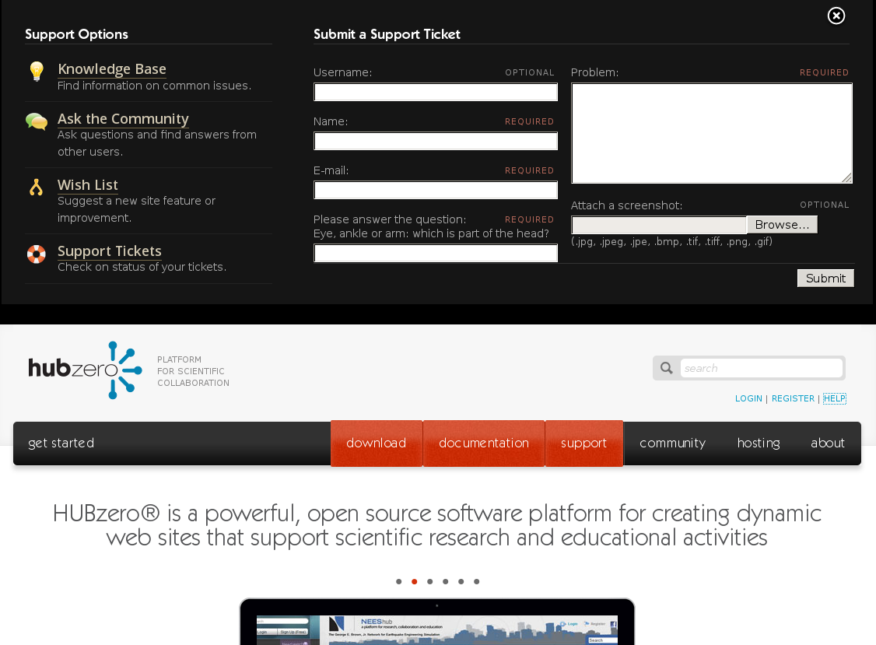

Slide 57

testuser
Writing to a Text Input:
1. Find the element
2. Clear the element
3. Send keys to the element
<label for=”trName”>
Name:
<span class=”required”>required</span>
<input id=”trName” type=”text” value=””
name=”reporter[name]”>
</label>
...
e = browser.find_element(by=BY.CSS, value=”input[id='trName']”)
e.clear()
e.send_keys(“testuser”)
...

Slide 58
testuser
tu@hubzero.org
Writing to a Text Input:
1. Find the element
2. Clear the element
3. Send keys to the element
<label for=”trEmail”>
E-mail:
<span class=”required”>required</span>
<input id=”trEmail” type=”text” value=””
name=”reporter[email]”>
</label>
...
e = browser.find_element(by=BY.CSS, value=”input[id='trEmail']”)
e.clear()
e.send_keys(“tu@hubzero.org”)
...

Slide 59
test problem
testuser
tu@hubzero.org
Writing to a Text Input:
1. Find the element
2. Clear the element
3. Send keys to the element
<label for=”trProblem”>
Problem:
<span class=”required”>required</span>
<textarea id=”trProblem”
name=”problem[long]”> </textarea>
</label>
...
e = browser.find_element(by=BY.CSS, value=”textarea[id='trProblem']”)
e.clear()
e.send_keys(“test problem”)
...

Slide 60
test problem
testuser
tu@hubzero.org
myscreenshot.png
Uploading a file:
1. Find the element
2. Send file path to element
<label for=”trUpload”>
Attach a screenshot:
<span class=”optional”>optional</span>
<input id=”trUpload” type=”file”
name=”upload”>
</label>
...
e = browser.find_element(by=BY.CSS,value=”input[id='trUpload']”)
e.send_keys(“$HOME/myscreenshot.png”)
...

Slide 61
test problem
testuser
tu@hubzero.org
myscreenshot.png
Pushing a button:
1. Find the element
2. Call the element's “click()” method
<div class=”submit”>
<input id=”send-form” type=”submit”
value=”Submit”>
</div>
...
e = browser.find_element(by=BY.CSS,value=”input[id='send-form']”)
e.click()
...

Slide 62
…
# File a Support Ticket
# Populate the Name field
e = browser.find_element(by=BY.CSS, value=”input[id='trName']”)
e.clear()
e.send_keys(“testuser”)
# Populate the Email field
e = browser.find_element(by=BY.CSS, value=”input[id='trEmail']”)
e.clear()
e.send_keys(“tu@hubzero.org”)
# Populate the Problem field
e = browser.find_element(by=BY.CSS, value=”textarea[id='trProblem']”)
e.clear()
e.send_keys(“test problem”)
# Populate the Upload field
e = browser.find_element(by=BY.CSS,value=”input[id='trUpload']”)
e.send_keys(“$HOME/myscreenshot.png”)
# Click the Submit button
e = browser.find_element(by=BY.CSS,value=”input[id='send-form']”)
e.click()
...

Slide 63
…
# File a Support Ticket
# Populate the Name field
e = browser.find_element(by=BY.CSS, value=”input[id='trName']”)
e.clear()
e.send_keys(“testuser”)
# Populate the Email field
e = browser.find_element(by=BY.CSS, value=”input[id='trEmail']”)
e.clear()
e.send_keys(“tu@hubzero.org”)
# Populate the Problem field
e = browser.find_element(by=BY.CSS, value=”textarea[id='trProblem']”)
e.clear()
e.send_keys(“test problem”)
# Populate the Upload field
e = browser.find_element(by=BY.CSS,value=”input[id='trUpload']”)
e.send_keys(“$HOME/myscreenshot.png”)
# Click the Submit button
e = browser.find_element(by=BY.CSS,value=”input[id='send-form']”)
e.click()
...
Text Input
Text Input
Text Input
Text Input
Button

Slide 64
test problem
testuser
tu@hubzero.org
myscreenshot.png
class Text(BasePageWidget):
def __init__(self, locator):
…
def value(self, text):
e = self.find_element(self.locator)
e.clear()
e.send_keys(text)
<label for=”trName”>
Name:
<span class=”required”>required</span>
<input id=”trName” type=”text” value=””
name=”reporter[name]”>
</label>
...
e = browser.find_element( by=BY.CSS,
value=”input[id='trName']”)
e.clear()
e.send_keys(“testuser”)
...
…
name = Text(“input[id='trName']”)
name.value('testuser')
...

Slide 65
test problem
testuser
tu@hubzero.org
myscreenshot.png
class Button(BasePageWidget):
def __init__(self, locator):
…
def click(self):
e = self.find_element(self.locator)
e.click()
<div class=”submit”>
<input id=”send-form” type=”submit”
value=”Submit”>
</div>
...
e = browser.find_element( by=BY.CSS,
value=”input[id='send-form']”)
e.click()
...
…
submit = Text(“input[id='send-form']”)
submit.click()
...

Slide 66
…
# File a Support Ticket
# Populate the Name field
name = Text(“input[id='trName']”)
name.value(“testuser”)
# Populate the Email field
email = Text(“input[id='trEmail']”)
email.value(“tu@hubzero.org”)
# Populate the Problem field
problem = Text(“textarea[id='trProblem']”)
problem.value(“test problem”)
# Populate the Upload field
upload = Text(“input[id='trUpload']”)
upload.value(“$HOME/myscreenshot.png”)
# Click the Submit button
submit = Button(“input[id='send-form']”)
submit.click()
...
Text Input
Text Input
Text Input
Text Input
Button

Slide 67
test problem
testuser
tu@hubzero.org
myscreenshot.png
class Text(BasePageWidget):
def __init__(self, locator):
…
def value(self):
e = self.find_element(self.locator)
return e.get_attribute('value')
<label for=”trName”>
Name:
<span class=”required”>required</span>
<input id=”trName” type=”text” value=””
name=”reporter[name]”>
</label>
...
e = browser.find_element( by=BY.CSS,
value=”input[id='trName']”)
e.get_attribute('value')
...
…
name = Text(“input[id='trName']”)
x = name.value()
...

Slide 68
test problem
testuser
tu@hubzero.org
myscreenshot.png
class Text(BasePageWidget):
def __init__(self, locator):
…
def value(self):
e = self.find_element(self.locator)
return e.get_attribute('value')
<label for=”trProblem”>
Problem:
<span class=”required”>required</span>
<textarea id=”trProblem”
name=”problem[long]”> </textarea>
</label>
...
e = browser.find_element( by=BY.CSS,
value=”input[id='trProblem']”)
e.text
...
…
problem = Text(“input[id='trProblem']”)
x = problem.value()
...

Slide 69
test problem
testuser
tu@hubzero.org
myscreenshot.png
class TextArea(BasePageWidget):
def __init__(self, locator):
…
def value(self):
e = self.find_element(self.locator)
return e.text
<label for=”trProblem”>
Problem:
<span class=”required”>required</span>
<textarea id=”trProblem”
name=”problem[long]”> </textarea>
</label>
...
e = browser.find_element( by=BY.CSS,
value=”input[id='trProblem']”)
e.text
...
…
problem = Text(“input[id='trProblem']”)
x = problem.value()
...

Slide 70
test problem
testuser
tu@hubzero.org
myscreenshot.png
class Upload(BasePageWidget):
def __init__(self, text_loc,browse_loc):
…
def value(self,value):
e = self.find_element(self.browse_loc)
e.get_attribute('value')
<label for=”trUpload”>
Attach a screenshot:
<span class=”optional”>optional</span>
<input id=”trUpload” type=”file”
name=”upload”>
</label>
...
e = browser.find_element( by=BY.CSS,
value=”input[id='trUpload']”)
e.send_keys('$HOME/myscreenshot.png')
...
…
problem = Upload(“input[id='trProblem']”)
problem.value('$HOME/myscreenshot.png')
...

Slide 71
…
# File a Support Ticket
# Populate the Name field
name = Text(“input[id='trName']”)
name.value(“testuser”)
# Populate the Email field
email = Text(“input[id='trEmail']”)
email.value(“tu@hubzero.org”)
# Populate the Problem field
problem = TextArea(“textarea[id='trProblem']”)
problem.value(“test problem”)
# Populate the Upload field
upload = Upload(“input[id='trUpload']”)
upload.value(“$HOME/myscreenshot.png”)
# Click the Submit button
submit = Button(“input[id='send-form']”)
submit.click()
...
Text Input
Text Input
TextArea
Upload
Button

Slide 72
Go to Support Webpages
* Knowledge Base
* Questions/Answers
* Wish List
* Support Tickets

Slide 73
Submit New Ticket
* Name, Email, Problem

Slide 74
Submit New Ticket
* Name, Email, Problem,
Captcha

Slide 75
Submit New Ticket
* Name, Email, Problem,
Captcha, Upload

Slide 76
…
# File a Support Ticket
# Populate the Name field
e = browser.find_element(by=BY.CSS, value=”input[id='trName']”)
e.clear()
e.send_keys(“testuser”)
# Populate the Email field
e = browser.find_element(by=BY.CSS, value=”input[id='trEmail']”)
e.clear()
e.send_keys(“tu@hubzero.org”)
# Populate the Problem field
e = browser.find_element(by=BY.CSS, value=”textarea[id='trProblem']”)
e.clear()
e.send_keys(“test problem”)
# Populate the Upload field
e = browser.find_element(by=BY.CSS,value=”input[id='trUpload']”)
e.send_keys(“$HOME/myscreenshot.png”)
# Click the Submit button
e = browser.find_element(by=BY.CSS,value=”input[id='send-form']”)
e.click()
...

Slide 77
…
# File a Support Ticket
# Populate the Name field
name = Text(“input[id='trName']”)
name.value(“testuser”)
# Populate the Email field
email = Text(“input[id='trEmail']”)
email.value(“tu@hubzero.org”)
# Populate the Problem field
problem = TextArea(“textarea[id='trProblem']”)
problem.value(“test problem”)
# Populate the Upload field
upload = Upload(“input[id='trUpload']”)
upload.value(“$HOME/myscreenshot.png”)
# Click the Submit button
submit = Button(“input[id='send-form']”)
submit.click()
...

Slide 78
…
# File a Support Ticket
# Populate the Support Ticket
po = TroubleReportForm(“#troublereport”)
data = {
'username' : 'hctest1',
'name' : 'hctest1 hctest1',
'email' : 'hctest1@hubzero.org',
'problem' : 'test problem text',
'captcha' : True,
'upload' : '/home/hctest1/myscreenshot.png',
}
po.submit_ticket(data)
...

Slide 79
…
# File a Support Ticket
# Populate the Support Ticket
po = TroubleReportForm(“#troublereport”)
data = {
'name' : 'hctest1 hctest1',
'email' : 'hctest1@hubzero.org',
'problem' : 'test problem text',
}
po.submit_ticket(data)
...

Slide 80
class TroubleReportForm(BasePageWidget):
def __init__(self):
...
self.username = Text(self,'username')
self.captcha = Captcha(self,'captcha')
self.problem = Text(self,'problem')
self.upload = Upload(self,'upload')
self.submit = Button(self,'submit')
…
def submit_ticket(self,data):
…
def open(self):
…
def close(self):
…
Page Description
Page Services

Slide 81
class TroubleReportForm(BasePageWidget):
def __init__(self):
...
self.username = Text(self,'username')
self.captcha = Captcha(self,'captcha')
self.problem = Text(self,'problem')
self.upload = Upload(self,'upload')
self.submit = Button(self,'submit')
…
def submit_ticket(self,data):
…
def open(self):
…
def close(self):
…
# open and close the need help pane
po = TroubleReportForm()
po.open()
po.close()

Slide 82
class TroubleReportForm(BasePageWidget):
def __init__(self):
...
self.username = Text(self,'username')
self.captcha = Captcha(self,'captcha')
self.problem = Text(self,'problem')
self.upload = Upload(self,'upload')
self.submit = Button(self,'submit')
…
def submit_ticket(self,data):
…
def open(self):
…
def close(self):
…
# submit a blank ticket
po = TroubleReportForm()
po.open()
data = {}
po.submit_ticket(data)

Slide 83
test problem
testuser
tu@hubzero.org
myscreenshot.png
class TroubleReportForm(BasePageWidget):
def __init__(self):
...
self.username = Text(self,'username')
self.captcha = Captcha(self,'captcha')
self.problem = Text(self,'problem')
self.upload = Upload(self,'upload')
self.submit = Button(self,'submit')
…
def submit_ticket(self,data):
…
def open(self):
…
def close(self):
…
# fill in the name, email, problem,
# upload a file, then submit the ticket
po = TroubleReportForm()
po.open()
data = {
'name' : 'testuser',
'email' : 'tu@hubzero.org',
'problem' : 'test problem',
'upload' : 'myscreenshot.png',
}
po.submit_ticket(data)

Slide 84
test problem
testuser
tu@hubzero.org
myscreenshot.png
class TroubleReportForm(BasePageWidget):
def __init__(self):
...
self.username = Text(self,'username')
self.captcha = Captcha(self,'captcha')
self.problem = Text(self,'problem')
self.upload = Upload(self,'upload')
self.submit = Button(self,'submit')
…
def submit_ticket(self,data):
…
def open(self):
…
def close(self):
…
# login to the website,
# fill in problem, upload file,
# then submit ticket
po = Login()
po.login_as('testuser','tupass')
po = TroubleReportForm()
po.open()
data = {
'problem' : 'test problem',
'upload' : 'myscreenshot.png',
}
po.submit_ticket(data)

Slide 85
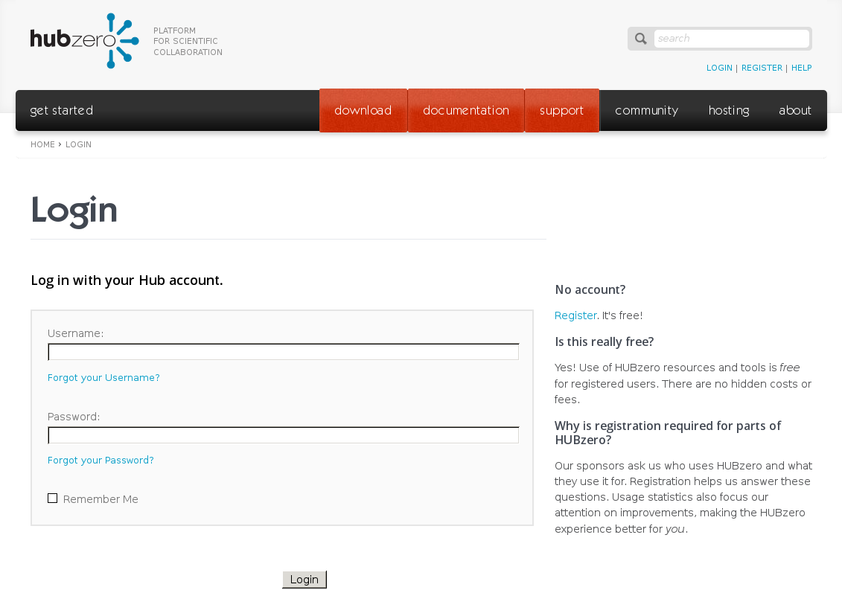

Slide 86
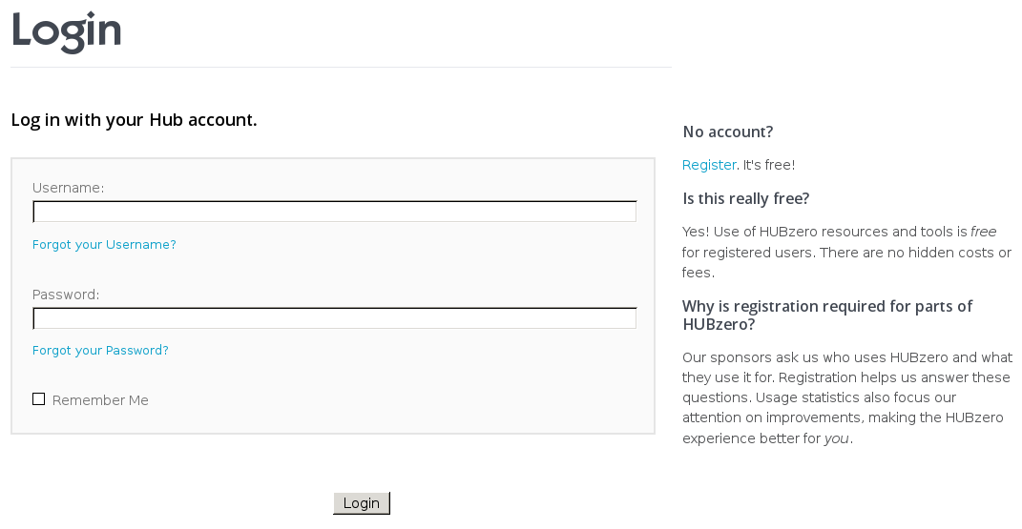

Slide 87
Links

Slide 88
Text Inputs

Slide 89
Checkbox

Slide 90
Button

Slide 91
class Login(BasePageWidget):
def __init__(self, locator):
...
self.username = Text(self,'username')
self.password = Text(self,'password')
self.remember = Checkbox(self,'remember')
self.remind = Link(self,'remind')
self.reset = Link(self,'reset')
self.register = Link(self,'register')
self.submit = Button(self,'submit')
def login_as(self,username,password):
self.username.value = username
self.password.value = password
self.submit.click()
Page Description
Page Services

Slide 92
class Login(BasePageWidget):
def __init__(self, locator):
...
self.username = Text(self,'username')
self.password = Text(self,'password')
self.remember = Checkbox(self,'remember')
self.remind = Link(self,'remind')
self.reset = Link(self,'reset')
self.register = Link(self,'register')
self.submit = Button(self,'submit')
def login_as(self,username,password):
self.username.value = username
self.password.value = password
self.submit.click()
po = Login('#hubForm')
po.login_as('testuser','testpassword')
po = Login('#hubForm')
po.remember.value = True
po.login_as('testuser','testpassword')
po = Login('#hubForm')
po.remind.click()
po = Login('#hubForm')
po.username.value = 'testuser'
po.submit.click()

