Slide 1
Book1
File created on: 17/03/2025 15:18:11

Slide 2
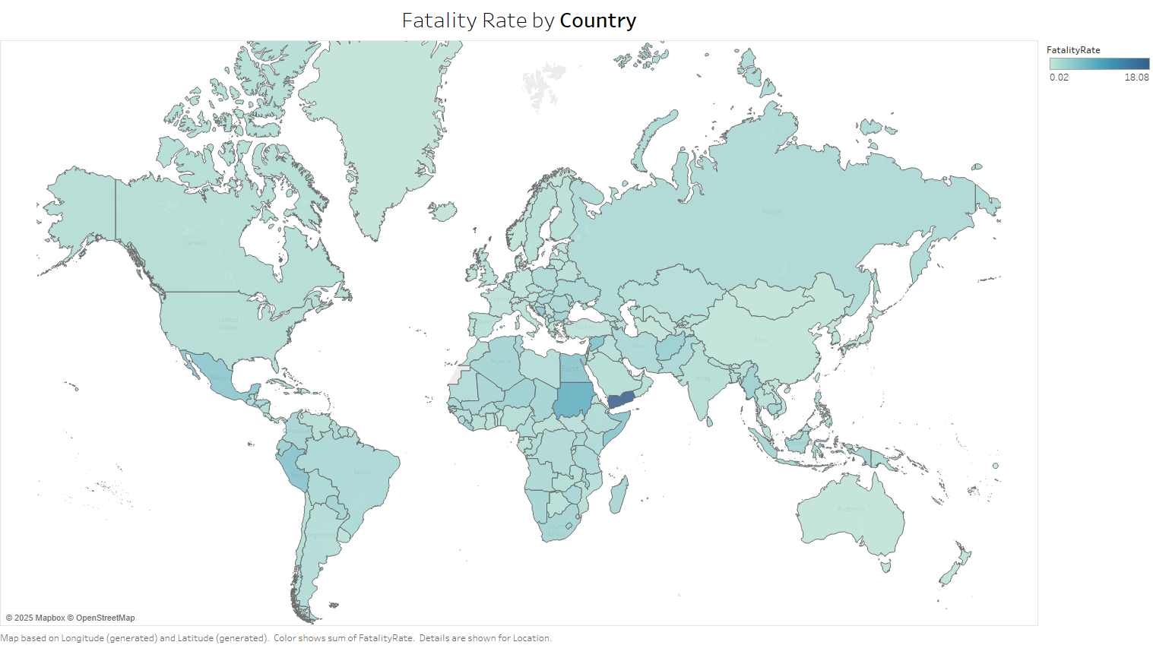

Slide 3
