Slide 1
Python
Design and Practical Scripting
Daniel Klopp

Slide 2
Overview
Introductions
Design: How Not To Earn the Enmity of Your Successors
Python Techniques
Extensible Examples

Slide 3
Introductions

Slide 4
Who Am I?
Linux for ~12 years
Paid Linux / Cisco for ~8 years
UVA, EE 2010
NRAO 2008-2013
  Linux Administration
  HPC, 1.5 PB Storage ( 0.5 PB Lustre)
  Kernel Development / Scripting
  Virtualization & Configuration Management

Slide 5

ALMA

Slide 6

Correlator Quadrant

Slide 7
Round Table
Introductions

Slide 8
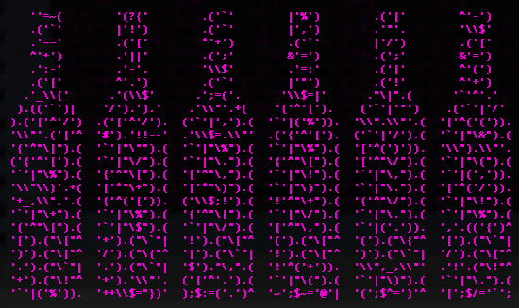
Design also known as
How Not To Earn The Enmity of Your Successors

Slide 9
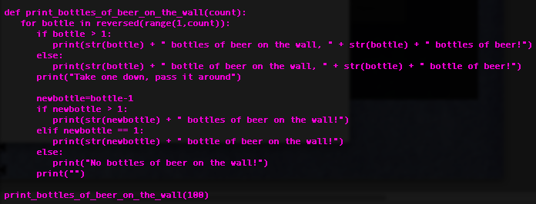
Obvious?

Slide 10
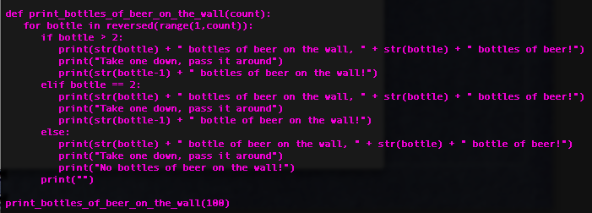
Improved Version

Slide 11
Documenting Code
See coding example attempt1.py

Slide 12
Documenting Code
See coding example attempt1.py
Compare with coding example attempt2.py

Slide 13
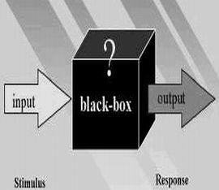
Black Boxes

Slide 14
Python Techniques
Operating on a file

Slide 15
Overriding Objects
http://rgruet.free.fr/PQR26/PQR2.6.html#SpecialMethods

Slide 20
Conclusion
Recommend one or several strategies
Give a summary of the expected results
Name the next steps to be taken
Delegate the various tasks

Slide 21
Exercises

