Slide 1
Chapter 3
Simple Graphics

Slide 2
Side Effects and Haskell
All the programs we have seen so far have no “side-effects.” That is, programs are executed only for their values.
But sometimes we want our programs to effect the real world (printing, controlling a robot, drawing a picture, etc).
How do we reconcile these two competing properties?
In Haskell, “pure values” are separated from “worldly actions”, in two ways:
  Types: An expression with type IO a has possible actions associated with its execution, while returning a value of type a.
  Syntax: The do syntax performs an action, and (using layout) allows one to sequence several actions.

Slide 3
Sample Effects or Actions
  State
    Intuitively, some programs have state that changes over time.
  Exceptions
    There may be an error instead of a final value
  Non-determinism
    There may be multiple possible final values
  Partial Computation
    There may be nothing: no final value, or anything else
  Communication
    There may be external influence on the computation
    Perform some Input or Output, as well as a final value.
    Draw graphics on a display

Slide 4
The do Syntax
Let act be an action with type IO a.
Then we can perform act, retrieve its return value, and sequence it with other actions, by using the do syntax:
do val <- act
... -- the next action
... -- the action following that
return x -- final action may return a value
Note that all actions following val <- act can use the variable val.
The function return takes a value of type a, and turns it into an action of type IO a, which does nothing but return the value.

Slide 5
do Syntax Details
:: Integer
:: IO Integer
:: IO Char
do x <- f 5
c <- getChar 7
putChar c
return (x + 4)
:: IO ()
(actions without
“v <- …”
usually have this type)
:: Char
:: IO Integer
(the type of the last action also determines the type of the entire do expression)

Slide 6
When IO Actions are Performed
A value of type IO a is an action, but it is still a value: it will only have an effect when it is performed.
In Haskell, a program’s value is the value of the variable main in the module Main. If that value has type IO a, then it will be performed, since it is an action. If it has any other type, its value is simply printed on the display.
In Hugs, however, you can type any expression to the Hugs prompt. But as for main above, if the expression has type IO a it will be performed, otherwise its value will be printed on the display.

Slide 7
Predefined IO Actions
  -- get one character from keyboard
  getChar :: IO Char
  -- write one character to terminal
  putChar :: Char -> IO()
  -- get a whole line from keyboard
  getLine :: IO String
  -- read a file as a String
  readFile :: FilePath -> IO String
  -- write a String to a file
  writeFile :: FilePath -> String -> IO ()

Slide 8
Recursive Actions
getLine can be defined recursively in terms of simpler actions:
getLine :: IO String
getLine =
do c <- getChar -- get a character
if c == '\n' -- if it’s a newline
then return "" -- then return empty string
else do l <- getLine –- otherwise get rest of
-- line recursively,
return (c:l) -- and return entire line

Slide 9
Example: Unix wc Command
The unix wc (word count) program reads a file and then prints out counts of characters, words, and lines.
Reading the file is an action, but computing the information is a pure computation.
Strategy:
  Define a pure function that counts the number of characters, words, and lines in a string.
    number of lines = number of ‘\n’
    number of words ~= number of ‘ ’ plus number of ‘\t’
  Define an action that reads a file into a string, applies the above function, and then prints out the result.

Slide 10
Implementation
  wcf :: (Int,Int,Int) -> String -> (Int,Int,Int)
  wcf (cc,w,lc) [] = (cc,w,lc)
  wcf (cc,w,lc) (' ' : xs) = wcf (cc+1,w+1,lc) xs
  wcf (cc,w,lc) ('\t' : xs) = wcf (cc+1,w+1,lc) xs
  wcf (cc,w,lc) ('\n' : xs) = wcf (cc+1,w+1,lc+1) xs
  wcf (cc,w,lc) (x : xs) = wcf (cc+1,w,lc) xs
  wc :: IO ()
  wc = do name <- getLine
  contents <- readFile name
  let (cc,w,lc) = wcf (0,0,0) contents
  putStrLn (“The file: “ ++ name ++ “has “)
  putStrLn (show cc ++ “ characters “)
  putStrLn (show w ++ “ words “)
  putStrLn (show lc ++ “ lines “)

Slide 11
Example Run
I typed this.
  Main> wc
  elegantProse.txt
  The file: elegantProse.txt has
  2970 characters
  1249 words
  141 lines
  Main>

Slide 12
Graphics Actions
Graphics windows are traditionally programmed using commands; i.e. actions.
Some graphics actions relate to opening up a graphics window, closing it, etc.
Others are associated with drawing lines, circles, text, etc.

Slide 13
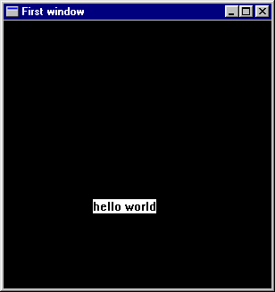
“Hello World” program using Graphics Library
This imports a
library,
SOEGraphics,
which contains
many functions
import SOEGraphics
main0 =
runGraphics $
do w <- openWindow "First window" (300,300)
drawInWindow w (text (100,200) "hello world")
k <- getKey w
closeWindow w

Slide 14
Graphics Operators
openWindow :: String -> Point -> IO Window
  Opens a titled window of a particular size.
drawInWindow :: Window -> Draw () -> IO ()
  Displays a Draw () value in a given window.
  Note that the return type is IO ().
getKey :: Window -> IO Char
  Waits until a key is pressed and then returns the character associated with the key.
closeWindow :: Window -> IO ()
  Closes the window (duh…).

Slide 15
Mixing Graphics IO with Terminal IO
spaceClose :: Window -> IO ()
spaceClose w =
do k <- getKey w
if k == ' ' then closeWindow w
else spaceClose w
main1 =
runGraphics $
do w <- openWindow "Second Program" (300,300)
drawInWindow w (text (100,200) “Hello Again")
spaceClose w

Slide 16
Drawing Primitive Shapes
The Graphics libraries contain simple actions for drawing a few primitive shapes.
ellipse :: Point -> Point -> Draw ()
shearEllipse :: Point -> Point -> Point -> Draw ()
line :: Point -> Point -> Draw ()
polygon :: [Point] -> Draw ()
polyline :: [Point] -> Draw ()
From these we will build much more complex drawing programs.

Slide 17
Coordinate System
Increasing x-axis
(0,0)
Increasing y-axis

Slide 18
Example Program
main2 =
runGraphics $
do w <- openWindow "Draw some shapes" (300,300)
drawInWindow w (ellipse (0,0) (50,50))
drawInWindow w
(shearEllipse (0,60) (100,120) (150,200))
drawInWindow w
(withColor Red (line (200,200) (299,275)))
drawInWindow w
(polygon [(100,100),(150,100),(160,200)])
drawInWindow w
(withColor Green
(polyline [(100,200),(150,200),
(160,299),(100,200)]))
spaceClose w

Slide 19
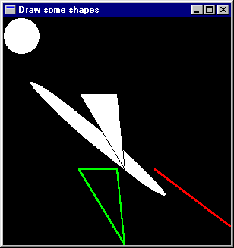
The Result
; drawInWindow w
(ellipse (0,0) (50,50))
; drawInWindow w
(shearEllipse (0,60)
(100,120)
(150,200))
; drawInWindow w
(withColor Red
(line (200,200)
(299,275)))
; drawInWindow w
(polygon [(100,100),
(150,100),
(160,200)])
; drawInWindow w
(withColor Green
(polyline
[(100,200),(150,200),
(160,299),(100,200)]))

Slide 20
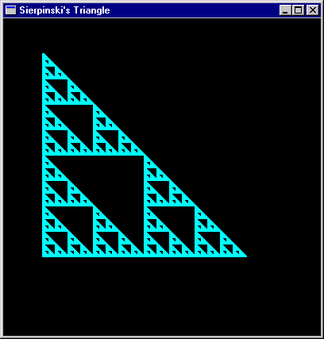
More Complex Programs
We’d like to build bigger programs from these small pieces.
For example:
  Sierpinski’s Triangle – a fractal consisting of repeated drawing of a triangle at successively smaller sizes.
As before, a key idea is separating pure computation from graphics actions.

Slide 21
Geometry of One Triangle
(x,y-size)
Remember that y increases
as we go down the page
size² + size² = hyp²
hyp
(x,y-size/2)
(x+size/2,y-size/2)
(x,y)
(x+size,y)
(x+size/2,y)

Slide 22
Draw 1 Triangle
(x,y)
fillTri x y size w =
drawInWindow w
(withColor Blue
(polygon [(x,y),
(x+size,y),
(x,y-size)]))
minSize = 8
size

Slide 23
Sierpinski’s Triangle
(x,y-size)
sierpinskiTri w x y size =
if size <= minSize
then fillTri x y size w
else let size2 = size `div` 2
in do sierpinskiTri w x y size2
sierpinskiTri w x (y-size2) size2
sierpinskiTri w (x + size2) y size2
main3 =
runGraphics $
do w <- openWindow "Sierpinski's Tri" (400,400)
sierpinskiTri w 50 300 256
spaceClose w
(x,y-size/2)
(x,y)
(x+size/2,y)
(x+size,y)

Slide 24
Question?
Whats the largest triangle sierpinskiTri ever draws?
How come the big triangle is drawn?

