Slide 1
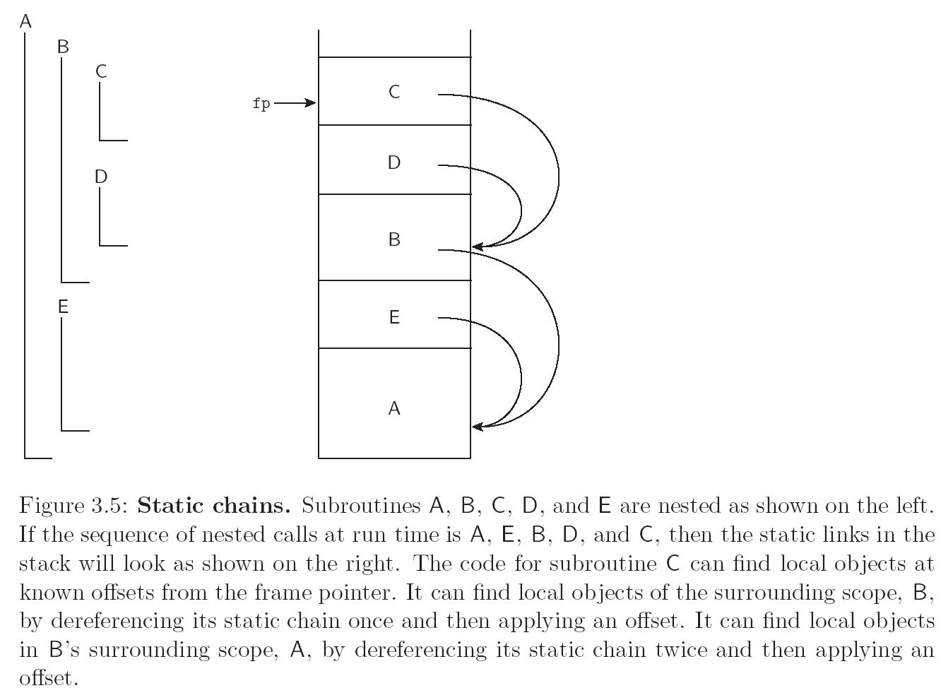
Scope Rules
Python code outline
def A:
def B:
def C:
... # C stuff
def D:
... # D stuff
... # B stuff
def E:
... #E stuff
...#A stuff

Slide 2
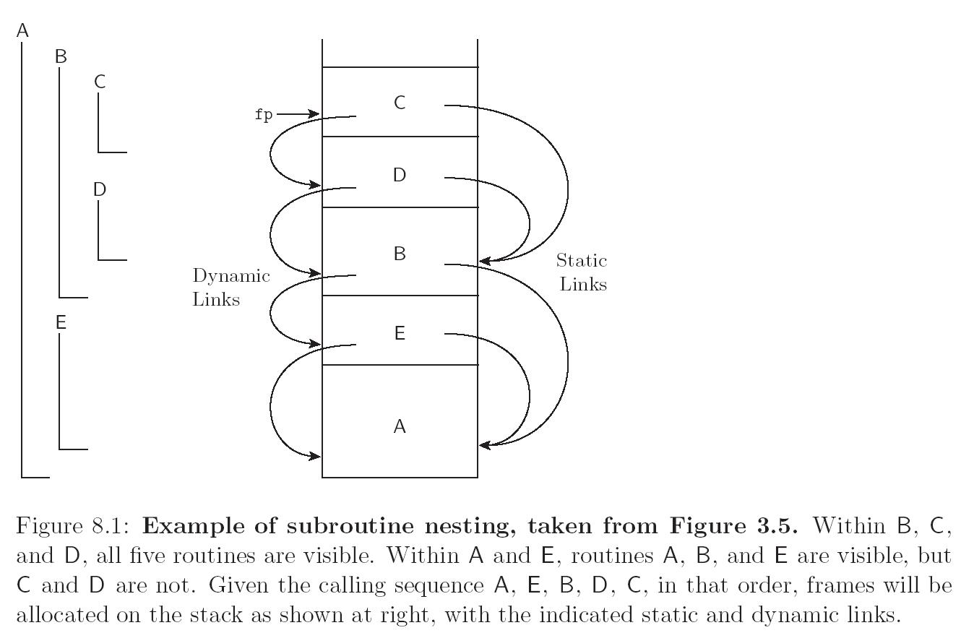
Review Of Stack Layout
Python code outline
def A:
def B:
def C:
... # C stuff
def D:
... # D stuff
... # B stuff
def E:
... #E stuff
...#A stuff

Slide 3
Simple recursive function call
...
int n;
int fact(void) {
int loc;
if (n>1) {
loc = n--;
return loc * fact();
} else {
return 1;
}
}
int n = 3;
…
fact();
Return value
Return address
fact(1)
Frame pt
loc
Return value
Return address
Dynamic Link
fact(2)
loc
Return value?
Return address
fact(3)
Dynamic Link
sp
loc
Program Stack
fp
…
n
Static memory
...

Slide 4
Simple recursive function call
...
sp
1
Return value
int n;
int fact(void) {
int loc;
if (n>1) {
loc = n--;
return loc * fact();
} else {
return 1;
}
}
int n = 3;
…
fact();
Return address
fact(1)
fp
Dynamic Link
loc
Return value ?
Return address
Frame pt
fact(2)
loc
2
Return value?
Return address
fact(3)
Dynamic Link
loc
3
Program Stack
…
n
1
Static memory
...

