Slide 1
Big Data Architecture and Cluster Optimization with Python
By: Chetan Khatri
Principal Big Data Engineer, Nazara Technologies.
Data Science & Machine Learning Curricula Advisor, University of Kachchh, Gujarat.
Pycon India 2016

Slide 2
Data Analytics Cycle
Understand the Business
Understand the Data
Cleanse the Data
Do Analytics the Data
Predict the Data
Visualize the data
Build Insight that helps to grow Business Revenue
Explain to Executive (CxO)
Take Decision
Increase Revenue

Slide 3
Capacity Planning (Cluster Sizing)
Telecom Business:
122 Operators , 4 Region(INDIA, Africa, ME, Latin America.
12 TB of Data per Year
11,00,000 Transactions per day.
Gaming Business:
6 Billion events per month = (near by) 15 TB of Data per year.
Total: 27 TB of Data per year

Slide 4
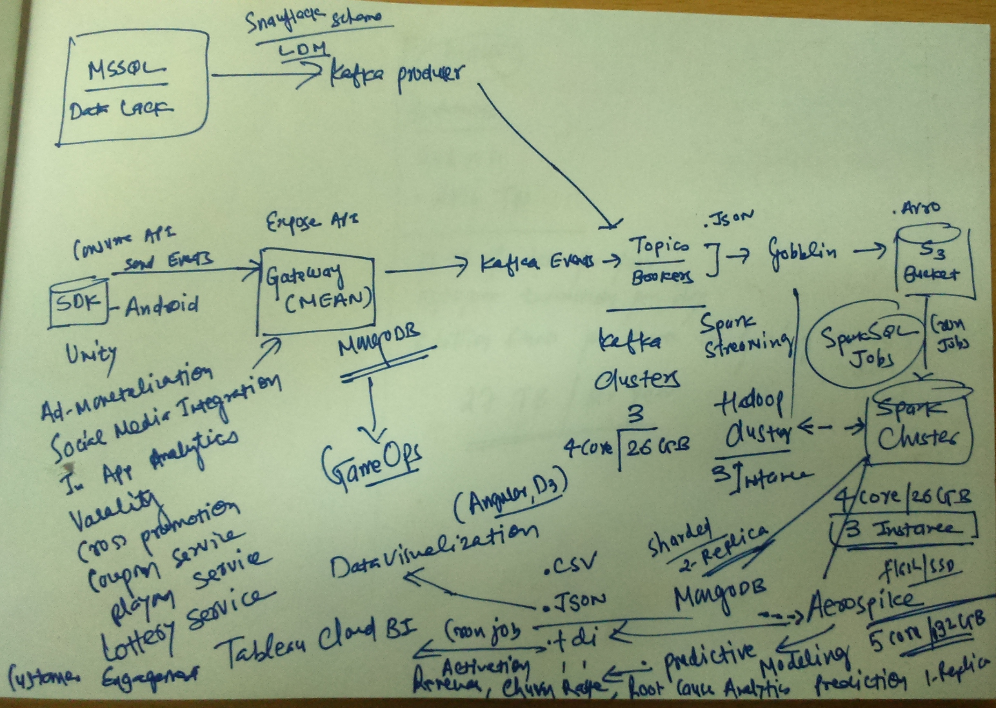

Slide 5
Predictive Modeling Cycle
1. Data Quality (Removing Noisy, Missing Data)
2. Feature Engineering
3. Choosing Best Model: " based on culture of Data, For ex. If continues data-points go with Linear Regression , If categorical binomial prediction requires then go with Logistic Regression, For Random sample of data(Feature randomization) and have better generalization performance. other like Gradient Boosting Trees for optimal linear combination of trees and weighted sum of predictions of individual trees."
Try from Linear Regression to Deep Learning (RNN, CNN)
4. Ensemble Model (Regression + Random Forest + XGBoost)
5. Tune Hyper-parameters(For ex in Deep Neural Network, Needs to tune mini-batch size, learning rate, epoch, hidden layers)
6. Model Compression - Port model to embedded / mobile devices using Compress matrices(Sparsify, Shrink, Break, Quantize)
7. Run on smart-phone

Slide 6
Big Data Cluster Tuning – OS Parameters
TPS (Transaction Per Second) - throughput for every Jobs.
Time Wait Interval - TCP - For ex. 4 min
Max.port
max.connection
sysctl net.ipv4.ip_local_port_range
sysctl net.ipv4.tcp_fin_timeout
Max Thread - sysctl -a | grep threads_max
echo 120000 > /proc/sys/kernal/threads_max
echo 600000 > /proc/sys
cat /proc/sys/kernal/threads_max
Number of Thread = Total Virtual Memory / (Stacksize * 1024 * 2024)

Slide 7
java.lang.OutOfMemoryError: Java heap space !
List Ram: free -m
Storage: df -h
ulimit -s // Stack memory
ulimit -v // Virtual Memory
echo 120000 > /proc/sys/kernal/threads_max
echo 600000 > /proc/sys/kernal/max_map_count
echo 200000 > /proc/sys/kernal/pid_max

Slide 8
Virtual Memory Configuration – swap configuration
sudo fallocate -l 20G /swapfile
sudo chmod 600 /swapfile
sudo mkswap /swapfile
sudo swapon /swapfile
sudo swapon -s
sudo nano /etc/fstab
/swapfile none swap sw 0 0

Slide 9
Maximum number of open files
ulimit -n
sudo nano /etc/security/limits.conf
* soft nofile 64000
* hard nofile 64000
root soft nofile 64000
root hard nofile 64000
sudo nano /etc/pam.d/common-session
session required pam_limits.so
sudo nano /etc/pam.d/common-session-noninteractive
session required pam_limits.so

Slide 10
Big Data Optimization: Tune kafka Cluster
buffer.memory: default
batch.size: "655357"
linger.ms: "5"
compression.type: lz4
retries: default
send.buffer.bytes: default
connections.max.idle.ms: default
bootstrap.servers
batch.size
linger.ms
connections.max.idle.ms = 10000
compression.type
retries

Slide 11
Spark Cluster Hyper parameter Tuning
1) ./spark-shell --conf
--conf spark.executor.memory=50g
--conf spark.driver.memory=150g
--conf spark.kryoserializer.buffer.max=256
--conf spark.driver.maxResultSize=1g
--conf spark.dynamicAllocation.enabled=true
--conf spark.shuffle.service.enabled=true
--conf spark.rpc.askTimeout=300s
--conf spark.dynamicAllocation.minExecutors=5
--conf spark.sql.shuffle.partitions=1024

Slide 12
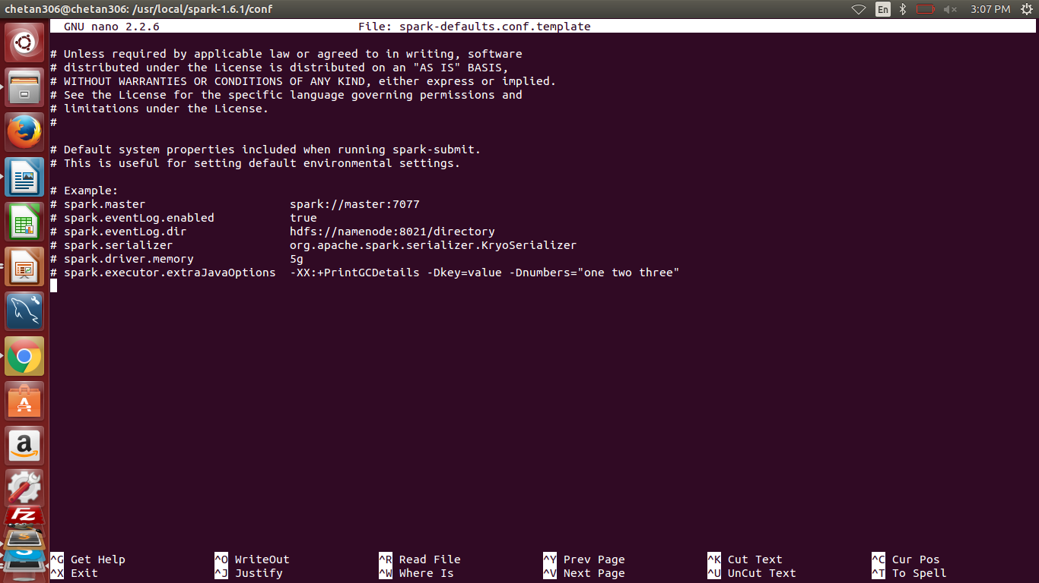
Spark Cluster Hyper parameter Tuning
2) Configuration in spark-defaults.conf at /usr/local/spark-1.6.1/conf

Slide 13
Spark Cluster Hyper parameter Tuning
spark.master spark://master.prod.chetan.com:7077
spark.serializer org.apache.spark.serializer.KryoSerializer
spark.eventLog.enabled true
spark.history.fs.logDirectory file:/data/tmp/spark-events
#spark.eventLog.dir=hdfs://namenode_host:namenode_port/user/spark/applicationHistory4
spark.eventLog.dir file:/data/tmp/spark-events

Slide 14
PySpark with Hadoop Demo

Slide 15
PySpark with Hadoop Demo- MapReduce with wordcount
>>> textFile = sc.textFile("file:///home/chetan306/inputfile.txt")
>>> textFile.count()
>>> textFile.first()
>>> wordCounts = textFile.flatMap(lambda line: line.split()).map(lambda word: (word, 1)).reduceByKey(lambda a, b: a+b)
>>> wordCounts.collect()

Slide 16
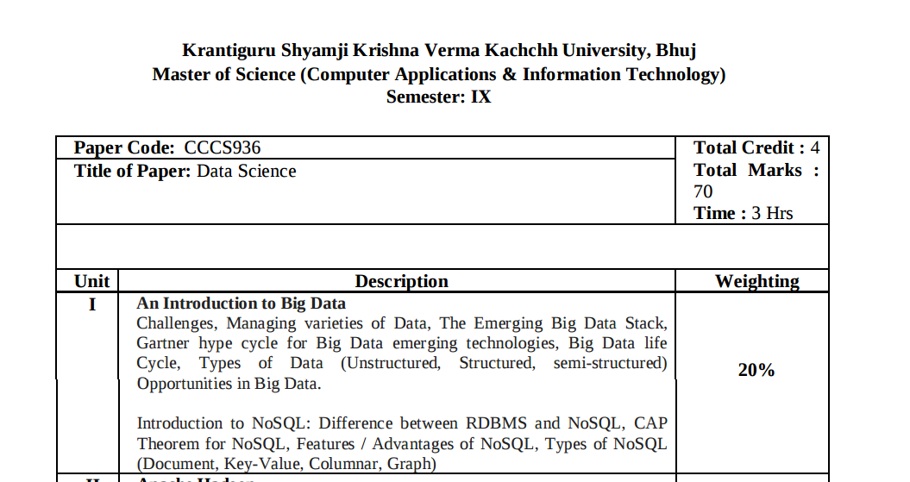
Data Science in University Education Initiative
Data Science Lab, Computer Science Department – University of Kachchh.

Slide 17
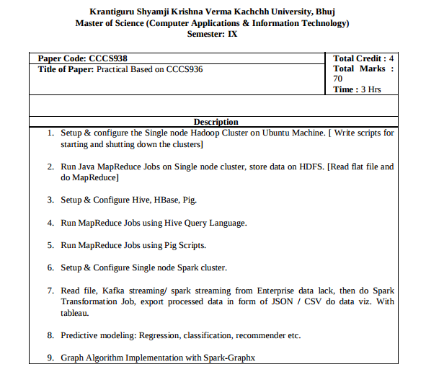
Data Science in University Education Initiative
- Machine learning / Data Science with Python

Slide 18
Questions ?

Slide 19
Resources
https://github.com/dskskv/pycon-india-2016
chetan@kutchuni.edu.in
Twitter: @khatri_chetan

