Slide 1


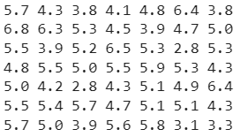



One sample X[i, :]
One label y[i]
Inputs (features)
$$X=$$
Outputs (labels)
$$y=$$
One feature X[:, j]

