Slide 1
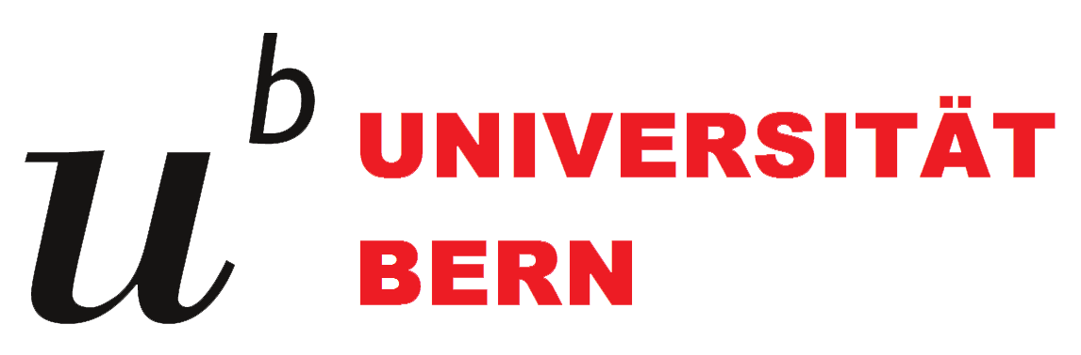
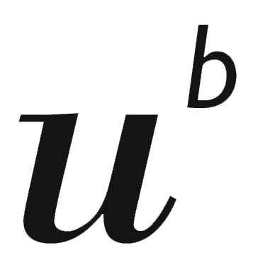
Introduction to Python
Day 1 · Your toolbox: Python, packages, uv & JupyterLab
World Trade Institute
Presenters:
Matteo Boi & Michael Horn
DSL
[02/10/2026]

Slide 2




Quick poll: raise your hand if…
No wrong answers: this helps us pitch the course at the right level.
…you have written an Excel formula
…you have used Stata, R or SPSS
…you have written a line of code
…you have ever opened a terminal
Whatever you raised: you are in the right room.

Slide 3



Why should a trade researcher code?
600+
5,000+
60+ years
WTO disputes since 1995: thousands of pages of legal text
six-digit product codes in the Harmonized System (HS)
of bilateral trade flows in UN Comtrade (since 1962)
That's millions of rows and thousands of pages. Copy & paste doesn't scale.
Code makes your research repeatable, shareable and checkable.

Slide 4




“But AI can write the code for me…”
AI is built with code
What is the average tariff in my data?
Most of today's AI tools are written in Python. A little Python shows you what is under the hood.
Sure! Here is the code:
AI writes code. You answer for it.
It produces analysis code in seconds. Your name is on the paper: you need to read and check it.
tariffs["rate"].mean()
AI becomes a tool for your data
Simple average or trade-weighted?
The AI didn't ask. Would you have noticed?
With a few lines of code, a model reads 600 dispute reports. No more pasting them into a chat.
Knowing some code turns AI from a black box into a tool you can check.

Slide 5





Today’s plan (1 h 45)
Welcome & motivation
1
What is Python?
By the end of today you will have…
2
Packages & libraries
uv installed (and Python with it)
Break
3
uv, the package manager
your first Python project
4
JupyterLab, your notebook
JupyterLab open in your browser
5
Live demo: set it all up
Outlook: VS Code
run your first notebook cell
Wrap-up & questions

Slide 6
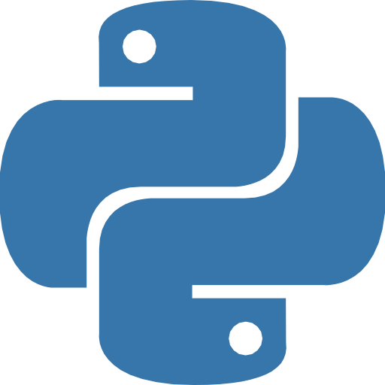
Part 1
What is Python?
…and why is it named after a comedy show?

Slide 7
A program is a recipe
In plain English
In Python
1. Take the import value: 2,500,000
2. Take the tariff rate: 12 %
3. Multiply them
4. Tell me the result
import_value = 2_500_000
tariff_rate = 0.12
duty = import_value * tariff_rate
print(duty)
Output: 300000.0
A computer is a very fast, very literal research assistant: it does exactly what you write. Nothing more, nothing less.

Slide 8
Python reads (almost) like English
1
A list: several values in one box, inside [square brackets]
countries = ["Chile", "Kenya", "Japan"]
for country in countries:
print("Hello from", country)
1
2
3
2
A loop: do the same thing for each item of the list
Output
3
Indentation (4 spaces) means “this line belongs to the loop”
Hello from Chile
Hello from Kenya
Hello from Japan
No semicolons, no curly braces: just words and spaces.

Slide 9



Meet Python
1991: created by Guido van Rossum, a Dutch programmer
Free & open source: built and maintained by a worldwide community
Named after Monty Python’s Flying Circus, not the snake
Used at Google, NASA, Netflix… and in most data-science and AI work today
python.org

Slide 10



What can Python do for your PhD?
Clean & merge data
Visualise
Analyse legal text
Combine tariff schedules, trade flows and country data
Publication-ready charts and maps
Search and compare hundreds of dispute reports or treaties
pandas
matplotlib, seaborn
re, spaCy
Collect web data
Econometrics
Automate the boring stuff
Download data automatically instead of clicking 200 times
Regressions, panel data, gravity models
Rename 500 PDFs, fill templates, call AI models
requests
statsmodels, pyfixest
pathlib, openai…

Slide 11

Myth vs. Fact
Myth
Fact
“I have to be good at maths.”
You need logic, not calculus. Most code is: load, filter, count, plot.
“I might break my computer.”
You won't. The worst case is an error message, and errors are clues.
“Real programmers know it all by heart.”
Everyone searches and asks AI. Reading docs is the real skill.
“It's too late for me to start.”
You only need a small part of Python to be productive.

Slide 12

Part 2
Packages & libraries
…or: why you will never code a regression from scratch

Slide 13





Python is a phone. Packages are apps.
install
pandas
numpy
Jupyter
Python
comes with the basics:
maths, dates, files…
+600k
“standard library”
plotly
scikit-learn
and more
Someone already built, tested and documented it. You just install it and use it.

Slide 14
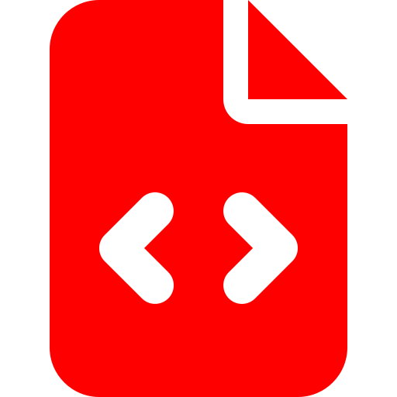

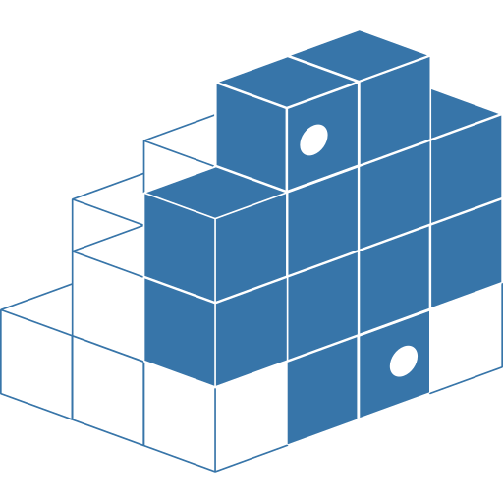
Module, package, library: what's the difference?
Module
Package
Library
One .py file with code in it
A folder of modules that you can install and share
Loose word for reusable code. In practice: package ≈ library
main.py
pandas
“the pandas library”
PyPI, the Python Package Index (pypi.org), is the “app store”: 600,000+ free packages.
Anyone can publish there, so stick to well-known, well-maintained packages.

Slide 15

Popular packages for researchers
pandas
numpy
matplotlib
Tables (“data frames”): like Excel, but for millions of rows
Fast maths on large arrays of numbers: the engine under pandas
Charts of every kind, ready for publication
statsmodels
Jupyter
scikit-learn
Regressions and econometrics, with Stata-like output tables
Notebooks: code, text and charts together in one document
Machine learning: classification, clustering, prediction

Slide 16
Using a package: install once, import every time
1
Install it once per project, in the terminal
What you get: a table
uv add pandas
reporter | partner | hs6 | tariff_%
CHE | BRA | 090111 | 0.0
EU | KEN | 060311 | 8.5
JPN | CHL | 030214 | 3.5
2
Import it at the top of your script, then use it
import pandas
tariffs = pandas.read_csv("tariffs.csv")
print(tariffs.head())
Illustrative, made-up numbers

Slide 17
Using a package: install once, import every time
1
Install it once per project, in the terminal
What you get: a table
uv add pandas
reporter | partner | hs6 | tariff_%
CHE | BRA | 090111 | 0.0
EU | KEN | 060311 | 8.5
JPN | CHL | 030214 | 3.5
2
Import it at the top of your script, then use it
import pandas as pd
tariffs = pd.read_csv("tariffs.csv")
print(tariffs.head())
Illustrative, made-up numbers
“as pd” gives pandas a nickname, so we can type pd instead of pandas.

Slide 18
The catch: packages need other packages
Now imagine…
numpy
Project A needs pandas 3
Project B needs pandas 2
Your co-author has pandas 1…
your project
pandas
python-dateutil
six
“But it works on my machine!”
tzdata
uv add pandas actually installed 5 packages: pandas + 4 it depends on.
We need a manager for this: uv.

Slide 19

Part 3
uv
…one tool to manage them all

Slide 20


Every project needs its own kitchen
Project A: thesis, chapter 2
Project B: paper with a co-author
a gravity model of trade
started in 2023
Its pantry (.venv)
Its pantry (.venv)
Python 3.13
pandas 3.0
statsmodels 0.14
no mixing
Python 3.11
pandas 2.1
matplotlib 3.8
Each project gets a private virtual environment: a folder called .venv with its own Python and packages. Projects can't break each other.

Slide 21




What is uv?
Fast
Written in Rust; its developers report 10–100× faster than the classic pip
Installs Python for you
No separate installer from python.org needed
One environment per project
by Astral · 2024 · free
docs.astral.sh/uv
Creates and manages the .venv kitchen automatically
Reproducible
Records exact versions, so your co-author gets the same setup

Slide 22
One tool instead of many
pip
venv
virtualenv
pyenv
pip-tools
poetry
uv
pipx
one tool, one set of commands
You will see these names in older tutorials. Today, uv covers all of them.

Slide 23




The uv workflow in four verbs
Create
Add
Run
Share
a new project, with its own kitchen
a package to this project only
your code, or JupyterLab, in the right environment
your co-author rebuilds the same setup
uv init
uv add pandas
uv run jupyter lab
uv sync
Same four verbs on Windows and Mac, for every project. We'll see them live in the demo.

Slide 24



What's inside a uv project?
analysis.ipynb / main.py: your code, as a notebook or a script
wti-python/
├── .venv/
├── .python-version
├── analysis.ipynb
├── main.py
├── pyproject.toml
├── uv.lock
└── README.md
pyproject.toml: the shopping list. What you asked for (“pandas”)
uv.lock: the receipt. Exactly what you got (pandas 3.0.6, numpy 2.5.3…)
.venv/: the pantry, where packages live. Never edit or share it: uv can rebuild it
Share with co-authors: your code + pyproject.toml + uv.lock. Never the .venv folder.

Slide 25
Part 4
JupyterLab
…a lab notebook for your code

Slide 26
A notebook: code, results and notes together
analysis.ipynb
1
Markdown cell
wti-python
analysis.ipynb
main.py
pyproject.toml
Tariff exposure
1
your notes, headings and explanations
Quick look at three partners (made-up rates).
2
Code cell
[1]:
import pandas as pd
trade = pd.read_csv("tariffs.csv")
trade
2
a few lines of Python, run with Shift+Enter
country tariff
0 Switzerland 0.02
1 Brazil 0.08
2 Kenya 0.12
3
3
Output
results appear right under the code
[2]:
trade.plot.bar(x="country", y="tariff")
4
Charts
4
plots live inside the document too
Switzerland
Brazil
Kenya

Slide 27
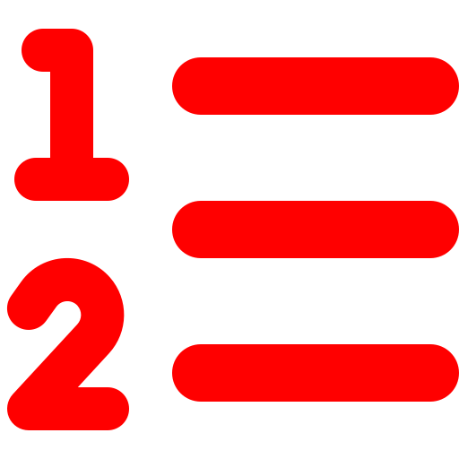




Why notebooks for research?
Step by step
Instant feedback
Notes next to code
Run one small piece at a time and check it before moving on
See tables and numbers the moment you run a cell
Explain your reasoning, like in a lab notebook
Charts inline
One file to share
Standard in research
Figures appear right where you made them
An .ipynb file keeps code, results and notes together
Widely used in data science, economics and teaching
Watch out: cells can be run in any order, so a notebook can show results that no longer match its code. Before trusting results: Restart the kernel and run all cells.

Slide 28


JupyterLab is just another package
Install it
Launch it
Your browser opens
The kernel
a package, added to your project like pandas
from the terminal, inside your project
but everything runs locally, on your laptop
the Python engine behind it, from your .venv
uv add jupyterlab
uv run jupyter lab
localhost:8888
Python 3 (.venv)
Remember the dependency tree? JupyterLab brings ~90 packages with it, and uv handles all of them.
The Jupyter family: Jupyter Notebook (classic, simpler) · JupyterLab (what we use) · Google Colab (in the cloud)

Slide 29

Live demo
Build your toolbox

Slide 30



What we'll do together
STEP 1
STEP 2
STEP 3
STEP 4
STEP 5
STEP 6
Open a terminal
Install uv
Create a project
Add pandas & JupyterLab
Launch JupyterLab
Run your first cell
Stuck? Raise your hand, we'll come to you. Error messages are clues, not failures.
Done early? Help your neighbour. Then change a number in a cell and run it again.

Slide 31
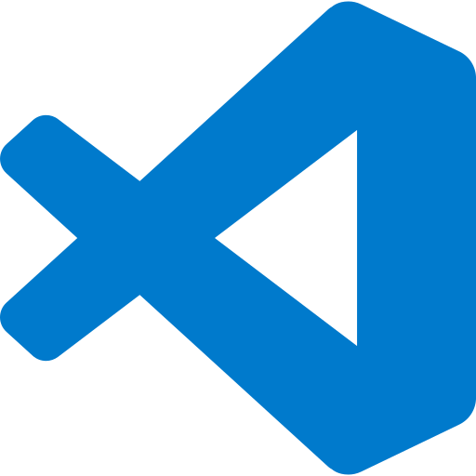
Outlook
VS Code
…what most people actually use today

Slide 32

VS Code: like Word, but for code
main.py — wti-python — Visual Studio Code
1
Explorer
1
EXPLORER
▾ WTI-PYTHON
.venv
main.py
pyproject.toml
uv.lock
2
the files of your project
import pandas as pd
print("Hello, WTI!")
2
Editor
4
where you write code
3
Terminal
where you type commands like uv
TERMINAL
> uv run main.py
Hello, WTI!
3
Extensions
4
add-ons: Python, Jupyter…

Slide 33
JupyterLab or VS Code?
JupyterLab
VS Code
great for exploring
great for building
Analysing data step by step
Bigger projects with many files
Learning and teaching
The most popular editor among developers
Analysis, charts and notes in one file
Extensions: Git, AI assistants, debugging…
Runs in the browser
Opens your Jupyter notebooks too
Not either/or: explore in a notebook, move stable code into scripts. For this course: JupyterLab.

Slide 34
Recap: your toolbox
Python
Packages
uv
JupyterLab
the language
ready-made tools
the manager
the notebook
writes the recipes
the apps on your phone
keeps each project's kitchen separate
your lab notebook
Python + packages, managed by uv, explored in JupyterLab.

Slide 35
Before next time
Checklist
Want more? (optional)
uv --version prints a version
The Python Tutorial
docs.python.org/3/tutorial
uv: Getting started
uv run jupyter lab opens JupyterLab
docs.astral.sh/uv
Your first notebook runs from top to bottom
JupyterLab documentation
jupyterlab.readthedocs.io
Try uv add matplotlib: what changed in pyproject.toml?
Automate the Boring Stuff with Python
automatetheboringstuff.com (free book)

Slide 36
Questions?

