Slide 1
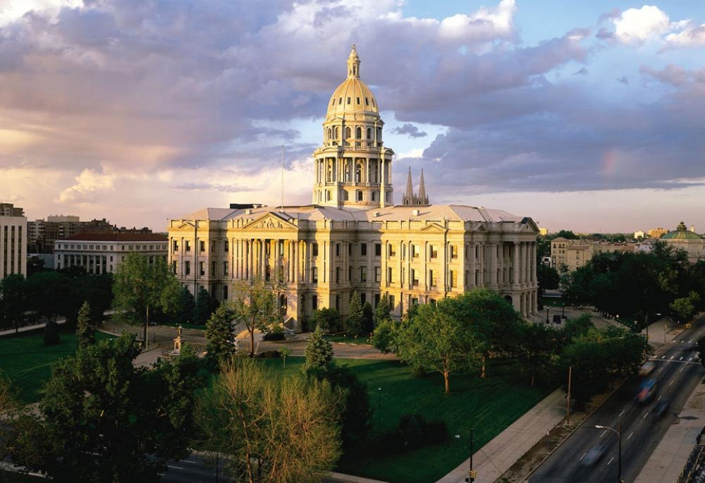
Colorado’s Political Landscape https://github.com/dslachar/analysis_of_crp_data
Samantha Werdel
Dave Palazzo
David LaCharite

Slide 2

Data Set and Motivation
Source: Center for Responsive Politics (CRP)
Independent and nonprofit research group that collects political finance data.
Required disclosures from Federal Election Committee
Data Tables: Across seven political cycles 1992-2016
1. Individual Contributions – 23 attributes
Amount, Address, Candidate ID
2. Candidate – 12 attributes
Political Affiliation, Congressional/Presidential Candidate, Results of the campaign

Slide 3
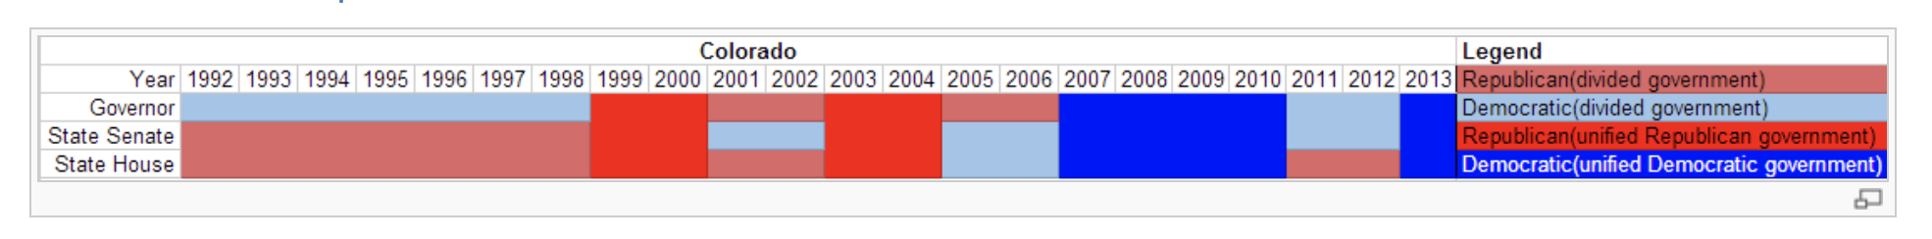
Literature Review
Based on our literature review:
Voting trends in Colorado have shifted rapidly over the last quarter century.
Once a solidly Republican state.
Colorado’s changing culture and influx of new residents from other regions has shifted Colorado voters more towards Democrats.
Source: https://ballotpedia.org/Colorado_General_Assembly
Why look at donor data when we have voter data?
Donor data provides additional insight into passion and intensity for a party, candidate, or issue.

Slide 4
Research Questions
How has this Colorado’s shifting political landscape effected trends in campaign donations?
We set out to use campaign finance data to observe trends over the last 25 years of Coloradan’s contribution to political campaigns by considering the following research questions:
What trends exist in magnitude of money given, number of donations and political affiliation?
Has there been a correlation between the amount of money donated and candidate success in elections?
How have political contributions evolved in different regions of the state?

Slide 5
Data Cleaning and Transformation
This was a relatively large dataset.
Clean up code
Size of Individuals dataset
Separator
Cleaning and transformation challenges we needed to address in order to get the data we needed to answer our research questions.
Occasionally missing data
Zip Codes
Win/Loss
Transformation
CO candidates
Party/Results
Notes:
Our clean up code had two functions (one for each individuals and one for candidates)
Came up with best (not perfect) separator put still had to split the columns up
In particular the individuals data set was the largest, before we really started to clean, took at only the CO individuals so we could work with a smaller data frame
Columns contained two or four characters, only wanted the first two

Slide 6
Summary Statistics
 | Total Donors | Total Amount | Max | Min | Median | Mean
1992 | 10,898 | $7,113,570 | $10,000 | $200 | $325 | $652.75
1996 | 18,728 | $13,774,660 | $5,000 | $100 | $400 | $735.51
2000 | 22,284 | $21,976,086 | $3,000 | $9 | $500 | $986.18
2004 | 49,145 | $39,929,759 | $150,000 | $2 | $500 | $812.49
2008 | 79,315 | $72,180,357 | $2,000,000 | $1 | $400 | $910.05
2012 | 80,692 | $82,503,809 | $1,000,000 | $1 | $320 | $1022.45
2016 | 500,376 | $108,923,999 | $1,000,000 | $1 | $35 | $217.68

Slide 7
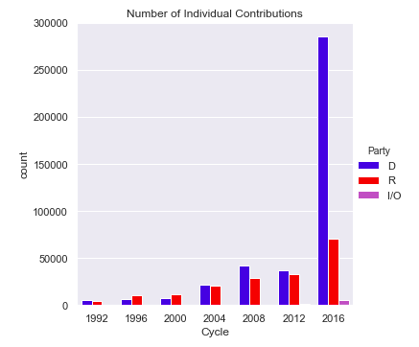
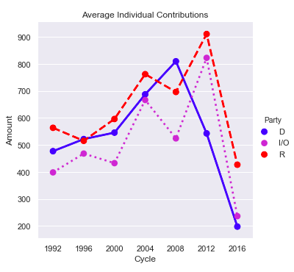
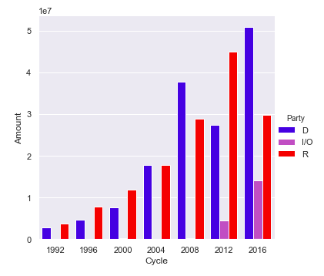
Summary Visualizations

Slide 8
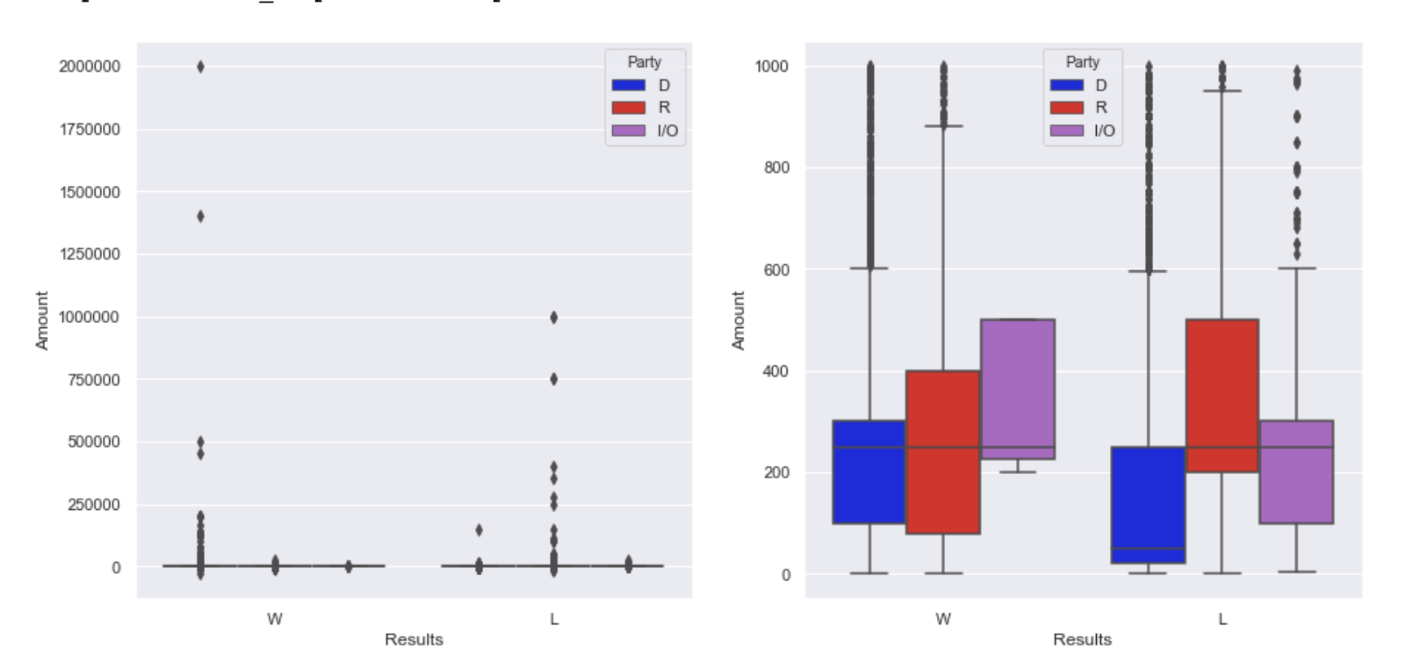
Amounts Given Over All of the Years

Slide 9
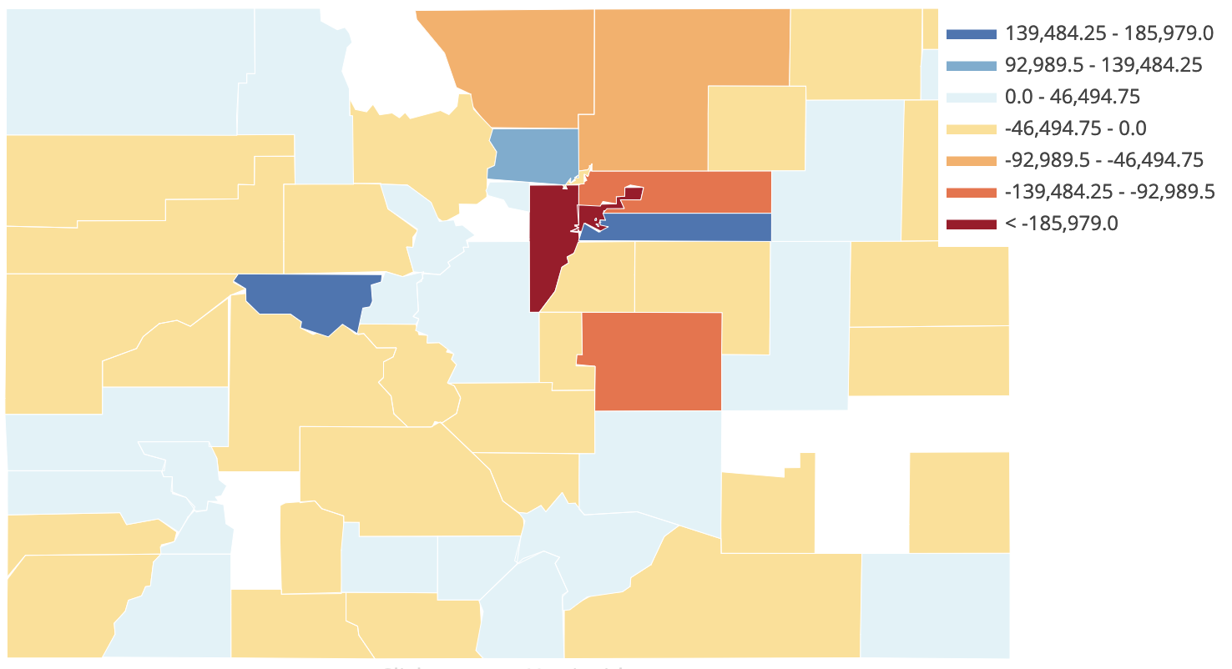
Colorado Net Democratic Political Contributions by County
1992

Slide 10
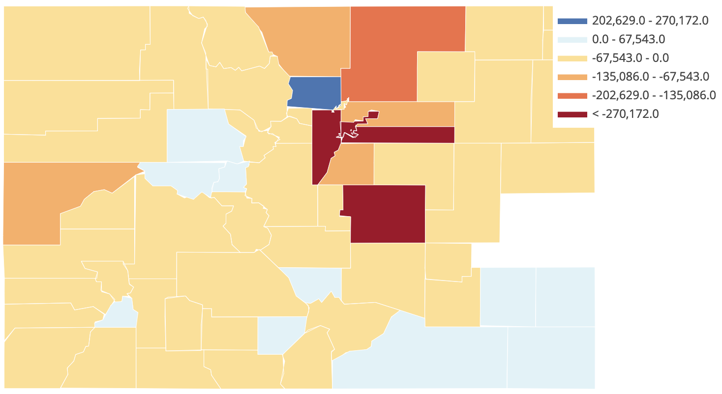
Colorado Net Democratic Political Contributions by County
1996

Slide 11
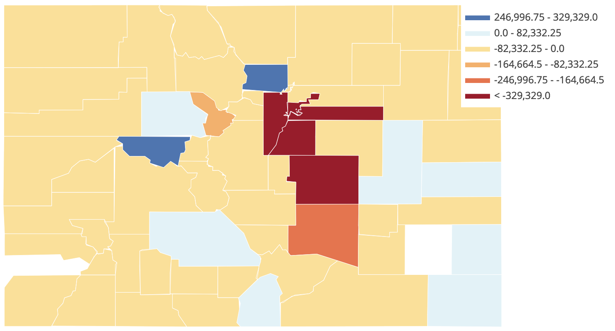
Colorado Net Democratic Political Contributions by County
2000

Slide 12
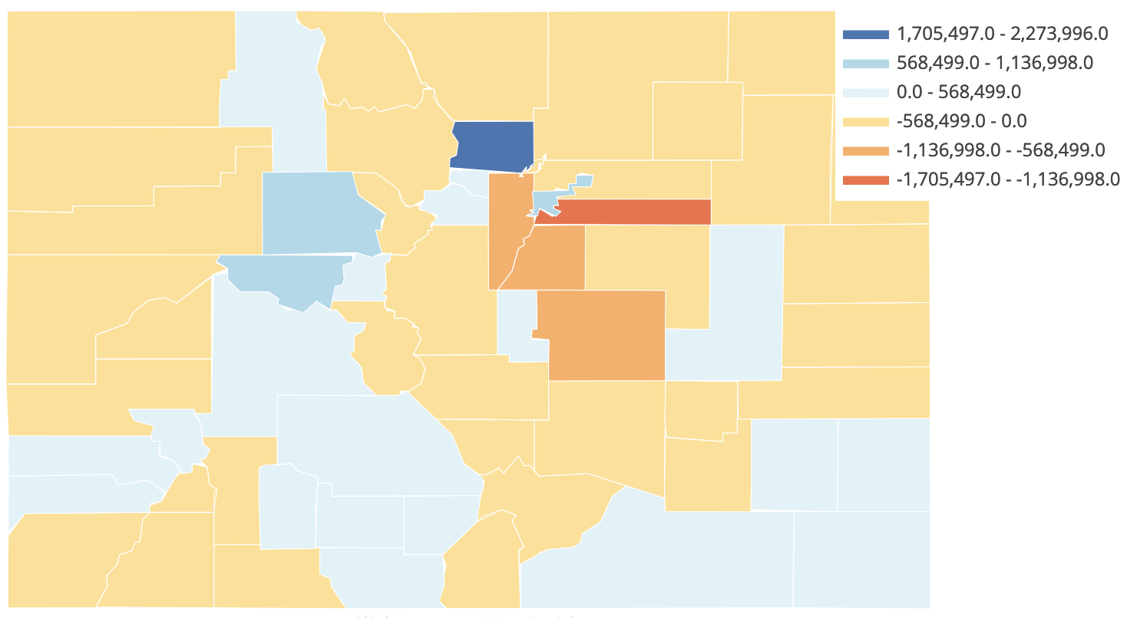
Colorado Net Democratic Political Contributions by County
2004

Slide 13
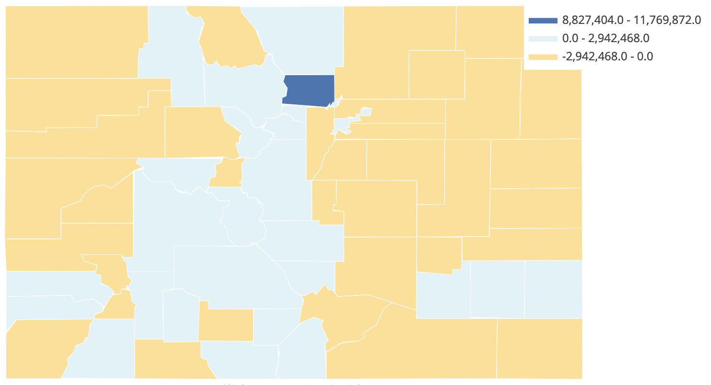
Colorado Net Democratic Political Contributions by County
2008

Slide 14
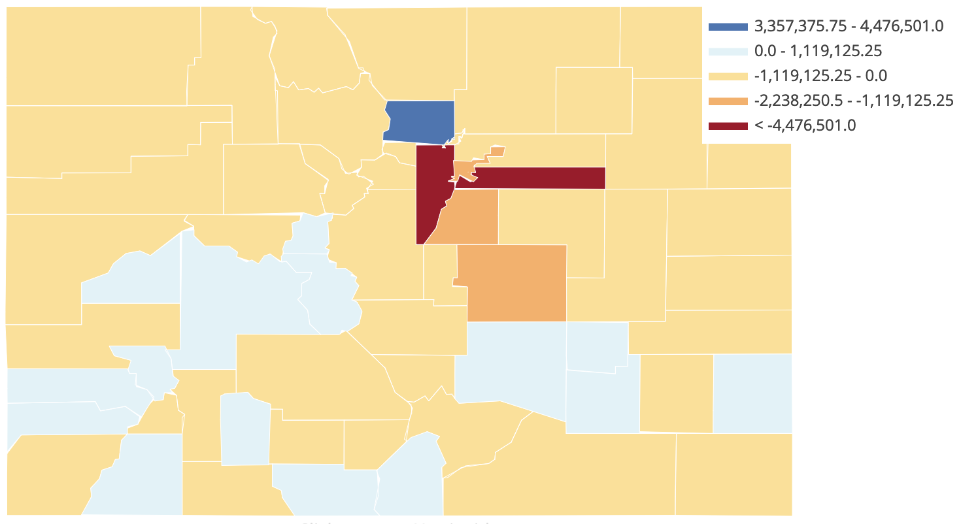
Colorado Net Democratic Political Contributions by County
2012

Slide 15
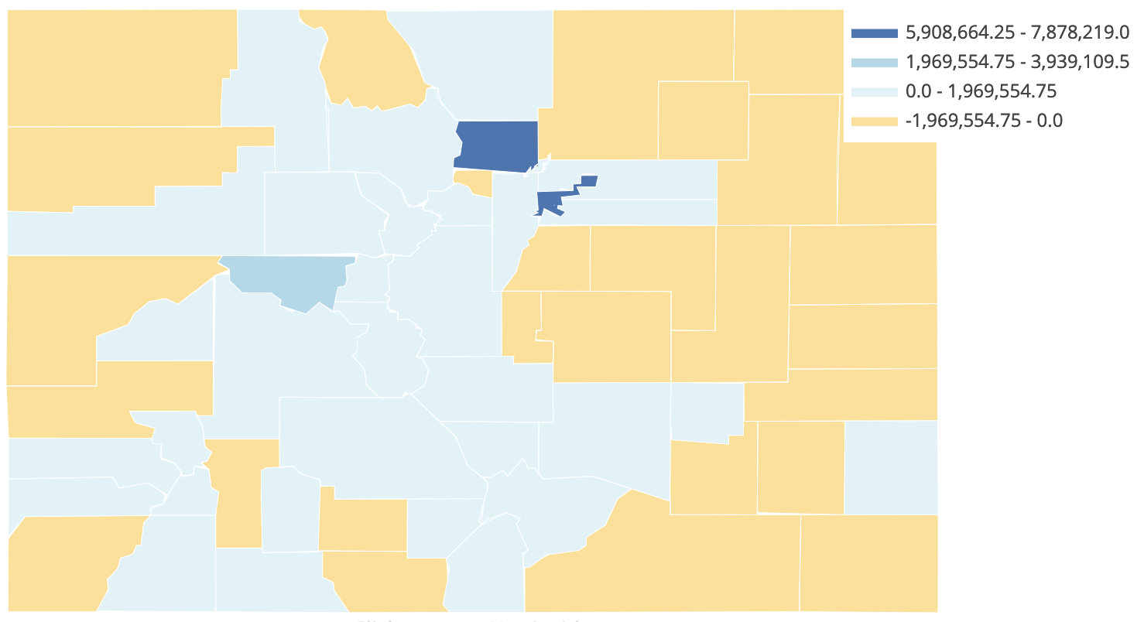
Colorado Net Democratic Political Contributions by County
2016

Slide 16






Citations

