Slide 1
Colorado’s Political Landsacpe
Samantha Werdel
Dave Palazzo
David LaCharite

Slide 2
Data Set and Motivation
The data used in this report is from the Center for Responsive Politics (CRP), an independent and nonprofit research group that collects political finance data.
Our report utilizes two data tables across seven political cycles, from 1992 – 2016. The first table is individual contribution data, which includes 23 attributes including contribution amounts and political affiliation of recipient.
Since the mid-1980s the amount spent on political elections by campaigns and outside groups, measured by the Federal Election Committee, has grown by 555 percent nationwide. While voting ultimately determines the result of any given election, analyzing political contributions can signal how passionate and invested individuals are in the success of a given candidate.

Slide 3
Research Questions
We set out to use campaign finance data to observe trends over the last 25 years of Coloradan’s contribution to political campaigns by considering the following research questions:
What trends exist in magnitude of money given, number of donations and political affiliation?
Is there a relationship between the amount of money donated and candidate success in elections?
How have political contributions evolved in different regions of the state?

Slide 4
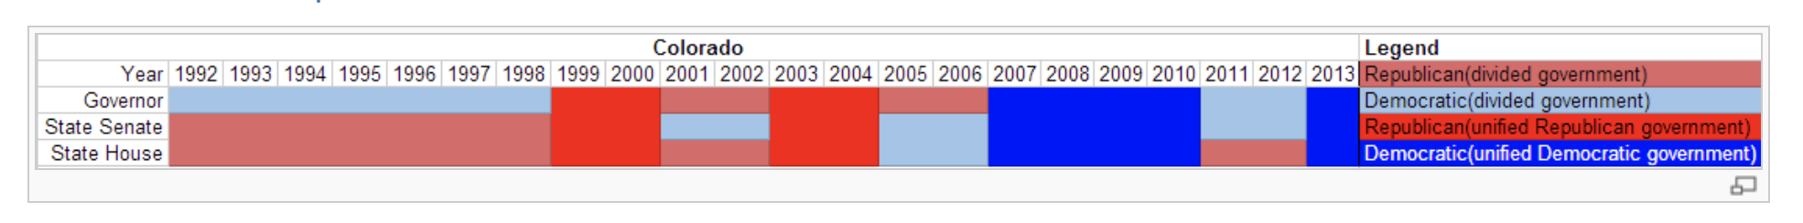
Literature Review
Based on our literature review, voting trends in Colorado have shifted rapidly over the last quarter century. While once a solidly conservative state, Colorado’s changing culture and influx of new residents from other regions has shifted Colorado’s politics more progressive.

Slide 5
Data Cleaning and Transformation
This was a very large but relatively clean dataset. However the dataset did contain several cleaning and transformation challenges we needed to address in order to get the data we needed to answer our research questions.
Some of these cleaning challenges included:
Occasionally missing data
Improperly formatted data for our uses. For example individual donor’s state and political party was imbedded in string with other information.
Additionally, in order work with Plotly Individual donor zip code had to be converted to county, which in turn had to be converted to Federal Information Processing Standard(FIPS) required by Plotly to plot geographic data by county.

Slide 6
Vis 1

Slide 7
Vis 2

Slide 8
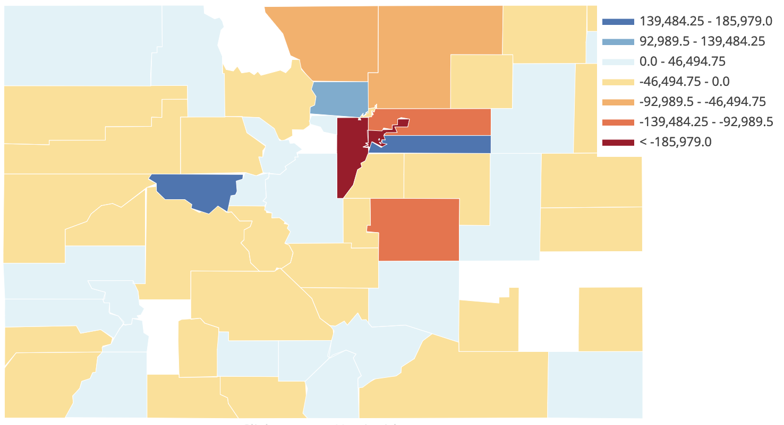
Colorado Net Democratic Political Contributions by County
1992

Slide 9
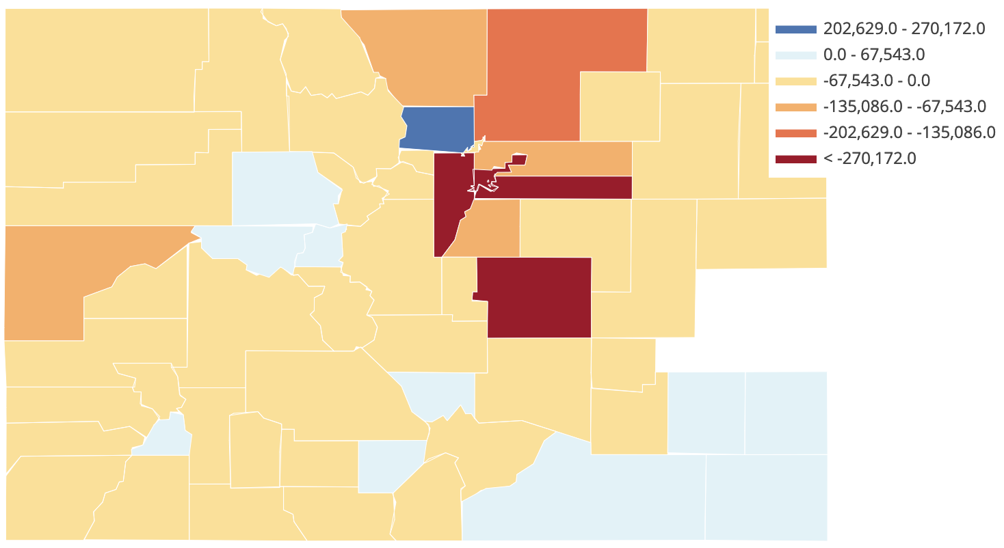
Colorado Net Democratic Political Contributions by County
1996

Slide 10
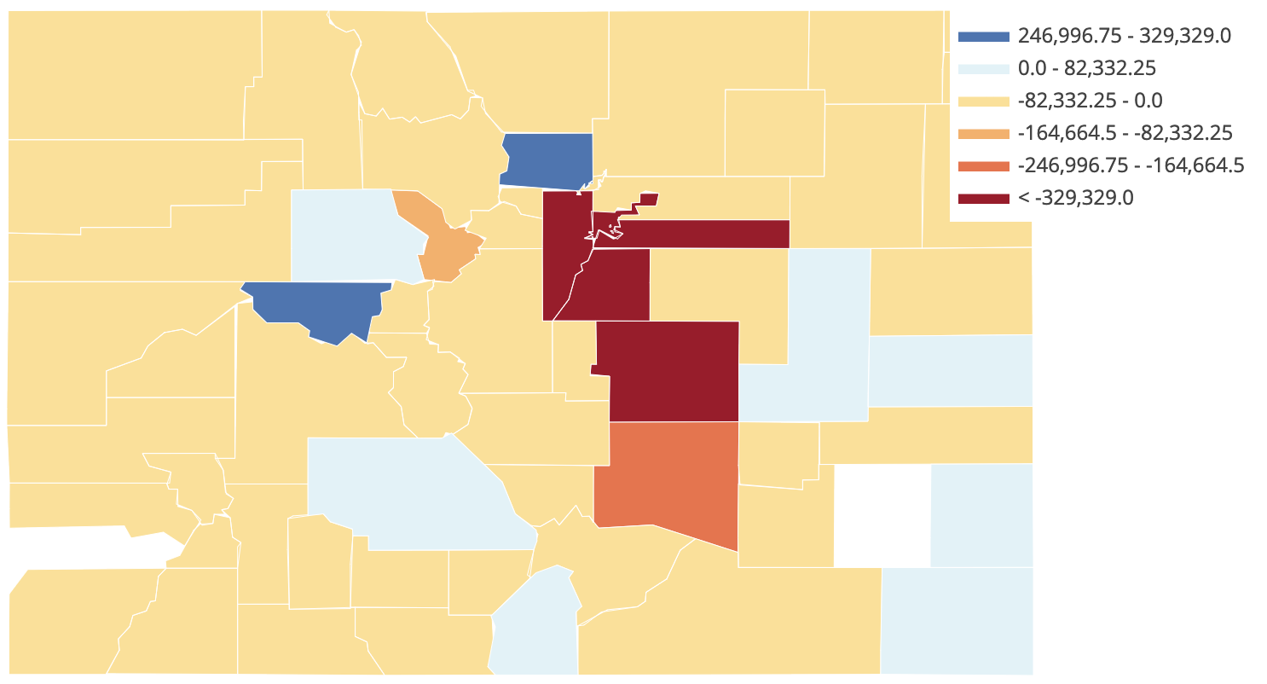
Colorado Net Democratic Political Contributions by County
2000

Slide 11
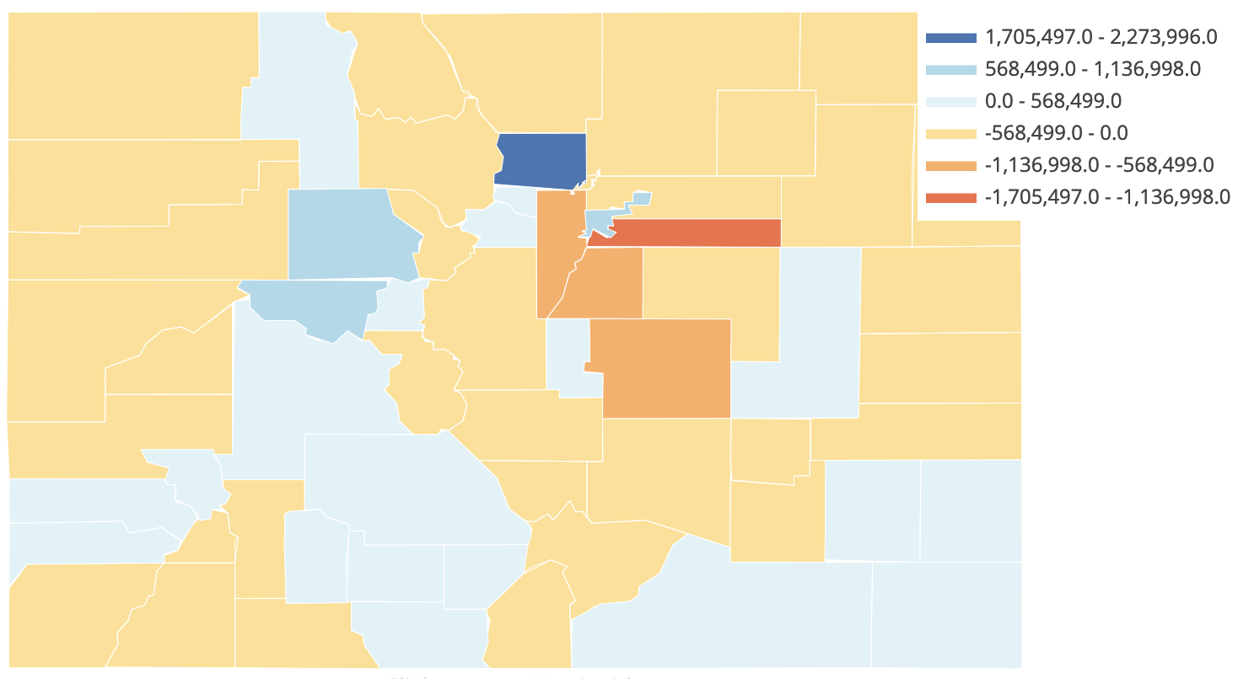
Colorado Net Democratic Political Contributions by County
2004

Slide 12
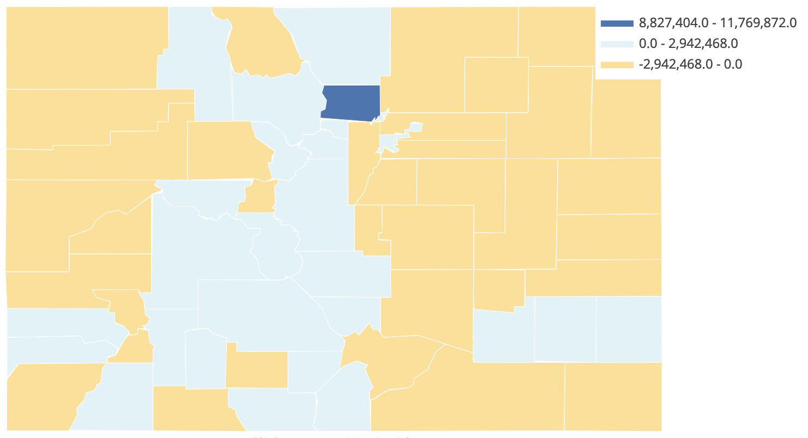
Colorado Net Democratic Political Contributions by County
2008

Slide 13
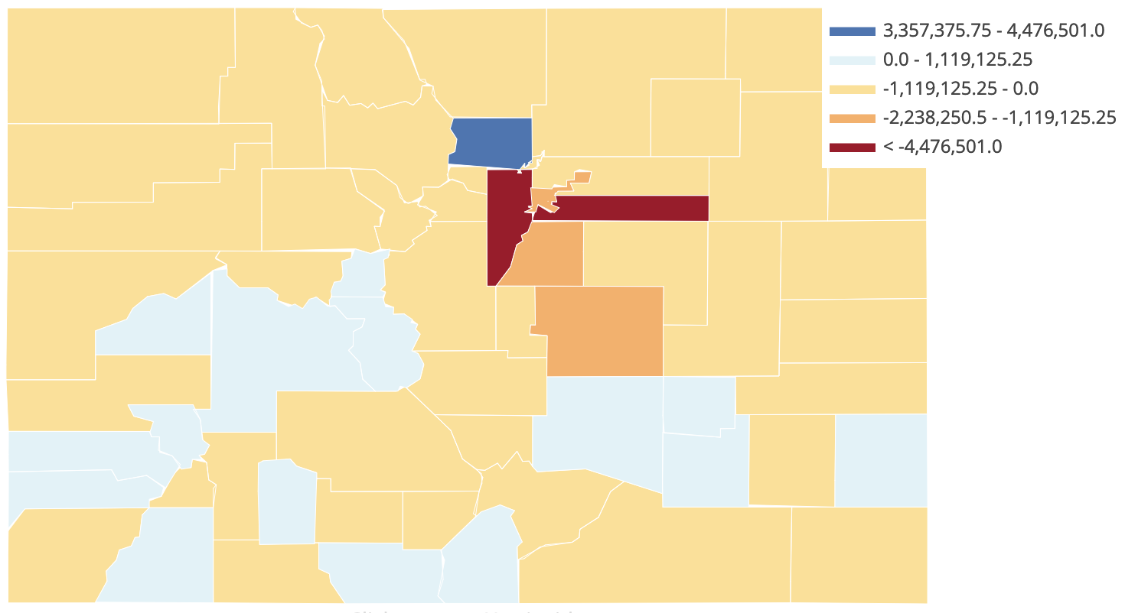
Colorado Net Democratic Political Contributions by County
2012

Slide 14
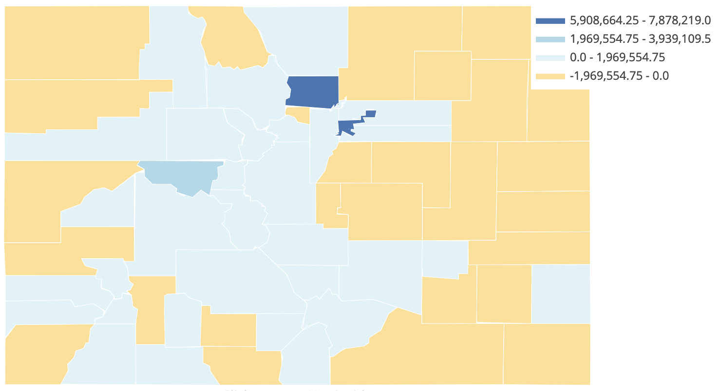
Colorado Net Democratic Political Contributions by County
2016

Slide 15
Conclusions

Slide 16
Citations

