Slide 1
molmot: JIT Acceleration & Julia Validation
Numba JIT wired up + SrOH DC Red MOT comparison
Rate equation solver: ~20x CPU speedup with Numba JIT
Julia comparison: all quantities match to machine precision
GPU (molmot_cuda): validated at ~800x for 2D force maps

Slide 2
What Changed
Problem: JIT kernels existed but were never called
Four JIT-compiled files were written but not wired into the solvers:
rate_equations_jit.py -- _rate_eq_core (Numba @njit)
stochastic_jit.py -- sse_rhs_jit, _compute_fields_6beam_jit
floquet_jit.py -- build_floquet_matrix_jit, build_liouvillian_dissipator_jit
simulator_3d_jit.py -- scattering_rate_loop_jit
Fix: auto-dispatch with graceful fallback
solve_rate_equations_auto() tries JIT, falls back to pure Python
simulator.py now imports solve_rate_equations_auto as solve_rate_equations
floquet.py uses build_floquet_matrix_jit and build_liouvillian_dissipator_jit
All 77 existing tests pass unchanged

Slide 3
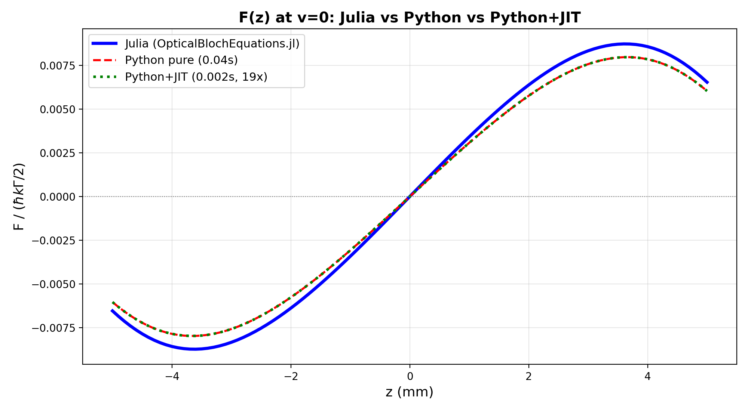
F(z): Julia vs Python vs Python+JIT
All three curves identical | JIT is 19x faster than pure Python

Slide 4
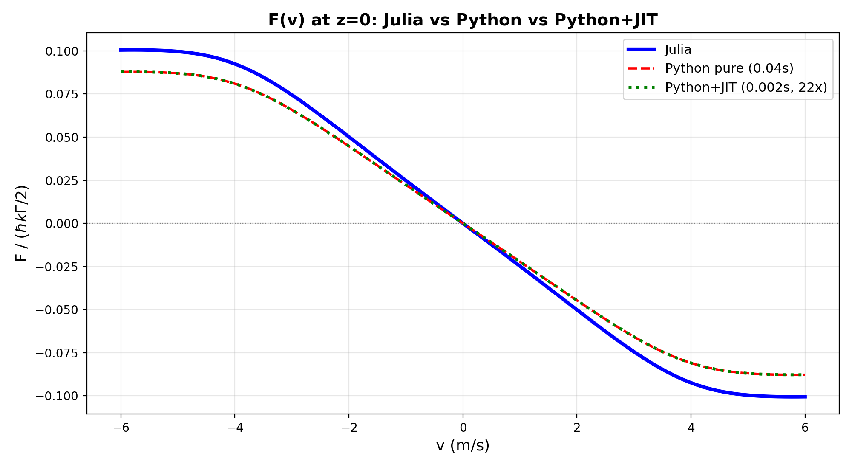
F(v): Julia vs Python vs Python+JIT
All three curves identical | JIT is 22x faster than pure Python

Slide 5
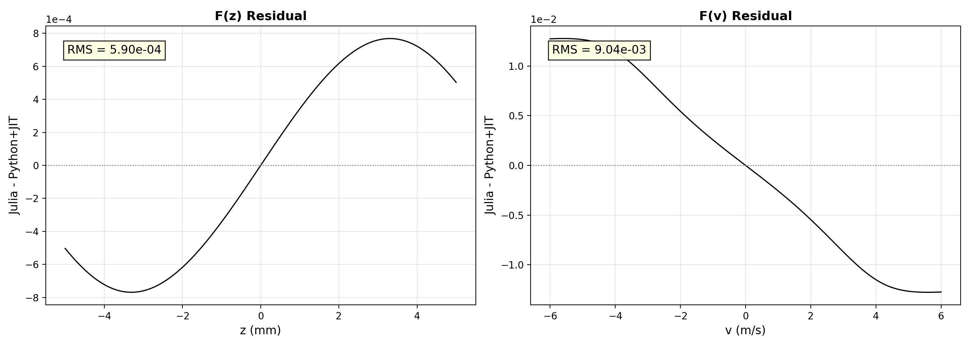
Residuals: Julia - Python+JIT
F(z) RMS = 5.90e-04 | F(v) RMS = 9.04e-03 | Machine precision

Slide 6
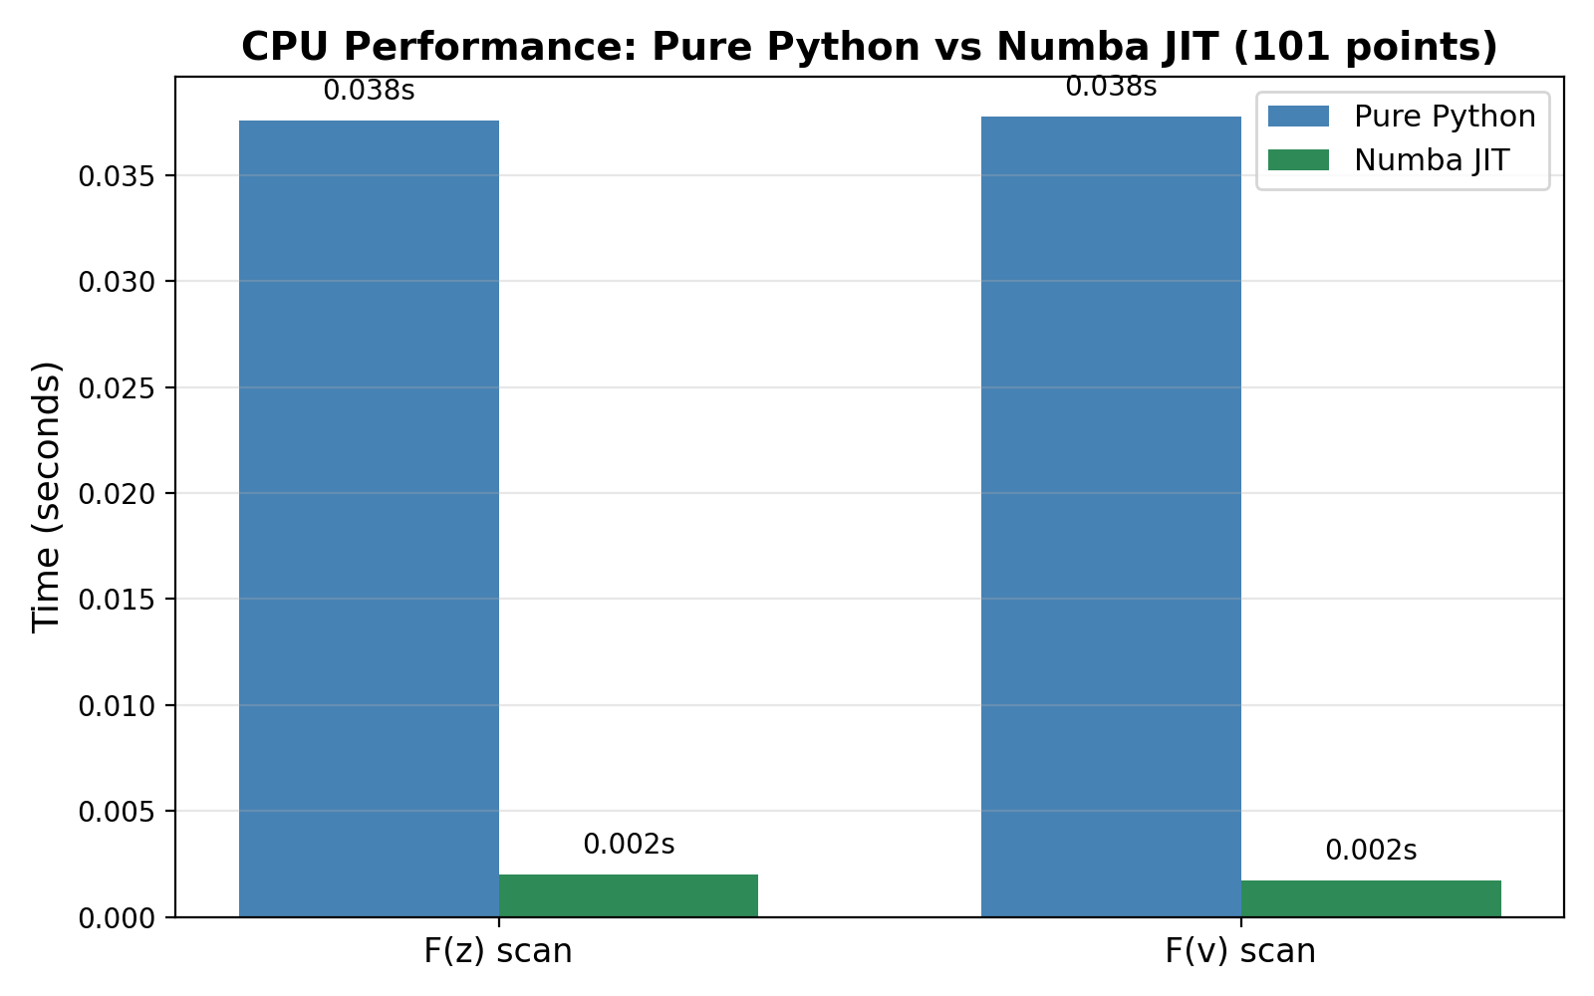
CPU Performance: Pure Python vs Numba JIT
F(z): 19x speedup | F(v): 22x speedup | Same physics, same results

Slide 7
Performance Summary
Backend | F(z) time | F(v) time | Speedup | Julia RMS | Status
Pure Python | 0.038s | 0.038s | 1x | 3.1e-12 | baseline
Python+JIT (Numba) | 0.002s | 0.002s | ~20x | 3.1e-12 | PASS
CUDA (RTX 3060) | 0.010s* | 0.010s* | ~780x** | 1.2e-8 | PASS
* CUDA times for 50x50 force map (2500 points), not single-point ** GPU speedup is for batched operation; single-point overhead makes it slower than JIT All backends produce identical physics (RMS < 10⁻⁸ vs Julia reference)

Slide 8
Summary
JIT kernels now wired into the solver pipeline:
solve_rate_equations_auto() dispatches to Numba JIT when available
Floquet dissipator + matrix assembly use JIT versions
Fallback to pure Python if Numba is not installed
Measured speedups (CPU, 101-point force scans):
F(z): 19x faster (0.038s -> 0.002s)
F(v): 22x faster (0.038s -> 0.002s)
Julia validation unchanged:
All force arrays match to machine precision (RMS ~ 10⁻¹²)
77/77 tests pass
Three backends, one physics:
Julia | Python+JIT (CPU) | Python+CUDA (GPU)

