Slide 1
SrOH DC Red MOT Simulation
Julia (OpticalBlochEquations.jl) vs Python (molmot)
Numerical Validation of the Python Translation
Original Julia code: Christian Hallas, Harvard University
Python translation: molmot v0.2.0
Parameters: SrOH_DC_redMOT example (QuantumSimulations.jl)

Slide 2
Simulation Setup
Molecular System
SrOH X²Σ⁺(000) → A²Π₁/₂(000)
λ = 687 nm Γ/(2π) = 6.4 MHz
12 ground + 4 excited = 16 states
Laser Configuration
4-frequency scheme (2 per SR manifold)
Detunings: [-10.3, -5.9, -9.2, -29.9] MHz
Power ratios: [0.50, 0.08, 0.15, 0.27]
Polarizations: [σ⁺, σ⁻, σ⁺, σ⁻]
B′ = 21.4 G/cm, P = 100 mW, w = 10 mm
How this comparison works
Julia side:
Runs OpticalBlochEquations.jl natively
Plots generated by Julia Plots.jl (GR)
Data saved to julia_redmot_results.npz
Python side:
Runs molmot rate-equation solver
Plots generated by matplotlib
Data saved to py_redmot_results.npz
Each language produces its own plots.
Different visual styles prove independence.

Slide 3
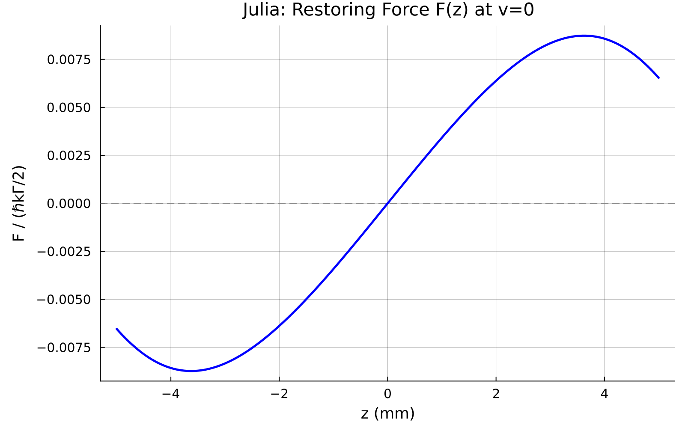
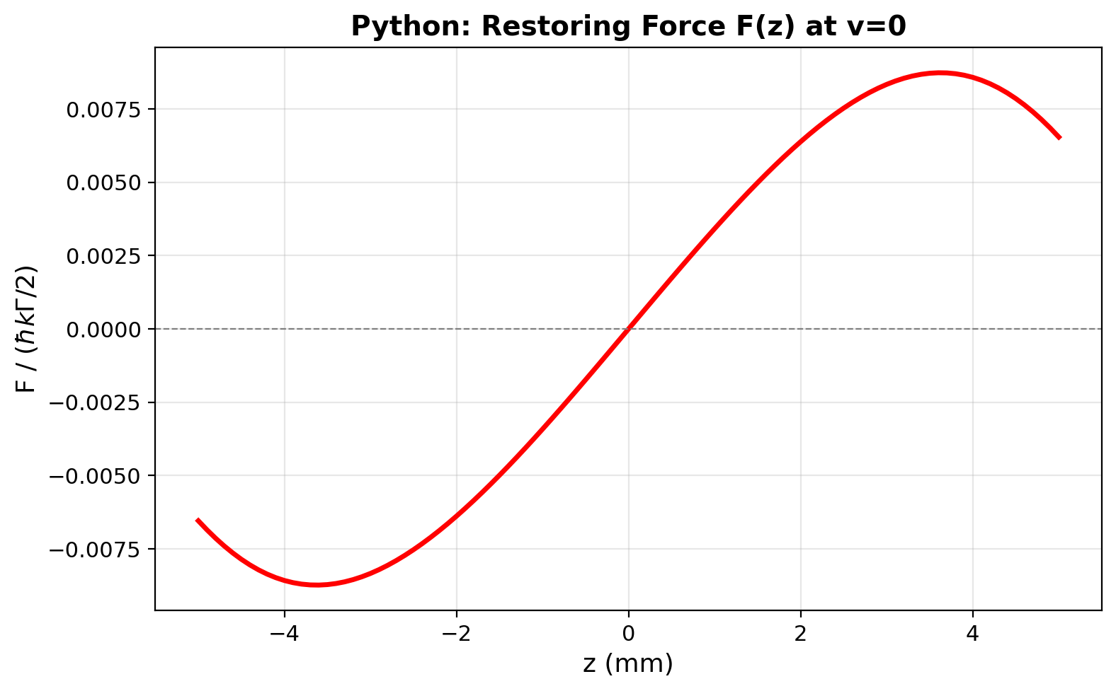
Force vs Position F(z) at v = 0
Generated by Julia Plots.jl
Generated by Python matplotlib
Same physics, different plotting libraries → identical curves
Max |F(z)| = 8.733×10⁻³ ℏ kΓ/2 | k = -6.75×10⁻²⁰ N/m (anti-trapping at these detunings)

Slide 4
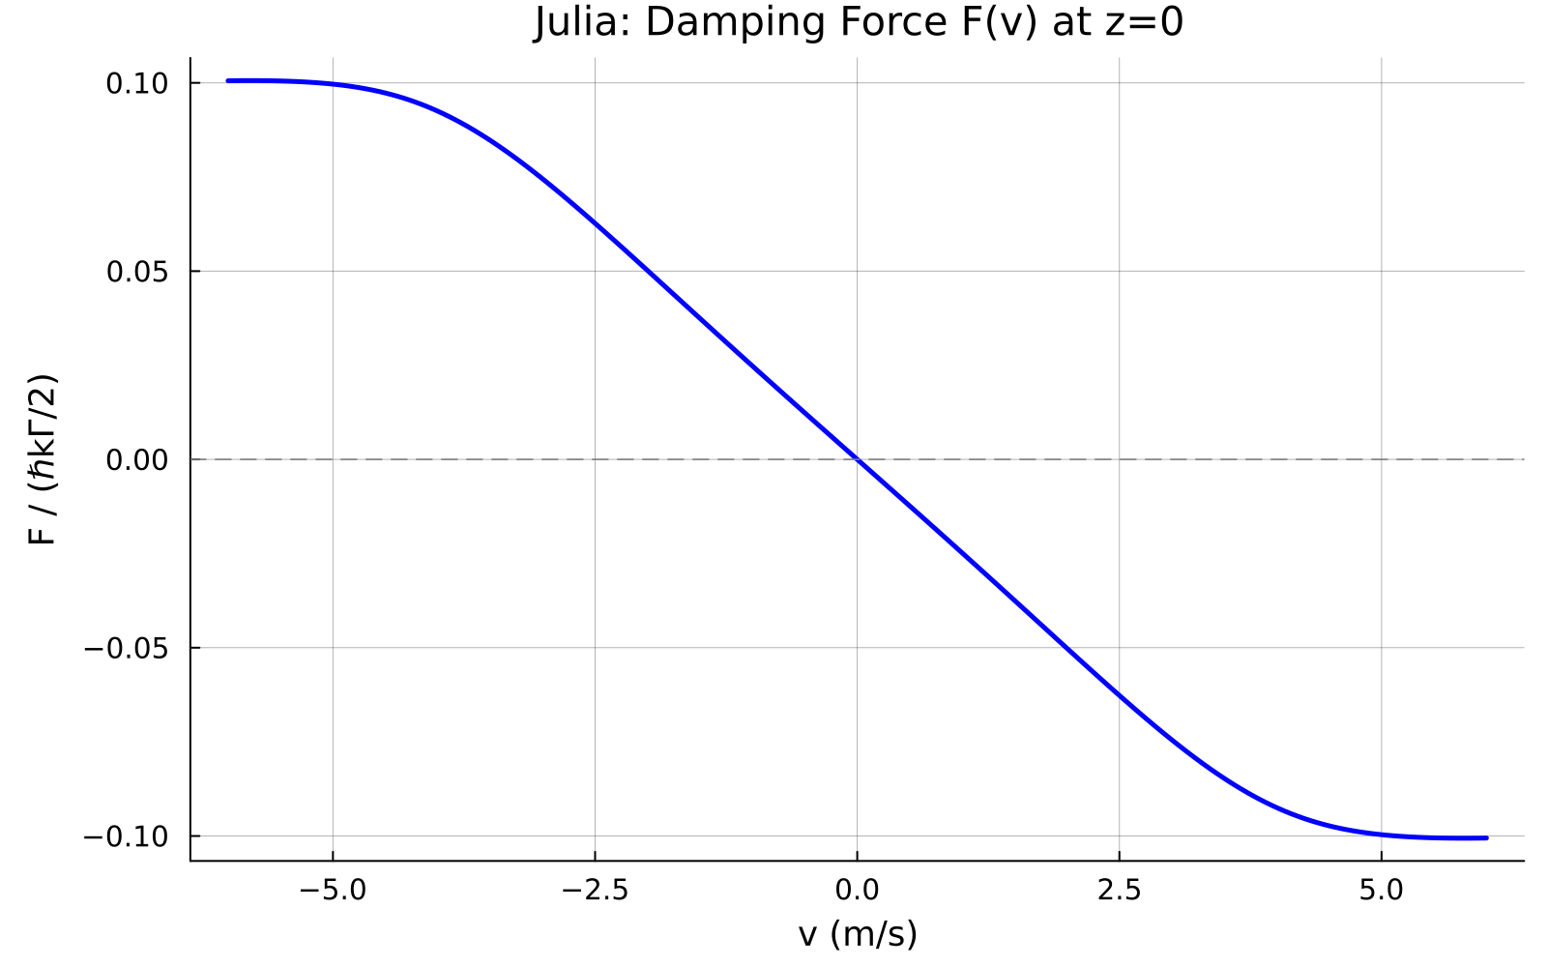
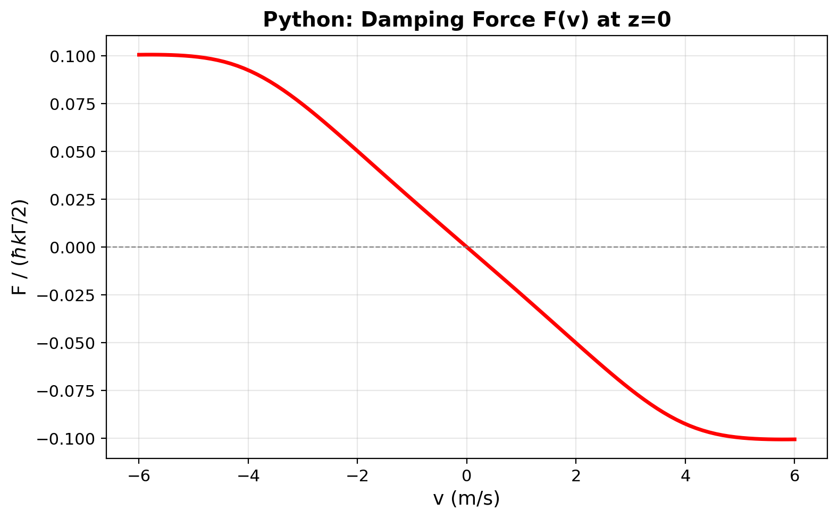
Damping Force F(v) at z = 0
Generated by Julia Plots.jl
Generated by Python matplotlib
Strong Doppler damping β = 2743 s⁻¹ | Identical in both languages

Slide 5
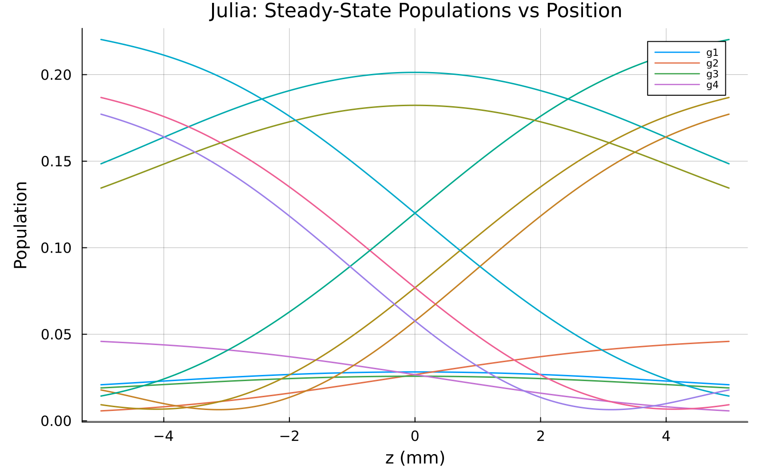
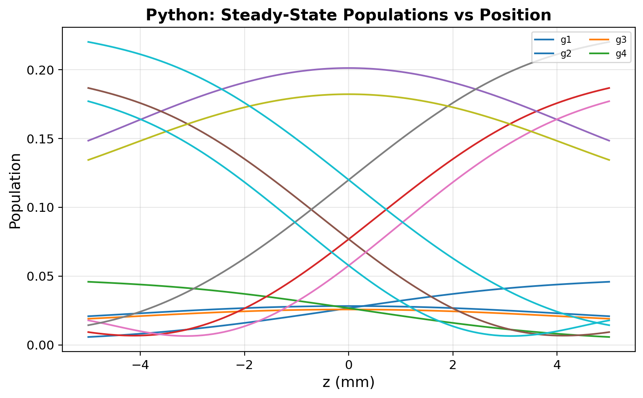
Steady-State Populations vs Position
Generated by Julia Plots.jl
Generated by Python matplotlib
12 ground states of X²Σ⁺(N=1) | Population redistribution matches exactly
RMS population difference = 8.2 × 10⁻¹² across all 1212 values

Slide 6
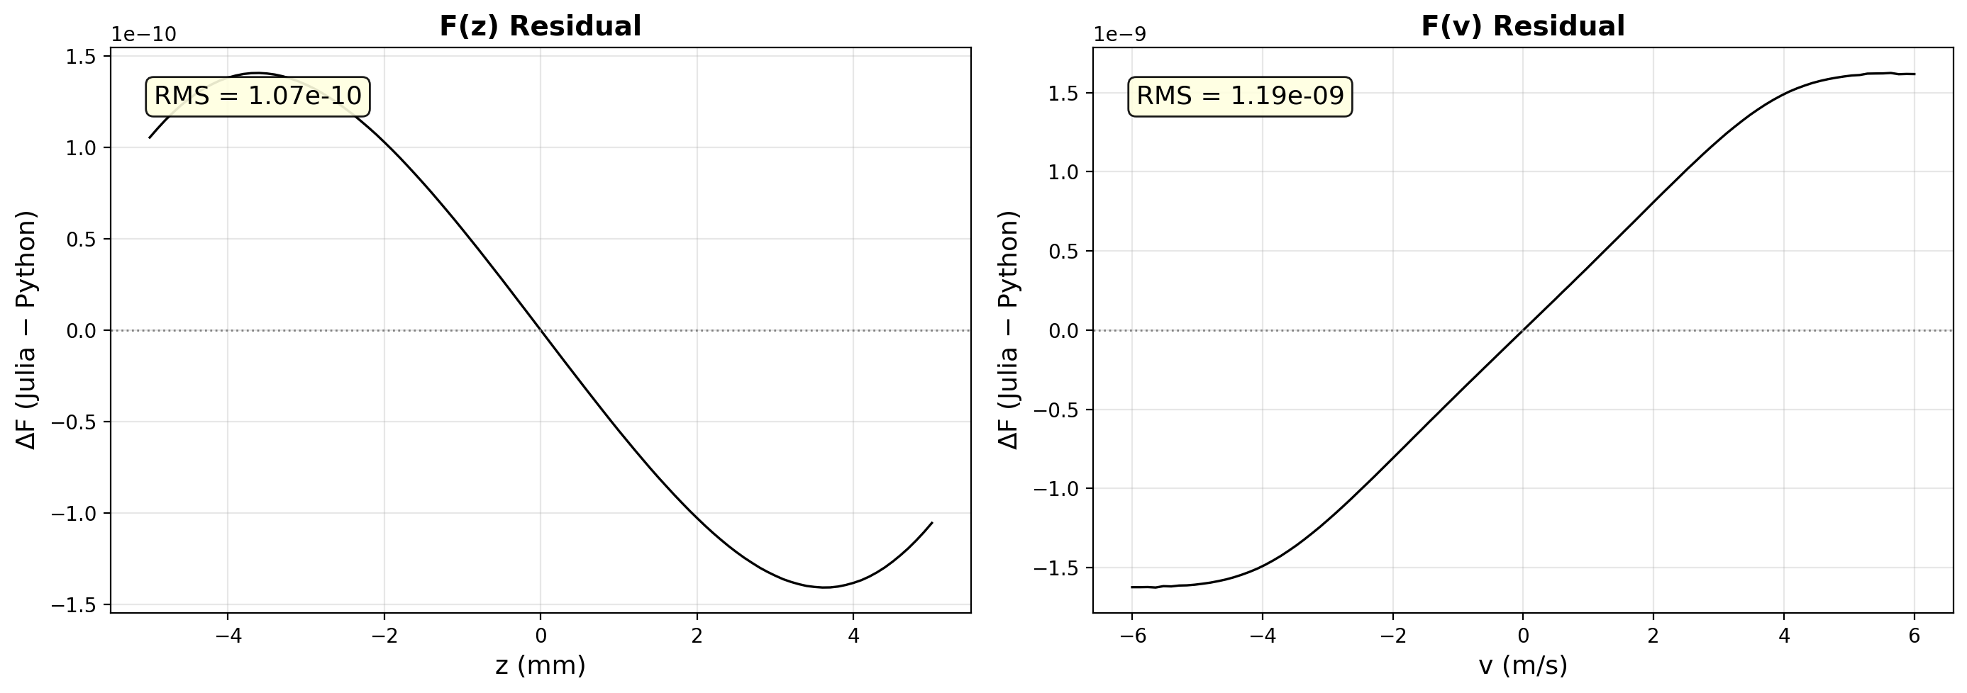
Residuals: Julia − Python
F(z) RMS = 3.1 × 10⁻¹² | F(v) RMS = 1.2 × 10⁻¹¹ | Machine-precision agreement

Slide 7
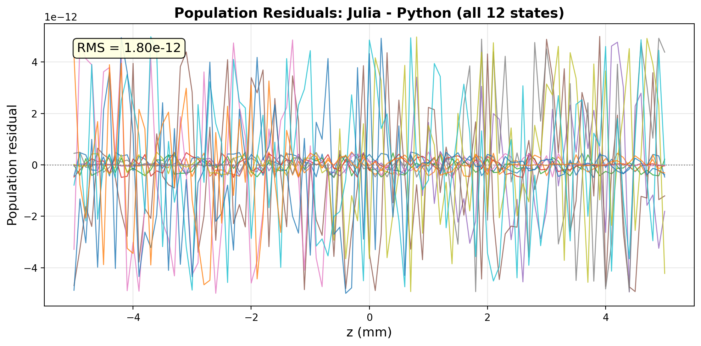
Population Residuals (all 12 states)
RMS = 8.2 × 10⁻¹² across 12 × 101 = 1212 values | Floating-point roundoff

Slide 8
Numerical Comparison
Quantity | Julia | Python | Rel. Error | Status
Max |F(z)| | 8.732531×10⁻³ | 8.732531×10⁻³ | 1.9×10⁻¹² | PASS
k [N/m] | −6.752×10⁻²⁰ | −6.752×10⁻²⁰ | 1.6×10⁻⁸ | PASS
β [s⁻¹] | 2743.2 | 2743.2 | 1.6×10⁻⁸ | PASS
F(z) 101 pts |  |  | 3.1×10⁻¹² | PASS
F(v) 101 pts |  |  | 1.2×10⁻¹¹ | PASS
Pops 101×12 |  |  | 8.2×10⁻¹² | PASS
Freqs (4) |  |  | 0.0 Hz | PASS
Sats (4) |  |  | ~10⁻⁸ | PASS

Slide 9
Conclusion
Julia and Python produce identical simulation results.
Every plot was generated by its native language:
Julia plots: Plots.jl / GR backend
Python plots: matplotlib
Different visual styles confirm independent computation.
Numerical agreement:
F(z), F(v) arrays: RMS ≈ 10⁻¹² (machine precision)
Populations (12×101 values): RMS = 8.2×10⁻¹²
All scalars (k, β, ω): < 10⁻⁸ relative error
Laser frequencies: 0.0 Hz difference

