Slide 1


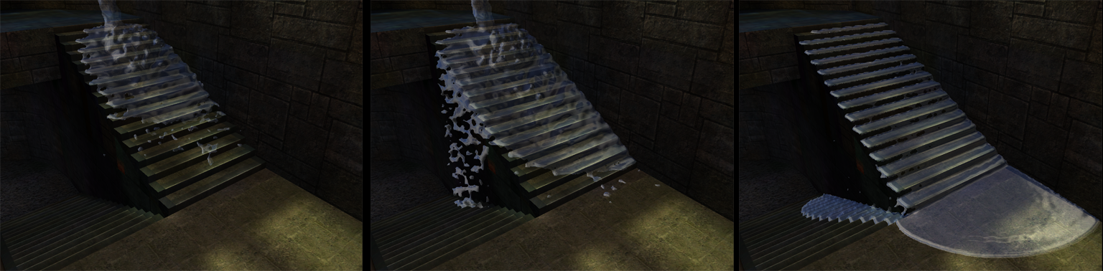
Real Time Fluids in Games
Matthias Müller-Fischer, ageia

Slide 2
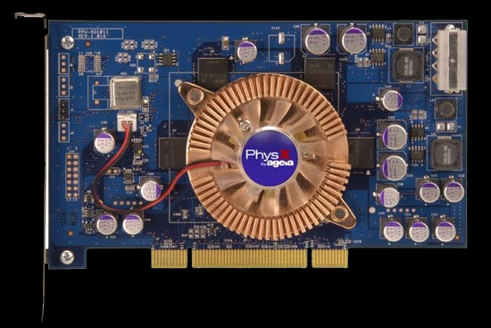
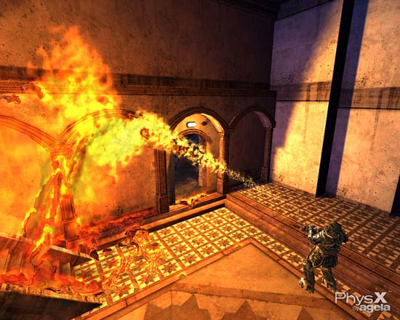
ageia
PhysX accelerator chip (PPU)
PhysX SDK (PPU accelerated)
  rigid bodies + joints
  cloth simulation
  fluid simulation (SPH)

Slide 3
Real Time Fluids in Games
Fluids in Games
Heightfield Fluids
  A very simple program
  Mathematical background
Particle Based Fluids
  Simple particle systems
  Smoothed Particle Hydrodynamics (SPH)

Slide 4
Game Requirements
CHEAP TO COMPUTE!
  40-60 fps of which fluid only gets a small fraction
Low memory consumption
  Must run on consoles
Stable even in non-realistic settings
Visually plausible

Slide 5
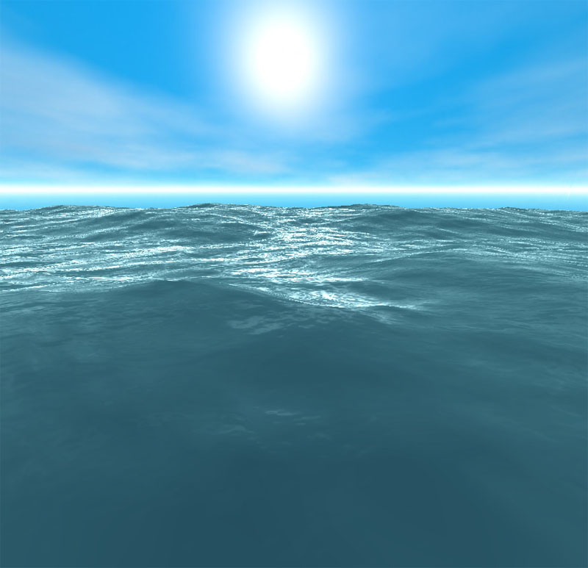
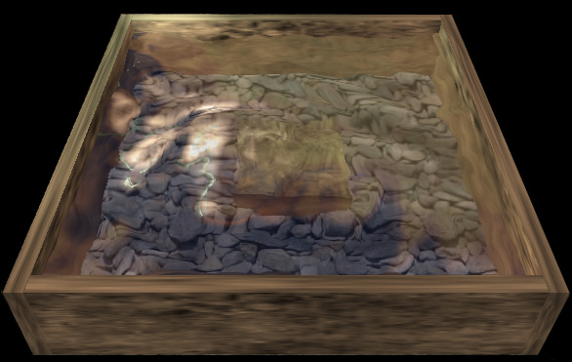
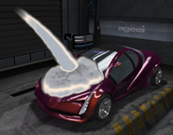
Solutions
Procedural Water
  Unbounded surfaces, oceans
Heightfield Fluids
  Ponds, lakes
Particle Systems
  Splashing, spray, puddles

Slide 6
Procedural Animation
Simulate the effect, not the cause
No limits to creativity
  E.g. superimpose sine waves:
  meshuggah.4fo.de, [2],[3]
  See Splish Splash session!
Difficult but not impossible:
  Fluid – scene interaction

Slide 7
Heightfield Fluids

Slide 8
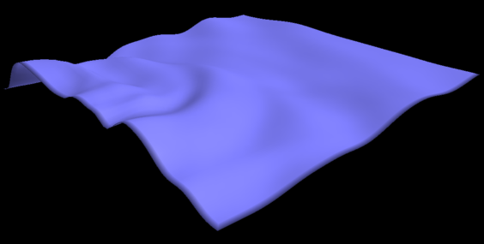
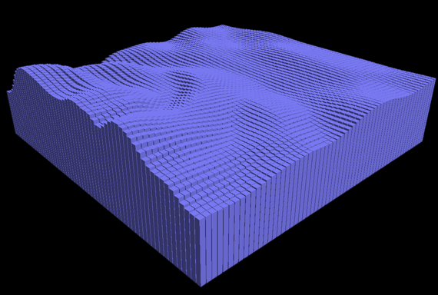
Heightfield Fluids
u
u
y
j
x
i
continuous
discrete
Represent fluid surface as a 2D function u(x,y)
Pro: Reduction from 3D to 2D
Cons: One value per (x,y) → no breaking waves

Slide 9
Heightfield „Hello World“
A trivial algorithm with impressive results!
Initialize u[i,j] with some interesting function, v[i,j]=0
loop
v[i,j] +=(u[i-1,j] + u[i+1,j] + u[i,j-1] + u[i,j+1])/4 – u[i,j]
v[i,j] *= 0.99
u[i,j] += v[i,j]
endloop
Clamp on boundary e.g. def. u[-1,j] = u[0,j]

Slide 10
The Math Behind It
u
Infinitesimal element
Vibrating string
f
A
f_{u}
u
x
x
x+dx
u(x) displacement normal to x-axis
Assuming small displacements and constant stress σ
Force acting normal to cross section A is f = σΑ

Slide 11
PDE for the 1D String
u
Infinitesimal element
Vibrating string
f
A
f_{u}
u
x
x
x+dx
Force acting normal to cross section A is f = σΑ
Component in u-direction f_{u} ≈ u_{x}σΑ (u_{x} derivative w.r.t. x)
Newton’s 2nd law for an infinitesimal segment
(ρΑdx)u_{tt} = σΑu_{x}|_{x+dx} - σΑu_{x}|_{x} →
ρ u_{tt} = σ u_{xx}

Slide 12
The 1D Wave Equation
For the string we have ρ u_{tt} = σ u_{xx}
Standard form: u_{tt} = c² u_{xx}, where c²= σ/ρ
General solution:
u(t) = a · f (x + ct) + b · f (x - ct) for any function f.
Thus, c is the speed at which waves travel

Slide 13
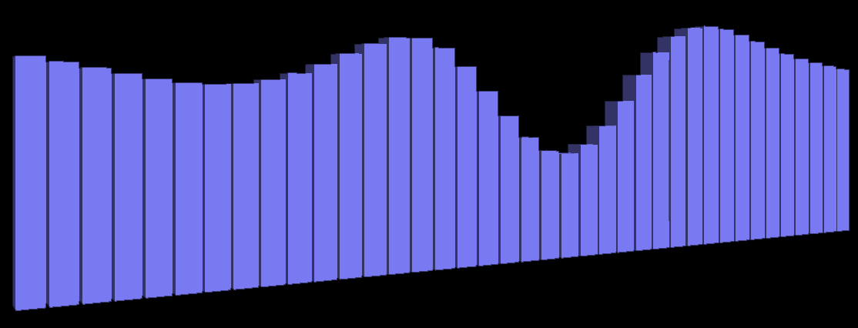
Intuition
u_{tt} = c² u_{xx}
Positive curvature is accelerated upwards
Negative curvature is accelerated downwards

Slide 14
The 2D Wave Equation
The wave equation generalizes to 2D as
u_{tt} = c² (u_{xx} + u_{yy})
u_{tt} = c² ∇²u
u_{tt} = c² Δu

Slide 15
Discretization
Replace the 2nd order PDE by two first order PDEs
u_{t} = v
v_{t} = c² (u_{xx} + u_{yy})
Discretize in space and time
(semi-implicit Euler, time step Δt, grid spacing h)
v^{t+1}[i,j]= v^{t}[i,j] +Δtc²(u[i+1,j]+u[i-1,j]+u[i,j+1]+u[i,j-1]-4u[i,j])/h²
u^{t+1}[i,j]= u^{t}[i,j] +Δt v^{t+1}[i,j]
We are where we started! (without damping)

Slide 16
Remarks on Heightfields
The simulation is only conditionally stable
  Courant-Friedrichs-Lewy stability condition: cΔt < h
Boundary conditions needed
Mirror: Reflection
Periodic: Wrap around

Slide 17
Particle Based Fluids

Slide 18
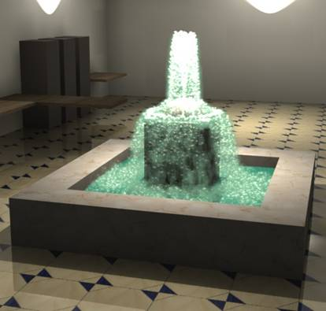
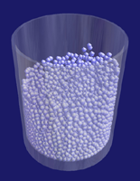
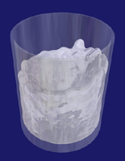
Particle Based Fluids
Particle systems are simple and fast
Without particle-particle interaction
  Spray, splashing
With particle-particle interaction
  Small puddles, blood, runnels
  Small water accumulations

Slide 19
Simple Particle Systems
Particles store
mass, position, velocity,
external forces, lifetimes
x_{i}
m_{i}
Integrate
d/dt x_{i} = v_{i}
d/dt v_{i} = f_{i}/m_{i}
v_{i}
f_{i}
Generated by emitters,
deleted when lifetime is exceeded
emitter

Slide 20
Particle-Particle Interaction
d
No interaction → decoupled system → fast
For n particles n² potential interactions!
To reduce to linear complexity O(n)
define interaction cutoff distance d

Slide 21
Spatial Hashing
d
d
Fill particles into grid with spacing d
Only search potential neighbors in adjacent cells
Map cells [i,j,k] into 1D array via hash function h(i,j,k)

Slide 22
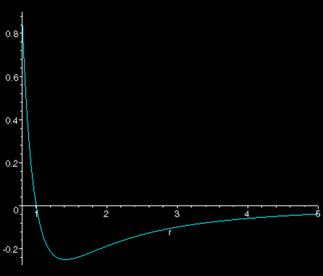
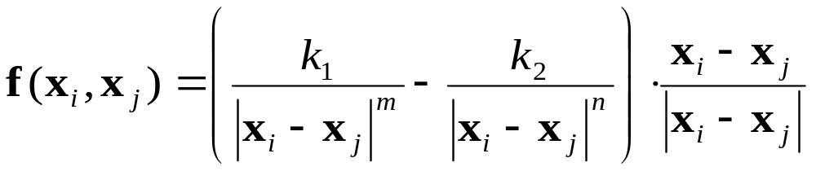
Lennard-Jones Interaction
For simple fluid-like behavior:
Repulsion
Equilibrium
Attraction
k₁, k₂, m, n control parameters

Slide 23
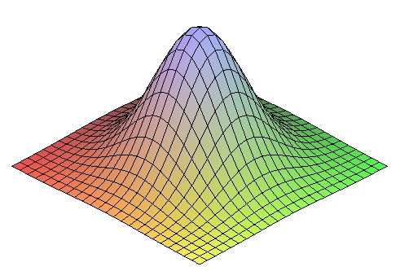
Solving Navier-Stokes Eqn.
How formulate Navier-Stokes Eqn. on particles?
We need continuous fields, e.g. v(x)
Only have v₁, v₂, .. v_{n} sampled on particles
Basic idea:
  Particles induce smooth local fields
  Global field is sum of local fields

Slide 24
SPH
Smoothed Particle Hydrodynamics
Invented for the simulation of stars [5]
Often used for real-time fluid simulation in CG [6]
Use scalar kernel function W(r)
  Symmetric: W(|x-x_{i}|)
  Normalized: ∫ W(x) dx = 1
r
x_{i}
x

Slide 25
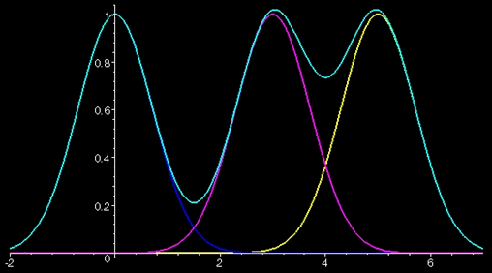
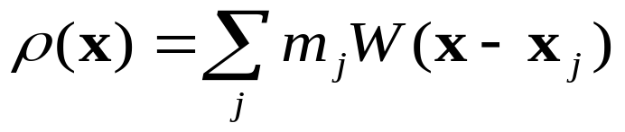

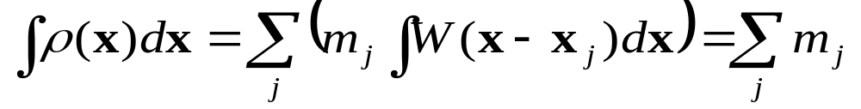
Density Computation
Global density field
Density of each particle
Mass conservation guaranteed

Slide 26
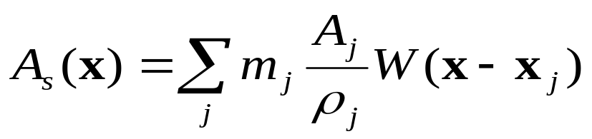
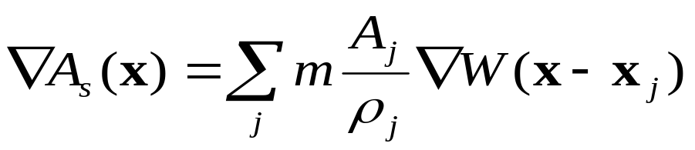
Smoothing Attributes
Smoothing of attribute A
Gradient of smoothed attribute

Slide 27
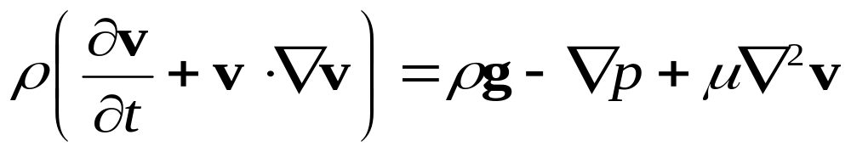
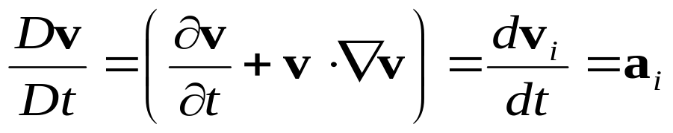
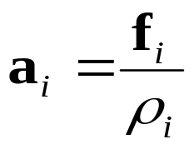
Equation of Motion
Because particles follow the fluid we have:
The acceleration a_{i} of particle i is, thus
f_{i} is body force evaluated at x_{i}

Slide 28
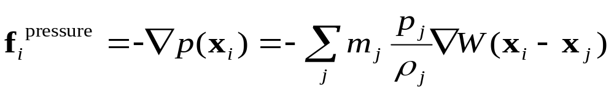
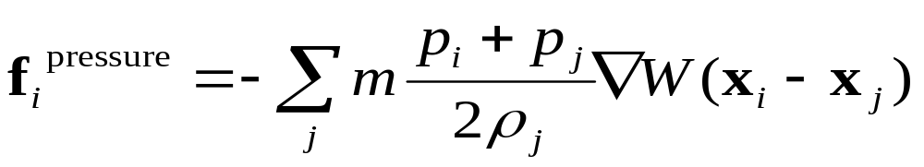
Pressure
The pressure term yields
Symmetrize (SPH problem: actio ≠ reactio)
where p_{i} = kρ_{i} and k gas constant

Slide 29

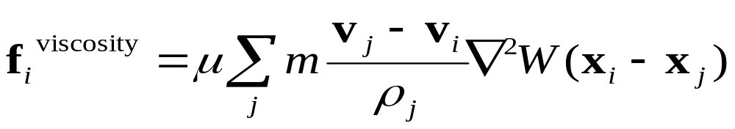
Remaining Forces
Gravity as in simple particle systems
Viscosity (simmetrized)

Slide 30
Remarks on SPH
Incompressibility
  Pressure force reacts to density variation (bouncy)
  Predict densities, solve for incompressibility [8]
Rendering
  Marching cubes of density iso surface [6]
  Sprites, depth buffer smoothing
Combine particles and heightfields [7]

Slide 31
References 1/2
[1] AGEIA: www.ageia.com, physx.ageia.com
[2] A. Fournier and W. T. Reeves. A simple model of ocean waves, SIGGRAPH 86, pages 75–84
[3] D. Hinsinger, F. Neyret, M.P. Cani, Interactive Animation of Ocean Waves, In Proceedings of SCA 02
[4] A. Jeffrey, Applied Partial Differential Equations, Academic Press, ISBN 0-12-382252-1

Slide 32
References 2/2
[5] J. J. Monaghan, Smoothed particle hydrodynamics. Annual Review of Astronomy and Astrophysics, 30:543–574, 1992.
[6] M. Müller, D. Charypar, M. Gross. Particle-Based Fluid Simulation for Interactive Applications, In Proceedings of SCA 03, pages 154-159.
[7] J. O’Brien and J. Hodgins, Dynamic simulation of splashing fluids, In Computer Animation 95, pages 198–205
[8] S. Premoze et.al, Particle based simulation of fluids, Eurographics 03, pages 401-410

