Slide 1
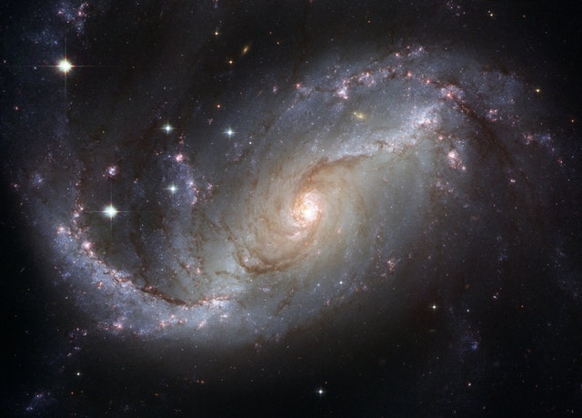
Online Passport System
Ann Tuck, Ki Kim, Makiko Vaughan, Scott Matthews

Slide 2
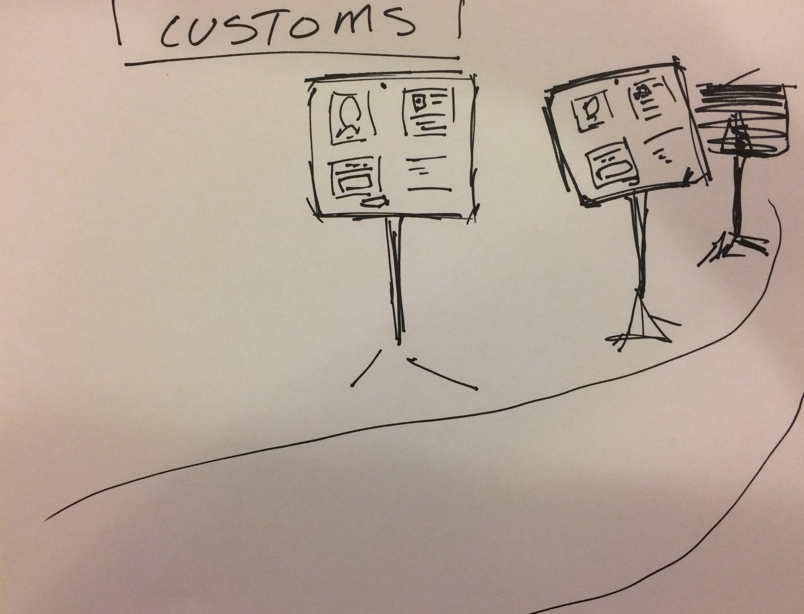

Slide 3
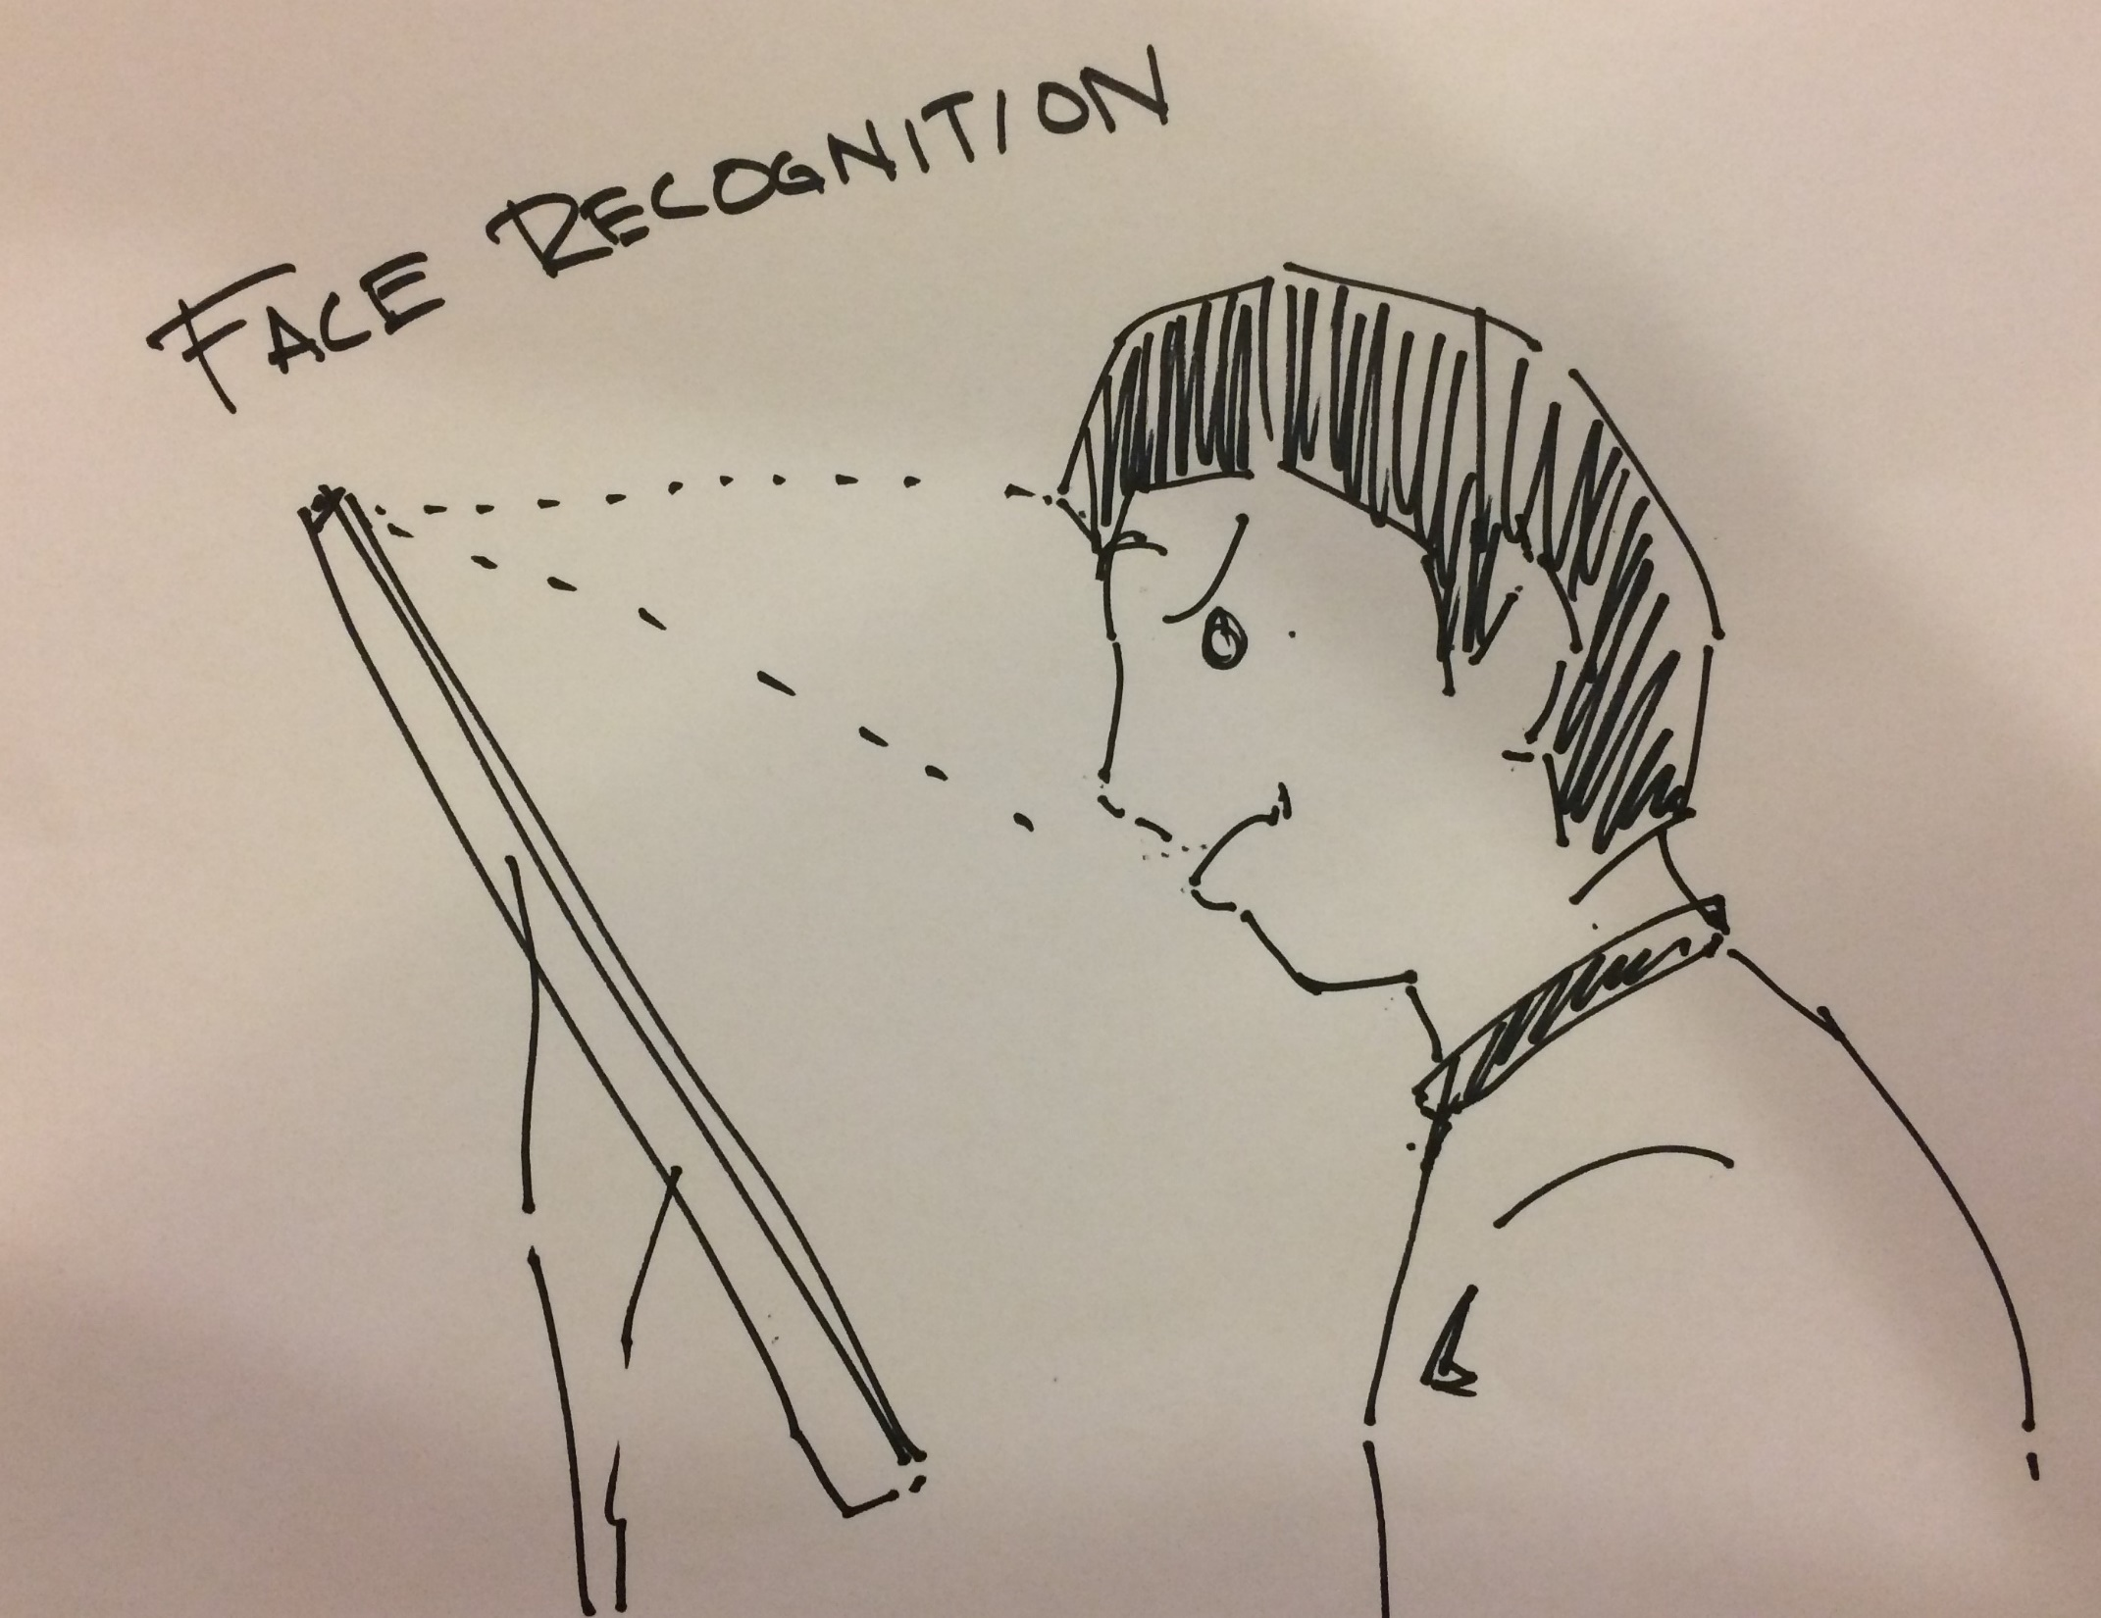

Slide 4
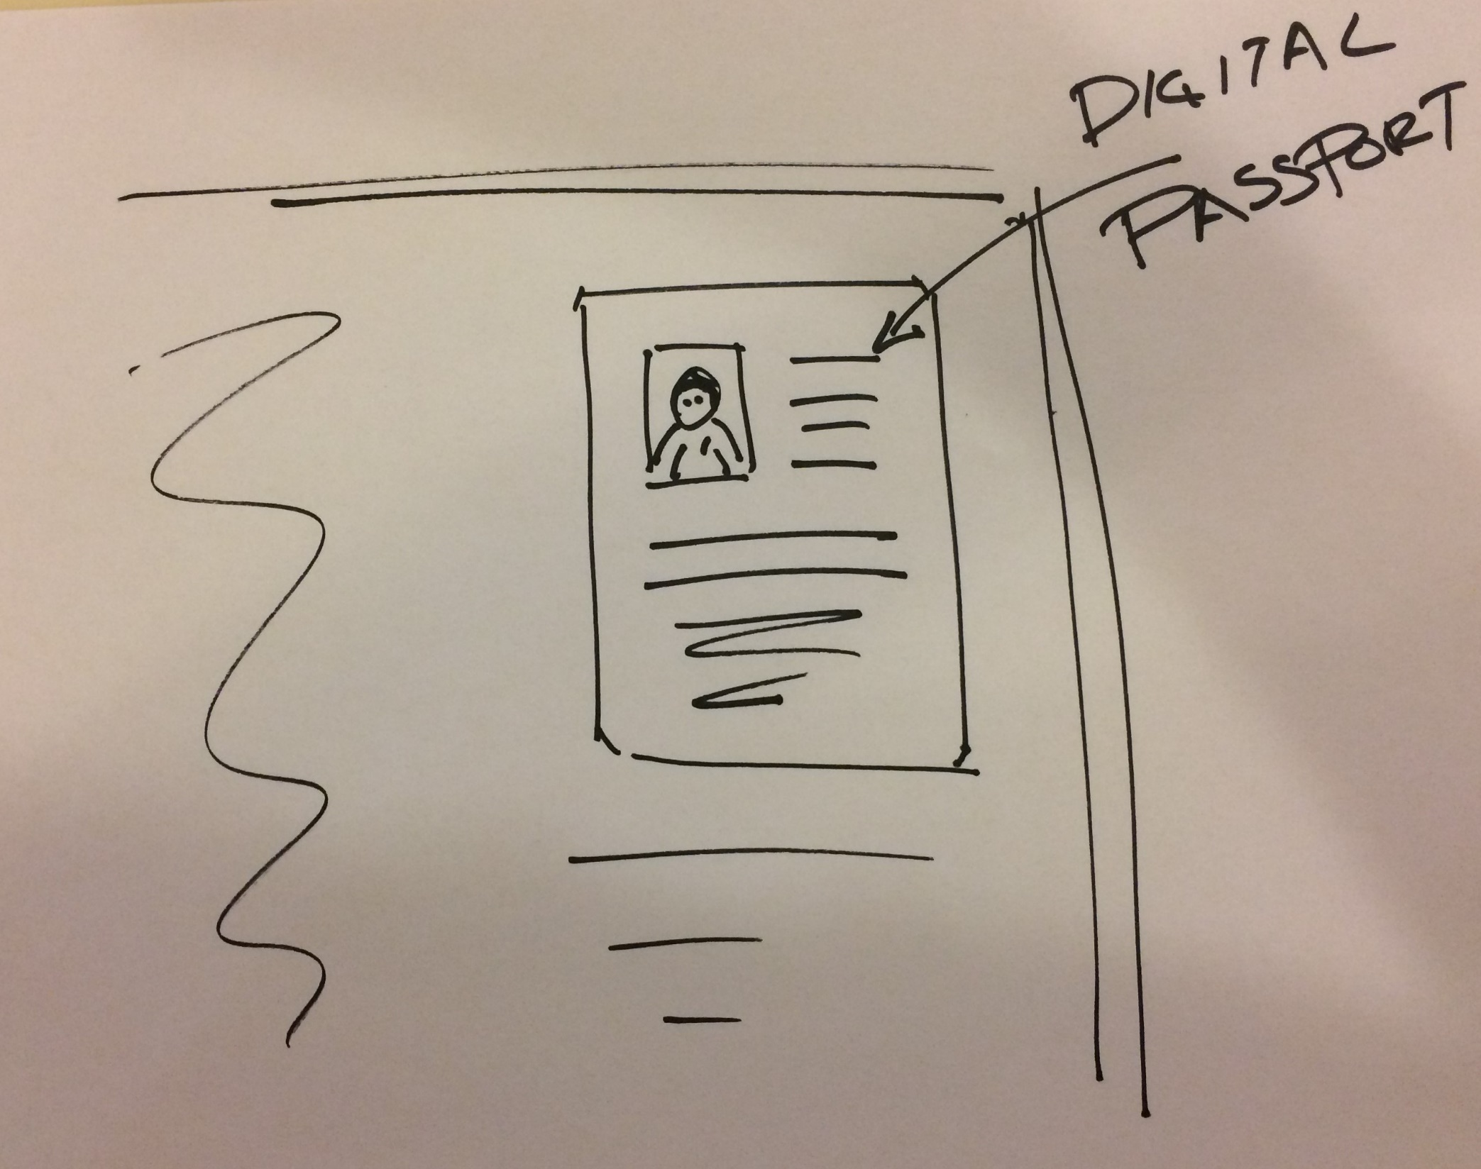

Slide 5
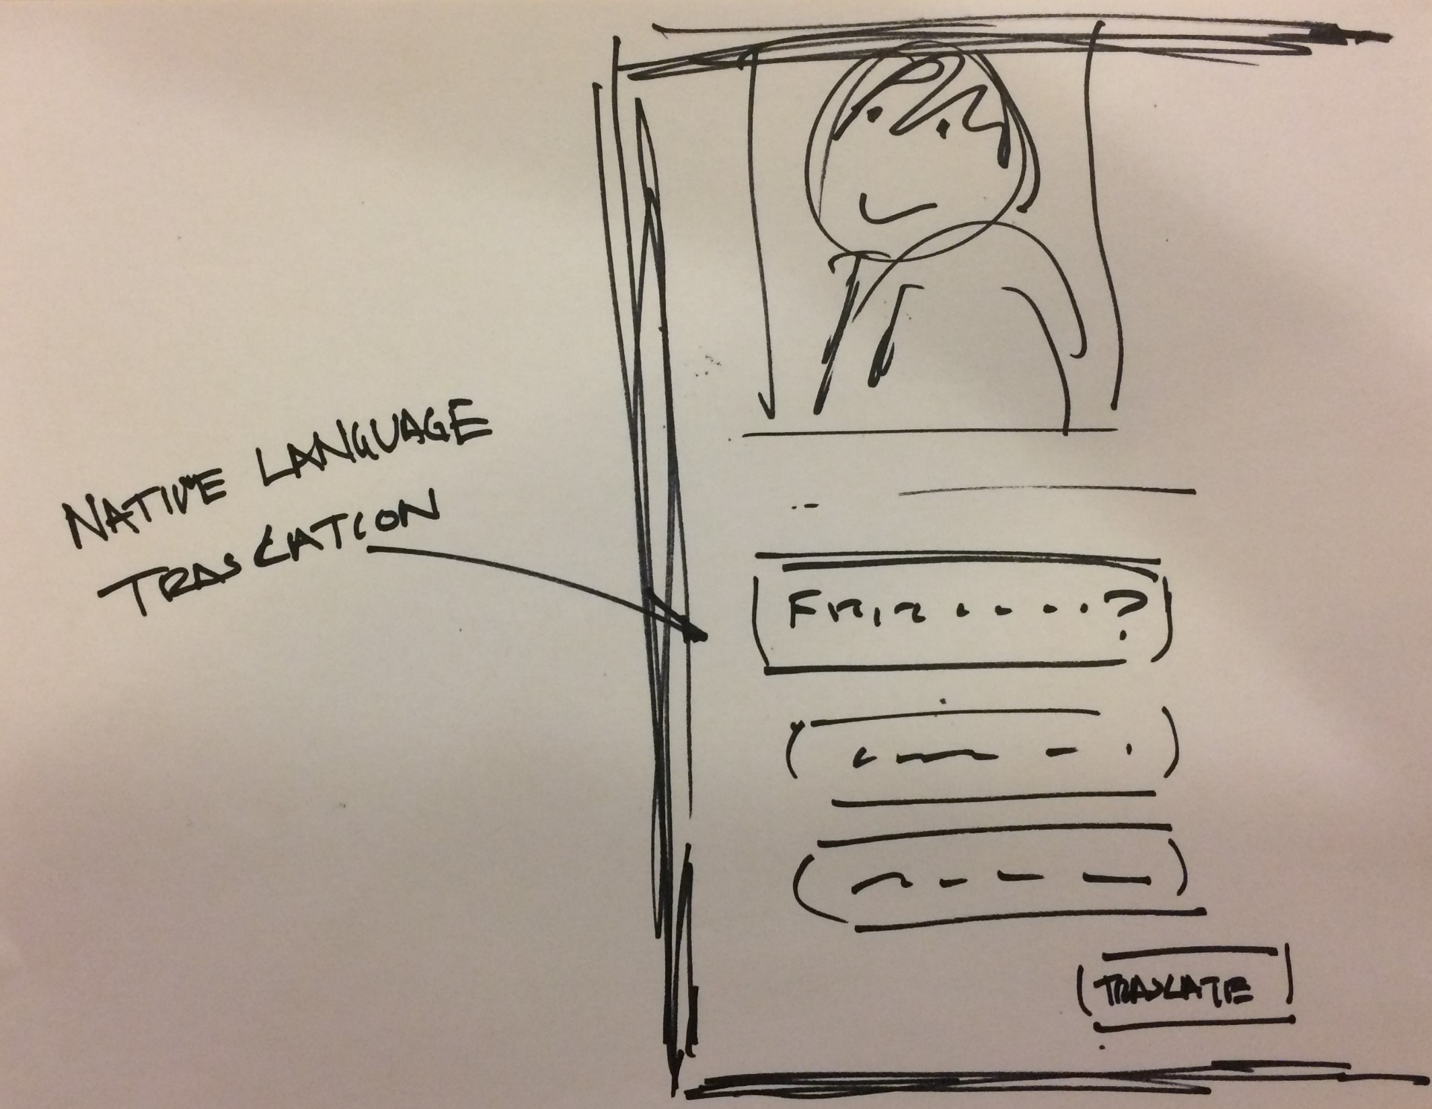

Slide 6
