Slide 1
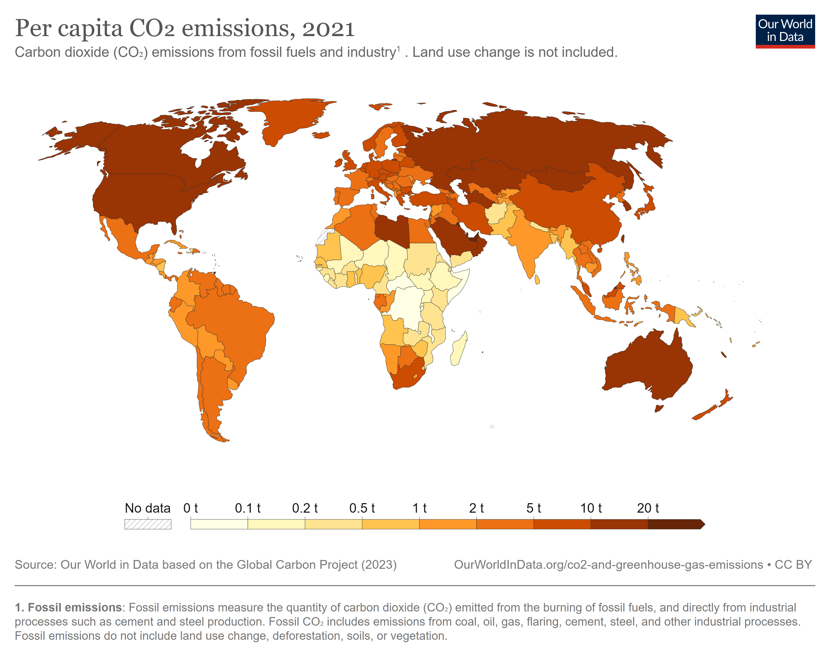
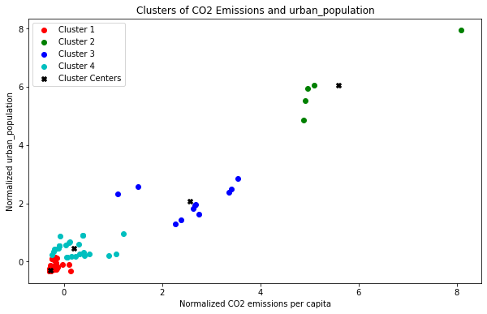
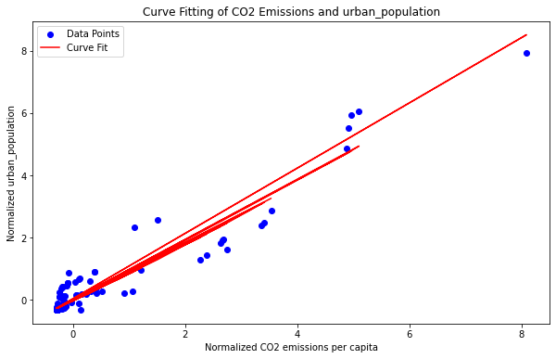
Analysis of CO2 Emissions and Urban Population Growth DILPREET SINGH MAHAL 22014268
INTRODUCTION
Understanding the relationship between CO2 emissions and urban population growth is crucial for effective climate change mitigation and sustainable urban planning. In this analysis, we will explore the dataset on CO2 emissions and urban population from the World Bank and employ clustering and fitting methods to identify patterns and trends.
METHODS:
Clustering: We will use K-Means clustering to group countries based on their normalized values for CO2 emissions per capita and the growth rate of urban population. By examining the resulting clusters, we can identify distinct patterns of CO2 emissions and urbanization across countries and regions.
Fitting: We will fit regression models to the time series data of CO2 emissions and urban population growth for each country. Using simple functions such as linear regression, we will analyze the relationship between these variables and predict future CO2 emissions based on projected urban population growth.
Our analysis reveals distinct clusters of countries based on their CO2 emissions and urban population growth. For instance, one cluster may consist of countries with high CO2 emissions and rapid urban population growth, while another cluster may comprise countries with low emissions and slower urbanization. We will present these findings using a cluster membership plot and provide a narrative describing the characteristics of each cluster.
CONCLUSION:
The analysis of CO2 emissions and urban population growth highlights the importance of sustainable urban development in mitigating climate change. By clustering countries based on these indicators and fitting regression models, we gain insights into the diverse patterns and trends worldwide. This knowledge can inform policymakers and urban planners in designing effective strategies for reducing CO2 emissions and promoting sustainable urbanization.

