Slide 1

an introduction to
Principal Component Analysis
(PCA)

Slide 2
abstract
Principal component analysis (PCA) is a technique that is useful for the
compression and classification of data. The purpose is to reduce the
dimensionality of a data set (sample) by finding a new set of variables,
smaller than the original set of variables, that nonetheless retains most
of the sample's information.
By information we mean the variation present in the sample,
given by the correlations between the original variables. The new
variables, called principal components (PCs), are uncorrelated, and are
ordered by the fraction of the total information each retains.

Slide 3
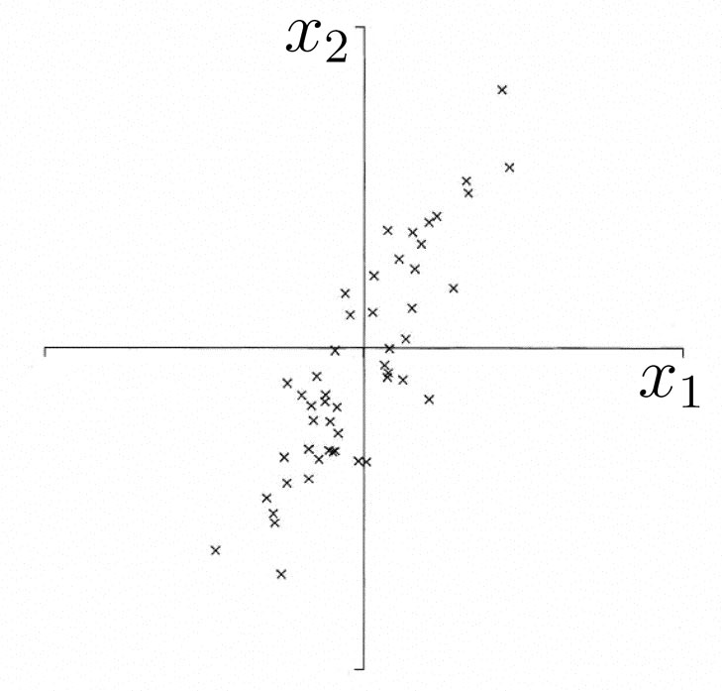
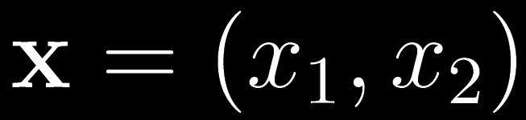
Geometric picture of principal components (PCs)
A sample of n observations in the 2-D space
Goal: to account for the variation in a sample
in as few variables as possible, to some accuracy

Slide 4
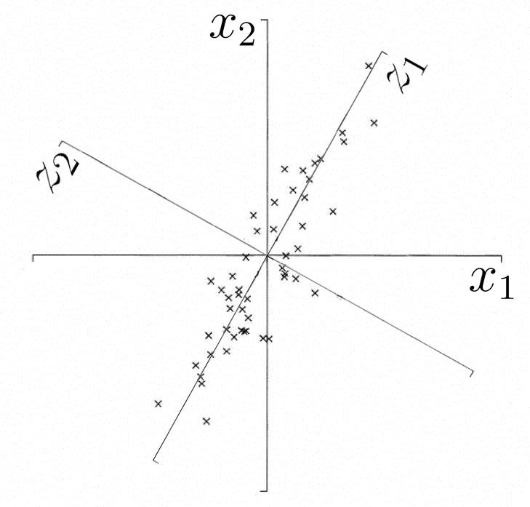



Geometric picture of principal components (PCs)
the 1st PC is a minimum distance fit to a line in space
the 2nd PC is a minimum distance fit to a line
in the plane perpendicular to the 1st PC
PCs are a series of linear least squares fits to a sample,
each orthogonal to all the previous.

Slide 5
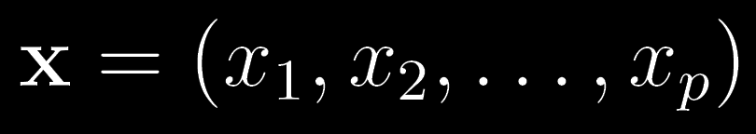
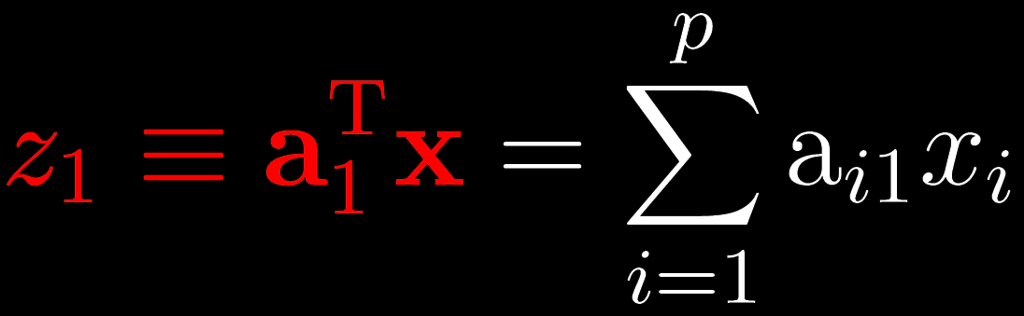
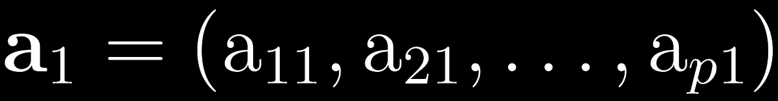

Algebraic definition of PCs
Given a sample of n observations on a vector of p variables
define the first principal component of the sample
by the linear transformation
λ
where the vector
is chosen such that
is maximum

Slide 6
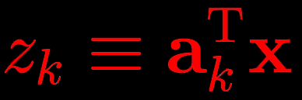
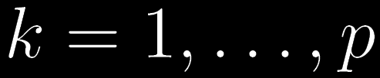
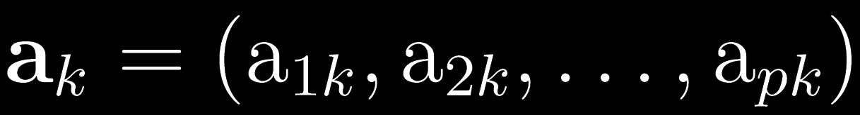




Algebraic definition of PCs
Likewise, define the k^{th} PC of the sample
by the linear transformation
λ
where the vector
is chosen such that
is maximum
subject to
and to

Slide 7



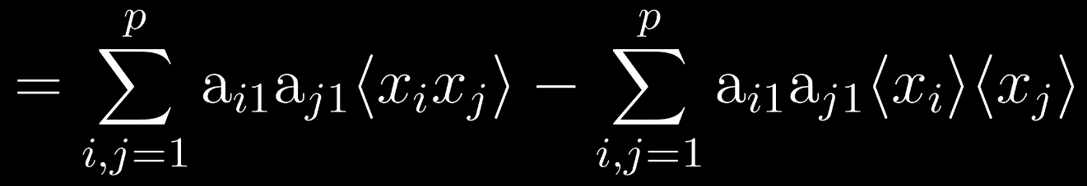
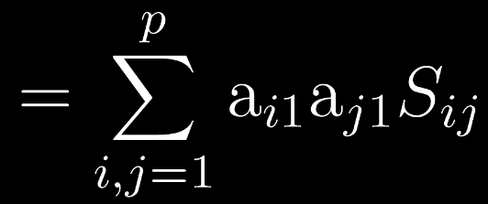


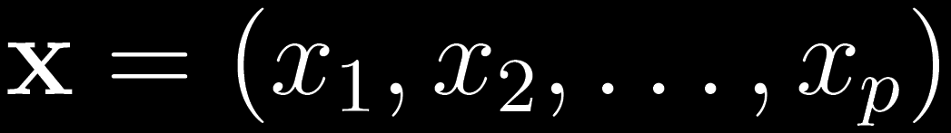
Algebraic derivation of coefficient vectors
To find first note that
where
is the covariance matrix for the variables

Slide 8

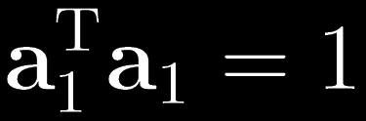
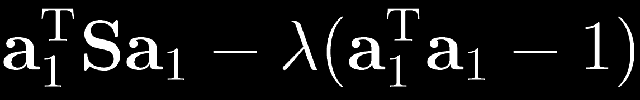

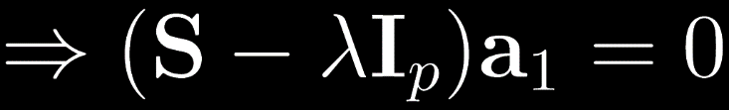



Algebraic derivation of coefficient vectors
To find maximize subject to
Let λ be a Lagrange multiplier
then maximize
by differentiating…
therefore
is an eigenvector of
corresponding to eigenvalue

Slide 9

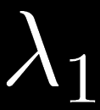

Algebraic derivation of
We have maximized
So is the largest eigenvalue of
The first PC retains the greatest amount of variation in the sample.

Slide 10



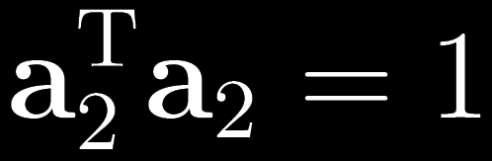


Algebraic derivation of coefficient vectors
To find the next coefficient vector maximize
subject to
and to
First note that
then let λ and φ be Lagrange multipliers, and maximize

Slide 11



Algebraic derivation of coefficient vectors
We find that is also an eigenvector of
whose eigenvalue is the second largest.
In general
The k^{th} largest eigenvalue of is the variance of the k^{th} PC.
The k^{th} PC retains the k^{th} greatest fraction
of the variation in the sample.

Slide 12
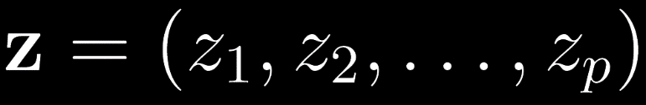





Algebraic formulation of PCA
Given a sample of n observations
on a vector of p variables
define a vector of p PCs
according to
where is an orthogonal p x p matrix
whose k^{th} column is the k^{th} eigenvector of
Then
is the covariance matrix of the PCs,
being diagonal with elements

