Slide 1
Perceptron Algorithm

Slide 2
Perceptron
Linear threshold unit (LTU)
x₀=1
x₁
w₁
w₀
w₂
x₂
Σ
.
.
.
Σ_{i=0}^{n} w_{i} x_{i}
g
w_{n}
x_{n}
1 if Σ_{i=0}^{n} w_{i} x_{i} >0
o(x_{i}) =
-1 otherwise
{

Slide 3
Possibilities for function g
Sign function
Step function
Sigmoid (logistic) function
sign(x) = +1, if x > 0
-1, if x ≤ 0
step(x) = 1, if x > threshold
0, if x ≤ threshold
(in picture above, threshold = 0)
sigmoid(x) = 1/(1+e^{-x})
Adding an extra input with activation x₀ = 1 and weight
w_{i, 0} = -T (called the bias weight) is equivalent to having a
threshold at T. This way we can always assume a 0 threshold.

Slide 4
Using a Bias Weight to
Standardize the Threshold
1
-T
w₁
x₁
w₂
x₂
w₁x₁+ w₂x₂ < T
w₁x₁+ w₂x₂ - T < 0

Slide 5
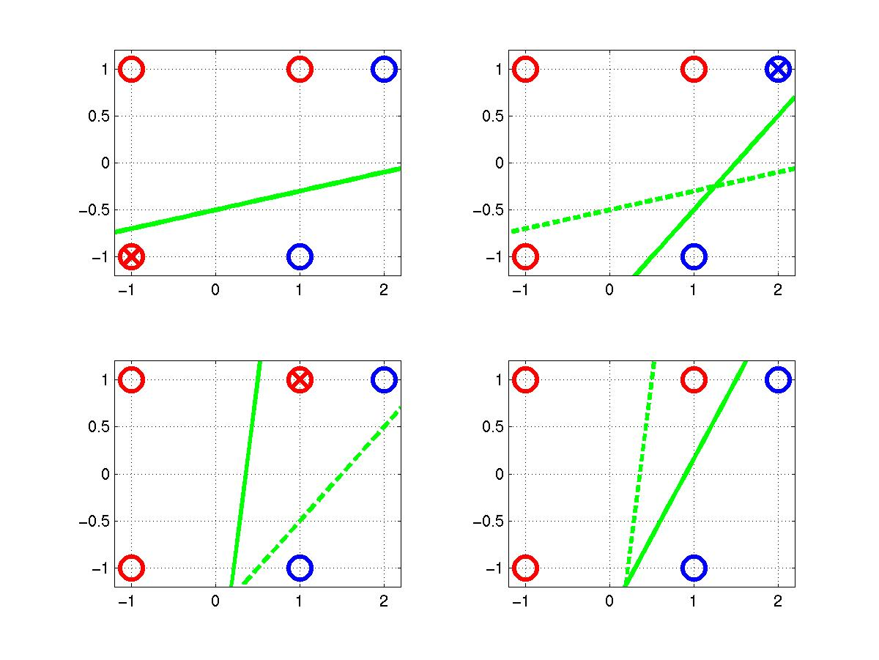
Perceptron Learning Rule
t = -1
t = 1
o=1
w = [0.25 –0.1 0.5]
x₂ = 0.25 x₁ – 0.5
x₂
x₂
o=-1
(x, t)=([-1,-1], 1)
o = sgn(0.25+0.1-0.5)
=1
x₁
x₁
(x, t)=([2,1], 1)
o =sgn(0.45-0.6+0.3)
=1
(x, t)=([1,1], 1)
o = sgn(0.250.7+0.1)
= 1
Δw = [0.2 –0.2 –0.2]
x₂
x₂
Δw = [0.2 –0.4 –0.2]
Δw = [0.2 0.2 0.2]
x₁
x₁
-0.5x₁+0.3x₂+0.45>0 ⇨ o = 1

