Slide 1
Dr. Cough
ON-CALL Online Specialist AT YOUR SERVICE
Dr. MOHAN VENKATARAMANA

Slide 2

Dr. Cough will see you now.
PROBLEM STATEMENT.
Transmission of infection at the workplace etc., is a major problem affecting people’s productivity and well-being.
Office
Schools (Children can transmit infection)
Social gatherings
Confined spaces (e.g. airplanes)

Slide 3
Dr. Cough will see you now.
PROBLEM - IMPACT
Workplace illnesses aren’t simply an annoyance, they are an incredibly costly problem for facility executives. Absenteeism and “presenteeism” (when employees come to work sick) can dramatically reduce productivity — to the sum of $227 billion in losses to the U.S. economy each year, according to a study by The Integrated Benefits Institute, a health research organization.

Slide 4
Dr. Cough will see you now.
OUR SOLUTION
Our App will detect the seriousness of the problem and alert the person to proactively take precautionary steps.
Non-intrusive / non-confrontational
Easy to monitor and manage
Privacy ensured

Slide 5
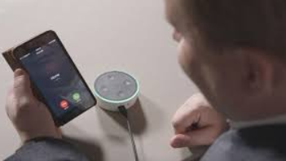
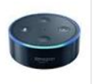
Dr. Cough will see you now.
TECHNICAL DETAILS
Dr. Cough Software Application on the cloud
Recommendation Stay/Go home
Predictive Analytics Algorithms
Database Training data sets
Cough Sample
AMAZON ECHO APP
Machine Learning / Artificial Intelligence

Slide 6

Dr. Cough will see you now.
DEMO
AMAZON ECHO APP
Dr. Cough Software Application on the cloud

Slide 7
Dr. Cough will see you now.
BUSINESS CASE
Our App will be in the cloud and can be accessed by Alexa and Echo Dot devices.
Other non Amazon devices in future
Deployed in Offices, Schools etc.
Personal edition (smartphone version)

