Slide 1

NATURAL LANGUAGE PROCESSING

Slide 2

Text Processing

Slide 3

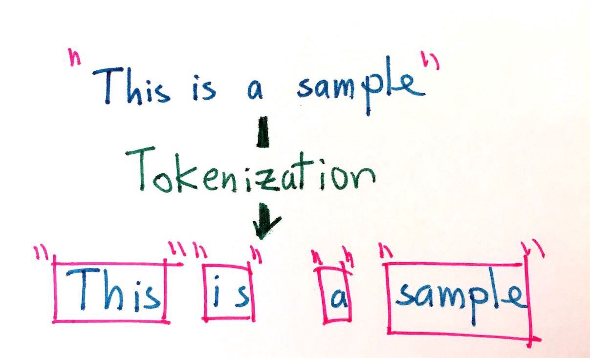

TEXT DATA CLEANING TECHNIQUES
  Tokenization
  The process involves taking any text and splitting it into "tokens"
  Usually the tokens chosen are individual words but can be sentences as well.
PROBLEMS: YOU CAN LOSE IMPORTANT MEANING LIKE "NEW YORK" GETS SPLIT INTO "NEW" AND "YORK" THUS LOSING THE GEOGRAPHICAL MEANING. A GOOD MACHINE LEARNING APPLICATION WOULD TAKE THIS INTO CONSIDERATION BY CONSIDERING THE RELATIVE FREQUENCYOF PAIRS OF WORDS AND PERHAPS KEEP THOSE PAIRS AS A SINGLE WORD

Slide 4
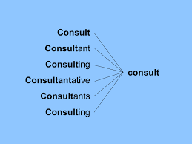
TEXT DATA CLEANING TECHNIQUES
  Stemming
  Removing prefixes and suffixes in order to reduce synonym words into their common form
  This can lead to some problems of creating spurious relations
  Stripes -> Strip
  Strip -> Strip

Slide 5
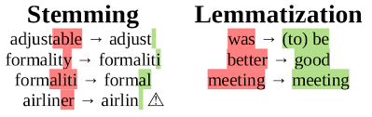
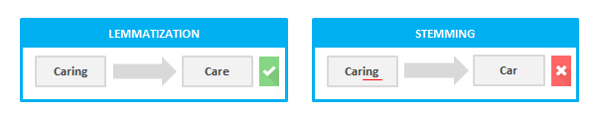
TEXT DATA CLEANING TECHNIQUES
lemmatization looks beyond word reduction and considers a language’s full vocabulary to apply a morphological analysis to words. The lemma of ‘was’ is ‘be’ and the lemma of ‘mice’ is ‘mouse’.

Slide 6
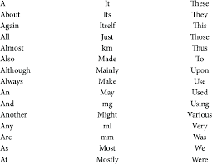
TEXT DATA CLEANING TECHNIQUES
Removal of stop words
Stop words are common words which are usually removed to not be interpreted as noise

Slide 7
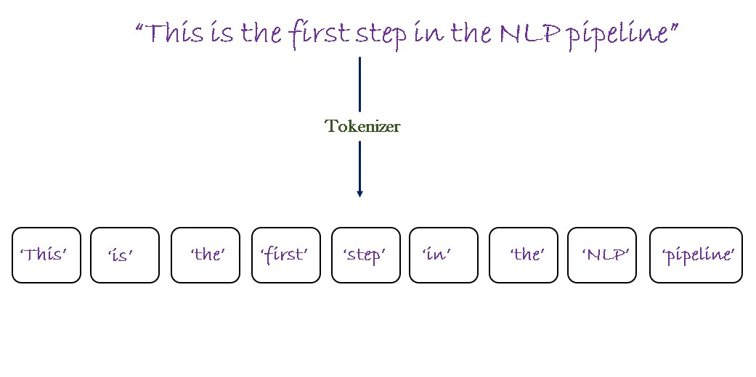
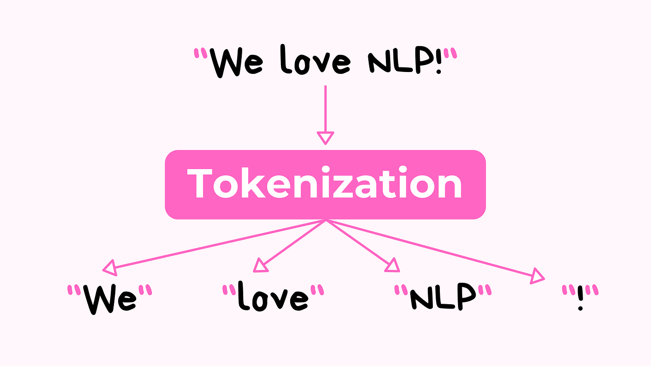
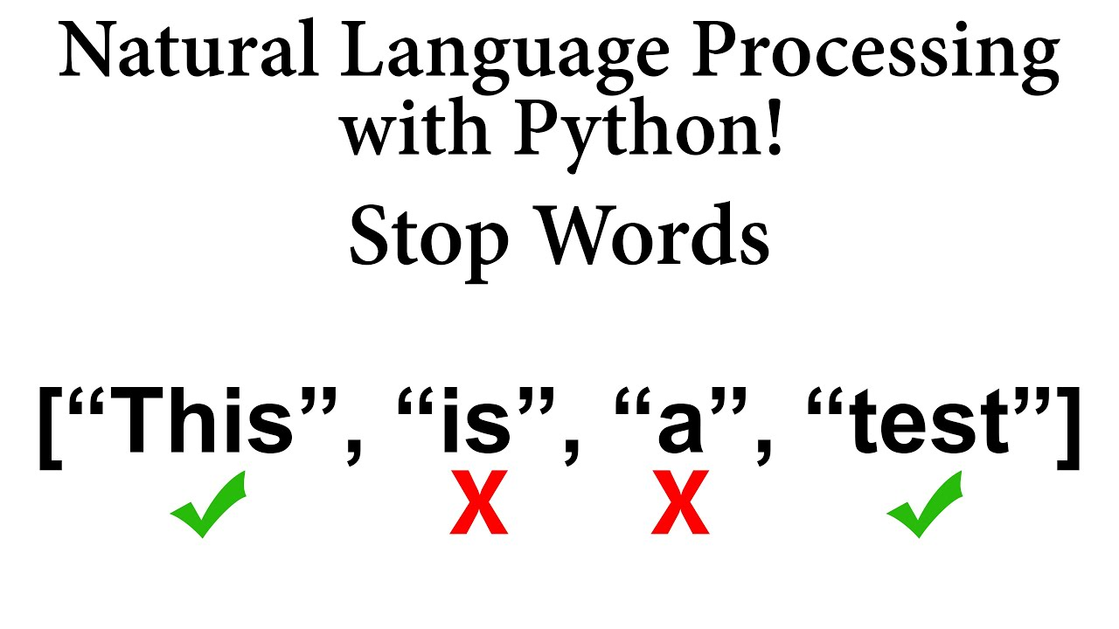
TOKENIZATION
& STOPWORDS
REMOVAL

Slide 8
Word-Embeddings

Slide 9
WHAT ARE WORD-EMBEDDINGS
Word embeddings are dense vector representations of words where similar words are located close to each other in the embedding space.
Each word is encoded as a point in a multi-dimensional space (e.g., 100, 200, or 300 dimensions).
Purpose:
  Embeddings translate the unstructured nature of language into numerical forms that machine learning models can process.
Dimensionality:
  Each dimension captures some aspect of a word’s meaning.
  Higher-dimensional embeddings (e.g., 300) capture finer-grained relationships but require more computation.

Slide 10
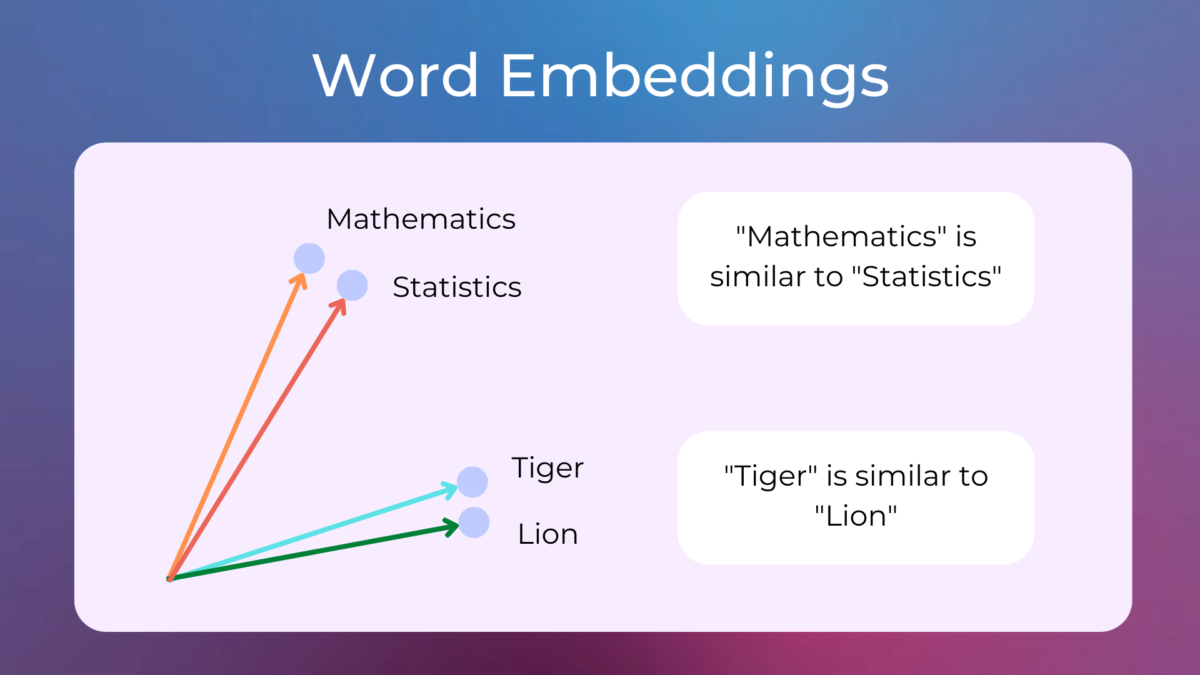
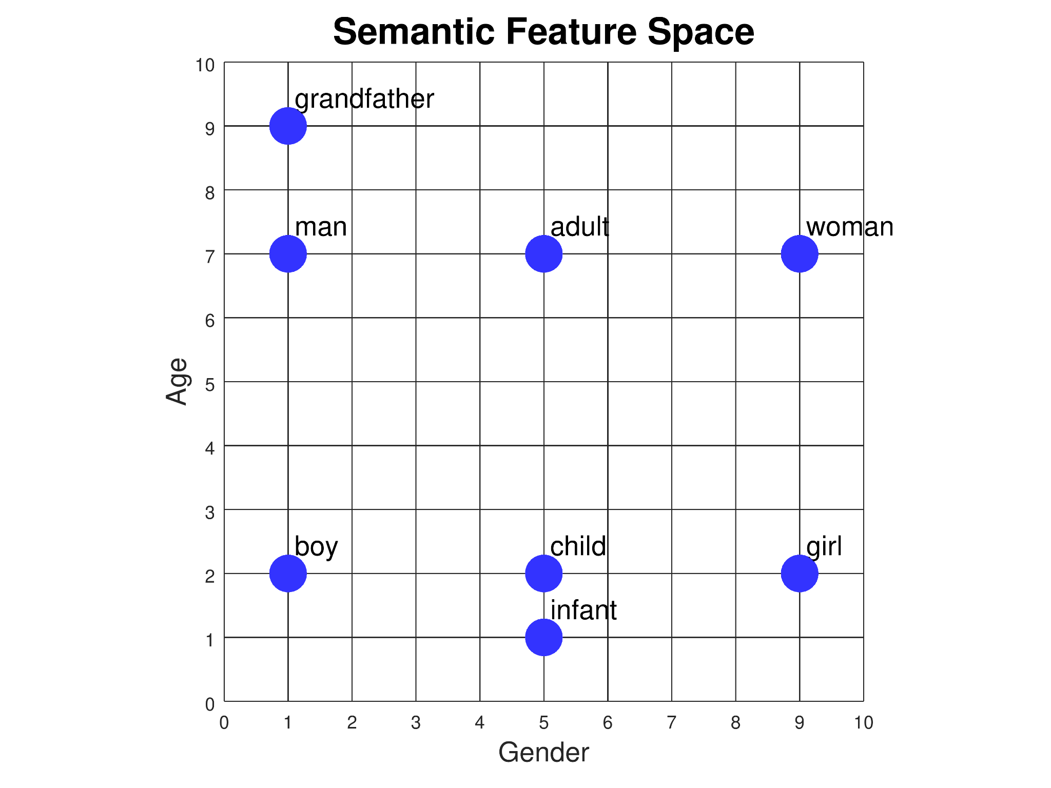
WHAT ARE WORD-EMBEDDINGS

Slide 11
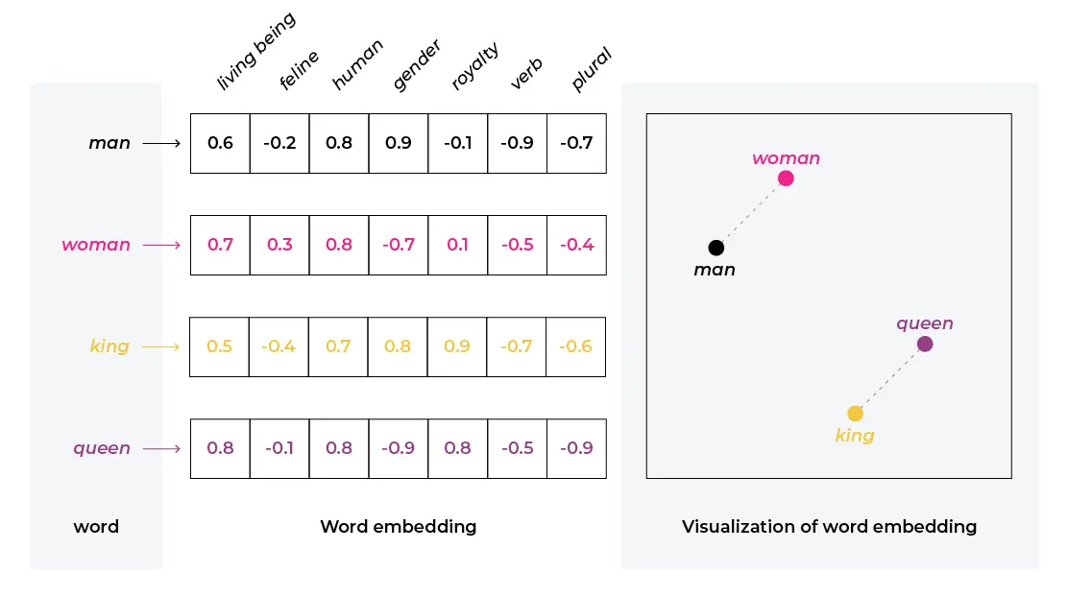
WHAT ARE WORD-EMBEDDINGS

Slide 12
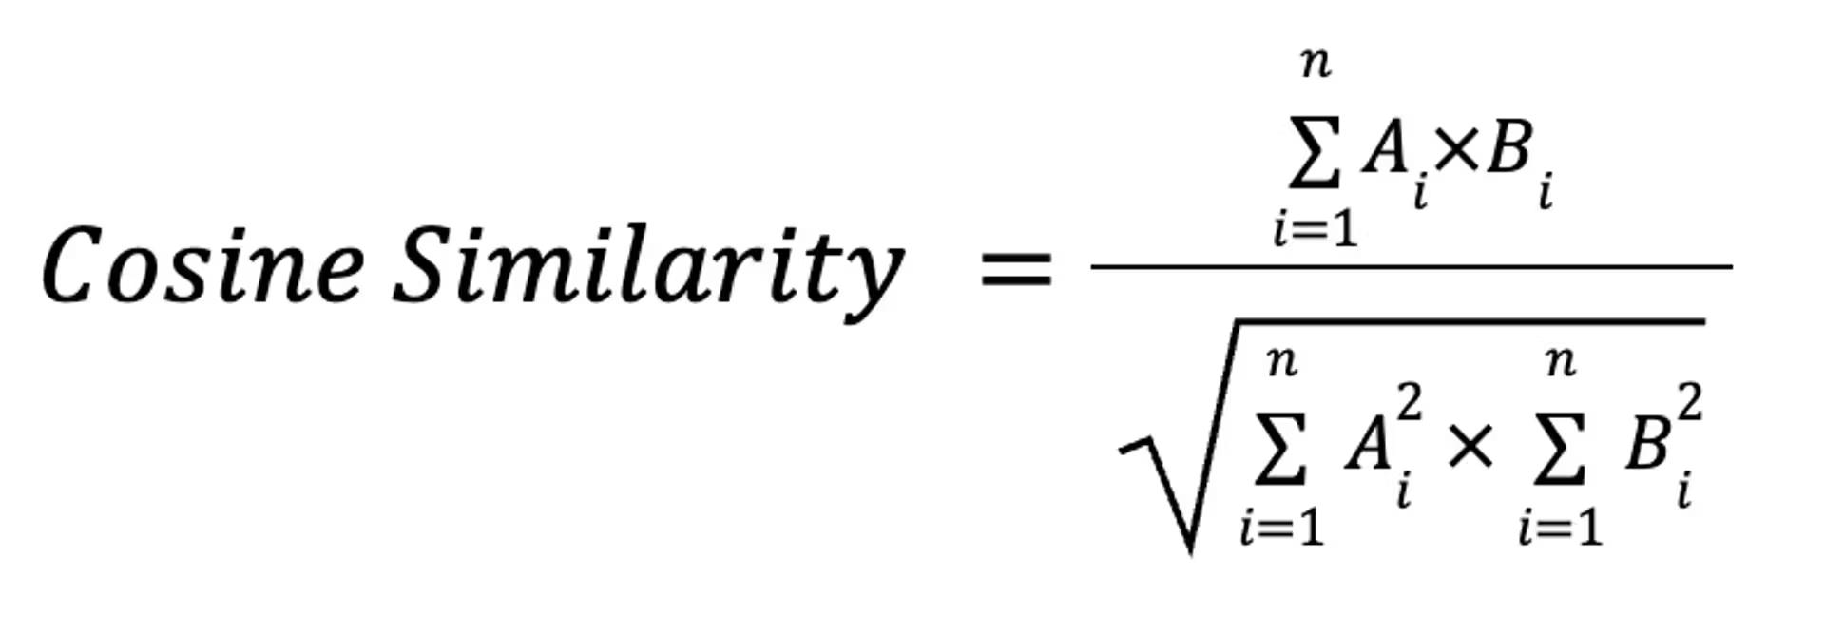
WHAT ARE WORD-EMBEDDINGS

Slide 13
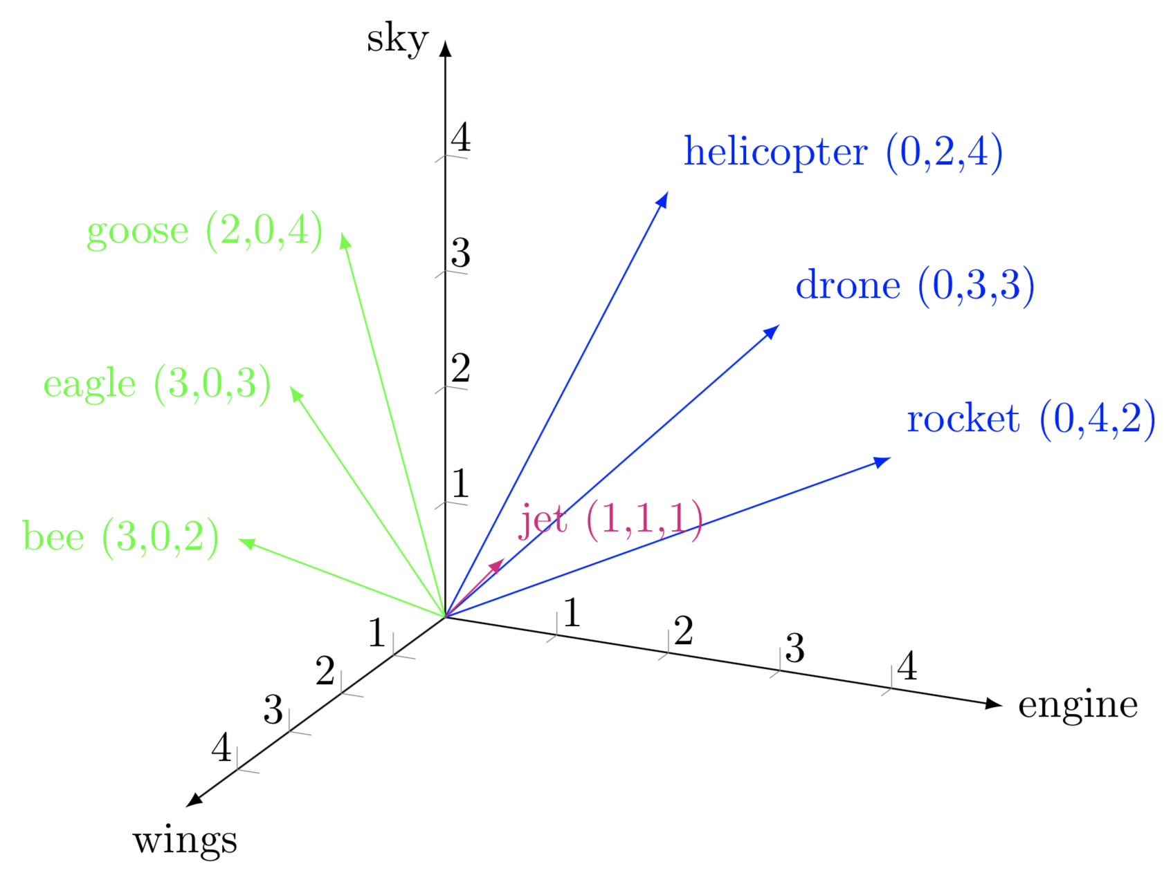
WHAT ARE WORD-EMBEDDINGS

Slide 14
Word-Embeddings

Slide 15
EMBEDDINGS
Pro : can be used pre-trained if your application is generic. For the vast majority of cases the word embeddings trained on Wikipedia are good enough
Pro: can be customized from a pre-learned model at a fraction of the cost. If you have a relatively modest corpus, you can piggyback on a pre trained model that already knows most of the smeantics of english
Con: can be quite difficult to train from scratch. Pretty much only google and a few other large data holders can create these models (or... OpenAI)

Slide 16
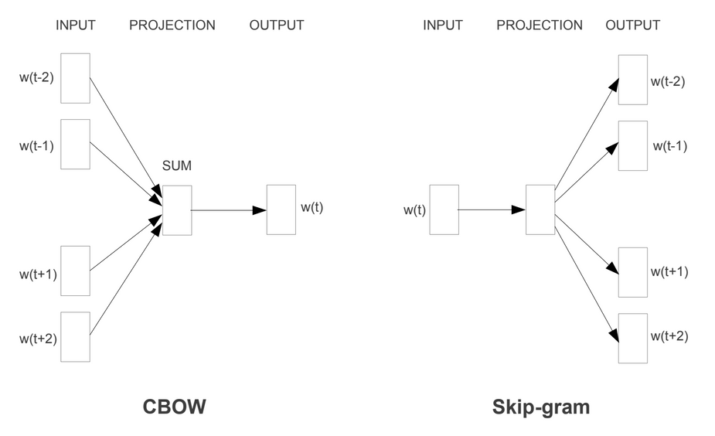
WORD EMBEDDINGS - WORD2VEC
Enriches the notion of autoencoder by considering not only the word but also the words that show up around it
Two versions, depending if it's more important to guess the word based on the context or predict the context based on the word
We have huge corpuses for training, essentially all of literature created so far

Slide 17

WORD EMBEDDINGS - BERT FAMILY
Word2Vec still associates the same vector to the same word
BERT - Bidirectional Encoder Representations from Transformers consider not only the word but also it's context *during encoding*, which means it can extract different meanings from the same word
"the man robbed a bank" vs "the bank of the river was flooded"

