Slide 1



Data Science and Machine Learning
Generative AI II

Slide 2
Retrieval augmented generation (RAG)

Slide 3
RAGs
RAG is a cutting-edge NLP technique that combines document retrieval with generative models. It retrieves relevant information from a database and uses it as input to generate accurate, context-specific response
Benefits:
✅ Accuracy: Responses are grounded in reliable sources.
🔹 Context Awareness: Adaptable to the user’s input and specific needs.
🔹 Scalability: Handles vast amounts of data efficiently.Applications:
🔌 Chatbots for customer support.
🕵️‍♂️ Question-answering systems for research.
📈 Technical document analysis for specialists

Slide 4
RAG vs Fine-Tuning
No training required – You don’t need to modify the model.
Faster and cheaper – No GPU training, no long processing times.
Easily updatable – Just update or swap the documents, no need to retrain.
Access to recent or private data – You can include documents with up-to-date or company-specific information.
Explainable outputs – RAG retrieves relevant documents, so you can see where the answer came from.
Lower risk of overfitting – Your data stays external; the model doesn't memorize it.
Scalable – Add more documents without increasing the model size.
.

Slide 5
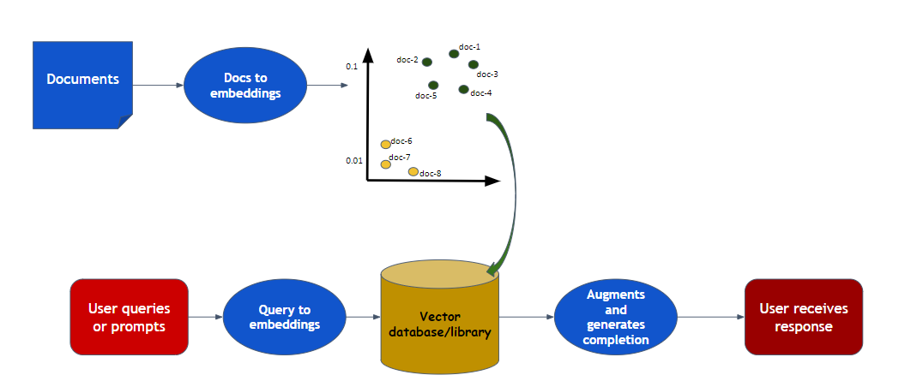
RAG Workflow
🔎 Document Retrieval: Locate relevant information from a document store or database based on a user’s query.
🔬 Embeddings: Use embeddings (dense numerical vectors) to represent text, enabling efficient similarity search and retrieval.
🤖 Generative AI: Feed the retrieved data into a generative model to produce responses tailored to the user’s query.

Slide 6
Embeddings Overview
🔹 OpenAI Embeddings: High-quality, general-purpose models (e.g., text-embedding-ada-002).
🔹 SentenceTransformers: Lightweight, domain-specific models like all-MiniLM-L6-v2.

Slide 7

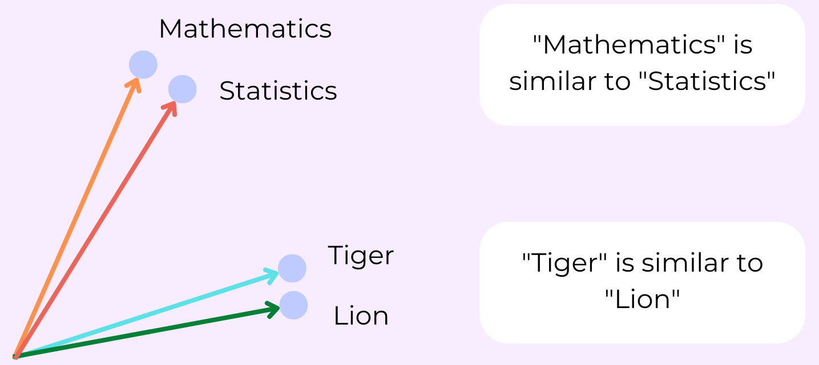
Cosine Similarity
Cosine similarity measures how similar two vectors are by calculating the cosine of the angle between them.

Slide 8
ChromaDB

Slide 9
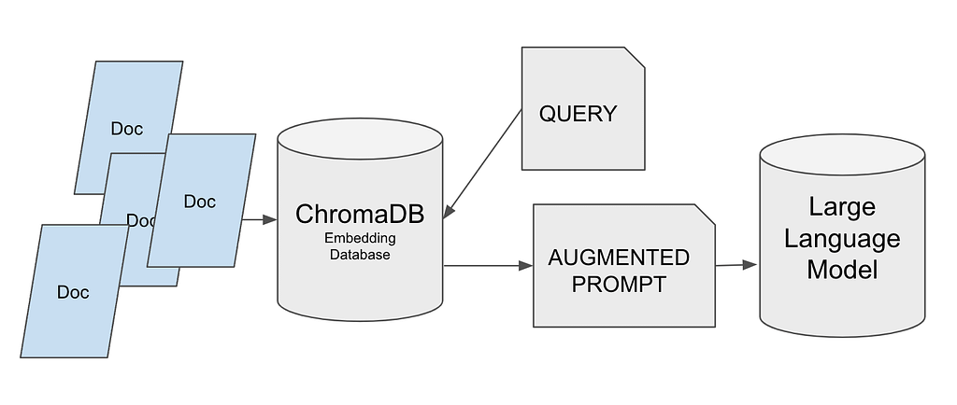
ChromaDB
ChromaDB is a vector database designed for efficiently storing and retrieving embeddings.
🔹 Why Use ChromaDB?
Enables fast similarity searches.
Scales well with large datasets.
🔹 How It Works: Documents ➔ Embeddings ➔ Stored in ChromaDB for efficient retrieval.

