Slide 1
Design Structure Matrix your code as model
Johan van den Muijsenberg

Slide 2
Agenda
Cost Of Software Complexity
Reasons we fail
Design Structure Matrix
Summary

Slide 3
The Cost of Software Complexity

Slide 4
Impact of Poor Software Dependencies
Rigidity
Extra effort cascading changes due to chain of dependencies
Immobility
Can not isolate reusable parts due to excessive dependencies
Fragility
Frequent unexpected failures in other parts due to complex or implicit dependencies
Insufficient Testability
Can not unit test due to excessive dependencies
Notes:
Rigidity
Case: You want to respond to market changes quickly
Problem: Huge effort required
Root cause: Chain of changes required due dependency chain. Propagation cost, average impact
Impact: Missed opportunities
Immobility
Case: You want to reuse parts of existing software for similar product. Common situation because companies often have range of more or less similar products
Problem: Can not isolate components
Root cause: due to excessive dependencies
Impact: Whole code base of existing product copied instead of just required parts. If happens often code base to maintained explodes and team size increases.
Fragility
Case: You want make change
Problem: Change one area break code in other place
Root cause: Not understood dependencies
Impact: Schedule not predictable. Feature not delivered in time.
Test ability
Case: You want to improve product reliability or refactor software design and need tests as a safety net. Testting is an enabling factor in agile.. Earrly integration.
Problem: Can not test component individually
Root cause: Cyclic dependencies and/or coupling via concrete classes instead of interface or abstract classes

Slide 5
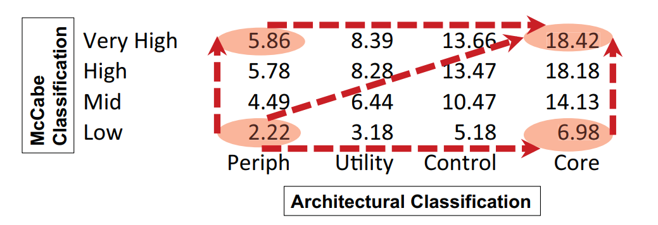
Cost of Software Complexity
Architectural complexity is expensive.
8x more defects
50% lower productivity
10x higher staff turnover
Source: Technical Debt in Large Systems: Understanding the cost of software complexity - Dan Sturtevant
Notes:
Impact see http://www.incose.org/enchantment/docs/13Docs/13Jun_TechDebtLgSystems.pdf

Slide 6
Reasons we fail

Slide 7
Reasons - Human
Lack of awareness design principles
Lack of training/coaching
Project/human short term focus
Consistent high project pressure will lead to accumulation of technical debt and will hurt productivity
Prototype
Extend
Consolidate
Reduce technical debt
Increase technical debt

Slide 8
Reasons – Architecture Control
Insufficient software architecture definition
In many cases architectural definition absent or provides insufficient guidance
PowerPoint architecture
Insufficient software architecture control
No validation if implementation conforms architectural definition
Developers can easily violate intended architecture
By modifying source code

Slide 9
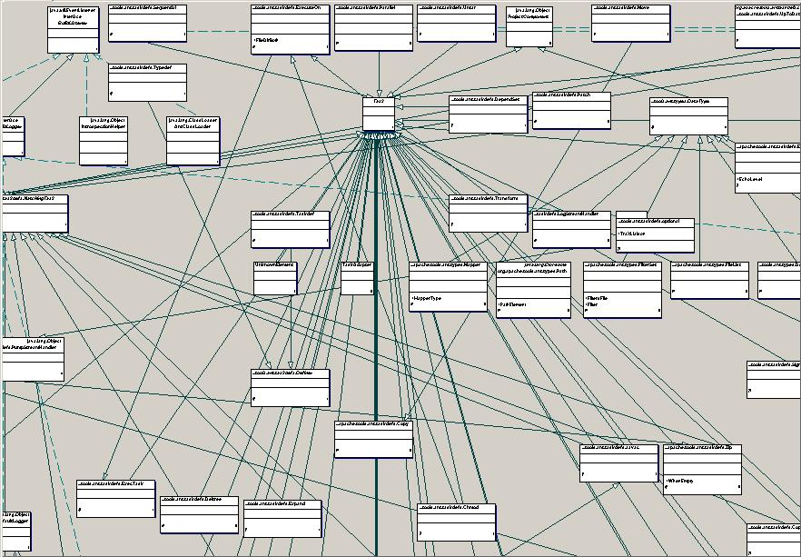
Reasons – Architecture Visualization
UML not suitable for managing software architecture
Difficult to keep in synch with code
Easily overwhelmed by dependencies
Dependencies in model not in any view
Hard to determine which dependencies are bad

Slide 10
Dependency Structure Matrix

Slide 11
DSM Overview
Consists of two parts
Matrix to visualize dependencies
Algorithms which can be applied on the matrix
Can be used to manage dependencies any kind of system which has
A hierarchy of elements
Dependencies between elements
Has been used for very complex systems

Slide 12
Example in UML
Wrong direction
Skip layer
Cycle
Not used

Slide 13
Example in UML
Many ingoing dependencies
Wrong direction
Many outgoing dependencies *
Skip layer
Cycle
Not used
* Not drawn to avoid visual clutter

Slide 14
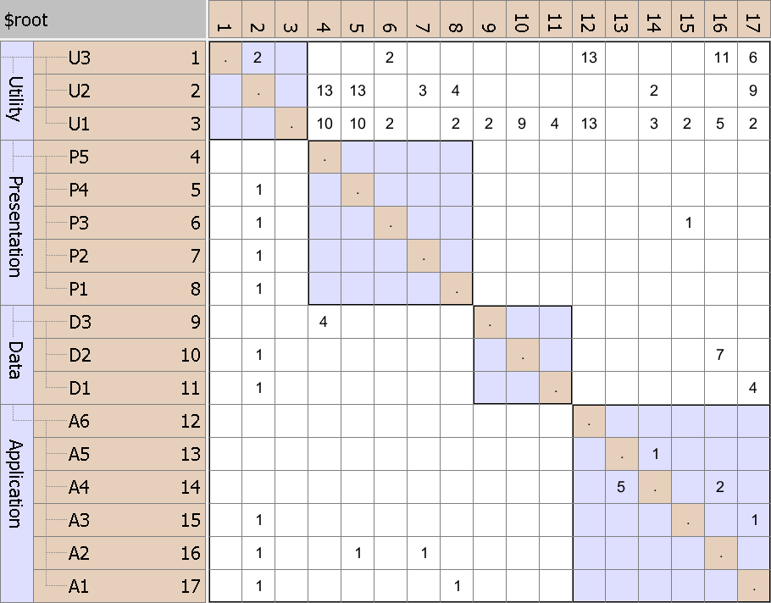
DSM Definition
NxN matrix
Same rows and columns
Hierarchy
Identity line
Value indicates strength
P5 uses D3
Initial DSM

Slide 15
Key Strength - Concise
Dependencies from A1 to U1, U2 and U3
individually
Initial DSM

Slide 16
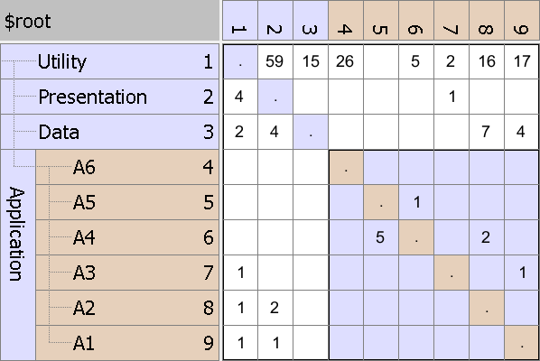
Key Strength - Concise
Dependencies from A1 to U1, U2 and U3
aggregated
Partially collapsed DSM

Slide 17
Key Strength - Concise
Internal dependencies shown
Partially collapsed DSM

Slide 18
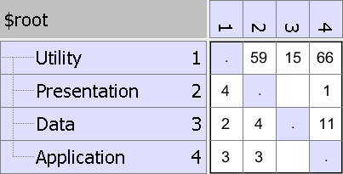
Key Strength - Concise
Fully collapsed DSM
Internal dependencies hidden

Slide 19
Key Strength – Discover Layering
Find actual layering by partitioning algorithms
Algorithm tries to get as much as possible dependencies below identity line
Many dependencies above identity line
DSM before partitioning

Slide 20
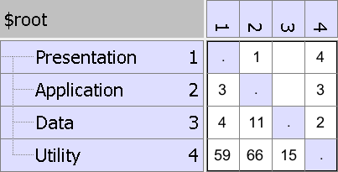
Key Strength – Discover Layering
Found actual layering after applying partitioning algorithm
Cycle easily visible
Consumers to top
Providers to bottom
DSM after partitioning

Slide 21
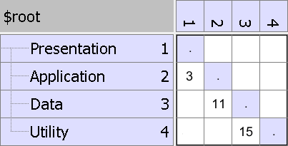
Key Strength – Discover Layering
Discover type of layering - Strict
Only dependencies on layer below
Strict Layering Pattern

Slide 22
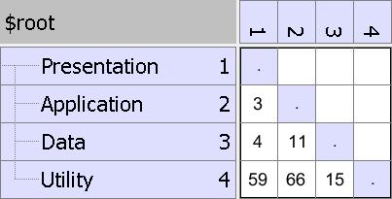
Key Strength – Discovery Layering
Discover type of layering - Relaxed
Dependencies on multiple layers below
Relaxed Layering Pattern

Slide 23
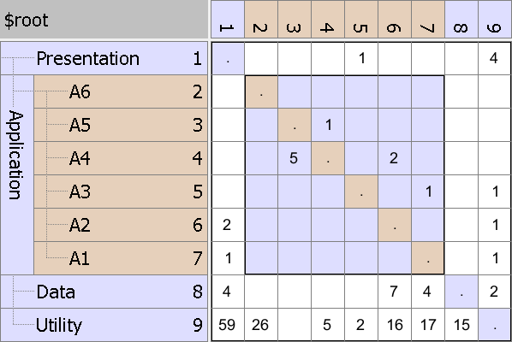
Key Strength – Discover Interfaces
Discover public, internal and unused code
Not used
Encapsulated
Public interface
Encapsulation Pattern

Slide 24
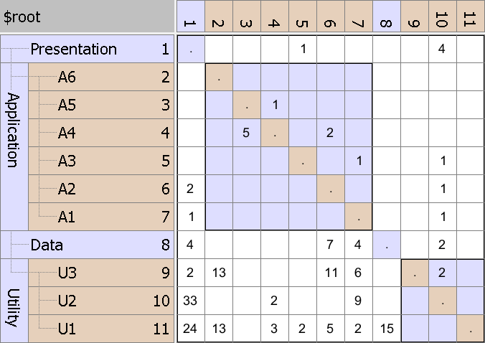
Key Strength – Discover Usage Patterns
Discover utility modules used in entire software
Elements used in entire software like utilities and data access objects
Bus Pattern

Slide 25
Key Strength – Discover Usage Patterns
Discover modules with large change impact
U2 has many in and out going dependencies
Change Propagator Pattern

Slide 26
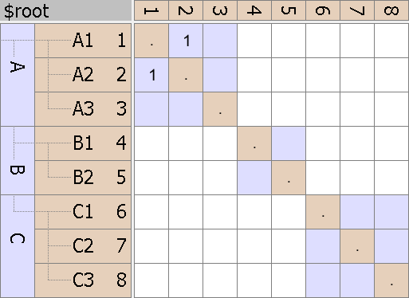
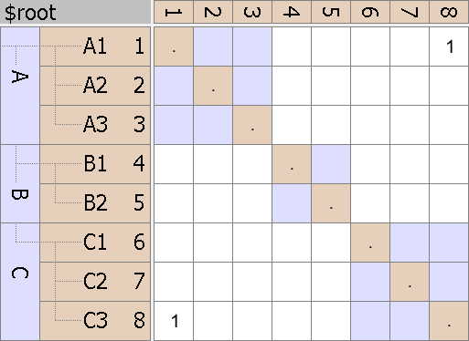

Key Strength - Metrics
Cycles have negative impact on defect rate
System Cycle
Cycles between classes in same module
Intercomponent Cycle
Cycles between classes in different modules
Hierarchical Cycle
Classes involved in cycle or creating cycle between modules
System Cycle
Intercomponent Cycle
Hierarchical Cycle

Slide 27
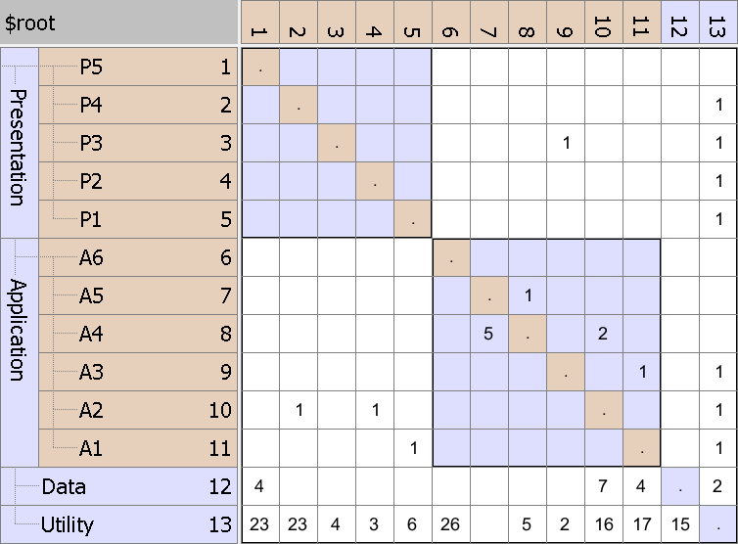
Key Strength – Refactoring
Fix hierarchical cycle by moving element
Hierarchical cycle due to
A3 using P3
which violates layering
Initial DSM

Slide 28
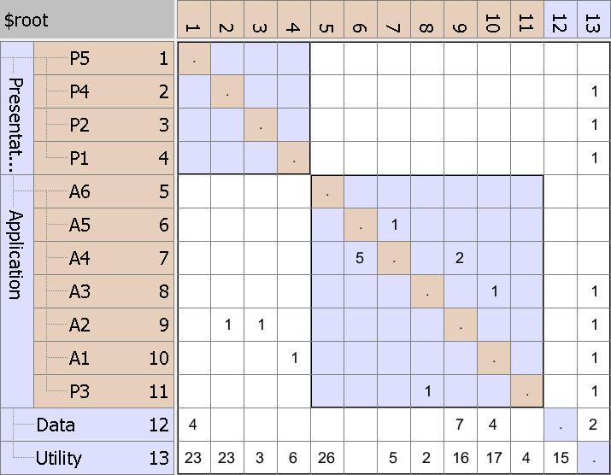
Key Strength – Refactoring
Result
Cycle removed by moving P3
Refactored DSM

Slide 29
Key Strength - Communication
Can be used to visualize desired architecture.
Can be encoded using rules.

Slide 30
Common Use Cases
Discover the Architecture and Identify Issues with Interdependencies
DSM Analysis
Specify/Enforce Architectures
Layers, Components, Interfaces with Dependency Rules
Track, Measure and Report on Changes and Trends
Metrics
Re-engineer/Refactor
Impact Analysis

Slide 31
Tooling
Lattix DSM Tool (commercial)
www.lattix.com
Intelij IDEA Ultimate Java IDE (commercial)
https://www.jetbrains.com/idea/
CppDepend/NDepend/JArchitect (commercial)
https://www.cppdepend.com/
https://www.ndepend.com/
https://www.jarchitect.com/
Visual Studio DSM plug-in .NET (open source)
http://www.tom-carter.net/
DSM Suite based on plugin above (open source)
https://dsmsuite.github.io/

Slide 32
Summary

Slide 33
Summary
Is a powerful technique for analyzing, improving, and managing complex system architectures and dependencies
Can be adopted at any stage of the project

Slide 34

References
Design Structure Matrix Methods and Applications
Steven D. Eppinger and Tyson R. Browning
www.dsmweb.org
General information on DSMs
Achieving Agility Through Architecture Visibility
Carl Hinsman, Neeraj Sangal and Judith Stafford
Interesting if you want to explore use of DSM for system or organization modeling
Excellent article on case study

