Slide 1
Design Structure Matrix your code as model
Johan van den Muijsenberg

Slide 2
Agenda
Introduction
DSM overview
DSM tooling
Summary

Slide 3
The cost of software complexity

Slide 4
Impact of Poor Software Dependencies
Rigidity
Extra effort cascading changes due to chain of dependencies
Immobility
Can not isolate reusable parts due to excessive dependencies
Fragility
Frequent unexpected failures in other parts due to complex or implicit dependencies
Insufficient Testability
Can not unit test due to excessive dependencies
Source: Robert C. Martin
Notes:
Rigidity
Case: You want to respond to market changes quickly
Problem: Huge effort required
Root cause: Chain of changes required due dependency chain. Propagation cost, average impact
Impact: Missed opportunities
Immobility
Case: You want to reuse parts of existing software for similar product. Common situation because companies often have range of more or less similar products
Problem: Can not isolate components
Root cause: due to excessive dependencies
Impact: Whole code base of existing product copied instead of just required parts. If happens often code base to maintained explodes and team size increases.
Fragility
Case: You want make change
Problem: Change one area break code in other place
Root cause: Not understood dependencies
Impact: Schedule not predictable. Feature not delivered in time.
Test ability
Case: You want to improve product reliability or refactor software design and need tests as a safety net. Testting is an enabling factor in agile.. Earrly integration.
Problem: Can not test component individually
Root cause: Cyclic dependencies and/or coupling via concrete classes instead of interface or abstract classes

Slide 5
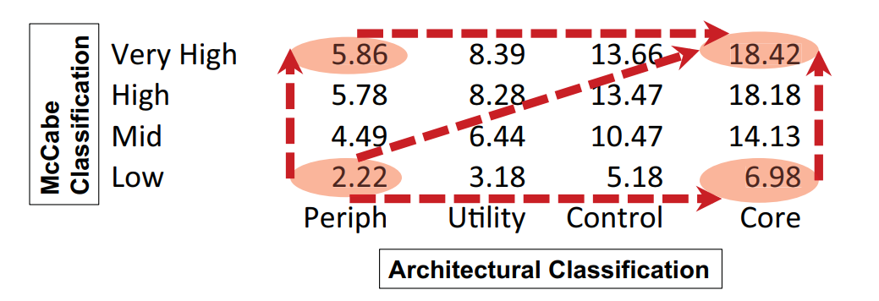
Cost of Software Complexity
Architectural complexity is expensive.
8x more defects
50% lower productivity
10x higher staff turnover
Source: Technical Debt in Large Systems: Understanding the cost of software complexity - Dan Sturtevant
Notes:
Impact see http://www.incose.org/enchantment/docs/13Docs/13Jun_TechDebtLgSystems.pdf

Slide 6
Dependency management is hard

Slide 7
Reasons - Human
Lack of awareness design principles
Lack of training/coaching
Project/human short term focus
Consistent high project pressure will lead to accumulation of technical debt and will hurt productivity
Prototype
Extend
Consolidate
Reduce technical debt
Increase technical debt

Slide 8
Reasons – Architecture Control
Insufficient software architecture definition
In many cases architectural definition absent or provides insufficient guidance
PowerPoint architecture
Insufficient software architecture control
No validation if implementation conforms architectural definition
Developers can easily violate intended architecture
By modifying source code

Slide 9
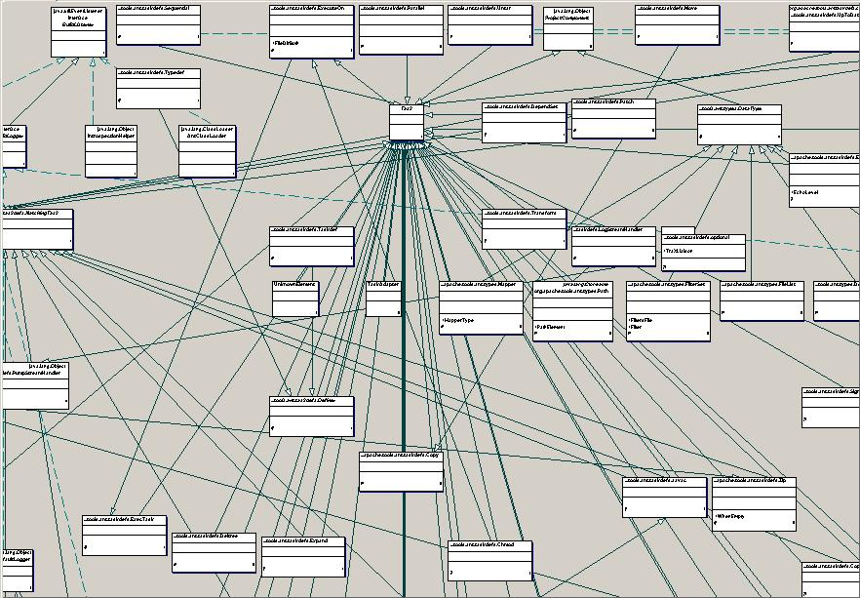
Reasons – Architecture Visualization
UML not suitable for managing software architecture
Difficult to keep in synch with code
Easily overwhelmed by dependencies
Dependencies in model not in any view
Hard to determine which dependencies are bad

Slide 10
Dependency Structure Matrix

Slide 11
DSM Overview
Consists of two parts
Matrix to visualize dependencies
Algorithms which can be applied on the matrix
Can be used to manage dependencies any kind of system which has
A hierarchy of elements
Dependencies between elements
Has been used for very complex systems

Slide 12
Example in UML
Wrong direction
Skip layer
Cycle
Not used

Slide 13
Example in UML
Many ingoing dependencies
Wrong direction
Many outgoing dependencies *
Skip layer
Cycle
Not used
* Not drawn to avoid visual clutter

Slide 14
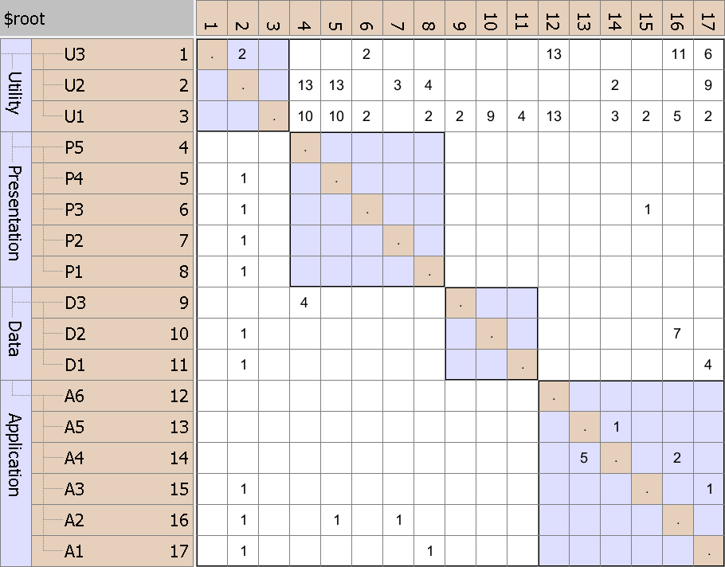
Same rows and columns
DSM Elements
Identity line
Dependency
Hierarchy
Initial DSM

Slide 15
DSM Usage – A2 consumers?
Initial DSM
U2 uses A2
P4 uses A2
P2 uses A2

Slide 16
DSM Usage – A2 providers ?
A2 uses U3
A2 uses U1
A2 uses D2
A2 uses A4
Initial DSM

Slide 17
Key Strength - Concise
Dependencies from A1 to U1, U2 and U3
individually
Initial DSM

Slide 18
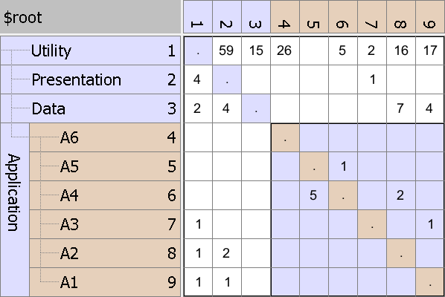
Key Strength - Concise
Dependencies from A1 to U1, U2 and U3
aggregated
Partially collapsed DSM

Slide 19
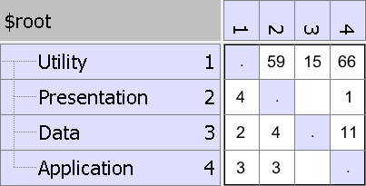
Key Strength - Concise
Dependencies from Application to Utility elements
aggregated
Fully collapsed DSM

Slide 20
Key Strength – Architectural Discovery
Find actual layering by partitioning algorithms
Algorithm tries to get as much as possible dependencies below identity line
Many dependencies above identity line
DSM before partitioning

Slide 21
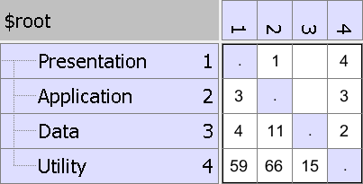
Key Strength – Architectural Discovery
Found actual layering after applying partitioning algorithm
Cycles easily visible
Consumers to top
Providers to bottom
DSM after partitioning

Slide 22
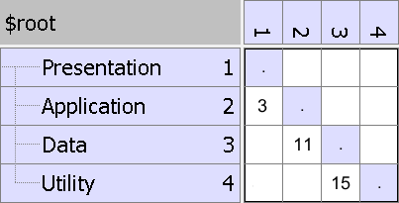
Key Strength – Architectural Discovery
Discover type of layering - Strict
Only dependencies on layer below
Strict Layering Pattern

Slide 23
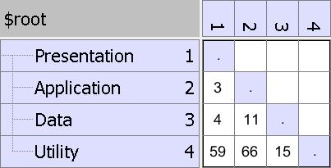
Key Strength – Architectural Discovery
Discover type of layering - Relaxed
Dependencies on multiple layers below
Relaxed Layering Pattern

Slide 24
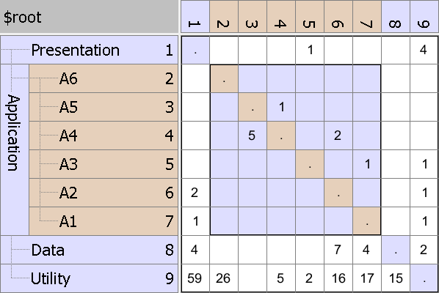
Key Strength – Architectural Discovery
Discover public, internal and unused code
Not used or top element
Encapsulated
Intended public interface
Accidental public interface
Encapsulation Pattern

Slide 25
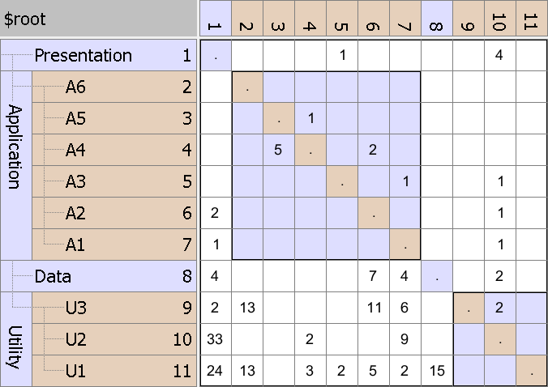
Key Strength – Architectural Discovery
Discover utility modules used in entire software
Elements used in entire software like utilities and data access objects
Bus Pattern

Slide 26
Key Strength – Architectural Discovery
Discover modules with large change impact
U2 has many in and out going dependencies
Change Propagator Pattern

Slide 27
Key Strength - Communication
When names reflects problem domain
It allows reasoning about software using domain knowledge
Allows define dependency rules
In the form of ‘can use’ and ‘can not use’ dependency rules

Slide 28
Key Strength - Communication
Fills gap between conceptual architecture and source code.
Software Architecture
Describes only key elements/concepts and decisions
Use DSM to capture elements and relations in detail
Gap
Source code implementation
Source Code

Slide 29
Key Strength – Refactoring
Design Level Refactoring (Fowler)
Limited Scope/Risk/Effort, IDE support
Architecture Level Refactoring
Large Scope/Risk/Effort
Need tools to understand
Dependency structure
Impact of changes
The implemented architecture does often not conform to the intended architecture.
Use DSM to increase reliability impact analysis.
Notes:
Rigidity
Case: You want to respond to market changes quickly
Problem: Huge effort required
Root cause: Chain of changes required due dependency chain. Propagation cost, average impact
Impact: Missed opportunities
Immobility
Case: You want to reuse parts of existing software for similar product. Common situation because companies often have range of more or less similar products
Problem: Can not isolate components
Root cause: due to excessive dependencies
Impact: Whole code base of existing product copied instead of just required parts. If happens often code base to maintained explodes and team size increases.
Fragility
Case: You want make change
Problem: Change one area break code in other place
Root cause: Not understood dependencies
Impact: Schedule not predictable. Feature not delivered in time.
Test ability
Case: You want to improve product reliability or refactor software design and need tests as a safety net. Testting is an enabling factor in agile.. Earrly integration.
Problem: Can not test component individually
Root cause: Cyclic dependencies and/or coupling via concrete classes instead of interface or abstract classes

Slide 30
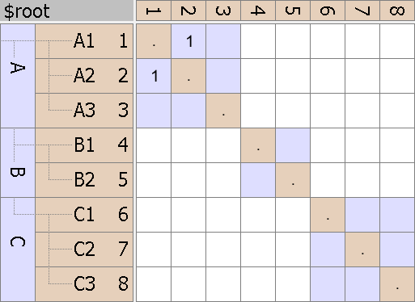

Key Strength – Refactoring
System Cyclicality – Cycle between elements
Fix by changing elements (John Laxos – Levelization)
Hierarchical Cyclicality – Cycle caused by wrong packaging
Fix by moving elements
A1 -> A2
A2 -> A1
A1 -> C3
C2 -> A2
System Cycle
Hierarchical Cycle
See: CppCon 2016: John Lakos “Advanced Levelization Techniques (YouTube)

Slide 31
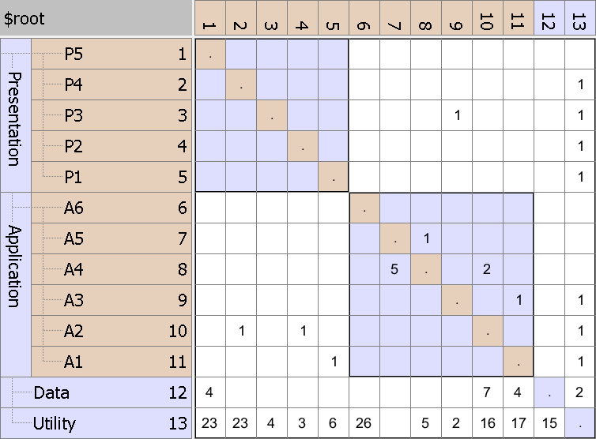
Key Strength – Refactoring
Fix hierarchical cycle by moving element
Hierarchical cycle due to
A3 using P3
which violates layering
Initial DSM

Slide 32
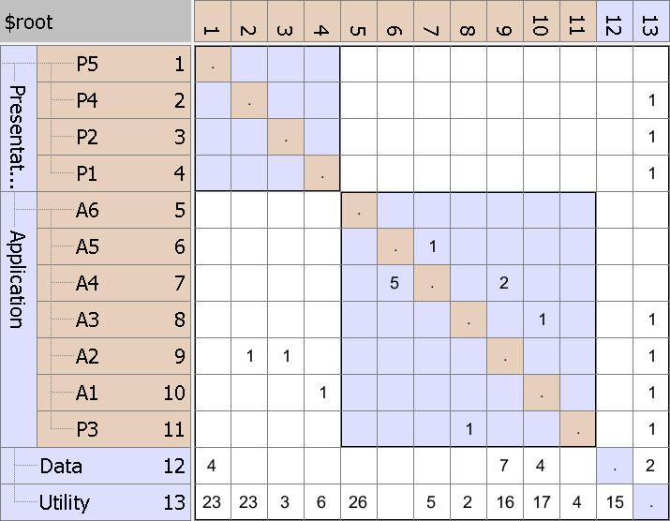
Key Strength – Refactoring
Result
Cycle removed by moving P3
Refactored DSM

Slide 33
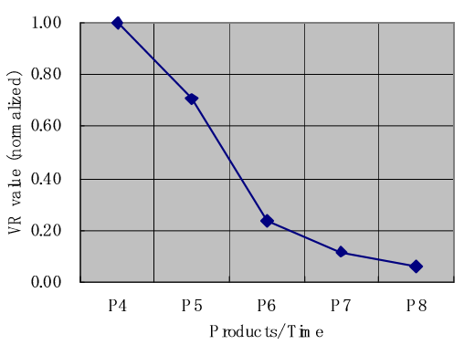
Key Strength - Metrics
Number of cycles (System and Hierarchical Cycles)
Expected relative defect rate and productivity (Sturtevant)
Violation Ratio against defined rules (Maki)
VR = (number of access violations)/(number of total accesses) × 100 [%]
Source: Technical Debt in Large Systems: Understanding the cost of software complexity - Dan Sturtevant
Source: Architecture migration using DSM in a large scale software project - Takashi Maki, Ricoh

Slide 34
DSM Tooling

Slide 35
DSM Tooling
Lattix DSM Tool (commercial)
www.lattix.com
Intelij IDEA Ultimate Java IDE (commercial)
https://www.jetbrains.com/idea/
CppDepend/NDepend/JArchitect (commercial)
https://www.cppdepend.com/
https://www.ndepend.com/
https://www.jarchitect.com/
Visual Studio DSM plug-in .NET (open source)
http://www.tom-carter.net/
DSM Suite C++, Java, .NET, UML (open source)
https://dsmsuite.github.io/

Slide 36
DSM Suite - Goals
To offer a free solution and thereby significantly lowering the threshold for applying DSMs.
To support a number of well known programming languages and environments.
To allow for easy extension to support other programming languages and environments.
To allow integration into a continuous integration build chain.

Slide 37
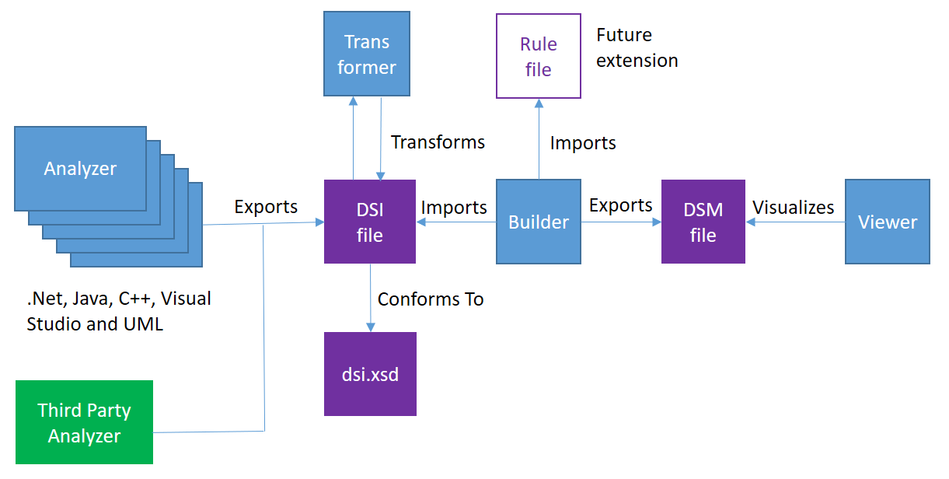
DSM Suite - Overview

Slide 38
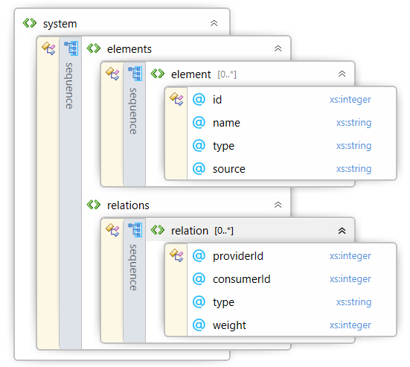
DSM Suite - DSI File Format
Defines elements and their relations
Element names are unique.
Element names are dot separated names similar to namespaces.
The dot separated parts represent a hierarchy.
Application.A2
Utility.U1

Slide 39
DSM Suite - Analyzer
Extracts information from source, binaries or other data.
Exports this information to a DSI file.
A few standard analyzers are provided.

Slide 40
DSM Suite - Supported Analyzers
 | Elements | Hierarchy | Dependencies
C++ | File | Directories | File includes
C# | Type | Namespaces | Type dependencies
Java (uses Jdeps) | Type | Namespaces | Type dependencies
Visual Studio | Files | Directories or Solution/Project Folders | Project references or file includes
Sparx EA | UML element | UML package | UML connector
GraphML (experimental) | GrapML node | GraphML edge | GraphML edge
If none of the provided analyzers suites your needs, it is possible to write your own analyzer as long as its writes the result to a DSI file.

Slide 41
DSM Suite - Transformer
Apply transformations on the DSI file.
Examples:
Add transitive relations e.g. for C++ not only direct includes, but also indirect includes.
Move elements hierarchy. This feature can be used to:
Provide a better perspective (e.g. split test and product architecture)
For analysis of a potential architectural refactoring.

Slide 42
DSM Suite - Builder
Uses DSI file as input and builds DSM file.
Retrieves the elements.
Builds the element hierarchy.
Retrieves the relations between the elements.
Calculates the derived dependency weights for all cells.
Flags cyclic relations, so the can emphasized in the DSM.
In the future it might also evaluate dependency rules to verify that the code conforms to the defined architecture.

Slide 43
DSM Suite - Viewer
Opening DSM file
Modifying the DSM file
Move elements up or down
Partition a section of the DSM model
Saving the changes in the DSM file
Changing the view of the DSM
Change the zoom level
Highlight cyclic dependencies on or off
Reporting
Report all cyclic dependencies
Report all dependency between two elements by selecting a cell and right clicking it

Slide 44
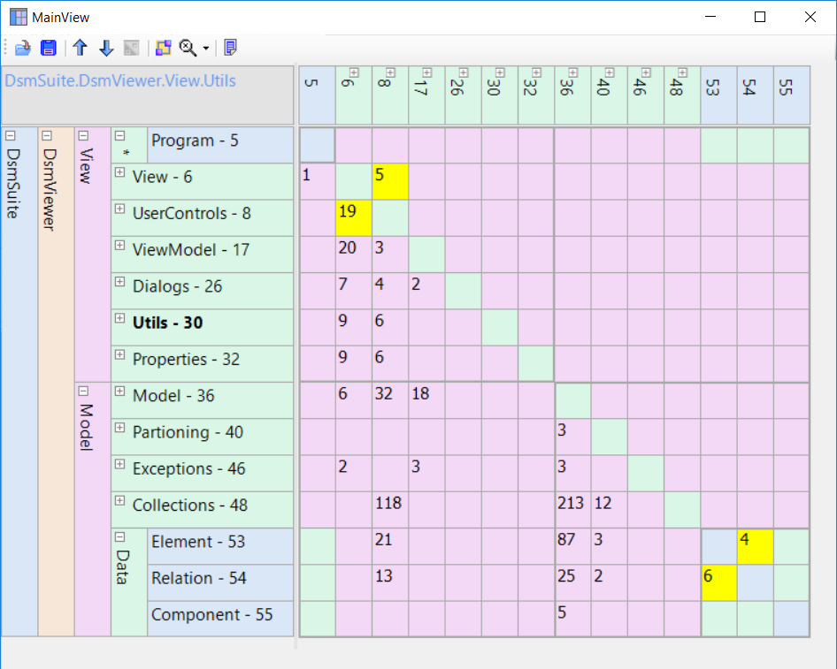
DSM Suite - Viewer

Slide 45
Architecture migration using DSM

Slide 46
Introduction
It is essential to determine the appropriate architecture and maintain conformance.
In projects with a long life cycle, changes in the architecture cannot be avoided owing to changes in requirements and technologies.
Continuous and planned refactoring is thus essential to lengthen the life of the architecture.
Architecture migration using the source code of products from the former architecture to the new architecture using DSM to ensure product continuity.
Source: Architecture migration using DSM in a large scale software project, Takashi Maki, Ricoh

Slide 47
Process
Change source code by developer or automated
Extract dependencies from codebases, databases, models…
Create DSM
Transform DSM
Establish Rules
Modify Code
Check conformance
Align structure with needs Requirements, Technology, Organizational

Slide 48
Summary

Slide 49
Summary
Can be adopted at any stage of the project
Specify/Enforce Architectures: Layers, Components, Interfaces with Dependency Rules
Track, Measure and Report on Changes and Trends: Metrics
Architectural Discovery: Identify structure existing code base
Re-engineer/Refactor: Impact Analysis
Can be applied at multiple levels
Architecture, Component and Class

Slide 50

References
Achieving Agility Through Architecture Visibility
Carl Hinsman, Neeraj Sangal and Judith Stafford
Architecture migration using DSM in a large scale software project
Takashi Maki, Ricoh
Design Structure Matrix Methods and Applications
Steven D. Eppinger and Tyson R. Browning
www.dsmweb.org
General information on DSMs

