Slide 1
Overview

Slide 2
Comparer
Analyzer
Compares
Analyzer
Analyzer
Analyzer
DSI
file
Viewer
DSM
file
Analyzer
Exports
Imports
Visualizes
.Net, Java, C++, Visual Studio and UML
Conforms To
dsi.xsd
Third Party Analyzer

Slide 3
Many dependencies
Wrong direction
Skip layer
Cycle
Not used

Slide 4
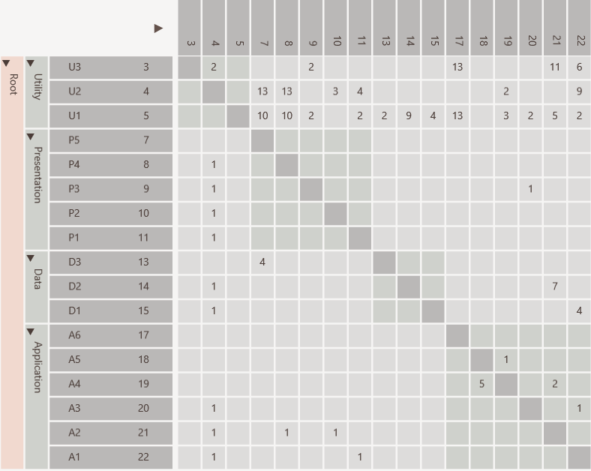
Same rows and columns
Identity line
Value indicates strength
P5 uses D3
Hierarchy

Slide 5
Dependencies from A1 to U1, U2 and U3
individually

Slide 6
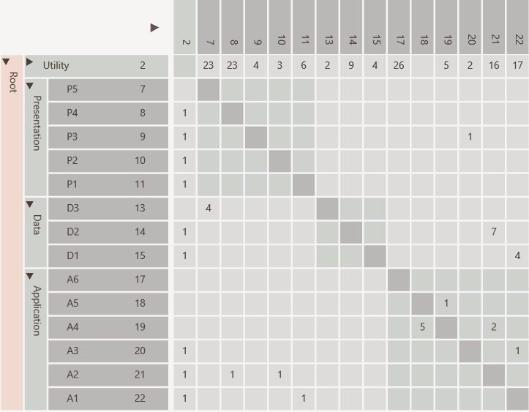
Dependencies from A1 to U1, U2 and U3
aggregated

Slide 7
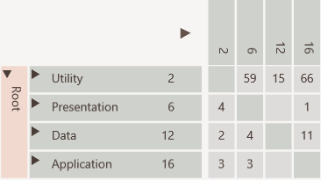
All dependencies between Application and Utility collapsed

Slide 8
Many dependencies above identity line

Slide 9
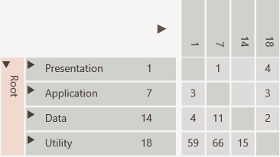
Consumers to top
Cycle easily visible
Providers to bottom

Slide 10
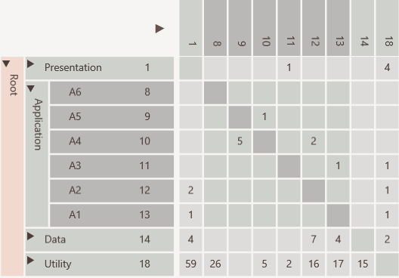
Not used
Encapsulated
Public interface
Encapsulation Pattern

Slide 11
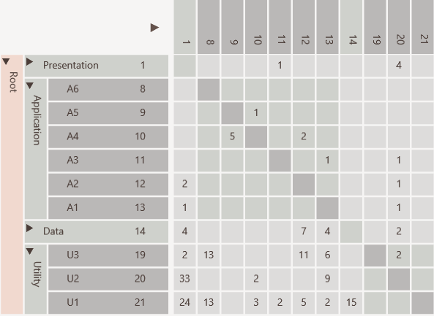
Elements used in entire software like utilities and data access objects
Bus/Utility Pattern

Slide 12
U2 has many in and out going dependencies
Change Propagator Pattern

Slide 13
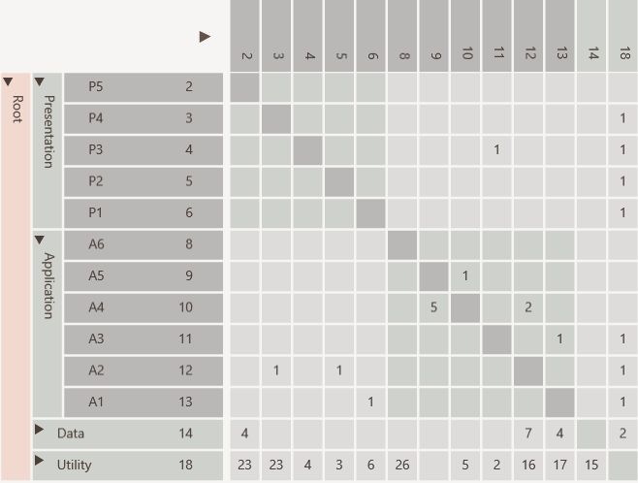
Hierarchical cycle due to
A3 using P3
which violates layering
Before

Slide 14
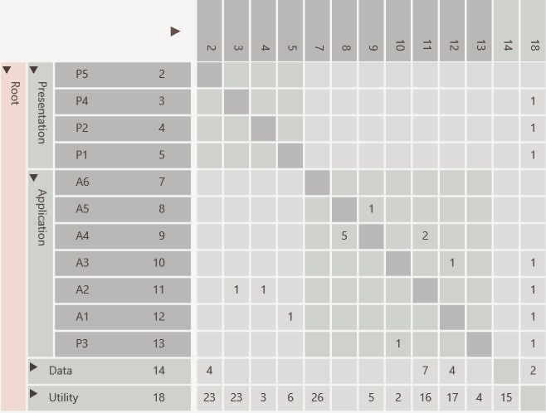
Cycle removed by moving P3
After

Slide 15
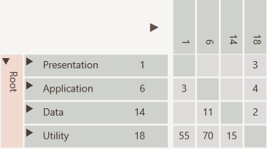

Slide 16
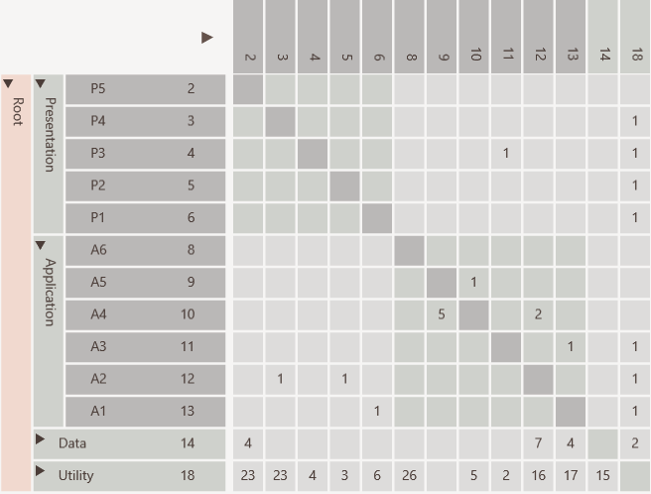
Hierarchical Cycle
Cycle removed by moving P3
Cycle removed by moving P3
System Cycle

Slide 17
User Guide

Slide 18
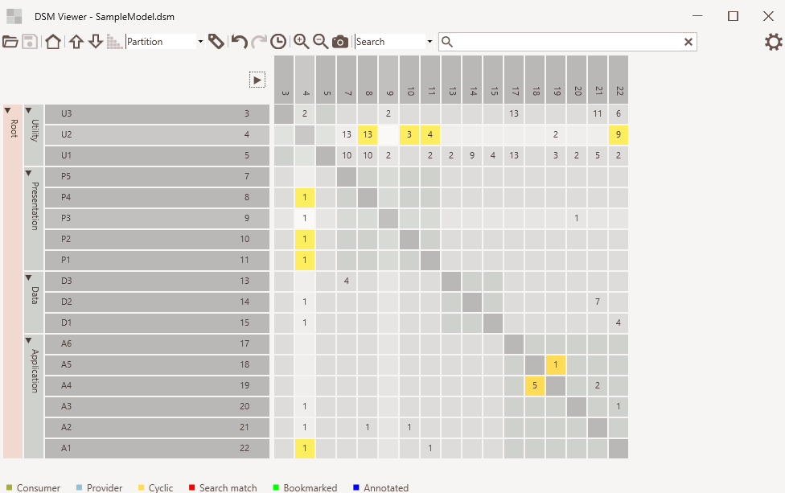
Cell
selected
Element Hierarchy
Cell
hovered

Slide 19
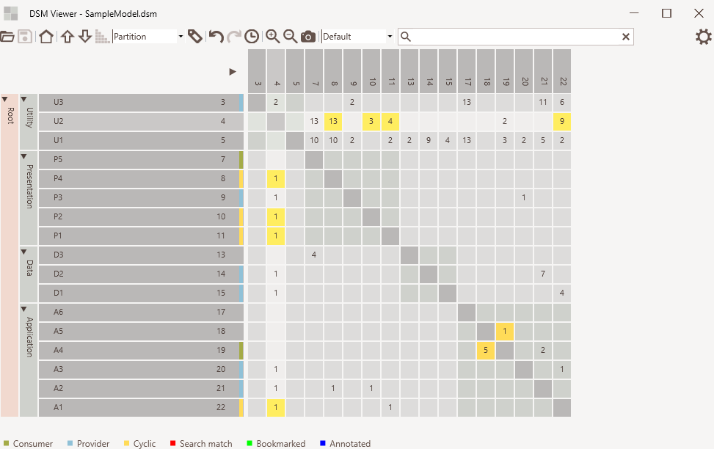
Default mode
Consumer/provider indicators
Normal dependency
Cyclic dependency

Slide 20
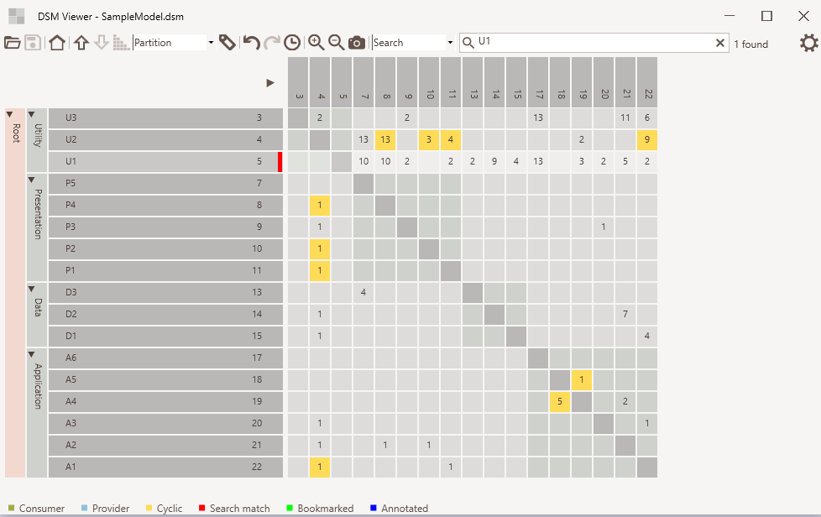
Search mode
Search text
Elements found
Match indicator

Slide 21
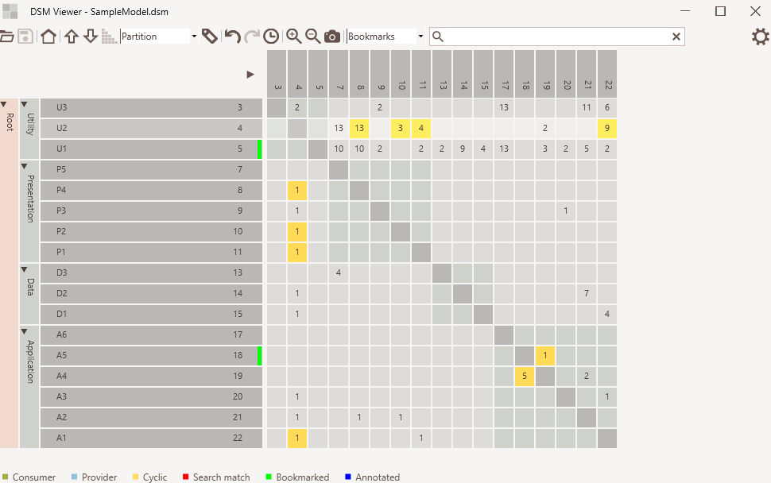
Bookmark mode
Bookmarked
indicator

Slide 22
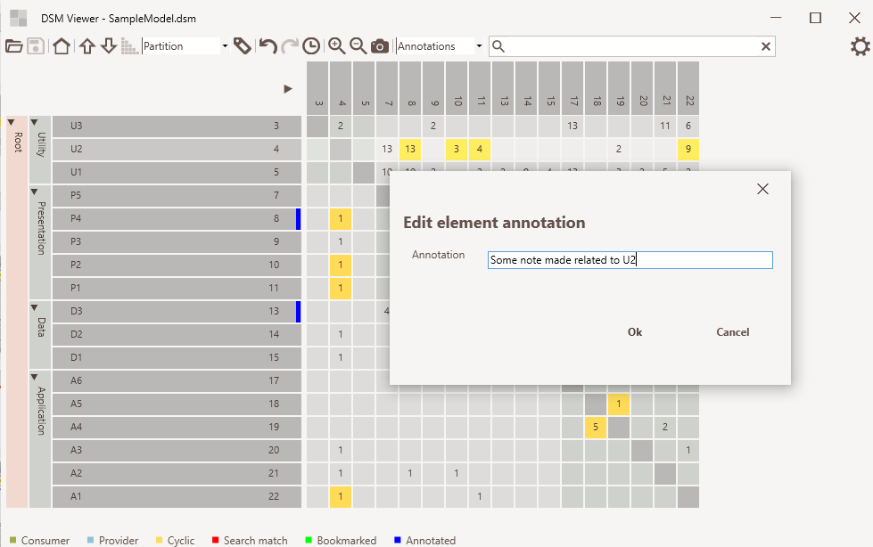
Annotation mode
Annotated
indicator

Slide 23
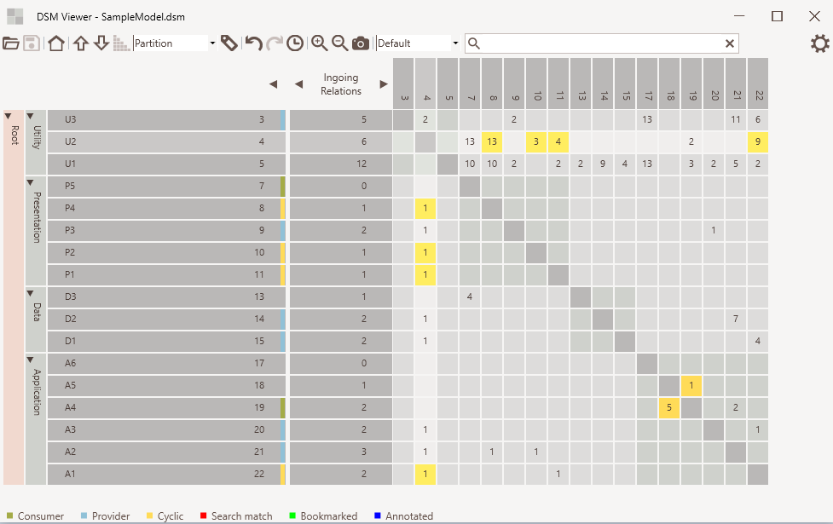
Expand / collapse
Metrics selection
Metrics values

Slide 24
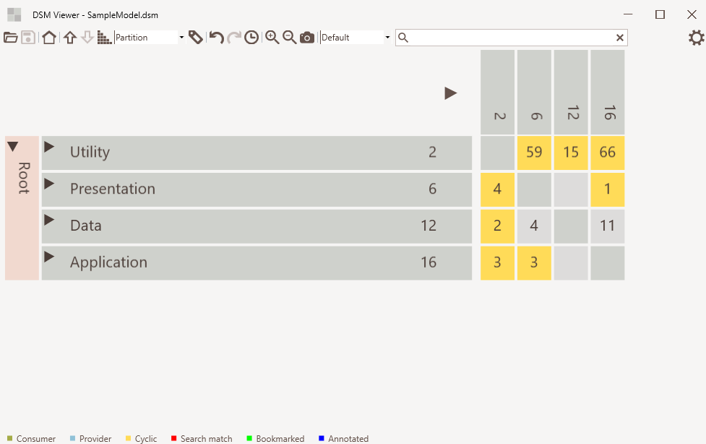
Zoom in/out
Screenshot

Slide 25
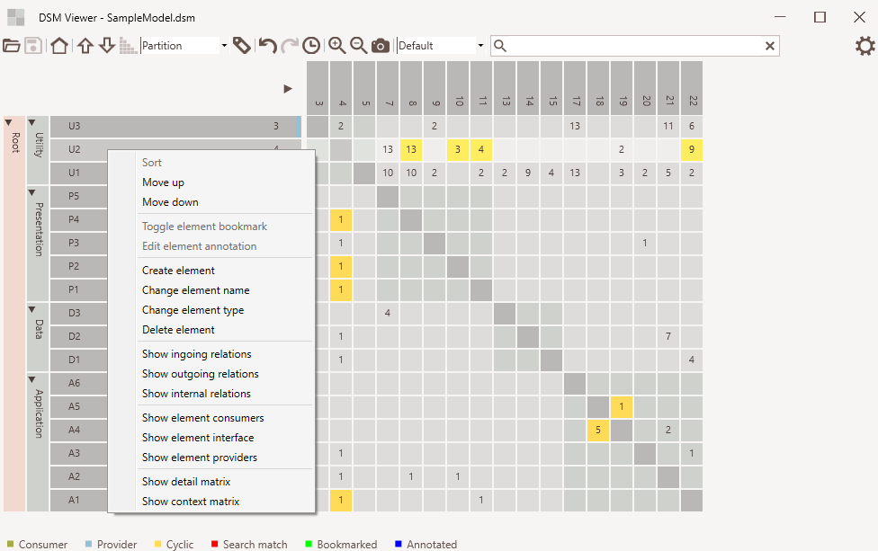
Element context menu

Slide 26
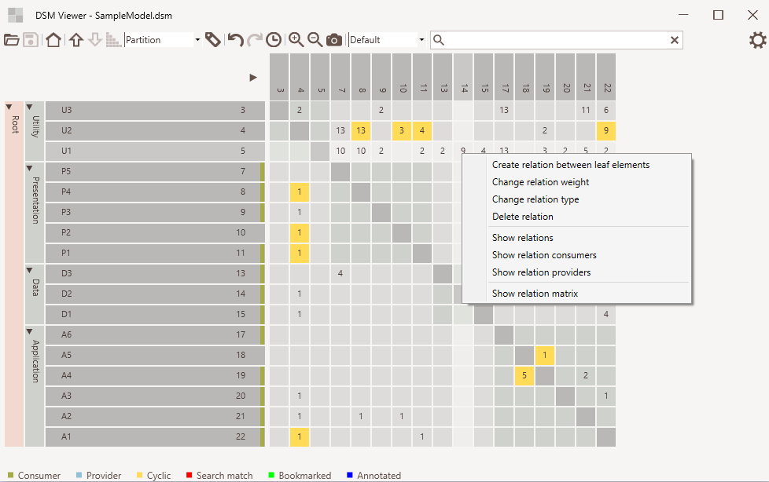
Relation context menu

Slide 27
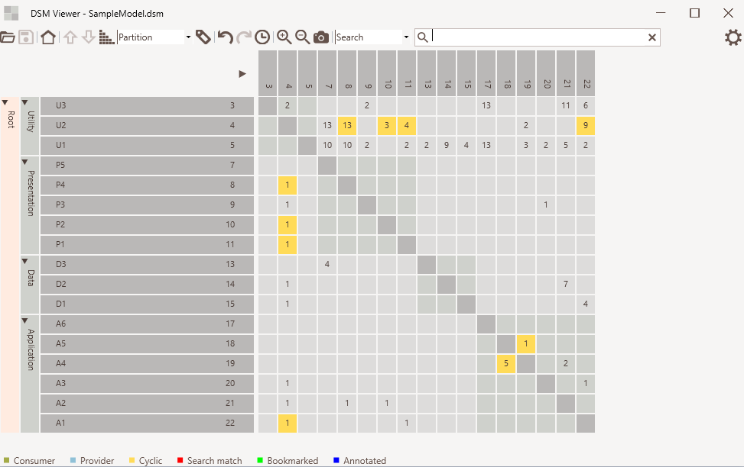
Move up/down
Sort
Undo/redo and history
Move element using drag and drop
Edit relation using cell context menu
Edit element using cell context menu

