Slide 1
Trans
former
Rule file
Future extension
Standard
Analyzer
Transforms
Imports
Analyzer
Analyzer
Analyzer
DSI
file
DSM Builder
DSM
File
DSM
Viewer
Analyzer
Exports
Imports
Exports
Visualizes
.Net, Java, C++, Visual Studio, GrapML and UML
Conforms To
DSI Schema
Third Party Analyzer

Slide 2
Wrong direction
Skip layer
Cycle
Not used

Slide 3
Many ingoing dependencies
Wrong direction
Many outgoing dependencies
Skip layer
Cycle
Not used

Slide 4
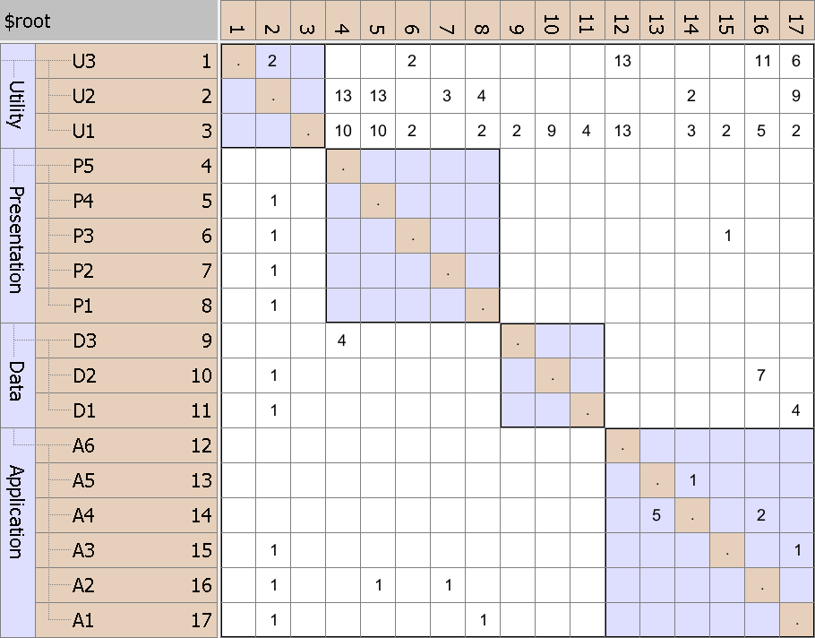
NxN matrix
Same rows and columns
Hierarchy
Identity line
Value indicates strength
P5 uses D3

Slide 5
Dependencies from A1 to U1, U2 and U3
individually

Slide 6
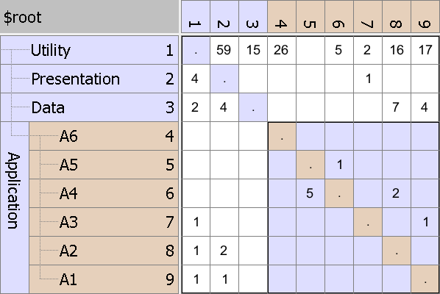
Dependencies from A1 to U1, U2 and U3
aggregated

Slide 7
Key Strength - Concise
Internal dependencies shown
Partially collapsed DSM

Slide 8
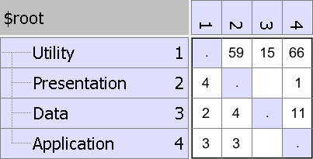
All dependencies between Application and Utility collapsed

Slide 9
Many dependencies above identity line
DSM before partitioning

Slide 10
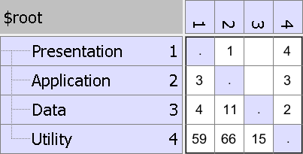
Cycle easily visible
Consumers to top
Providers to bottom
DSM after partitioning

Slide 11
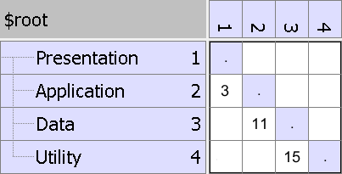
Only dependencies on layer below
Strict Layering Pattern

Slide 12
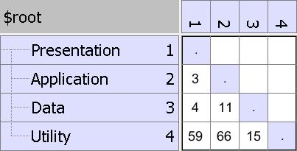
Dependencies on multiple layers below
Relaxed Layering Pattern

Slide 13
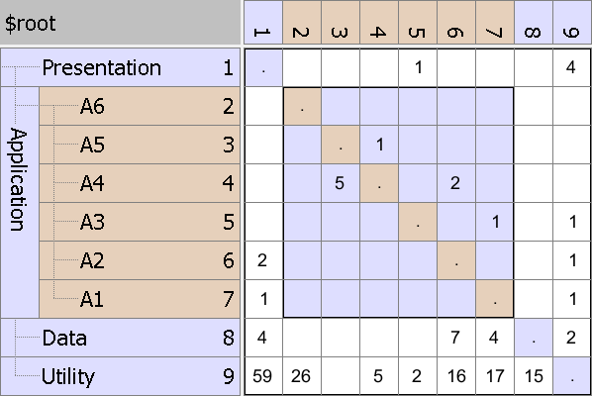
Not used
Encapsulated
Public interface
Encapsulation Pattern

Slide 14
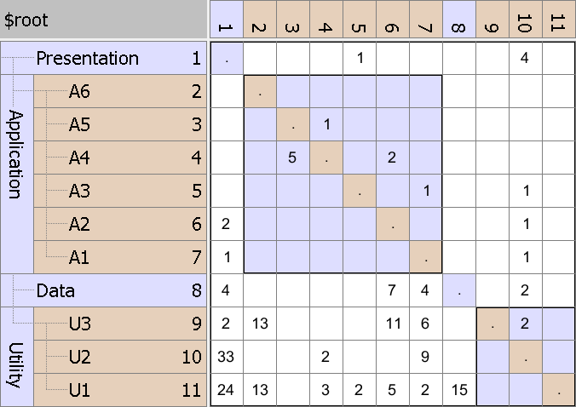
Elements used in entire software like utilities and data access objects
Bus/Utility Pattern

Slide 15
U2 has many in and out going dependencies
Change Propagator Pattern

Slide 16
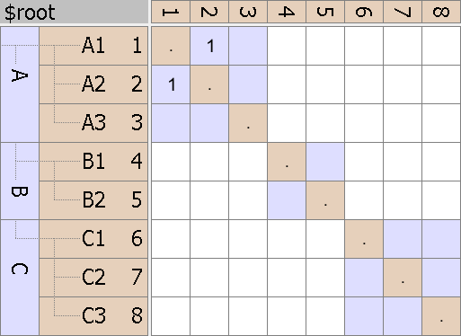
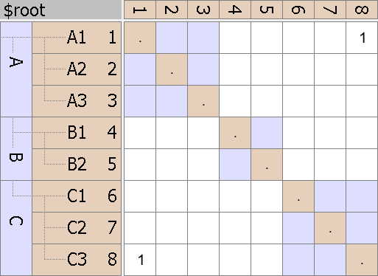

System Cycle
Intercomponent Cycle
Hierarchical Cycle

Slide 17
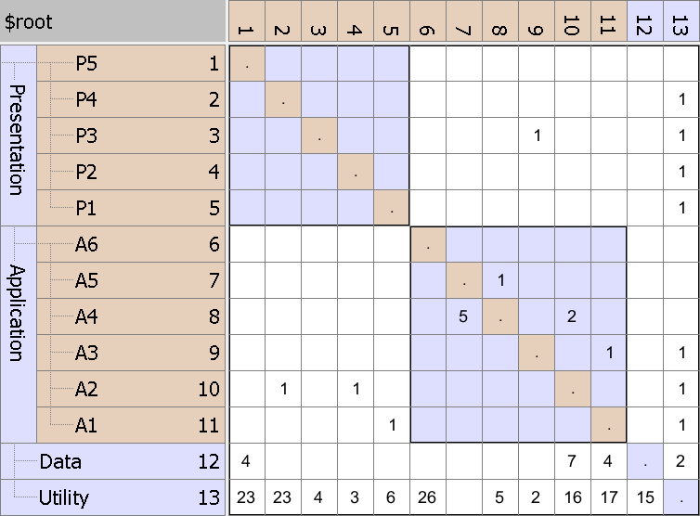
Hierarchical cycle due to
A3 using P3
which violates layering
Before

Slide 18
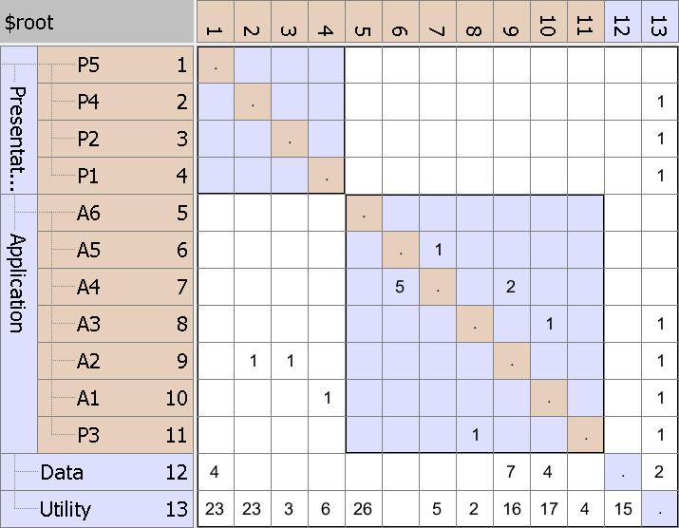
Cycle removed by moving P3
After

