Slide 1
Visualizing COVID19 data from different countries
Martin Beneš
Supervisor: Krzysztof Bartoszek
732A76 Research Project
2020-01-12

Slide 2
Goals
Download mortality, population and COVID19 death data.
Design similarity measure for administrative divisions.
What features are used?
Are regions of Czechia, Poland and Sweden comparable?
Clusters? Outliers?
Design similarity measure for the COVID19 deaths data.
Use the metric to make regional comparison.
Clusters? Outliers?
Explain the observations

Slide 3
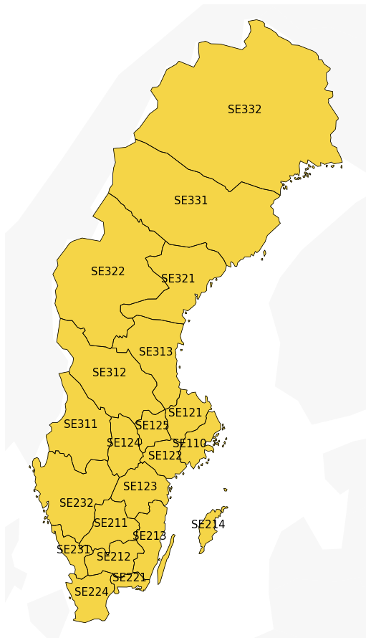
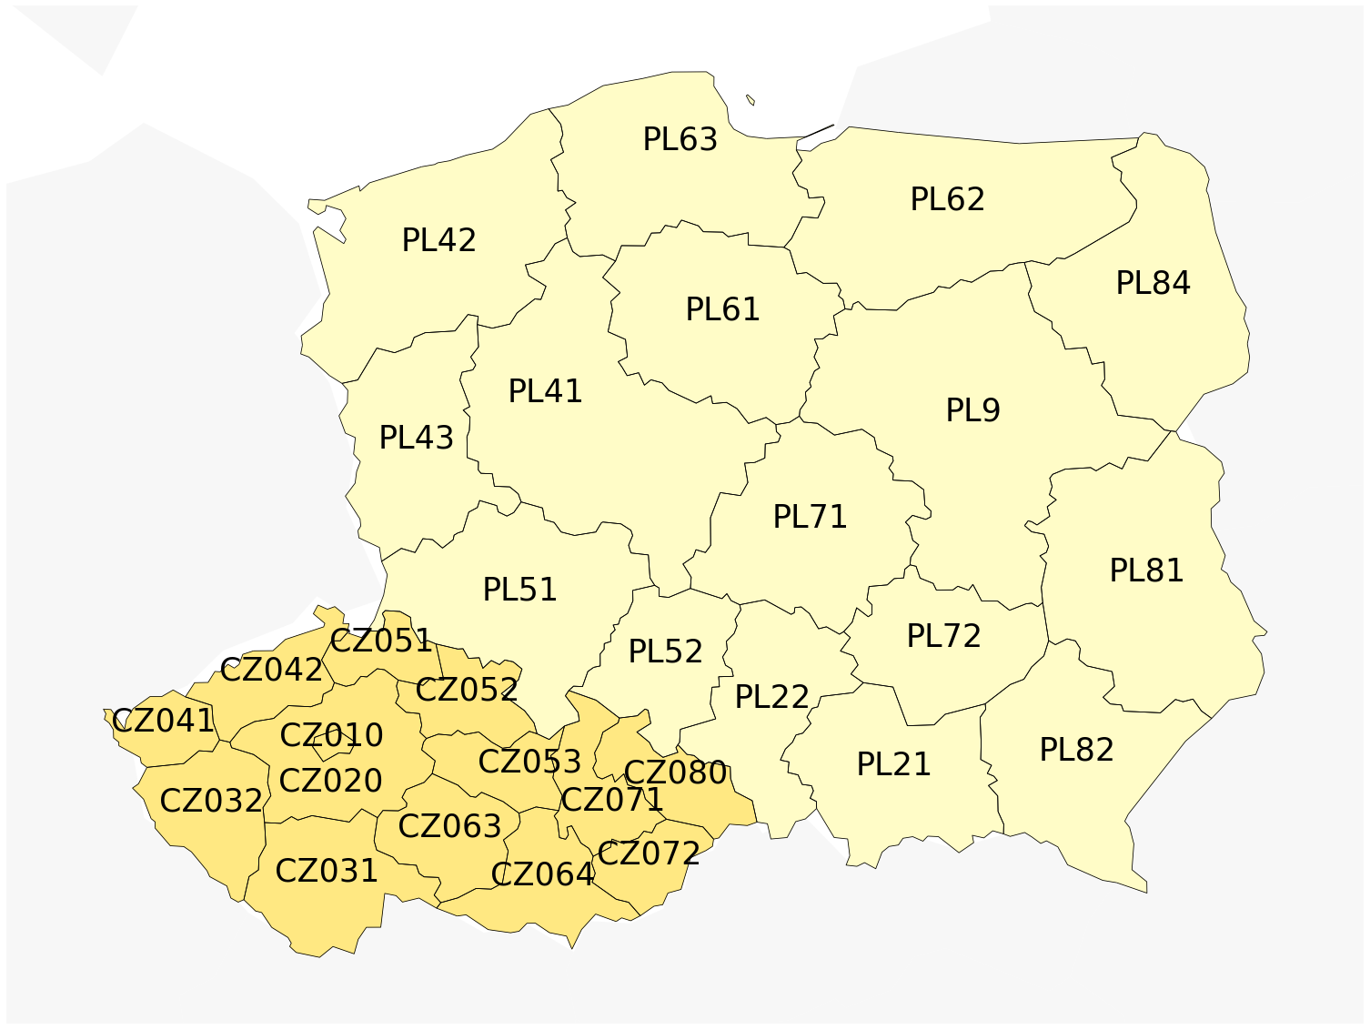
Administrative divisions

Slide 4
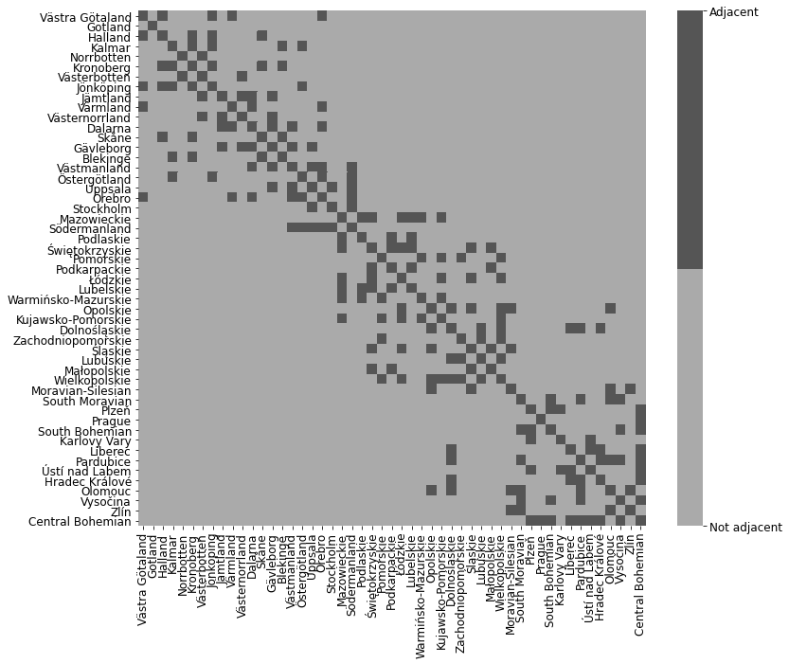
Administrative divisions

Slide 5
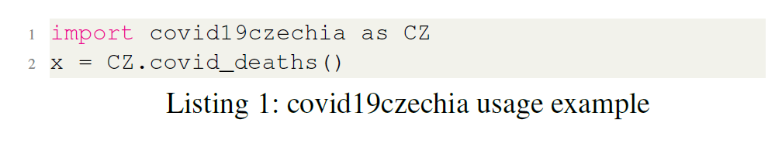
Data: Czechia
https://onemocneni-aktualne.mzcr.cz/
Death cases with date, sex, age, region (LAU-1)
CSV format
Python package covid19czechia

Slide 6
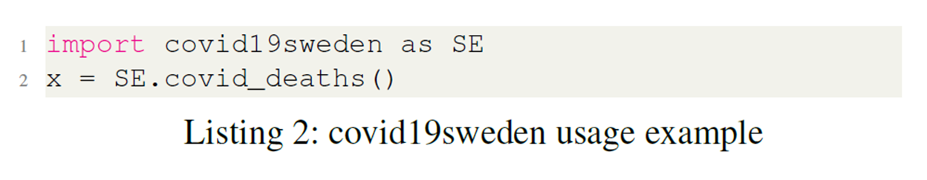
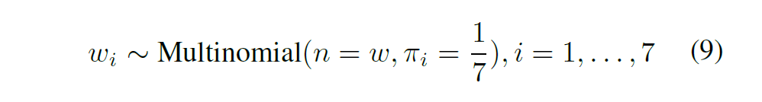
Data: Sweden
https://scb.se/om-scb/nyheter-och-pressmeddelanden/overdodligheten-fortsatter-att-sjunka-efter-toppen-i-april/
Weekly counts by region (NUTS-3)
XLSX format
Python package covid19sweden

Slide 7
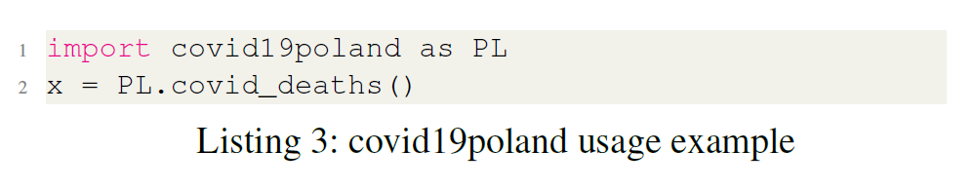
Data: Poland
https://twitter.com/MZ_GOV_PL
RegEx parsing the tweets
Data between 2020-03-12 and 2020-10-09 = by region, gender, age
Data between 2020-10-10 and 2020-11-23 = overall country counts
https://www.gov.pl/web/koronawirus/pliki-archiwalne-wojewodztwa
Data after 2020-11-24 = overall regional counts
CSV
Python package covid19poland

Slide 8
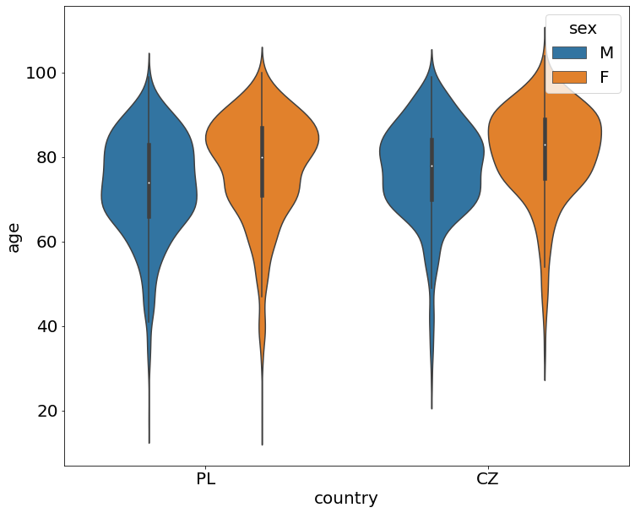
Age distribution

Slide 9
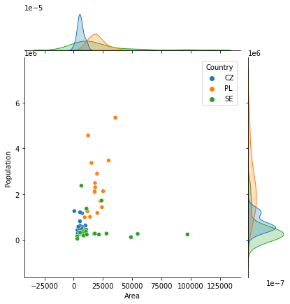
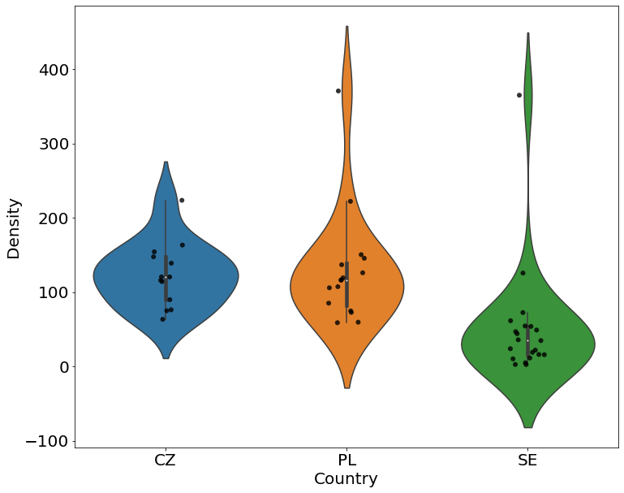
Region statistics
Population, area
Population density

Slide 10
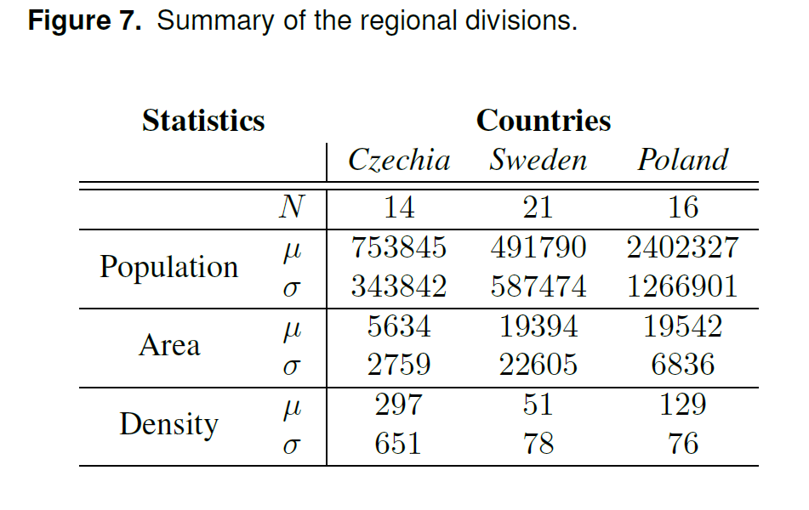
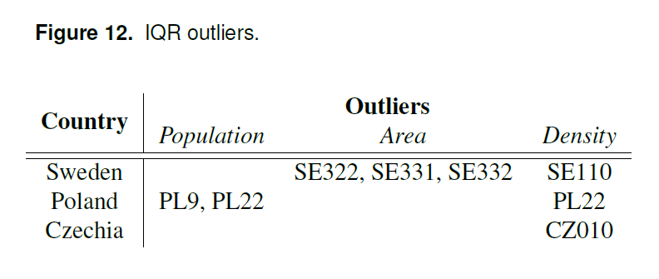
Region statistics

Slide 11
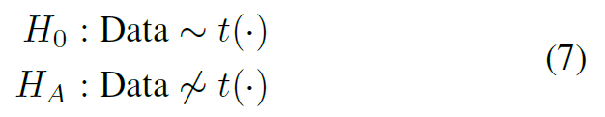
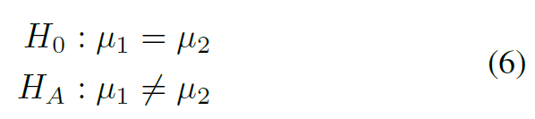
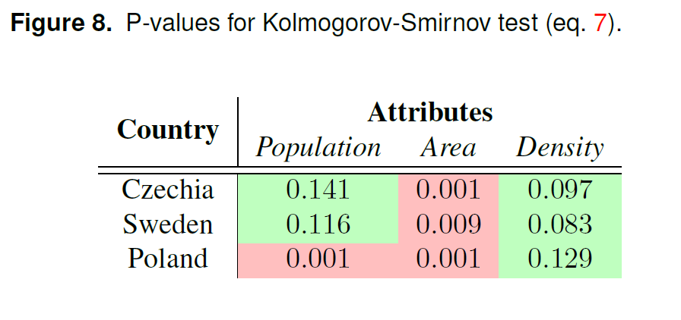
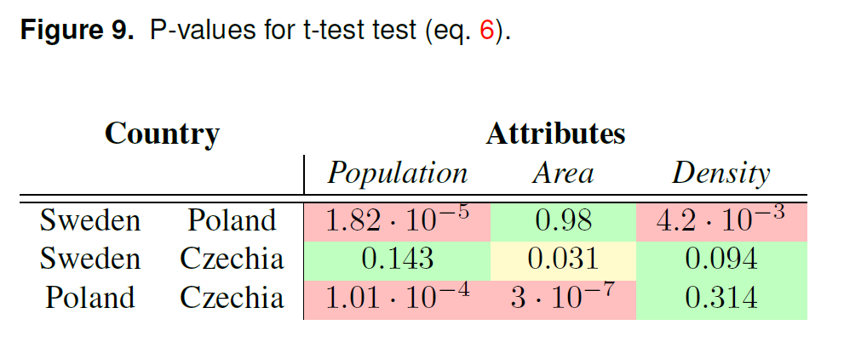
Regional statistics

Slide 12
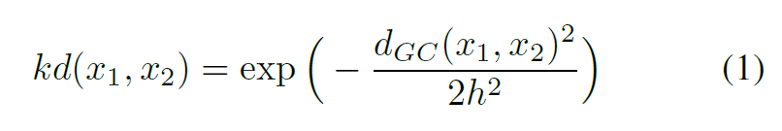
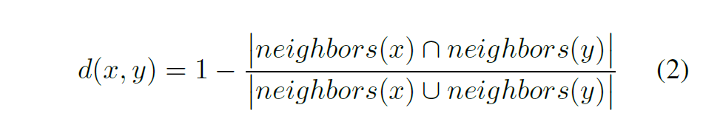
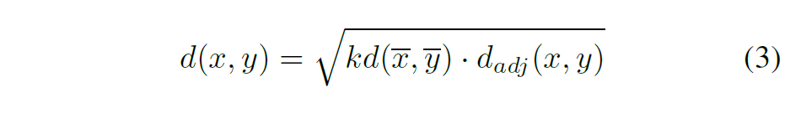
Regional comparison
Hypothesis: Close regions might form outbreak clusters.
What are close regions?
Close by distance
Close by number of common neighbors
Both

Slide 13
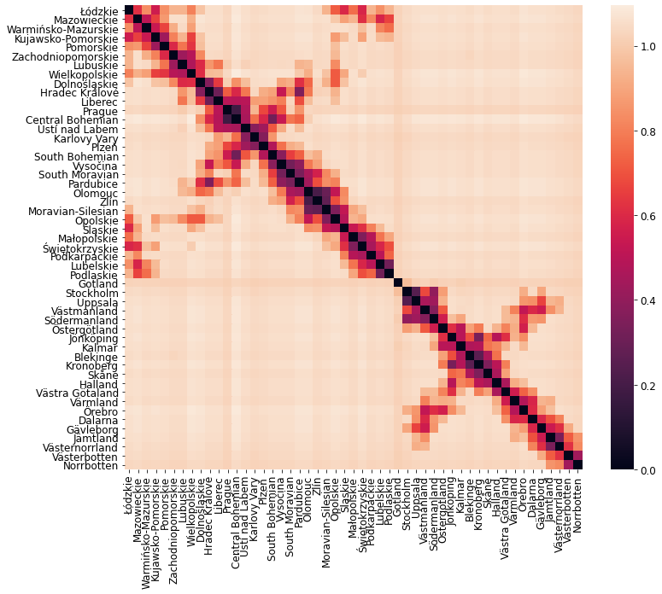
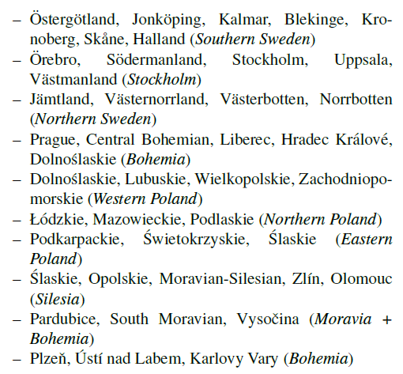
Regional comparison: location

Slide 14
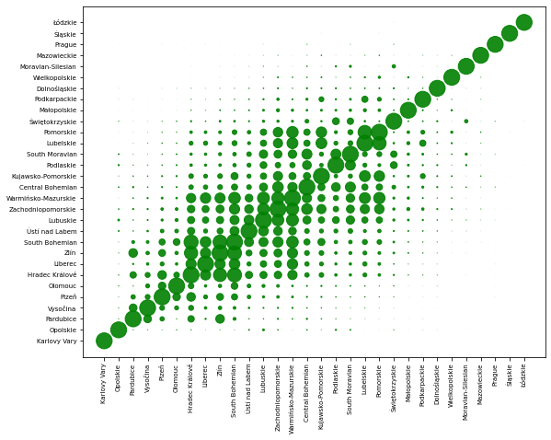
Czekanowski diagram

Slide 15
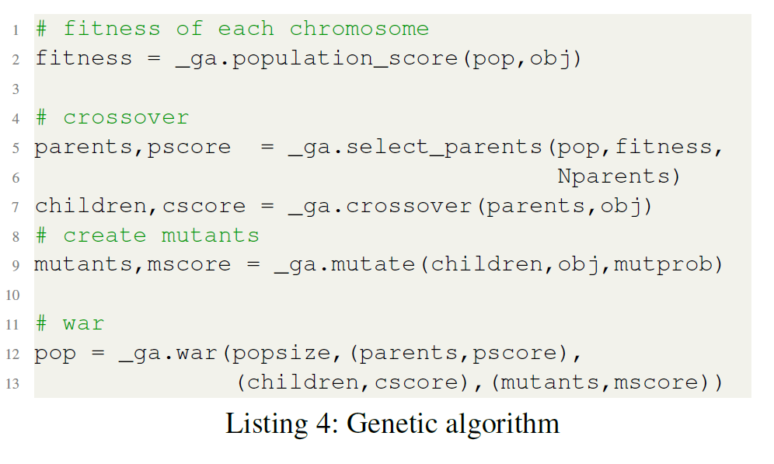
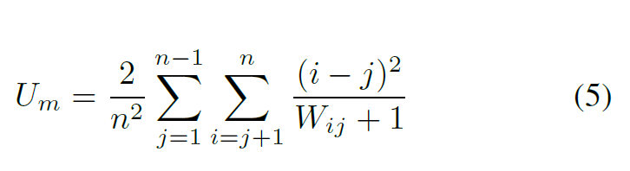
Czekanowski diagram

Slide 16
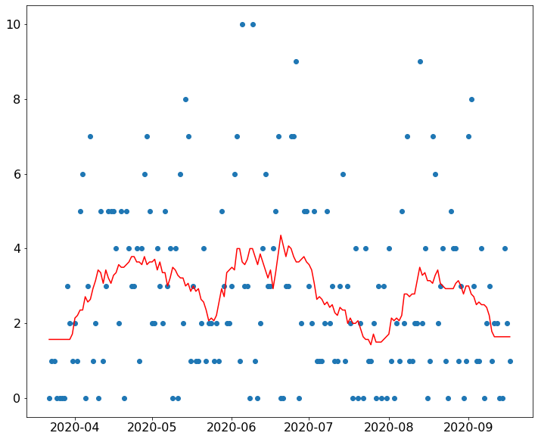
Smoothing

Slide 17
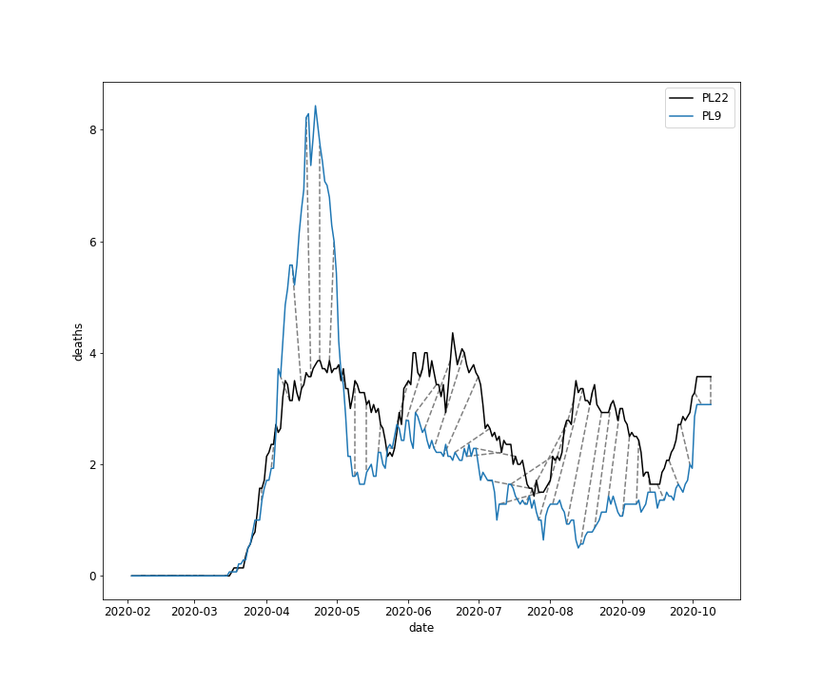
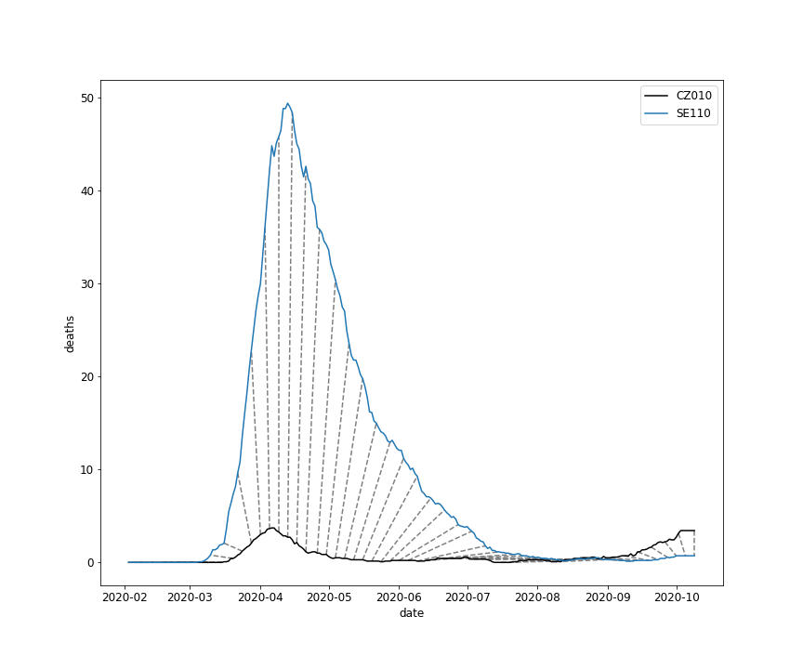
Dynamic Time Warping

Slide 18
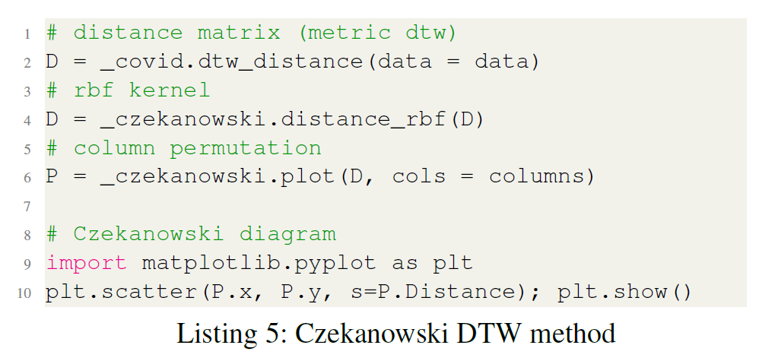
Epidemic comparison
Method
Dynamic Time Warping (DTW)
RBF kernel
Czekanowski diagram

Slide 19
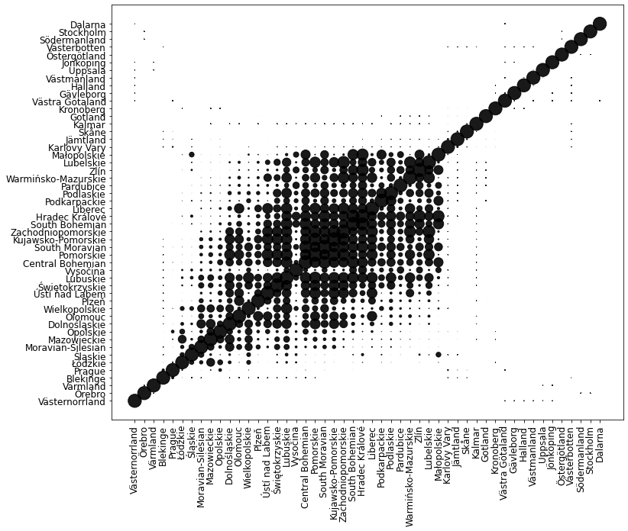
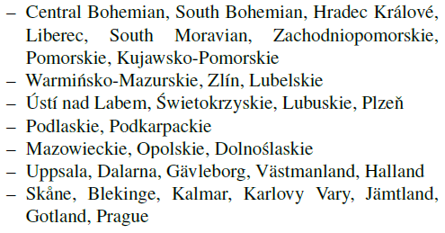
Results

Slide 20
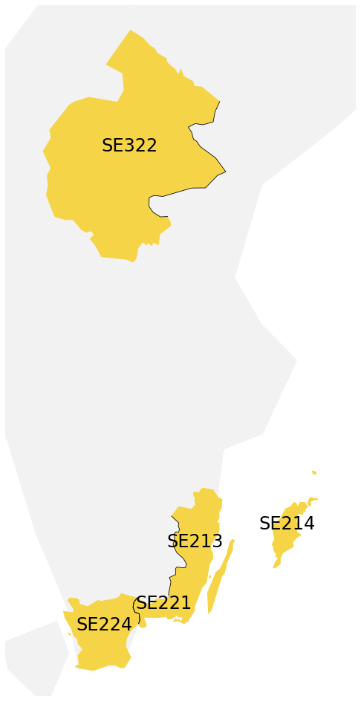
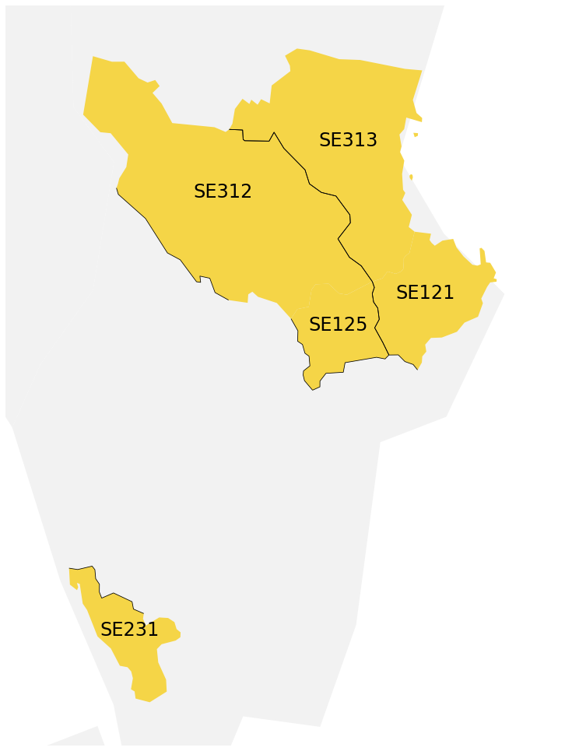
Results

Slide 21
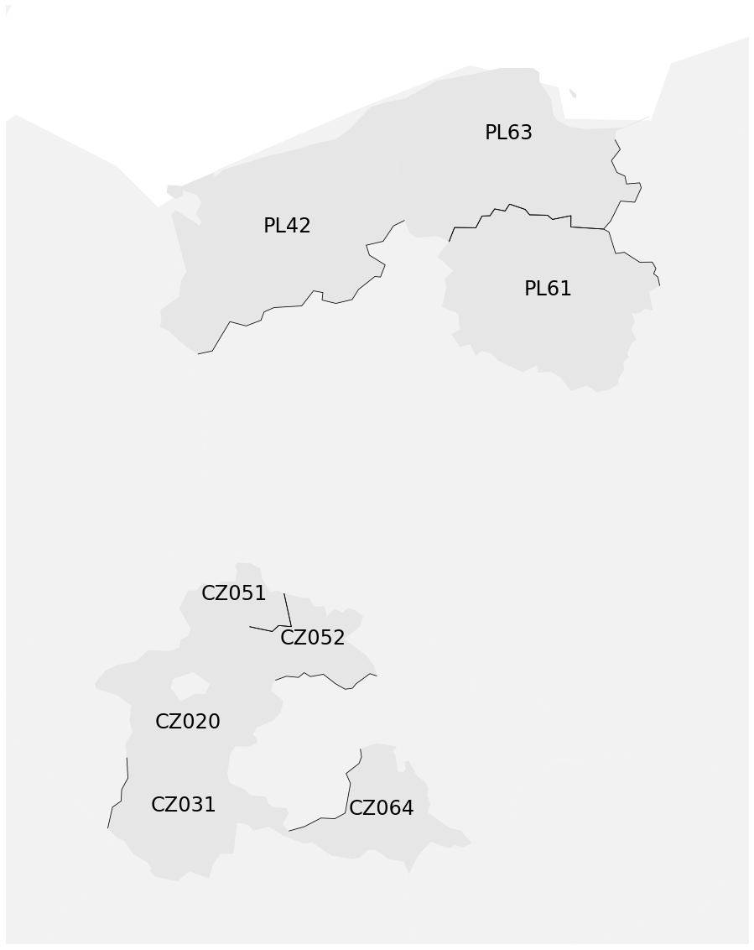
Results

Slide 22
Conclusions
Method yields reasonable results.
Parameter values (kernel width) are crucial.
Close regions sometimes do form infection clusters.

Slide 23
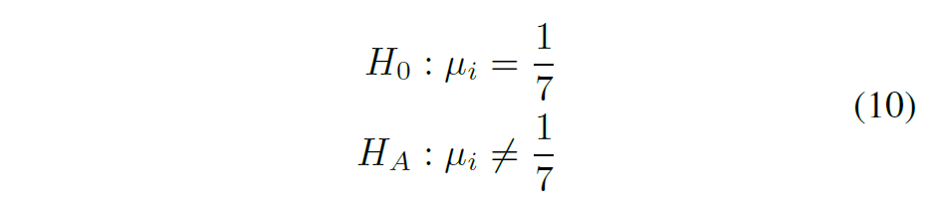
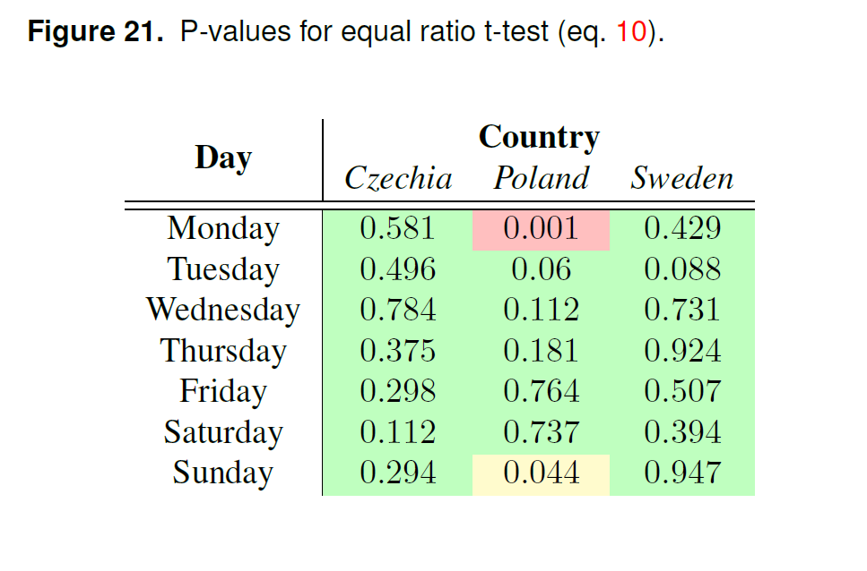
Weekday-independent deaths

Slide 24
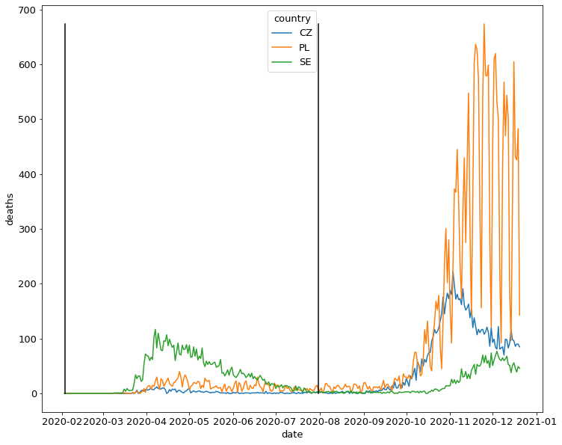

Slide 25
Thank you for attention! Děkuji za pozornost! Dziękuję za uwagę!

