Slide 1
BITS Pilani presentation
Sivasubramanian Natarajan
WILP Division

Slide 2
Introduction to Fintech (Merged - MBAZG516/PDFTZG516)(S1-24)
Lecture No. 1 / Week 1

Slide 3
Academic Term | First Semester 2024-2025
Course Title | Introduction to FinTech
Course No | MBA ZG516/ PDFT ZG516
Lead Instructor | Sivasubramanian Natarajan

Slide 4
Introduction and Course Objectives
No. | Course Objective
CO1 | Discuss the overview of the disruption to different financial services by FinTech.
CO2 | Discuss the current state of FinTech including funding trends and developments, major players and investors.
CO3 | Discuss the key enablers of a digital economy and their underpinning technologies.
CO4 | Discuss the role of data science and big data, artificial intelligence and machine learning in the FinTech space.
CO5 | Discuss FinTech innovations and disruptions to the asset services segment, capital markets and investment management.
CO6 | Discuss some of the innovations in the lending and crowdfunding space, the robo advisory front, wealth technology (WealthTech), and insurance technology (InsurTech).
Textbook(s)
T1 | Fintech: The New DNA of Financial Services by Pranay Gupta and T. Mandy Tham (De|G Press), 2019.
T2 | Fintech Future: The Digital DNA of Finance by Sanjay Phadke (SAGE Publications India Pvt Ltd), First Edition, 2020.
Reference Book(s)
R1 | Future Fintech Framework by Kartik Swaminathan (Notion Press), 2021.
R2 | Fintech in India by Dr. Komal Mistry (Phoenix International Publication House), 2023.

Slide 5
Structure of the Course
Content Structure
An Overview of Fintech
The Ecosystem of Financial Services Intermediaries
The Evolution of Financial Services Activities
Fintech in the Context of the Digital Economy
The Landscape of FinTech
Future Fintech Framework
Key FinTech Themes
FinTech Players - Current and Emerging
FinTech Digital Lifecycle
FinTech Logical Architecture
FinTech API Marketplace
Emergence of New Roles and Career Opportunities
Enablers of a Digital Economy
Digital Identity
Cloud Computing
Blockchain and Distributed Ledger Technology 2.0
Content Structure
Data Science and Big Data
Data Science and Big Data
Artificial Intelligence
Machine Learning
Disruptions in the Financial Services World
Open Banking: Digital Payments Systems
Disruption in Asset Servicing
Disruption in Capital Markets
Disruption in Investment Management
Online Marketplace Lending
Lending and Crowdfunding
Robo-Advisory and Multi-Asset Allocation
WealthTech and InsurTech
Legal Implications of Fintech

Slide 6
Learning Outcomes
No. | Learning Outcome
LO1 | To be able to understand the terminology and implications of FinTech.
LO2 | To be able to understand the role of key technology enablers of a digital economy like digital identity, blockchain, distributed ledger technology and cloud computing.
LO3 | To be able to compare and contrast different ML and AI algorithms that can be used in the FinTech space.
LO4 | To be able to understand different business models in FinTech space across the world.
LO5 | To be able to evaluate different FinTech business models in asset services segment, capital markets and investment management.
LO6 | To be able to design a new FinTech model by understanding a business need.

Slide 7
Week 1 Focus
Session 1 | Contact Hours | Topic Title | Study / HW Resource Reference
 | 1 and 2 | Introduction to Fintech-Overview | T1, Class materials

Slide 8
Introduction - The Fintech Overview
It is a generally accepted principle, delivering financial services through technology is collectively called as FinTech.
The 'technology' part in Fintech is leveraged for
Operational process automation
Customer services delivery.
Business functions

Slide 9
Fintech and financial services
The evolution of financial technology, or technology in general has characteristics as below
Using technology for automating routine processes
Availability of data, more freely than before.
Technology enabled direct connectivity, removing the need for an intermediary to orchestrate the transaction workflow.
Few examples of financial system intermediaries are retail bank, Insurance company, Investment bank and asset management company,
Corporate and Investment bank and Private bank catering to different categories of end customers.
Characteristics of financial system intermediaries
Exchange of information
Exchange of capital

Slide 10
Functions of a bank
Traditionally banks were created with three main functions, the below three points are summary headings of banking theories by the same name.
1. Financial intermediation - Accept deposits and lend
2. Credit creation - Purchase promissory note and assist asset acquisition by individuals and corporate
3. Fractional reserve banking - Generate cash in the economy (Money multiplier), - For every deposit used for lending deposit a fraction of the deposit with central bank.
Regulation plays critical part in the shaping of above functions and roles. A financial institution may adopt technology to optimize its offering, alternatively a technology company could offer an improved business model. Therefore, technology plays both roles as a catalyst and as a critical component of the business model.
It is to be noted, but for the function 'Credit creation' all the other functions are overlapping with Non-banking financial services company as well. By Regulation only banks are permitted to create cash / credit for asset Purchase.

Slide 11
Impact of Fintech
Fintech’s impact financial services. We will look at impact to the businesses in financial services, under two headings
Technology
Trends
The impact of technology has resulted in | The impact of trends have resulted in possibilities such as,
Automation of processes for efficiency and speed Information acquisition cost has become lower Production and distribution functions, with the help of technology has done away with the need for middlemen | a. New Business Models b. Transformation of business processes c. Emergence of fintech as a discipline

Slide 12
Impact and possibilities
Technology and Trends make an impact on existing business landscape.
The impact leads to a set of possibilities that evolves.
Evolution of possibilities leads to widely accepted solutions that disrupts and challenges the status quo.
Technology
Trends
Impact
Evolution of possibilities
Solutions

Slide 13
Nature of disruption
The disruption manifests itself as new business models or transformation of existing business processes.
New Business Models
Startups come up with improved business models delivering utility services and are able to disrupt the incumbents.
Transformation of Business processes
Incumbent businesses adopts fintech to transform existing processes making them more efficient.

Slide 14
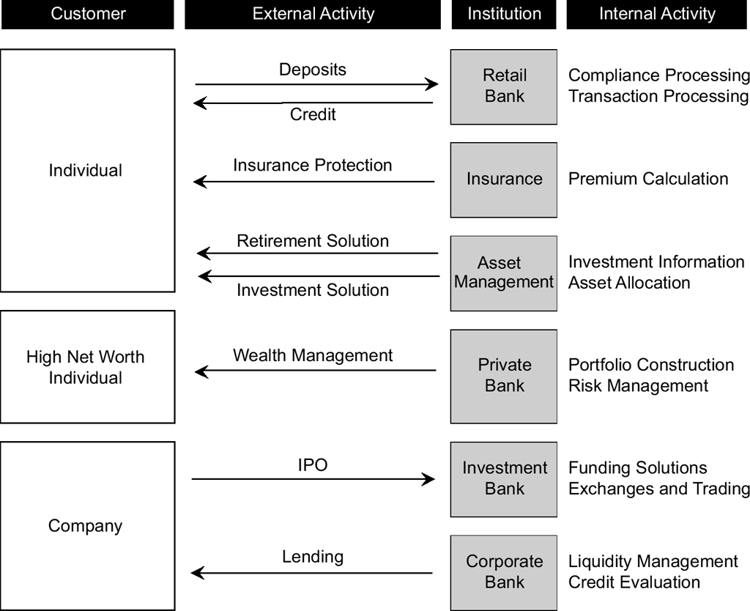
Activities in Fintech

Slide 15
Why fintech activities are key
Fundamental concepts of fintech as a discipline
Data Capture
Data Analysis
Implementing the data-based knowledge.
The above concepts combined with activities of financial services (Image reference) result in new business models.

Slide 16
Evolution of financial services activities
Evolution of financial services activities leads to business process transformation. This is what we see in the market today as a major trend. (Why ? )
The below are example processes, already evolving
Compliance processes
Transaction processing
Insurance calculations
Investment and Risk management decisions
Investment solutions
Financing solutions

Slide 17
Case Study - How data insights gives AirBnB an edge over Uber.
Insights from Jonathan Knee
Note the importance and stress on the point about data generated by technology
Three key structural attributes drive the value of network effects in the digital domain.
The first is the minimum market share at which the network can achieve financial breakeven.
The second is the nature and durability of the customer relationships spawned by the network.
And the third is the extent to which the data generated by the network facilitates product and pricing optimization.
The structural attributes quoted for 'AirBNB' business, relies heavily on digital mechanism for
1. Acquiring customers
2. Transaction and revenue growth and
3. Data with feedback + insights on consumer behavior.
The above data is utilized for understanding Customer acquisition cost, Customer stickiness, revenue growth and forecasting. All these metrics are typical of a digital business and is sought after for valuation of the company.

Slide 18
Embracing Disruption
Quote from Jonathan Knee
With the help of other sources of competitive advantage, network-effects businesses can deliver remarkable value to users and riches to entrepreneurs and investors.
On their own, however, network effects in a digital context are a peculiarly fragile barrier to entry.
Seen in this light, entrepreneurs and investors should treat the identification of network effects as the beginning, not the end, of their analysis.
Meanwhile, platform operators should curb any complacent confidence that they may have in their destinies as the conquerors of global markets.
Instead, they should redouble their efforts to establish complementary barriers before getting displaced by one of what are likely to be many competing platforms
Network Effects
Barrier to entry
Disrupted by competitors
Growth by network effects model is easier to replicate

Slide 19
Embracing Disruption – From the text-book
Companies and their management teams fall into four categories of progressive phases of evolution, when faced with a disruptive change such as fintech:
–The Naysayers: who deny any meaningful impact from a new technology or process and worse still gather facts to disprove its usefulness. This is why startups are difficult and why new technologies tend to be disruptive rather than augmentative.
–The Charlatans: who publicly say that their firm is using new technologies and techniques, because it’s seeming like a good marketing pitch, but are doing very little internally to incorporate its usefulness. This stage is present when a new technology has developed sufficiently to be noticeable but is still below critical mass or unproven.
–The Early-adopters: who have come to believe that utilizing the new technology is in their interest, have a business plan and have created internal teams to take advantage of the new paradigm to augment their existing business model.
–The Believers: If not the start-ups themselves, these are the firms who are convinced of the philosophy of a new technology and are prepared to reorient their companies for the future along with the implementation of a new structure.

