Slide 1
BITS Pilani presentation
Sivasubramanian Natarajan
WILP Division

Slide 2
Introduction to Fintech (Merged - MBAZG516/PDFTZG516)(S1-24)
Lecture No. 12 / Week 12

Slide 3
Week 12 Focus
Session 1 | Contact Hours | Topic Title | Study / HW Resource Reference
 | 23 and 24 | Marketplace Lending | T1, Class materials

Slide 4
Recap
Fintech is characterized by its treelike structure, which clarifies the way fintech is organized across the different financial services in the market today.
Fintech Ecosystem
Financial Services
Domains (Banking, Payments, Lending, Insurance, Wealth Management)
Themes
Trends
Domain activity
Domain specific service providers
Ecosystem Players
Regulation
Capital
Partnership / Alliances
Tech enabled Business
Tech Powered Business
Fintech Frameworks
Digital Identity
Cloud Computing
AI ML
Open API and Banking

Slide 5
Week 12 Agenda Summary
Marketplace Lending
Lending in general involves risk, a lender is expected to plan for all risk situations.
Lending without doubt is a business model with revenue potential.
Primary risk management in lending involves
Credit scoring of borrowers
Effectiveness of loan collection
Identifying capital sources for loan disbursements
Marketplace lending carries these characteristics because in the business model there is little change.
Regulatory requirements are different for Banks, NBFC and fintech companies participating in the lending marketplace

Slide 6
Introduction to Marketplace Lending

Slide 7
Chronology of lending and its impact
Decade | Broad commentary on progression | Impact
1960 | Banks only player in lending | Predominantly corporate
1970 | Advent of consumer durables financing | Retail lending
1980 | NBFC accepting deposits and lend to retail and corporate | Inclusiveness
1990 | Truck financing | Age of economy expansion
2000 | Mortgage financing | Economy expansion
2015 | Marketplace lending / New business models | Access to lending sources made easier Multiple campaigns can be supported. (School fees, marriage, charity, donation, social cause)
 | Non NBFCs participation in lending | BNPL, Slice, Crowdfunding

Slide 8
Business model Traditional lending
Loan Origination
Loan Processing
KYC
Credit Check
Loan Agreement
Disbursement
Recovery / Loan servicing
Capital requirement / Source of funds Individual wealth Pool of funds by interested investors Bank deposits / savings | Regulatory documentation requirements Processing fees collected from borrower Partnership with credit rating agency | Principal, Interest, Tenure and repayment schedule agreement Collateral requirement as mandated by RBI Insurance requirements | Transfer to account Transfer to merchant in case of purchase of goods Transfer to landowner in case of mortgage | Monthly usually Monitoring Ageing of outstanding Reporting to RBI Reporting to credit agency Recovery through collateral
Onetime Revenue
Revenue from Interest earnings

Slide 9
Business model disruption
Marketplace lending
Online connectivity makes processing time shorter
Agreements can be digitally signed
Multiple source of funds
Loan Origination
Loan Processing
KYC
Credit Check
Loan Agreement
Disbursement
Recovery / Loan servicing
Online presence makes customer acquisition cheaper and easy

Slide 10
Business model disruption
Innovative Business Models
Non NBFCs in lending business and act as Sourcing and Servicing partners
Multiple source of funds through lending partners
Banks and NBFC find it easier to invest in a Non-NBFC lending partner.
Loan Sourcing
Loan Origination
Loan Processing
KYC
Credit Check
Loan Agreement
Disbursement
Recovery / Loan servicing
Company A focus on lead generation and customer acquisition
Innovative credit scoring

Slide 11
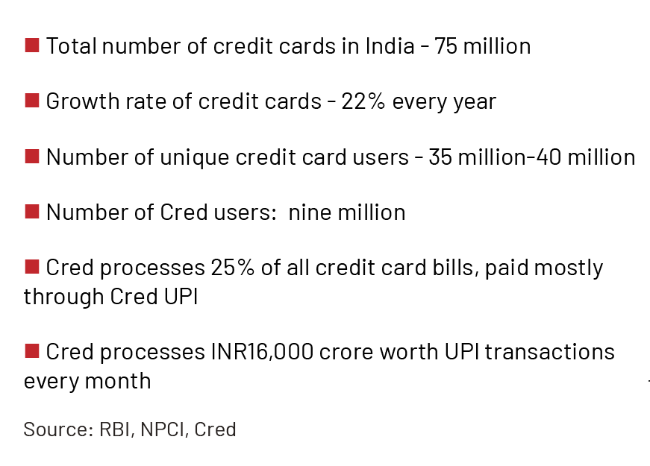
Marketplace lending
Cred Business Model Case study
The Business Model of CRED positions itself to act as a debt collection agent and as a source of data for credit rating
Cred has around 9 million customers and a quarter of the country’s credit card bills are paid through its platform. This amounts to INR15,000 crore worth of credit card bills every month.
Cred primary revenue are fees from partner for prompt repayment of credit card bill
Cred generates a credit score before onboarding users and educates its customers about the importance of a good credit score.
This gives Cred the confidence to disburse personal loans within a few minutes without any documentation.
Source: ETPRIME, RBI, NPCI

Slide 12
P2P Lending

Slide 13
P2P Lending
Marketplace lending broadly indicates function of matching borrowers and lenders using an online platform without a traditional bank intermediary.
Although the model, originally started as a “peer-to-peer” concept for individuals to lend to one another, the market has evolved as more institutional investors have become interested in funding the activity.
As such, the term “peer-to-peer lending” has become less descriptive of the business model and current references to the activity generally use the term “marketplace lending.”

Slide 14
P2P lending process
Marketplace lending typically involves a prospective borrower submitting a loan application online where it is assessed, graded, and assigned an interest rate using the marketplace lending company’s proprietary credit scoring tool.
Credit grades are assigned based on the marketplace lending company’s unique scoring algorithm, which often considers
Borrower’s credit score
Debt-to-income ratio
Income and other factors set by the marketplace lender.

Slide 15
P2P lending frameworks
A loan will be funded by investors pledging sufficient capital. This is also referred to as sourcing.
As an alternative to funding loans through retail investments
Institutional investors can provide funding through whole loan purchases or direct securitizations. (Breaking the loan amount into parts).
When a borrower’s requested loan amount is fully pledged, the marketplace lending company originates and funds the loan through one of two frameworks:
the company lends the funds directly (subsequently referred to as a “ direct marketplace lender”) or
the company partners with a traditional bank to facilitate the loan transaction (subsequently referred to as a “bank-affiliated marketplace company”).

Slide 16
Crowdfunding

Slide 17
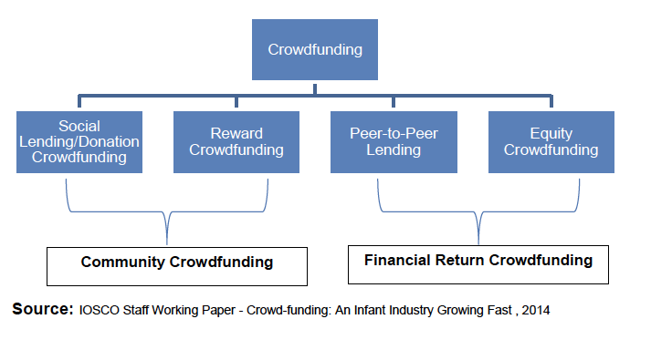
Crowdfunding dynamics

Slide 18
Crowdfunding dynamics
'Crowd Funding' generally refers to a method of funding a project or venture through small amounts of money raised from many people, typically through a portal acting as an intermediary.
There are numerous forms of crowd funding: some are charitable donations that provide intangible benefits but no financial returns; others, such as equity crowd funding would fall within the domain of financial markets.
The “crowd” is composed of individuals who may or may not have experience or knowledge of financial markets.
There are two current equity crowdfunding investment models: investor‐led and company‐led.

Slide 19
Investor-led approach to crowdfunding
In the case of investor‐led approach that benefits investors is that they receive the same share class and price as the angels, whether they are investing Rs1,000 or Rs100,000.
They also have the same rights in following their money in later rounds, enabling them to avoid excessive dilution.

Slide 20
Company led approach to crowdfunding
This is often not the case on crowdfunding platforms that operate the company‐led model
.
With the “company‐led” approach to crowdfunding, the company seeking capital sets its own terms of investment and decides its own valuation.
Additionally, Companies can choose to issue more than one class of share.
Often founders get A shares,
whereas
Ordinary investors get B shares, that come without voting or pre‐emption rights.

Slide 21
Equity based crowdfunding
In Equity Based Crowdfunding, in consideration of funds solicited from investors, Equity Shares of the Company are issued.
It refers to fund raising by a business, particularly early-stage funding, through offering equity interests in the business to investors online.
Businesses seeking to raise capital through this mode typically advertise online through a crowdfunding platform website, which serves as an intermediary between investors and the start-up companies.
Traditionally, Start-ups are funded through private equity, angel investor or loan arrangements with a financial institution.
Any offering of public equity takes place only after the product or business becomes commercially viable. However, in Equity based Crowdfunding solicitation is done at an earlier stage.
Some examples of equity crowdfunding platforms are Syndicate Room, Crowdcube and Seedrs.
Source Consultation Paper on Crowdfunding in India, SEBI 2014

Slide 22
Equity based crowdfunding process
Companies Act requires a company proposing to make a public issue to make a listing application to recognized stock exchanges. It requires the issuing company to file a Prospectus with Registrar of Companies.
Company offering securities through private placement shall not release any public advertisements or utilize any media, marketing or distribution channels or agents to inform the public at large about such an offer.
Only accredited investors are authorized to participate in crowdfunding.
Source Consultation Paper on Crowdfunding in India, SEBI 2014

Slide 23
Insights - 1
The investor‐led model of crowdfunding has clear benefits for investors over the company‐led model.
As crowdfunding continues to grow, issues such as the protection of investors, transparency, and education will assume an ever-greater importance.
Companies that put the investor first will be well‐placed to take advantage of these changes.
P2P Lending is regulated by RBI
Crowdfunding is regulated by SEBI

Slide 24
Insights – 2 : Institutional trading platform
SEBI has permitted listing of Small and Medium Enterprises (SME), including start-up companies, on the Institutional Trading Platform (ITP) (also called SME exchange)
While such companies are listed on the platform, they are not permitted to raise capital.
Since the trading lot has been mandated as 10 lakh, participation in this platform is restricted to informed investors, registered with SEBI.
The companies listed in ITP are SMEs and start-up companies which get visibility by listing in the stock exchanges, without any public issue of their securities.

