Slide 1
BITS Pilani presentation
Sivasubramanian Natarajan
WILP Division

Slide 2
Introduction to Fintech (Merged - MBAZG516/PDFTZG516)(S1-24)
Lecture No. 2 / Week 2

Slide 3
Academic Term | First Semester 2024-2025
Course Title | Introduction to FinTech
Course No | MBA ZG516/ PDFT ZG516
Lead Instructor | Sivasubramanian Natarajan

Slide 4
Introduction and Course Objectives
No. | Course Objective
CO1 | Discuss the overview of the disruption to different financial services by FinTech.
CO2 | Discuss the current state of FinTech including funding trends and developments, major players and investors.
CO3 | Discuss the key enablers of a digital economy and their underpinning technologies.
CO4 | Discuss the role of data science and big data, artificial intelligence and machine learning in the FinTech space.
CO5 | Discuss FinTech innovations and disruptions to the asset services segment, capital markets and investment management.
CO6 | Discuss some of the innovations in the lending and crowdfunding space, the robo advisory front, wealth technology (WealthTech), and insurance technology (InsurTech).
Textbook(s)
T1 | Fintech: The New DNA of Financial Services by Pranay Gupta and T. Mandy Tham (De|G Press), 2019.
T2 | Fintech Future: The Digital DNA of Finance by Sanjay Phadke (SAGE Publications India Pvt Ltd), First Edition, 2020.
Reference Book(s)
R1 | Future Fintech Framework by Kartik Swaminathan (Notion Press), 2021.
R2 | Fintech in India by Dr. Komal Mistry (Phoenix International Publication House), 2023.

Slide 5
Structure of the Course
Content Structure
An Overview of Fintech
The Ecosystem of Financial Services Intermediaries
The Evolution of Financial Services Activities
Fintech in the Context of the Digital Economy
The Landscape of FinTech
Future Fintech Framework
Key FinTech Themes
FinTech Players - Current and Emerging
FinTech Digital Lifecycle
FinTech Logical Architecture
FinTech API Marketplace
Emergence of New Roles and Career Opportunities
Enablers of a Digital Economy
Digital Identity
Cloud Computing
Blockchain and Distributed Ledger Technology 2.0
Content Structure
Data Science and Big Data
Data Science and Big Data
Artificial Intelligence
Machine Learning
Disruptions in the Financial Services World
Open Banking: Digital Payments Systems
Disruption in Asset Servicing
Disruption in Capital Markets
Disruption in Investment Management
Online Marketplace Lending
Lending and Crowdfunding
Robo-Advisory and Multi-Asset Allocation
WealthTech and InsurTech
Legal Implications of Fintech

Slide 6
Learning Outcomes
No. | Learning Outcome
LO1 | To be able to understand the terminology and implications of FinTech.
LO2 | To be able to understand the role of key technology enablers of a digital economy like digital identity, blockchain, distributed ledger technology and cloud computing.
LO3 | To be able to compare and contrast different ML and AI algorithms that can be used in the FinTech space.
LO4 | To be able to understand different business models in FinTech space across the world.
LO5 | To be able to evaluate different FinTech business models in asset services segment, capital markets and investment management.
LO6 | To be able to design a new FinTech model by understanding a business need.

Slide 7
Week 2 Focus
Session 1 | Contact Hours | Topic Title | Study / HW Resource Reference
 | 3 and 4 | Future Fintech Framework | R1, Class materials

Slide 8
Introduction – Future fintech framework
Fintech is characterized by its treelike structure, which clarifies the way fintech is organized across the different financial services in the market today.
Hubs of activity
Financial services
Themes
Trends
Fintech Ecosystem
Players
Technology implements themes and trends into solutions
Players assist in implementing the intended Business Models

Slide 9
Contrasting Business models using Technology
The focus on how the technology manifests itself into the Fintech scheme of things determines whether it is a tech enabled or tech powered business.
Tech enabled Business
Tech Powered Business
What is common between the two ?
Both have capabilities to disrupt the ecosystem of Fintech
Both are reliant on Technology
The above distinction is within the scope of the textbook, I am yet to see this used widely in the Industry sense.

Slide 10
Contrasting approaches of technology in financial services
The tech in tech enabled business acts on, existing internal and external activities of the fintech business through following actions,
Surround
Replace
Supplant
A tech powered business,
Is used for New products and services
Disrupt complete business models, existing.

Slide 11
What is required for encouraging Fintech
A very first question is why fintech growth is essential and important ?
The economy need growth, For growth to be speedy, money movement should also get aligned.
Digital exchange (Digitized cash) enhances the speed of money movement
When money moves it creates something of value,
Utility value like an asset or goods
Exchange value like cash or investments
Keeping money in motion is key objective of digital economy and fintech enables that. Central bank plays a key role in choreography and orchestration of this aspect.
Digital economy enables financial inclusion.
Fintech creates ecosystem of financial services and non-financial business complementary to the ecosystem.

Slide 12
Fintech growth needs control
The control for fintech growth could be brought about by Regulation and Central Bank Policy, On the other hand the need exists for fostering Growth and Innovation.
The government of Singapore have produced an architecture consisting of ten key elements which could be considered key for fostering fintech ecosystem.
The core of this architecture is Regulation and the fintech structure objectives are,
Enable innovation
Retain stability
Sustain soundness of finance

Slide 13
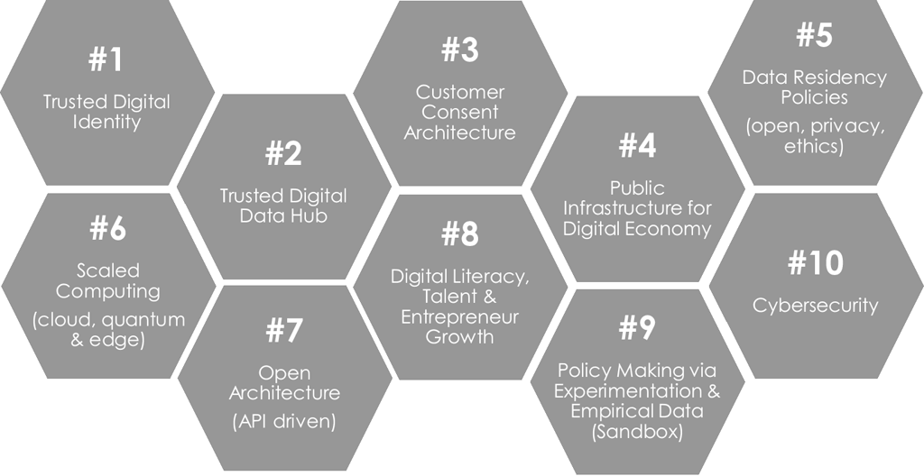
Enablers of Fintech
Source: Digital Economy Singapore, Presentation by Mohanty S., Monetary Authority of Singapore, 2018

Slide 14
Identity
In Digital world Identity is key to tracing actions performed by individuals with access to the applications.
Going a step further applications enable the delivery of financial services to the end user.
How does application become aware 'Who is using my functions?’
This is a special topic in Information security under the tagline 'Identity Management’.
Uniqueness of Identity
A unique identity among a large population of possible customers is an essential criteria for an effective Identity management.
For example, in India 'Aadhaar' is fast becoming the identity of choice and is used by various applications specifically the Government to Citizen services.
The linkage of Aadhar and PAN card with Bank accounts extends Aadhar as a national identity.

Slide 15
Identity stored in a Trusted Database
A trusted database which is tuned for ensuring the comprehensiveness and accuracy of data is essential for implementing Digital identity.
A trusted database is centralized and kept highly secure.
All applications integrate with this database for meeting the confidentiality objectives.
For a national identity Government plays a key role in setting up this database.

Slide 16
Consent Architecture
While the identity establishment is a unique design challenge regulation must establish mandates for sharing the digital identity information to the consumer of the same, like Business applications, only with with the owner’s consent.
In enterprise business scenario the Information security policy lay down the guidelines for implementing the consent architecture.
An example is using a ‘Google ID’ to register and login to ‘Economic times’ newspaper website.

Slide 17
Digital Infrastructure
While the data to store the digital identity and establishing trust and consent is key to digitizing financial services, the infrastructure which provides these functions are critical.
In addition, the infrastructure should be capable of the following
High Availability
Robustness of data. This is achieved using techniques like clustering replication etc.,
Controls for making sure only the authorized are allowed to make changes to the data
Data encryption.

Slide 18
Data Residency
Data Residency or Data localization
Every central bank across the world are regulating where the data used for financial services are stored. The data is categorized broadly as
Personally identifiable Data
Transactional Data
Authentication, Audit data
Financial Data
Additionally, the data is also classified as
Restricted – Information such as passwords
Confidential – Intended only for those who need them
Public
The data category and data classification are key requirements for designing the data treatment such as whether it is to be encrypted
In storage
In processing
Always

Slide 19
Scaled computing
Scalability of the infrastructure is a key design element
Scalability ensures
Availability of additional processing power during times of high load
Storage expandability on demand
Expandability of memory
Dynamic increase in network bandwidth
The above requirement assumes no compromises, meeting the security objectives in delivering the financial services.
CPU
Storage
Memory
Network

Slide 20
Open Architecture
‘Open’ ness in architecture is a stated objective of financial services critical for the players in the ecosystem to integrate and interact with each other
The critical elements in scope for meeting the objectives are
API – External and Internal activities
Data format – Exchange of information between systems yet to be integrated with API
Using common protocols for data transfer and secure connections
The Hardware and software makers play role of enablers in achieving the objectives
API
Data format
Protocols
Hardware and Software

Slide 21
Talent Hub
A Hub is a niche area of activity essential for participating in a single or multiple ecosystems.
Creating a Fintech talent hub is a mandate for every central bank planning for growth in the digital economy.
Where skills are not available in domestic government policies help in bringing expats and creating opportunities for co-existing with domestic talent.
Opportunities follow growth in the Ecosystem, complementing talent search and fitment efforts.
Education
Skills development
Talent search
Opportunities

Slide 22
Policy making
Policies in Fintech are essential for balancing growth with stability. Growth is achieved through government sponsored
Incubators
Accelerators
Tools created by central bank for achieving growth are
Regulatory Sandbox
Regulatory Policy
The sandbox helps central bank to formulate fintech policies.
Example
The trends in payments brought about frictionless payment as a theme.
The regulation controlled the innovation by mandating a transaction limit for the ’Tap and Go’ solution.

Slide 23
Cybersecurity
Cybersecurity is an evolution of Security in Technology
It is complemented through solutions like
Secured connections between systems
Establishment of Trust
Monitoring of anomalies in the infrastructure
Information security primarily data security was the start point of the thinking behind security in general
Cybersecurity is necessitated because of the open architecture that allows systems to interact freely over the internet cloud.
Every IT asset in financial services is a cyber asset.
The key elements of cybersecurity are
Infrastructure and Hardware / Software hardening
Cyber resilience (What to do after an anomaly is detected?)

