Slide 1
BITS Pilani presentation
Sivasubramanian Natarajan
WILP Division

Slide 2
Introduction to Fintech (Merged - MBAZG516/PDFTZG516)(S1-24)
Lecture No. 3/ Week 3

Slide 3
Academic Term | First Semester 2024-2025
Course Title | Introduction to FinTech
Course No | MBA ZG516/ PDFT ZG516
Lead Instructor | Sivasubramanian Natarajan

Slide 4
Week 2 Focus
Session 1 | Contact Hours | Topic Title | Study / HW Resource Reference
 | 5 and 6 | Future Fintech Framework cont. | R1, Class materials

Slide 5
Future fintech Framework
– A recap
Fintech is characterized by its treelike structure, which clarifies the way fintech is organized across the different financial services in the market today.
Fintech Ecosystem
Financial Services
Domains (Banking, Payments, Lending, Insurance, Wealth Management)
Themes
Trends
Domain activity
Domain specific service providers
Ecosystem Players
Regulation
Capital
Partnership / Alliances
Tech enabled Business
Tech Powered Business

Slide 6
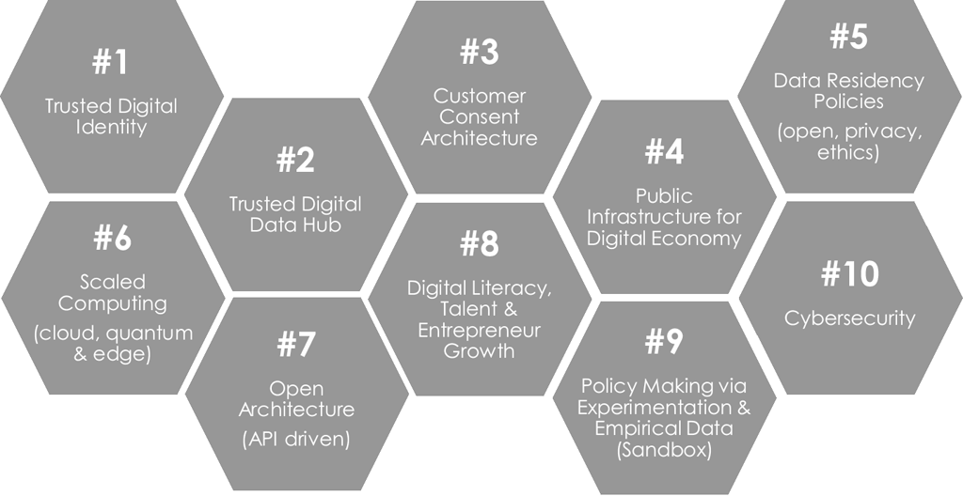
Representative Fintech Framework 1
Source: Digital Economy Singapore, Presentation by Mohanty S., Monetary Authority of Singapore, 2018

Slide 7
Representative Fintech Framework 2
Fintech ecosystem
Financial inclusion
ICT penetration
O&T knowhow
Innovation
Capital Sources
Regulatory support
Source: RBI Digital Fintech Framework

Slide 8
Future fintech framework (3F) from reference textbook
Themes and Trends
Fintech framework (3F)
Key fintech aspects

Slide 9
Themes and Trends
1. Onboarding
2. Alternate Data Sources
3. Profiling
4. Digital Footprint and Identity
5. Analytics
6. Payments
7. Digital Currencies
8. Tokenization
9. Disintermediation
10. Aggregation
11. Share of wallet
12. Single View of Customer
13. Advisory and Execution
14. Education
15. Community
16. P2P
17. Connected
18. More real time
19. Portability
20. Interoperability
21. User Interface and User experience
22. Interfaces
23. Loyalty and Rewards
24. Gamification
25. Partnerships
26. Emergence of Platforms
27. Marketplaces
28. Convergence and Bundling of Products across segments
29. Digital Only Offerings
30. Phygital Offerings
31. Customized solutions
32. Microsolutions and sachetization
33. Seamlessness
34. Omnichannel
35. Beyond Borders
36. Multilingual
37. Chatbots
38. Differential Pricing
39. Consent Architecture
40. Embedding
41. Open Banking
42. Concierge Services
43. Societal Impact
44. Assurance Based Services
45. Unbundling and Bundling
46. Privacy
47. Security
48. Frauds
49. Disputes
50. Big Data
51. AI ML
52. NLP and NLU
53. Workflow Automation Solutions
54. RPA
55. Internet of Things
56. Biometrics
57. Blockchain
58. API
59. Cloud
60. 5G
61. Web 3.0
62. Augmented and Virtual Reality
63. Quantum computing

Slide 10
Fintech future framework
Fintech Digital Lifecycle
Acquire | Secure | Engage | Transact | Grow | Service | Offboard
The government of Singapore have produced an architecture consisting of ten key elements which could be considered key for fostering fintech ecosystem.
The core of this architecture is Regulation and the fintech structure objectives are,
FDLC
FAM
FLARE

Slide 11
FDLC - Acquire
Acquire
Secure
Engage
Transact
Grow
Service
Offboard
Acquiring of Customers
Promotion
Cold Calls
Advertisement
Influencing
Leads
References
Customer gets customer
Onboarding
Create Digital Identity
Unique Relationship reference with the company

Slide 12
Secure
Acquire
Secure
Engage
Transact
Grow
Service
Offboard
How to authenticate and identify user post onboarding
What security mechanisms are in vogue across the various fintech domains ?
Credit / Debit cards for ATMs
QR payments for POS and vending machines
Mobile phone with NFC
Cards with RFID
Each of the mechanism provide a unique user experience and utility for the customer.
Regulations also play a critical role for imposing constraints on the security mechanisms.
RFID cards and NFC are easily compromised.
Regulation policy permits or disallow transaction based on value, according to the security mechanism used by the customer.

Slide 13
Engage
Acquire
Secure
Engage
Transact
Grow
Service
Offboard
Analytics are used extensively for keeping customer engaged during the journey of the customer with the financial services organization
Analytics helps
Profiling of the customer
Customize communication
Introduce cross functional offerings
Segment customers, create a community
Organizing events
Organizing marketplaces and search for offerings
Promotions

Slide 14
Transact
Acquire
Secure
Engage
Transact
Grow
Service
Offboard
Customer must be encouraged and motivated to transact on the financial services platform.
The transactions bring revenue and fees for the platform essential for recovering Customer Acquisition Cost.
Financial services firm use the following levers for influencing customer’s decision to transact
Timing the Offer
Discounting
Attractive prices
Incentives
Improving customer experience for the full lifecycle of a transaction

Slide 15
Grow
Acquire
Secure
Engage
Transact
Grow
Service
Offboard
It is critical to grow the customer base
It is equally critical to retain existing customers through creating customer stickiness to the offerings
Apple ecosystem convenience
Products tight coupling
Subscription
The economic concepts that are at play here are
CAC – Customer acquisition cost
Gross Take rate (Gross Merchandise value)
Net Promoter score

Slide 16
Service
Acquire
Secure
Engage
Transact
Grow
Service
Offboard
Education and Awareness
Customer experience
Customer satisfaction
Decisioning
Reporting and Analytics
Survey and feedback

Slide 17
Offboard
Acquire
Secure
Engage
Transact
Grow
Service
Offboard
Customer’s relationship records are made dormant, keeping in mind future ‘re-acquisition’.
Clean exit, reconcile and square off dues.
A complex offboarding process is unwarranted, because the activities cannot be tied to positive revenues.

Slide 18





Fintech Logical Architecture
Initiate
Payment Message construct
Payment Fulfilment
Message Processing
Data Processing
Workflow
CHANNELS
API
Authorization
Validation
LookUp
Policy / Rules
API
NPCI
VISA
Merchant Channel
Transaction State management
Back Office Integration
Master Card
Enterprise Systems Integration
Core Bank Systems
DB
SMS G/W
CBS
DCMS

Slide 19
Fintech API Marketplace (FAM)
A computer-based ecosystem of applications exist in silos in its own memory space.
Some of the applications have to interact with each other to pass data, state of the other application etc., etc.,
Within the computer box the applications use Inter process communications.
When applications on two or more different computers need to interface it is typically implemented using API
In financial services specifically offerings are delivered digitally through API that interface with Internet browser, An application on another server or Mobile applications.
This gave rise to new revenue model; Each API has fee associated, according to the nature of service delivered and consumed by the channels.

Slide 20

Fintech API Marketplace (FAM)
Example use cases
MOBILE TO SERVER API
SERVER TO SERVER API
Merchant Channel
2
3
Customer is presenting VISA card for booking hotel on my portal
Dear VISA please help authorize this transaction
VISA
Core Bank Systems
I want to book hotel on makemytrip
SMS G/W
CBS
DCMS
1

Slide 21
Key aspects of Fintech 1
Fintech Players current
Regulators like Central Bank RBI, NPCI, IRDAI, SEBI etc.,
Banks, Insurance companies, Wealth management firms, Stock exchange, Lenders, Funds etc.,
Authorized distributors or Intermediaries
Networks like SWIFT, NEFT, Clearing House, Depository(Demat a/c)
Card Networks (RuPay, VISA, Master Card)
Credit bureau
Tech Firms, Ecommerce
Fintech Players emerging
Aggregator or Payment facilitators
Robo advisor
Wallet / Prepaid card providers
Tech, Blockchain and cryptocurrency
BNPL

Slide 22
Key aspects of Fintech 2
Income, Cost and Pricing
Financial services players predominantly bet on Intermediation based offerings for their revenue.
The offerings are hosted on Platforms and delivered through Mobile, Internet, ATM POS and other channels.
Cost component
The hosting of the platforms and integration with channels are the investment aspect directly correlated with cost.
Pricing
The utility of each service determines the fees.
A domestic transaction attracts lower fee compared to a cross border / international transaction.
A multicurrency wallet recharge brings in revenue through forex conversion involved in loading the wallet.
Interchange (VISA / Mastercard) is bundled into the transaction fee.
A corporate may rent out a platform like Azure or AWS hosted service, the entire platform is priced and rented to the financial service corporate.

Slide 23
Key aspects of Fintech 3
Regulation and compliance
Cybersecurity
Privacy, Data protection, Data localization
Digital identity, tokenization and consent
Risk norms for Banks and financial services firms
Audit and assurance
Training certification, licensing
Client redressal / dispute management
API and data capture guidelines.
Business continuity, disaster recovery and crisis management planning
Ombudsman program

Slide 24
Key aspects of Fintech 4
Emerging roles
Data scientists
AI and ML specialists
Content and Digital Marketing manager
User Persona and User journey experts
Regulation, compliance and risk practitioners
API architects
DevOps engineers
Agile coaches
Cloud processing, edge computing infrastructure experts
User training and application testers

