Slide 1
BITS Pilani presentation
Sivasubramanian Natarajan
WILP Division

Slide 2
Introduction to Fintech (Merged - MBAZG516/PDFTZG516)(S1-24)
Lecture No. 4/ Week 4

Slide 3
Academic Term | First Semester 2024-2025
Course Title | Introduction to FinTech
Course No | MBA ZG516/ PDFT ZG516
Lead Instructor | Sivasubramanian Natarajan

Slide 4
Week 2 Focus
Session 1 | Contact Hours | Topic Title | Study / HW Resource Reference
 | 7 and 8 | Identity | T1, Class materials

Slide 5
Recap
Fintech is characterized by its treelike structure, which clarifies the way fintech is organized across the different financial services in the market today.
Fintech Ecosystem
Financial Services
Domains (Banking, Payments, Lending, Insurance, Wealth Management)
Themes
Trends
Domain activity
Domain specific service providers
Ecosystem Players
Regulation
Capital
Partnership / Alliances
Tech enabled Business
Tech Powered Business

Slide 6
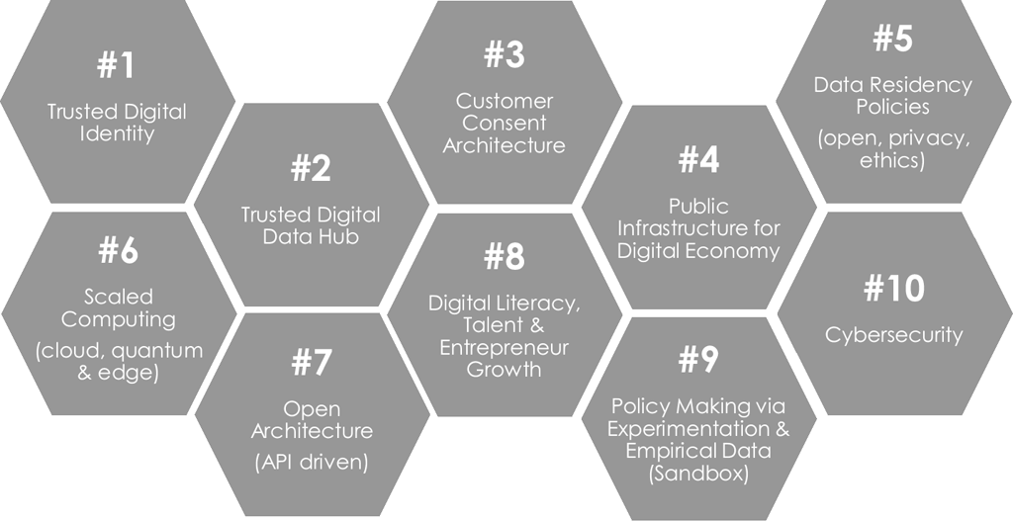
Representative Fintech Framework 1
Source: Digital Economy Singapore, Presentation by Mohanty S., Monetary Authority of Singapore, 2018

Slide 7
Representative Fintech Framework 2
Fintech ecosystem
Financial inclusion
ICT penetration
O&T knowhow
Innovation
Capital Sources
Regulatory support
Source: RBI Digital Fintech Framework

Slide 8
Week 4 Agenda Summary
Digital Identity is one of the key enablers of Fintech framework.
An identity, for an individual or corporate, financial assets and all document artefacts, is required to participate and function in the financial services world.
The digital twin of a physical identity is the digital identity and is essential for digital economy.

Slide 9
Why Digital Identity
Messaging
Business Rules
Reporting
Record keeping
The transactions in the financial services world function, basis an effective ‘messaging’ ‘business rules’ ‘reporting’ and ‘record keeping’.
Fintech achieves the above with an effective implementation of API, Rule engines, Report managers and Databases.
All financial transactions in the digital world happen between two entities.
However, for setting the context and personalize the transaction it is required to establish the digital identity of the entities involved.
This require unique digital identities to be created.

Slide 10
Need for Digital Identity -1
Level 1
Level 2
Level 3
Level 4
Person A fund transfers to Person B
In this case the participating entity at Level 1 are the two individuals.
Each of them require a unique digital identity within the BFSI ecosystem.
Additionally, many intermediaries are required to execute the fund transfer. Consider them as Level 2 entities.
Remitter Bank and Beneficiary Bank.
A payment rail such as NEFT, Mastercard or VISA
A payment facilitator, (either the bank or an outsourced service provider).
Note: In ATM, Smart phone, POS transactions the devices also have a digital identity
The funds need to have a digital identity as well, Consider as Level 3
Currency
Value
At level 4 comes, record keeping and reporting. For this purpose, the transfer need to be captured in a database. Context for the transfer is set using Account number or card number of the Level 1 entities.

Slide 11
Need for Digital Identity -2
Level 1
Level 2
Level 3
Level 4
Person A places a buy order for an Asset Stock B.
At Level 1, each of them require a unique digital identity within the BFSI ecosystem. In this case the stock exchange.
Additionally, many intermediaries are required to execute the order. Consider them as Level 2 entities.
Broker and Stock Exchange
A funding bank.
The funds need to have a digital identity as well, Consider as Level 3
Currency and Value, additionally, the asset purchased in this case Stock also has a digital identity.
At level 4 comes, record keeping and reporting. For this purpose, the transfer need to be captured in a database. Context for the transfer is set using Account number of the Level 1 entities, Additionally asset is stored in a demat account linked to the Person A.

Slide 12
Need for Digital Identity -3
Level 1
Level 2
Level 3
Level 4
Person A purchases auto insurance from Company B
In this case the participating entity at Level 1 are the two entities.
Each of them require a unique digital identity within the Insurance ecosystem.
Additionally, many intermediaries are required to execute the fund transfer. Consider them as Level 2 entities.
Remitter Bank of Person A and Beneficiary Bank of Insurance company B.
An intermediary such as Insurance Broker or aggregator.
A payment facilitator, (either the bank or an outsourced service provider).
At Level 3, Currency, Value, Vehicle ID and Insurance policy all have digital identity.
At level 4 comes, record keeping and reporting. For this purpose, the transfer need to be captured in a database. Context for the transfer is set using Policy number of the Level 1 entity.

Slide 13
Components of a Digital Identity
Unique Identity
Authentication
Authorization
Ownership (DRM)
Privacy and security
Every intermediary in BFSI assigns the customer, a relationship id linked to a unique account id or a credit card number or a loan account number or insurance policy or demat account etc.,
Systems need to be built for validating the identity of the customer against something that only the customer has access to. This linkage between identity and the validation is the first step in creating a unique identity.
Usually, this identity service is centralized in an enterprise directory server.

Slide 14
Components of a Digital Identity
Unique Identity
Authentication
Authorization
Ownership (DRM)
Privacy and security
Authentication is a very first step of the workflow before a customer can access a Business application.
Modern authentication systems require mutual validation between customer and the transacting entity.
Authentication performs the function of establishing linkage between the unique identity and the validation data to which only the customer is supposed to have access.
The validation data could be a ‘password’, a biometric such as fingerprint or face identifier, a onetime use password such as OTP, tokens etc., or a smart device such as a USB or EMV chip with certificate.

Slide 15
Components of a Digital Identity
Unique Identity
Authentication
Authorization
Ownership (DRM)
Privacy and security
Authorization is the process of confirming the customer’s privilege within the business application.
A fund transfer application require the customer to have sufficient funds in his / her account.
A sell order for a stock is validated against
Customer owning the stock (in the demat account).
Sufficient sell quantity is in the account.

Slide 16
Components of a Digital Identity
Unique Identity
Authentication
Authorization
Ownership (DRM)
Privacy and security
Ownership of an asset is established through linkages in the present digital economy. Because Account identifier is separate from the asset identifier.
In a banking system my account balance is a digital ‘value’ combination of currency and quantity.
The ‘value’ as recorded in my ‘Account ID’ and present as linked in the database establishes my ownership to the balance.
My customer id with Insurance company is different from my policy number. They need to be linked to confirm my ownership.

Slide 17
Components of a Digital Identity
Unique Identity
Authentication
Authorization
Ownership (DRM)
Privacy and security
Thinking exercise
How the ownership challenge is addressed in BlockChain, crypto world.

Slide 18
Components of a Digital Identity
Unique Identity
Authentication
Authorization
Ownership (DRM)
Privacy and security
Privacy and security all identity linked to a customer is essential
Insurance Policy number is confidential can be shared with Government officials and intermediaries for purchase and claims.
My account number can be shared with another entity only on a need-to-know basis. Sharing it with my employer for salary.
Personally identifiable information such as my Aadhar card and PAN number etc., is supposed to be highly confidential information, not to be shared without consent.
Passwords, biometric data etc., are highly restricted.

Slide 19
What is the market outlook
Identity Provider
Identity consumer
The market for identity is split between identity provider and identity consumer.
The identity consumer is also known as relying party.
Many social media applications have systems in place to federate and authenticate a User’s entity to the relying party.
Google
Facebook
Apple
Microsoft
LinkedIn
The government of India provides identity and authentication services through UIDAI to critical applications such as Tax filing etc.,

Slide 20
Challenges addressed by Digital Identity
A digital identity firstly solves comprehensively the design problem of digitization of systems.
With a well-established identity linkages across multiple systems automation of BFSI activities is made possible.
Example Use case
Customers PAN card and Aadhar card validated against UIDAI.
Customers account number is validated with Bank A for linkage of PAN and Aadhar card.
Customer’s account statement is perused for credit decisioning.
Finally, customer is assigned a loan account number with outstanding balance equal to the sanctioned amount. This is required for servicing the loan.

Slide 21
Impact of Digital identity on Business Models
Comprehensive Digitally powered platforms are made possible through establishment of digital identity across individuals, entities and assets.
Ability to address Privacy and Security needs meets the regulatory compliance requirement for the business operations.
Personalization and Tailoring of services according to a customer’s needs, obtained through analytics is made possible. This is an essential element of customer retention.

Slide 22
A Case for Digital identity management
Government of India, e-Governance context.
The Indian government for long tried solving the challenge of establishing a national identity.
Many disparate systems carried citizen identity such as passport, ration card, PAN card, Tax ID, mobile number etc,
Aadhar was created to link all these disparate identities.
The linkage solves two main challenges
Government to Citizen transactions for social welfare programs
Laying the foundation for aggregating the identities in future under one umbrella.

Slide 23
Aadhar Identity a Case study
Policy design for use of Aadhar
In 2013, the Reserve Bank of India (central bank) approved the inclusion of Aadhaar as an instrument of e-KYC wherein the biometric facility for instantaneous digital and online authentication and verification could be used to open accounts.
e-KYC Use case
This rapidly increased the pace at which accounts were opened. Banks reported savings of close to USD $1.5bn by using the Aadhaar e-KYC initiative.
Government to Citizen transfers
​After the Aadhaar was linked with all bank accounts, the government could ensure transfer of subsidies and social security payments to those accounts based on the Aadhaar numbers.
The welfare payments for the five largest governmental welfare schemes, namely the social security net, scholarships for the poor, the PDS and the employment guarantee act were transferred to the accounts linked to recipients’ Aadhaar numbers.
Aadhar as Identity and Authentication service
The biometric recognition facility of the Aadhaar assisted in providing better reach for banking and financial services in rural areas. Rural consumers did not have to hold physical identification documents or remember passwords.
As of July 2018, welfare scheme accounts had a closing balance of USD $11.6bn.
Source: Pranay Gupta. Gupta, Pranay_Tham, T. Mandy - Fintech_ the new DNA of financial services-De_G Press_Walter de Gruyter Inc (2019)

