Slide 1
BITS Pilani presentation
Sivasubramanian Natarajan
WILP Division

Slide 2
Introduction to Fintech (Merged - MBAZG516/PDFTZG516)(S1-24)
Lecture No. 5/ Week 5

Slide 3
Academic Term | First Semester 2024-2025
Course Title | Introduction to FinTech
Course No | MBA ZG516/ PDFT ZG516
Lead Instructor | Sivasubramanian Natarajan

Slide 4
Week 5 Focus
Session 1 | Contact Hours | Topic Title | Study / HW Resource Reference
 | 9 and 10 | Cloud computing | T1, Class materials

Slide 5
Recap
Fintech is characterized by its treelike structure, which clarifies the way fintech is organized across the different financial services in the market today.
Fintech Ecosystem
Financial Services
Domains (Banking, Payments, Lending, Insurance, Wealth Management)
Themes
Trends
Domain activity
Domain specific service providers
Ecosystem Players
Regulation
Capital
Partnership / Alliances
Tech enabled Business
Tech Powered Business
Fintech Frameworks
Digital Identity

Slide 6
Week 5 Agenda Summary
How cloud computing works ?
Cloud Services offering in the marketplace
Type of cloud implementation
Why use cloud services?
Cloud computing use cases

Slide 7
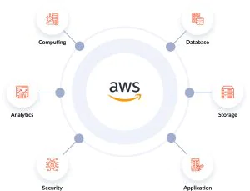
Cloud computing service providers in the Marketplace
Google Cloud
Microsoft Azure
IBM
Amazon Web Services

Slide 8
Cloud services offered by service providers
Platform as a service
Ideal for jumpstarting development of applications.
There would be little need for developers to worry about underlying platform requirements for deploying, testing and promoting the software release.

Slide 9
Cloud services offered by service providers
Infrastructure as a service
A very basic computing service.
The consumer rents only the hardware or virtual machine.
Software and other specifications required for platform are managed by consumer.

Slide 10
Cloud services offered by service providers
Application as a service
Understand through applications such as Google workplace, Office 365, Salesforce, Zoho works etc.,
Each customer customizes application in alignment with the company requirements.
Multiple versions of the same application virtually exist, independent and segregated for every customer.

Slide 11
Cloud services offered by service providers
Serverless computing
A notional concept.
Takes away the need for specifying the design aspects of computing.
The developers assume unlimited hardware, software, data and storage availability

Slide 12
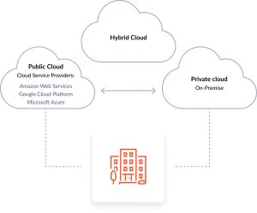
Type of Cloud implementation

Slide 13
Type of Cloud implementation
Private Cloud
The cloud computing resources are only available to the enterprise.
Ideal for augmenting IT requirements for a company.

Slide 14
Type of Cloud implementation
Public Cloud
Most social media websites today are hosted in the cloud and are open for public access.
Public cloud can be customized with a user id for each customer.
Examples of public cloud are Gmail, Google Drive etc.,

Slide 15
Type of Cloud implementation
Hybrid Cloud
Some parts of the cloud are private to the company availing the service.
A part of the cloud computing is open for integration with partners
Corporate interactions use shared cloud computing resources to collaborate. Examples are MS teams, Webex, zoom calls etc., which also facilitate content sharing.

Slide 16
Why use cloud computing?
Cloud computing facilitates quick setup and thereby enables time to market for fintech launches.
Quick and seamless scalability. Dynamic or on-demand computing resources scalability is achieved.
Reduces cost of ownership for the customer. Most maintenance and uptime requirements are met by the cloud services provider.
Investment requirements are greatly reduced.
Business continuity and disaster recovery is easily achieved.

Slide 17
Business continuity use cases
Application redundancy
Server redundancy
Data replication
Security
Data encryption
Data localization

Slide 18
Business continuity use cases
Server 1
Application instance 1
Application instance 2

Slide 19
Business continuity use cases
Server 1
Application instance 1
Server 2
Application instance 2

Slide 20
Business continuity use cases
Location 1 (Mumbai)
Application instance 1
Local 2 (Hyderabad)
Server 2
Server 1
Application Instance 2

Slide 21
Business continuity use cases
Location 1 (Mumbai)
Application instance 1
Location 2 (Hyderabad)
Server 2
Server 1
Application Instance 2
Database Server 1
Database server 2

Slide 22
Business continuity use cases
Location 1 (USA)
Application instance 1
Location 2 (India)
Server 1
Database server 1

Slide 23
Data security use cases
Data
Masking
Data
Encryption
Data
Tokenization

Slide 24
Cloud services terms of engagement
Ownership of the application lies with Customer or service provider
Ownership of Data
Licensing costs for Infrastructure (hardware and software)
Service level agreements
Cloud service uptime
Time taken to provide business continuity
Monitoring of servers for security, hacks and fraud
Analytics on server usage (Traffic information)
Fixed onetime cost, recurring cost and usage fees
Compliance requirements such as PCI DSS required for hosted fintech applications

Slide 25
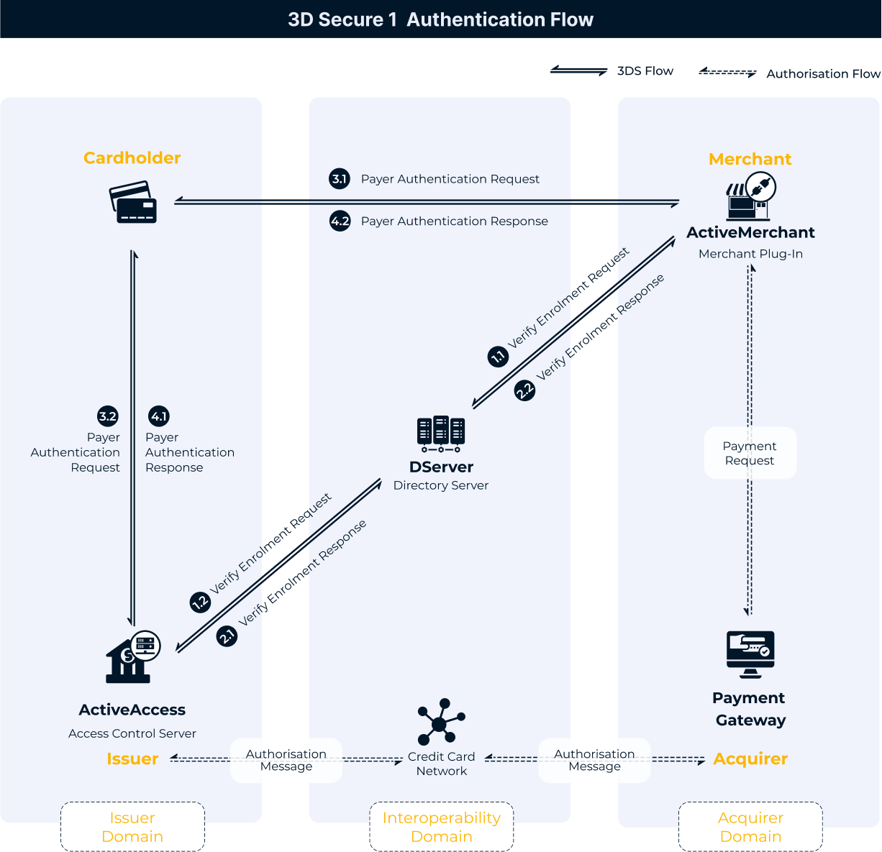
Fintech applications on cloud
Access control server and payment gateway are a hosted offering common in payments domain.
Both banks and fintech companies offer this service and widely used for payments processing
Traffic Insights and transaction analytics are automatically captured and presented

Slide 26
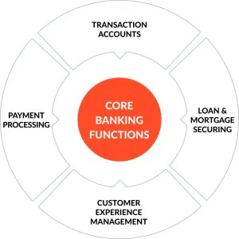
Banking as a service
Regulations permitting, a bank could open banking function as a service for use by partners and other banks.
A recent example is UPI.
P2P Lending
Buy Now Pay Later

