Slide 1
BITS Pilani presentation
Sivasubramanian Natarajan
WILP Division

Slide 2
Introduction to Fintech (Merged - MBAZG516/PDFTZG516)(S1-24)
Lecture No. 6 / Week 6

Slide 3
Academic Term | First Semester 2024-2025
Course Title | Introduction to FinTech
Course No | MBA ZG516/ PDFT ZG516
Lead Instructor | Sivasubramanian Natarajan

Slide 4
Week 5 Focus
Session 1 | Contact Hours | Topic Title | Study / HW Resource Reference
 | 9 and 10 | Blockchain and Distributed Ledger Technology 2.0 | T1, Class materials

Slide 5
Recap
Fintech is characterized by its treelike structure, which clarifies the way fintech is organized across the different financial services in the market today.
Fintech Ecosystem
Financial Services
Domains (Banking, Payments, Lending, Insurance, Wealth Management)
Themes
Trends
Domain activity
Domain specific service providers
Ecosystem Players
Regulation
Capital
Partnership / Alliances
Tech enabled Business
Tech Powered Business
Fintech Frameworks
Digital Identity
Cloud Computing

Slide 6
Week 6 Agenda Summary
Blockchain and Distributed Ledger Technology 2.0
What is blockchain in its totality and in the context of fintech?
What are smart contracts?
The economic impact of blockchain
Network effect
Less intermediary
Decentralized implementation
Consensus Protocols
Crypto Assets

Slide 7
Block Chain

Slide 8
Introduction Block Chain
Blockchain 2.0 could be considered as a platform with support for various elements such as
Crypto assets (Traditional assets and Token protocols)
Distributed Ledger
Consensus protocols
Smart contracts
Comments
Blockchain 1.0 was just BitCoin and P2P transfer of coins.
The Blockchain 2.0 specification was published in 2013 by Ethereum founder Vitalik Buterin.
Blockchain 3.0 is the future which are high-performance blockchains.
Blockchain 3.0 possess the features of both Blockchain 1.0 and 2.0, with scalability achieved through technical innovations and are characterized by high throughput (measured in TPS)
Cryptokitties, a DApp built on the Ethereum network
Examples of Blockchain 3.0 are Zilliqa, Dfinity and Hashgraph.

Slide 9
Defining Block Chain
Block Chain is more than cryptocurrency
It facilitates a centralized ledger system maintained and kept up to date through consensus among the nodes participating in the blockchain network.
It supports smart contracts, a replacement for paper. Criteria for triggering smart contract and what actions to be taken are defined in the smart contract itself.
Distributed Apps and Distributed Autonomous organization potentially disrupt Digital Portals.

Slide 10
Why Block Chain Matters
Block Chain allows peer to peer transactions without need for intermediary.
Business rules are embedded as smart contracts in the crypto coin itself.
This allows for a new economics to come into play
Less Intermediaries
Network effect, More users more efficiency, therefore scalable architecture can be achieved easily.
Decentralization prevents single point of failure.

Slide 11
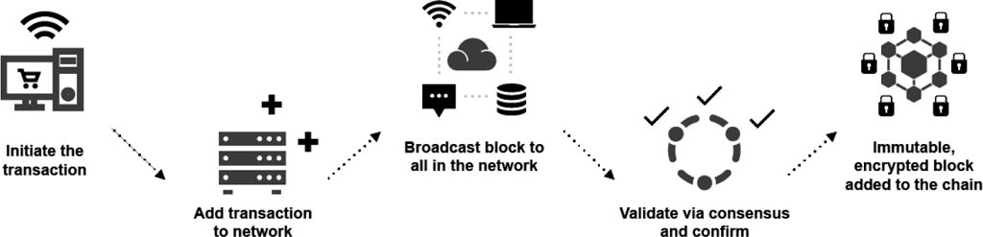
How block chain works
Users create transactions and submit them to the network, where they sit in a pool waiting to be included in a block
Miners compete to validate these transaction before they get included in a block
..

Slide 12
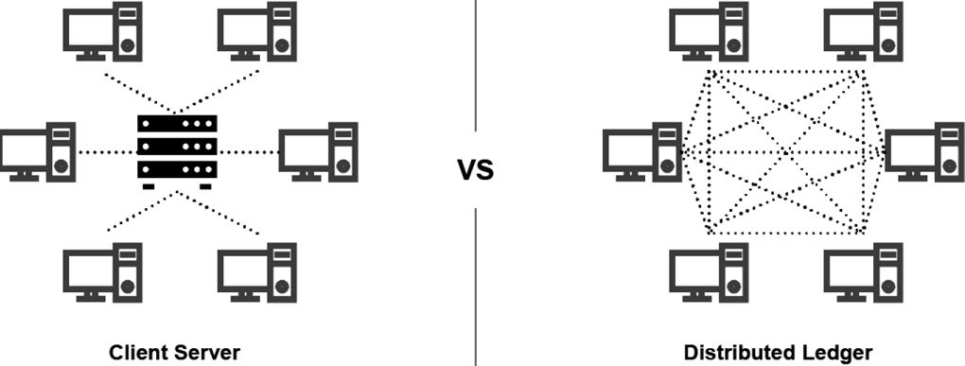
Underlying technologies in
Block chain
The concept of a node
Block chain has the data stored distributed across all participating nodes.
Each node in the block chain can only edit the blocks that it owns not the entire block chain.
Cryptographic Keys
Altering data in a block requires a unique cryptographic key pair.
Other nodes in the block chain with permission can view the data altered or created by a node.
Block Chain elements
Crypto as in Bit coin or CBDC
Distributed ledger technology
Smart contracts

Slide 13
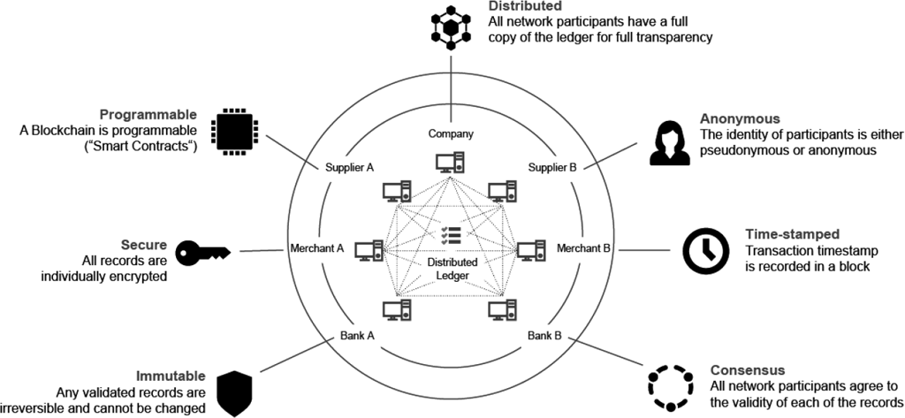
Perspectives in
Block chain illustrated

Slide 14
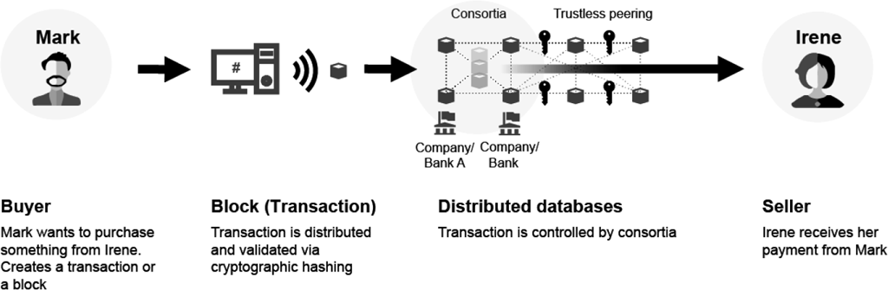
Perspectives in
Block chain Private
In permissionless implementation a central authority only makes the necessary changes. A view only copy is made to synchronize across nodes.

Slide 15
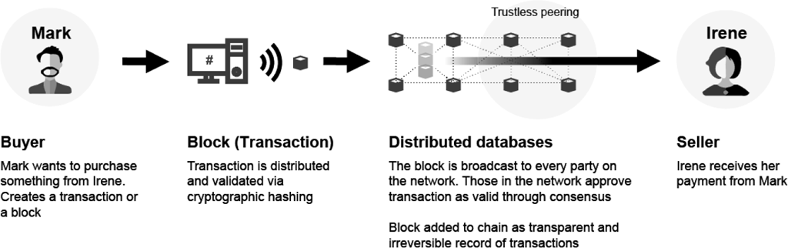
Perspectives in
Block chain Public
When distributed ledger is decentralized and made public it is also known as permissioned. Each node in the block chain could edit its copy of the blocks and allow the updates to synchronize across all participating nodes.

Slide 16
Public vs Private block chain a comparison
Category | Public Blockchains | Private Blockchains
Participation | Participation is not restricted and is open to any participation. | Read/write permissions can be restricted.
Permissions | Write: Anyone | Write: Operators control who can submit transactions.
 | Read: Anyone | Read: Public or restricted.
Transparency & Trust | Transactions are publicly recorded. Trust is established through node replication and consensus mechanisms. | Limited transparency (not all data is exposed). Trust is dependent on a central authority.
Valid Transactions | 51% of participating nodes | Based on pre-defined validators
Mining & Consensus Process | Anyone can mine (validate), Proof -of-Work is the primary consensus mechanism | Only permitted nodes are allowed to validate, various consensus mechanisms can be deployed
Privacy | Transaction details are public. Transacting participants remain anonymous or pseudonymous. For example, ZK-Snarks allows one to verify transactions while protecting users’ privacy. | Participants are known to the central authority/operator in the private blockchain. Privacy and security controls keep identities private. Transaction details are revealed only to transacting participants and remain confidential for non-transacting parties.

Slide 17
Public vs Private block chain a comparison, contd..
Category | Public Blockchains | Private Blockchains
Cost | Relatively low transaction cost | May be lower than public blockchain because of lower computing power required
Control | Neutral and decentralized (cannot be influenced by a single authority) | Centralized
Currency | Available cryptocurrency (such as bitcoin) | Proprietary crytocurrency
Performance | Generally slower. Dependent on the number of participating nodes and computational powers. | Generally faster because consensus can be limited to predefined validators.
Advantages | Open, greater chances for adoption, no single authority controls or governs | Greater degree of control, faster, greater degree of scalability (transaction volumes), privacy controls

Slide 18
Crypto Assets

Slide 19
Crypto Assets
Tokenization of Traditional assets
The way that Traditional Assets are being tokenized — the processes involved, how they then connect back to the “real world” — is intriguing, and clearly part of a growing trend. The underlying asset of a Traditional Asset Token is typically a “real world asset” which is governed by one (or more) centralised party but exists independently of the token’s existence on a blockchain.
Adding traditional assets onto blockchain technology requires for them to first be held in custody by a centralised party. They can then be tracked via an issuance of tokens which represent the ownership of assets on chain with the security guarantees that blockchains provide.
Trading and settlement can happen in a matter of seconds and at minimal cost (compared to t+3 + high fees, for example) due to the underlying technology. In theory, these assets are also divisible into smaller units, and as a consequence become more easily accessible.

Slide 20
Distributed Ledger

Slide 21
Distributed Ledger
R3 Corda
A blockchain platform and distributed ledger technology (DLT) that allows for the secure exchange of data and value between parties. R3 Corda is built on principles of privacy, security, and interoperability. It was launched in 2016 by a consortium of over 200 banks, financial institutions, and technology companies. The platform is used by many major financial institutions, including HSBC, ING, and J.P. Morgan.

Slide 22
Consensus protocols

Slide 23
Perspectives in
Block chain - Consensus
Proof of Work
Every time a user works on a block there is a need to validate the block before it gets included in the block chain.
This is a validation that the work took place
Miners are rewarded with transaction fees

Slide 24
Perspectives in
Block chain - Consensus
Proof of stake
Algorithm to choose creator of a block (Creation happens after validation)
The algorithm considers various factors that are randomly selected including when the last time was the user created a block
Proof of stake is now known as proof of authority
In CBDC the central bank is the default Authority to create the block.

Slide 25
Smart Contracts

Slide 26
Introduction
Smart Contracts
Smart Contract is a self executing digital contract.
Smart contract work based on
Defining events (Transaction in Fintech)
What action to take on occurrence and
What outcome is desired.
The parties that agree to the above smart contract structure and specifics can come together for a peer-to-peer interaction.

Slide 27
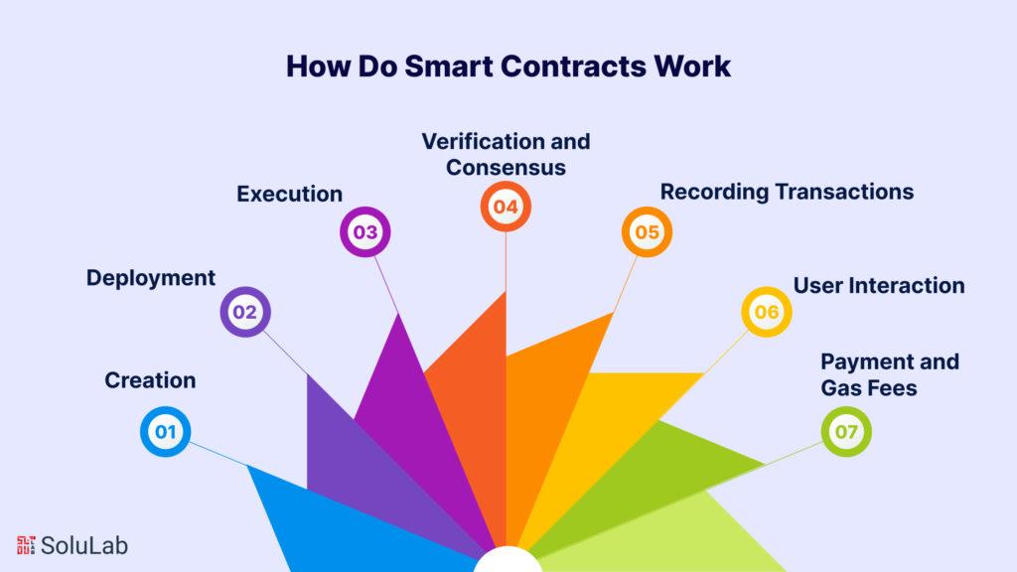
Smart Contracts
https://www.solulab.com/smart-contracts-iot-automating-devices-data-exchange/

Slide 28


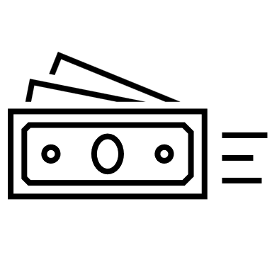
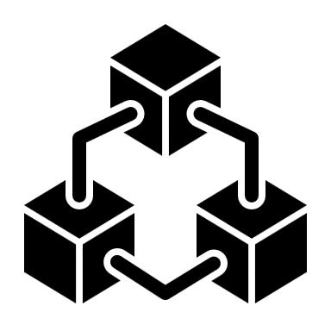

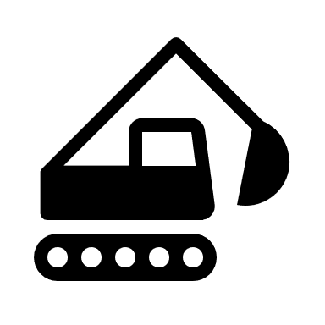
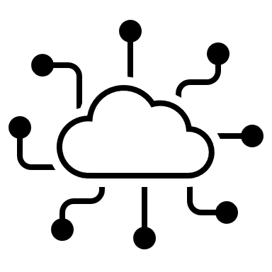

Smart Contracts in Trade Finance
Prior to making a purchase Buyer verifies smart contract for payment set by the seller and agrees to the contract. This is recorded in blockchain.
Buyer makes a purchase transaction to seller
2
3
4
5
1
6
7
Safely delivered event triggers smart contract to bank for releasing payment to seller.
Blockchain
Each step of the workflow records the workflow / transaction
Seller receives the request and demands bank guarantee
Buyer requests Bank to release Bank Guarantee
Seller ships the order.
Merchandise with IOT Device reaches buyer.
IOT sends ‘Safely delivered’ event to Blockchain
Bank guarantee is agreed by the bank, stored as a smart contract, in agreement with payment terms set by seller. (Release payment on delivery for example)

Slide 29


Imagine using Uber without an Uber App.
There are no intermediaries in this model, No 20% cut to Uber for matchmaking
Rider registers on the ride sharing blockchain
Driver registers on the ride sharing blockchain
2
3
4
5
1
6
7
Driver is paid in ‘Crypto’ or via other payment methods supported.
For external payment mechanisms, Software Oracles are used.
Blockchain
Each step of the workflow records the workflow / transaction
Driver makes his presence and availability through blockchain registry
Rider looks up for a ride and a smart contract is created for the requested pickup and drop
Rider reaches destination
GPS triggers successful drop
The successful drop event invokes the smart contract
Rider agrees to the smart contract, this is recorded in the blockchain.

