Slide 1
BITS Pilani presentation
Sivasubramanian Natarajan
WILP Division

Slide 2
Introduction to Fintech (Merged - MBAZG516/PDFTZG516)(S1-24)
Lecture No. 7 / Week 7

Slide 3
Week 7 Focus
Session 1 | Contact Hours | Topic Title | Study / HW Resource Reference
 | 9 and 10 | Big Data and Data Science | T1, Class materials

Slide 4
Recap
Fintech is characterized by its treelike structure, which clarifies the way fintech is organized across the different financial services in the market today.
Fintech Ecosystem
Financial Services
Domains (Banking, Payments, Lending, Insurance, Wealth Management)
Themes
Trends
Domain activity
Domain specific service providers
Ecosystem Players
Regulation
Capital
Partnership / Alliances
Tech enabled Business
Tech Powered Business
Fintech Frameworks
Digital Identity
Cloud Computing

Slide 5
Week 7 Agenda Summary
Big Data and Data Science

Slide 6













Introduction Big Data
Numbers
Real-time video
Video
Photo
Chat
Online Activity
The evolution of data over the years
From storing numbers and text to handling complex data like video, chat, photo and activity, Location information, demographics etc.,
Location

Slide 7
Big Data in financial services

Slide 8
Big Data in financial services
Large scale digitization of financial services
Owing to the conceptualization of digital money also known as digitization of cash, elements of the financial services delivery are now defined with the assumption that they can communicate with each other digitally.
The elements themselves manifest as channels (mobile, ATM POS etc.,) Payment service provider and Bank interfaces exposed through API.
All the above are computers in some form with the capability to integrate over a secure network.
Every financial activity has now become a message of interest carrying transactions of different nature depending on the services delivered.

Slide 9
Transaction data
How the data helps the financial services organization ?
Understand customer behavior and expectations
Understand the transaction volumes at various time of day ?
Seasonal transaction surges
Internal infrastructure issues contributed to success or failure of a transaction.
Process effectiveness in back-office processing

Slide 10
Transaction data insights
What are the external data captured in financial services delivery?
Customer data
Transaction information
Expense, deposit or withdrawal of cash
Channel used for performing the transaction
Timing of the transaction
Location of the transaction
Frequency of the spend or save

Slide 11
Internal Operation insights
A transaction use case
Whether the transaction was successful ?
If it was not successful which of the Financial organization's infrastructure led to the failure ?
Post transaction whether the back-office activities were carried out as per the set processes ?
Any auditable misses were identified during review internal audit or external audit

Slide 12
Big Data Tech Stack

Slide 13
Understanding Big Data
Before the data could be understood the Bank's infrastructure should prepare itself for storing the data. Planning for safeguarding and storage of data depends on the following elements or attributes of data
Elements | Description
Volume | Amount of data beyond the ability to analyze through conventional tools, there will be zettabytes of data required to be stored and processed.
Velocity | This is the speed of real time data is collected and processed.
Variety | Both structured and unstructured data provided by external sources
Veracity | Accuracy of data
Value | Monetization potential of the data.
Source: (Scroll down to Page 14 for English translation)
https://scindeks-clanci.ceon.rs/data/pdf/1451-4354/2022/1451-43542202147S.pdf

Slide 14
Preparing to store big data
Increasing Storage requirements
Gigabytes
Terabytes
Petabytes
Exabytes
Zettabytes
Form
Structured
Unstructured
Type
Numbers
Text
Media
Conversations (Multichannel)
Activity (Multichannel)
Location
Demographics

Slide 15
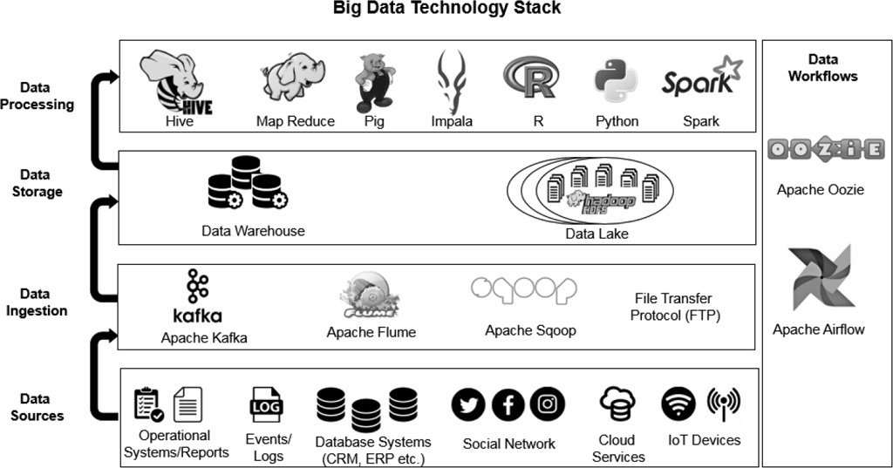
Big Data tech stack
Apache Kafka used for handling real-time data feeds. Apache Flume is used for moving bulk streaming data. Apache Sqoop is used for transferring data from a relational database to Hadoop HDFS.

Slide 16
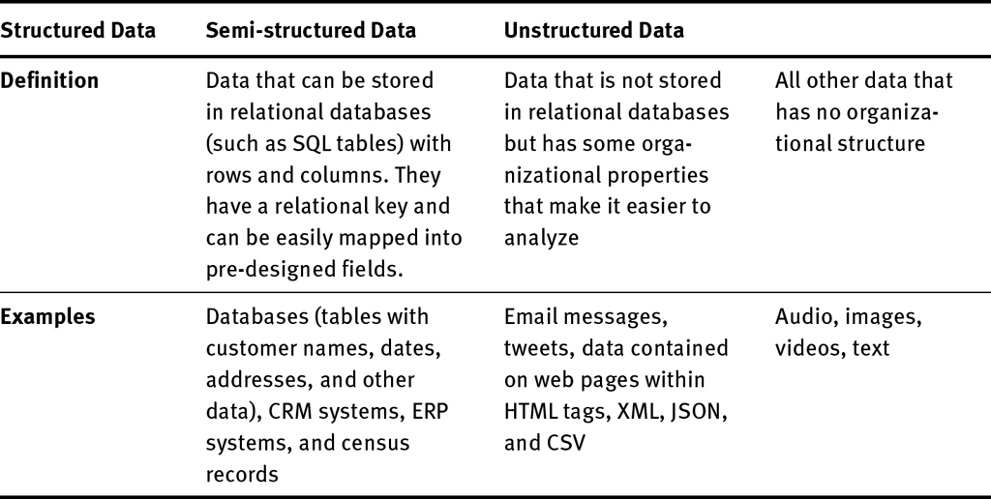
Understanding Data forms

Slide 17
Actionable data

Slide 18
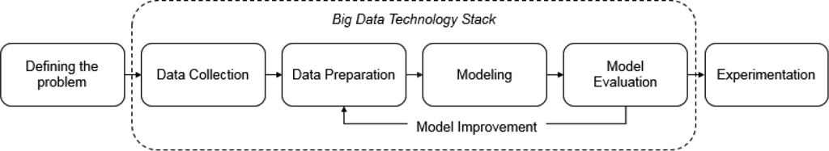
What to do with the data ?
Where does augmented analytics come in ?
We need to derive intelligence from the collected data
Techniques to generate intelligence
Automated Analytics using AI / ML tools
Desired output
Actionable Insights
Observations
Correlation
Prediction
Decision

Slide 19
Techniques for data analysis
The collected data need proper organization first.
For example, segmenting the data based on customer, type of transaction, time of transaction and seasonal surges.
Opening an account with bank or closing of account with the bank are also data of interest to Data scientist in financial organization.
All the data is organized or segmented and structured such that the resulting data set can support queries for delivering various insights for the business team.
How many customers on-boarded this month ?
How many accounts were closed ?
Transaction is peaking between 6.30 to 9 pm in the day.
Heavy volume experienced during seasonal festival holidays.
What was the overall transaction volume ?

Slide 20
Decision use cases based on data analysis
Because the customer on-boarding volume went down for this month should the business further explore reasons. How to find the reason ? The answer could lie in the data ? For example, the customer might have experienced repeated transaction failures over a sustained period of time.
If the business is able to correlate and establish a link between poor transaction experience and customer account closure, then it helps the planning for improving the experience of the customer by taking positive steps.
High volumes of transaction expected during holiday season means that the organization should capacity plan the infrastructure to handle the high volume of transactions and limit the failures.

Slide 21
Big data applications

Slide 22
Case study highlights
# | Case Study 1 | Case Study 2 | Case Study 3 | Case Study 4
Business | US restaurant chain Arby | German retail chain Otto | Bank of America | Online retailers
Insight | Renovated restaurants make more revenue | Merchandise delivered within 2 days experience lesser return rate | Top performing employees took breaks together | Analyze past transaction history
Decision | More restaurant remodel | Optimizing the stocking and shipping pattern | Implement a group break policy | What customers are likely to order in the month or next 30 days
Questions
Where are the data sources for gathering the data required for analytics ?
How to decide ?
What tools to use to identify data points relevant for the desired output ?

Slide 23
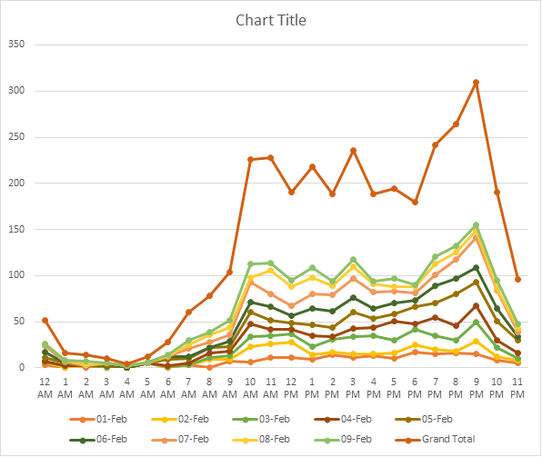
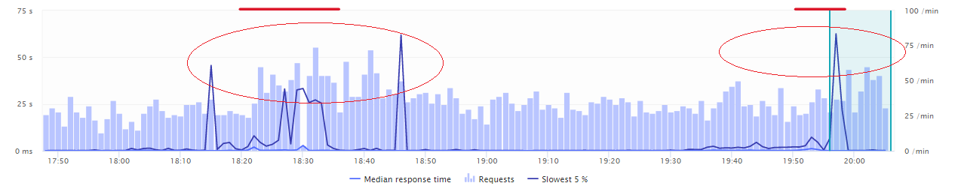
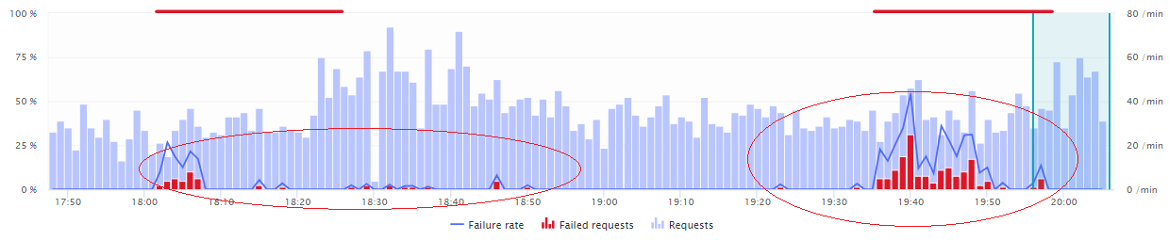
Data analysis in UPI operations
Time of day analysis
Analysis of the pattern of customer access to the UPI portal.
The peak times are the one which needs to be addressed by the financial organization
The organization plans for
High availability of the UPI portal
Take quick action in case of any failures through continuous monitoring.
Dynatrace / App Dynamics

Slide 24
Customer on-boarding analysis
Analysis of data related to failure during customer on-boarding in UPI.
The data is categorized into Technical Declines and Business declines

Slide 25
Transaction failures
For a fund transfer scenario, RBI mandates that in case the transaction is declined by the beneficiary bank, it should be immediately followed by reversing the debit on the remitter account.

Slide 26
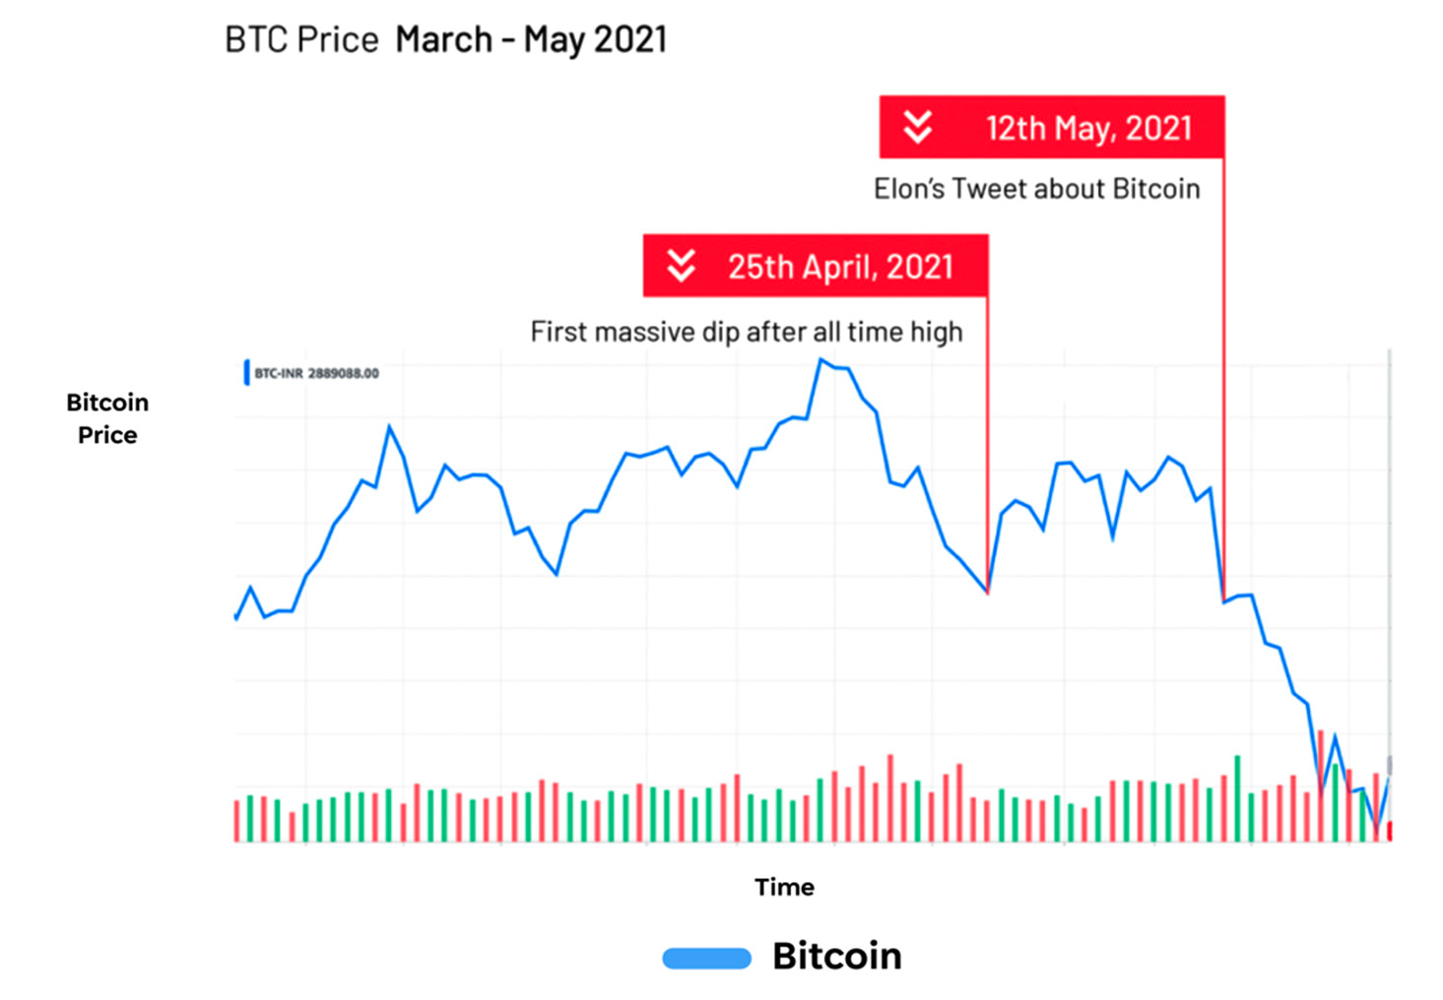
Sentiment analysis with Social network data
A case study, tweet about Bitcoin lowered the market value of Bit coin.
Source: https://www.mdpi.com/2024990

Slide 27
Data Scientist

Slide 28
Data Strategy
The questions from previous slide, leads us to discuss the role of a Data Architect or a data scientist
Data Sources | Data Processing | Data Presentation
Finalize Sources of Data | Design the data treatment Baseline the data points relevant for analytics Design the statistical and probabilistic tools required to model the data for providing insights, predictions and support decision making | Automate the data output using AI / ML Tools Data visualization Generate the desired output (Form + Content)

Slide 29
What is the disruption big data and analytics has brought about
New ways of doing things.
Large amounts of data collected by a financial institution through the transactions that reflects customer habits and patterns of behavior. This is available in digital form facilitating digital data processing through various tools and techniques.
Businesses can now take Informed Business Decisions
Understanding Market, Customers and trends
Business transformation and change to improve internal operations. Internal core processes is one of the distinctive capability for a financial institution.
Identify transaction failures and take action to optimize revenue by reducing failures.

Slide 30
What is the disruption big data and analytics has brought about
What this means for Fintech domain ?
The data is a strategic asset for the financial institution.
Data collected helps bank to effectively engage with customers
Banks have access to customer habits captured through transactions.
This can be used for tailoring upsell and cross-sell of products
Automated processes for decision making
Behavioral customer data are patterned and used for benchmarking spend patterns.
Anomalies in the spend pattern can be detected in real time to notify the bank about a possible fraud situation.

Slide 31
Key challenges
The need for Data Scientist as a role in organization is increasing
Data Security
How to protect large amounts of data from attacks?
Privacy and consent
Can organizations collect private information like name, address, phone number, health history etc., for analytics ?
Regulations – GDPR , DPDP Bill of India, Safe harbor, SOX etc.,
Growing volumes of data
Cloud storage increases server capacity, now focus is put on reducing Carbon footprint
Error analysis and Experimentation of Data Models, because Big data do not require a set data model. It is just reservoir of data.

Slide 32
How to prepare for the trend
Data Literacy across organization
Thinking the business critically in data terms
Designing the inputs required from data to generate insights, correlation, understand pattern, taking decisions and prepare action for long term and Short term
Data Strategy
What data my business needs
What output I need to generate to visualize data critically
How much of data is used and can be directly linked to business benefit
Data Governance
Data Quality and Data Security
Accuracy, Comprehensiveness and Completeness of Data
Hardware and software needs
Skills

Slide 33
Big Data Case study

Slide 34
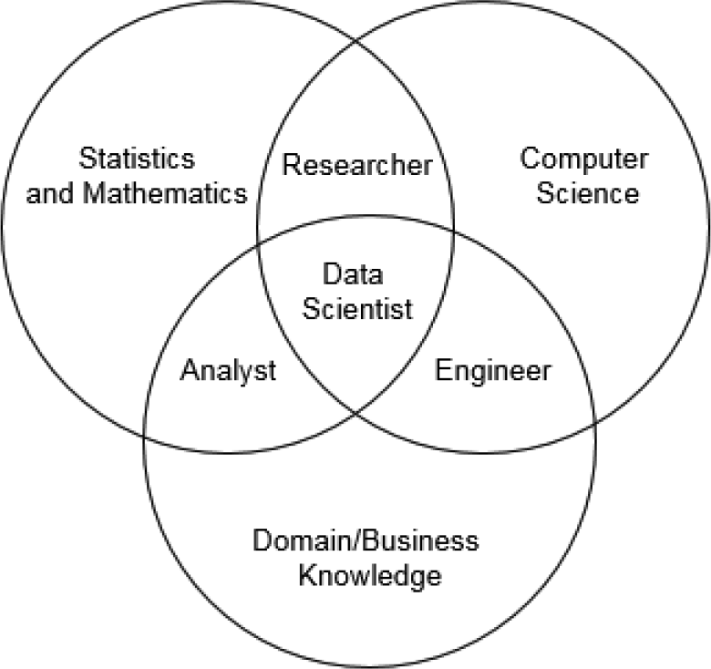

Who is a data scientist
Data science and industry research Dr. Shirley Coleman – Newcastle University, UK
Goal
Maintain inventory for customer purchases
Actions
Analyze customer purchasing patterns
By time of day, Monthly sales and Seasonal sales like festive season etc.,
Outcome
Plan the stock based on customer preferences for products and time driven purchase behavior

Slide 35
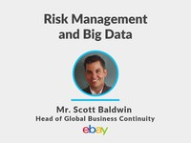
Frequently used solutions
Risk Analytics
Goal
Business Impact Analysis
Recovery time objective
Recovery point objective
Disaster recovery
Actions
Business continuity
Tabletop exercise for understanding possible disaster scenarios and recording feasible actions.
3. Outcome – driven by recovery time objective and recovery point objective
Data Backup and storage strategy
Split Location strategy for critical functions
Risk management and big data Mr. Scott Baldwin – eBay, USA

Slide 36

Frequently used solutions
Four types of big data
Transaction data
Customer data
External data
Social media data
Big data applications in corporate finance
Financial forecasting (goal and benefits)
“Net Present Value” of new product sales
Financial forecasting (suggested data)
Google Search analytics
Amazon Search and wish list
Facebook, Twitter likes
YouTube influencers
3. Outcome
Product launch and timing decisions.
Big data in Corporate Finance
Big data in corporate finance Dr. Michael Puleo – Fairfield University, USA

