Slide 1
BITS Pilani presentation
Sivasubramanian Natarajan
WILP Division

Slide 2
Introduction to Fintech (Merged - MBAZG516/PDFTZG516)(S1-24)
Lecture No. 9 / Week 9

Slide 3
Week 9 Focus
Session 1 | Contact Hours | Topic Title | Study / HW Resource Reference
 | 17 and 18 | Open Banking: Digital Payments Systems | T1, Class materials

Slide 4
Recap
Fintech is characterized by its treelike structure, which clarifies the way fintech is organized across the different financial services in the market today.
Fintech Ecosystem
Financial Services
Domains (Banking, Payments, Lending, Insurance, Wealth Management)
Themes
Trends
Domain activity
Domain specific service providers
Ecosystem Players
Regulation
Capital
Partnership / Alliances
Tech enabled Business
Tech Powered Business
Fintech Frameworks
Digital Identity
Cloud Computing
AI ML

Slide 5
Week 9 Agenda Summary
Open Banking: Digital Payments Systems
Open Banking
Open API
Digital Payments
Open Banking
Open API
Financial Services
Insurance
Investments
Lending
Payments

Slide 6
Background to Open Banking
Concept of Digital capital and B-web

Slide 7
Digital Capital
The movement of trends in capital and asset formation
Exchange (capital) was used to acquire the brick-and-mortar assets such as Land, Labor, Resources
In the industrial age capital was also used to acquire machinery required for producing assets such as finished products.
This gave rise to firms specializing in hubs/ pockets of specialized activity.

Slide 8
Digital Capital
In the information age the capital was used for acquiring computers to produce digital assets such as content and media. Along with advent of internet age this phenomena was also known as Internet of Information.
With the internet age firms in the specialized area of activity could be connected forming a Internet ‘Business Web’. For example, a firm producing media could connect with another firm for distributing the media to consumer for a price.
This was made possible through the design of API, a common protocol for communication between digitized firms.

Slide 9
Digital Capital
The trend of abstracting the functions of a brick-and-mortar firm into its digital form began in the 1990s.
Digitization involved defining and designing the
Business Logic – Achieved through Rule Engines
Intellectual property – Digital Assets
Data – Operational information
Computer to Computer and Human interactions – Through API
When all firms follow this trend and become digitized, which is what happened pre-Y2K and during dotcom era, it becomes easy to create a Business web that delivers value. This is also known as value chain.

Slide 10
Digital Capital
With internet making the connection between digitally enabled enterprises easily possible the potential to connect multiple firms in a Criss cross formation emerged.
Each formation led to a unique Business web of value leveraging the existing capability of the firm without the need for the firm to expand geographically. It required only scaling.
In the media company example, the media company could digitally connect to
A store where consumers can purchase the media
A streaming service for delivering the media for a subscription
With cryptocurrency and Web3 we are now experiencing the phenomena that is popularly known as Internet of Value

Slide 11
Digital Payments Introduction

Slide 12
Introduction Digital Payments
It is first important to understand the difficulty in separating Open Banking, Open API and Digital Payments.
Each evolved into its own standard and framework.
They are closely interconnected when it comes to Digital Payments.

Slide 13
Introduction to Open API
Application Programming interface
An API is a software tool that enables different computer systems to communicate.
API predominantly was used for internal interfacing of computers. It defined the specifications for the interfacing.
In recent times the API specs evolved as ‘Open API’ to enable seamless integration.

Slide 14
API benefits
Banks and Financial services organizations have been using API to interact with each other.
An organization’s internal IT system communicate through API integration.
Webservices was the initial standard which brought about the possibility of connecting systems over internal and external network.
The connections enable the functions of a system accessible non-intrusively without making major changes to the system code.

Slide 15
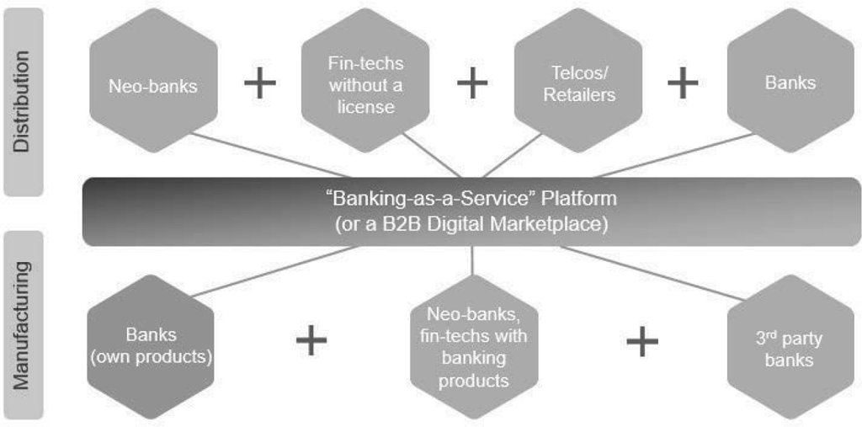
API in Financial services
Financial industry encountered two main challenges
Improve inclusivity
Extend the reach of delivery through new channels

Slide 16
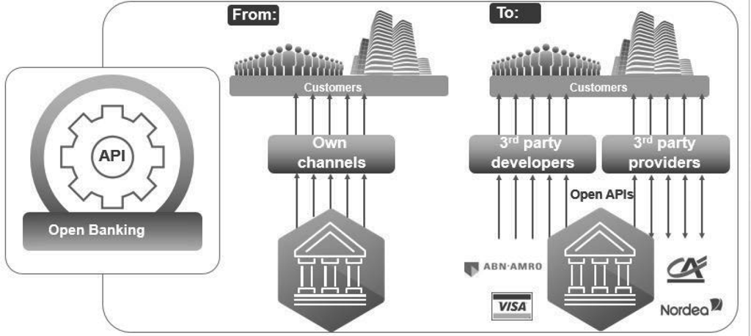
Open Banking as precursor to Open API
Bank had its own small network of customers and partners and operated through their own channels
Banks can extend their reach through devising a mechanism for large scale open integration

Slide 17
Background to Open API and Open banking.

Slide 18
Monopoly of banks and financial services
Digitization of financial services resulted in generation of data for every transaction insurance, payments, banking, investment or borrowing, a typical customer executes.
This data is monopolized because it is in the hands of banks and financial services provider.
This creates a monopoly for banks and becomes a strong barrier for fintech to enter the financial services domain.
The Payment Systems Directive 2 (PSD2) intends to break this monopoly and provide a level playing ground for fintech.

Slide 19
Digital Payments PSD 2
PSD 2 otherwise known as Payment systems directive 2 is a standard mooted and is implemented across Europe by the European implementation entity (EIE).
It may also be noted that the Indian Governments UPI (unified payments interface) is also an example of Open banking and open API.
Various aggregators like policy bazaar portals use standard open APIs to provide the search utility for insurance policy purchase decision.

Slide 20
PSD 2
PSD 2 has produced the following standards for fintech to participate in a level playing field
Account Information Service Providers (AISPs). AISP is a fintech category of companies, granted permission to access account data of an individual.
Transaction History
Money management tools based on available balance in the account.
Price comparison of financial products.
Applying for mortgage, loan or investment or purchase insurance etc.,
Payment Initiation Service Providers (PISPs)
Fintech categorized as authorized PISPs may request permission to connect to a bank account and initiate payments from the customer’s bank account. The example in India UPI is the Google Pay or Phone Pe or Paytm UPI PSP.

Slide 21
PSD 2
Account Servicing Payment Service Providers (ASPSP)
Account Servicing Payment Service Providers have typically been banks and similar financial institutions.
ASPSPs provide diverse payment methods, including online and card transactions, and direct debits. This versatility expands businesses' reach and simplifies transactions for consumers.
eIDAS certificate (Very similar to Aadhar e-sign)
eIDAS (electronic Identification, Authentication, and Trust Services) is an electronic signature, enable ASPSPs such as banks in European open banking to identify and authorise API connections from Third Party Providers such as PISPs and AISPs.

Slide 22
UPI – Unified payment interface
UPI was a precursor to PSD2
UPI implemented Open banking through standardized API published by NPCI (National Payment corporation of India).
UPI has the following standards broadly. (Many more like RuPAY, Circle, EMI etc)
PSP – A payment service provider like Google Pay or Paytm. The bank also develops and makes its UPI app available, in this case bank is competing with third party PSP.
Issuing Bank – Bank in which customer holds the savings account.
Registration – A customer can use any PSP app to register for UPI payments with his / her bank
BBPS – Bharat Bill payment system. Customer registers for utility payments. Utility service provider generates invoice and notifies customer of payment for the billing cycle.

Slide 23
API Architecture strategy

Slide 24









The different type of API Example use case
External Open API
API G/W
App Servers
API G/W
Web Server
Banking Mobile Channel
DMZ H/W
Load Balancer
External Partner only API for Large scale integration
Internal custom API
Merchant Channel
Web Server
Core Bank Systems
Typically, the APIs once published are protected via a ‘API Gateway’ that authenticates each connection before allowing access

Slide 25
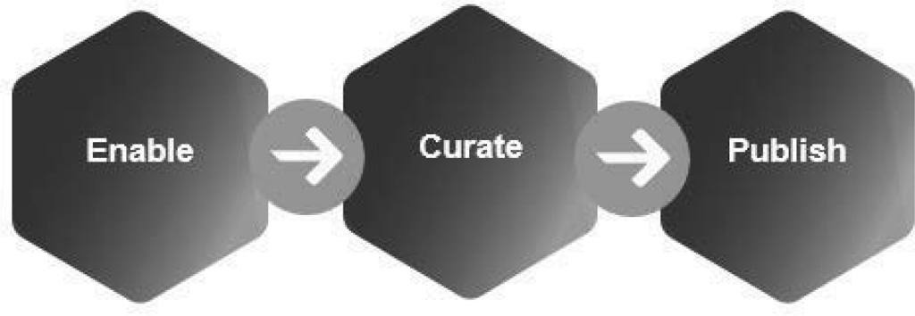
API Strategy
Enable | Curate | Publish
What APIs are required to be defined and what is the Business case? What data can be shared through the API? | Implement the API considering all functional and non-functional requirements | Access to the API Internal External
The above workflow is typical for publishing an API (Internal or external)
The architecture function in every enterprise focus on managing and governing the APIs workflow

Slide 26
Swagger OAS
Swagger is a leader in producing standards for the Open API specifications.
The Open API Specs (OAS) facilitates standardized way of passing trivial information such as customer data, transaction data, operation type, authentication etc., typical for any two systems to interface.
The specs allow a sandbox to be published to partners every time a new API is introduced. This allows partners to experience the implementation in sandbox itself before promoting for customer use.

Slide 27
Use cases for Open API

Slide 28
Open API uses in practice
 | Description | Use Case
In Insurance | White Labelling | Underwriting intelligence can be made available for a fee to other insurance providers
Tax services | Tax workflow | Tax returns process can be converted into a set of API and be made available for a fee
Banking | Authenticating credit card transactions | Authentication and authorization of transactions by issuer of the card is an essential element of card not present transactions
 | Card Issuance | Card Issuance know how can be made available through API

Slide 29


Open API uses in practice
High level user journey Insurance
2
I need car insurance proposal for a customer here are the details, please advise premium schedule
Insurance Broker intermediary
Example ICICI
Lombard group underwriting Agency
Here are the premium details for the details provided
1
I need car insurance here are my details
3
Here is your policy proposal, please make payment for issuing the policy
Insurance Broker intermediary
ICICI
4

Slide 30
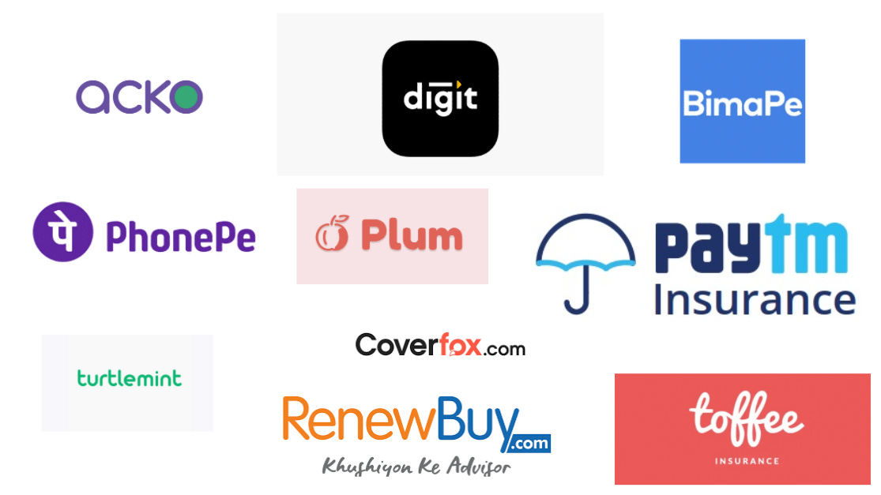
Insurance policy aggregator
Source: https://www.investkaroindia.co.in/p/policybazaardeepdive

Slide 31
Open API How to prepare

Slide 32
Open API Strategy
Every collaborative organizations including banks realize the need for collaborative architecture through interfacing mechanisms such as the Open API.
Open API means following a universally accepted standard for API definition.
Open API makes the API readable and easy for integration.
The current Open API specs is versioned v3.0. Swagger is a popular Open API editor.

Slide 33
Why Open API
Open API, a technical tool is the solution to Banks improving their reach to collaborate
Open API makes it easier for developers in partner companies to read the specs and integrate with the banking systems non-intrusively.
Open API makes the code re-usable across multiple partners for BFSI companies scale their reach.

Slide 34
Challenges in Open API
Establishing Trust
With Partner and Open Api, establishing trust digitally is essential
Solutions like using digital certificates, token-based sessions using OAUTH are typical
API gateways provide extra layer of trust
Security
Data security using encryption techniques to secure the payload that is exchanged between two systems
Control
The enterprise admin should have the ability, in real time, to configure
Access Control
Unpublish or publish an API

Slide 35
Open API
How to prepare for the trend
Understand the digital capital
Tangible digital capital
Hardware and software requirements for Open API
Human Capital requirements for Open API
Intangible digital capital
Intellectual expertise required to digitize and expose the business functions for partner interfacing
The business use case
How the integration with partners through the API contribute to the profitability and sustainable growth of the enterprise

Slide 36
Conclusion
Open API as a catalyst in sustainable growth and profitability

Slide 37
Hown Open API nurtures scale and growth
Open API facilitates aggregation and collaboration in financial services. Example use cases
Billdesk aggregates bill payments capability through a payment gateway service accessed by many utility service providers because
For the utility services provider the cost of implementing payment gateway for the purpose of customer payments is not cost effective.
It is easier for a utility service provider like electricity or gas to hire access services like Billdesk and leverage the payment gateway function

Slide 38
How the Open API helped sustain value chain
The digitization of financial services requires the services provider of Banking, Insurance and Investment and payment services follow an architecture model that is interoperable and loosely coupled. This helps the firms sustain the value chain.
PhonePe was able to Switch from ‘YES Bank’ to ‘ICICI bank’ for providing UPI services when YES bank was under moratorium.
The mobile interfacing specs followed by financial service providers make it easier to upgrade the User experience with minimal change to their internal systems.

