Slide 1
BITS Pilani presentation
Sivasubramanian Natarajan
WILP Division

Slide 2
Introduction to Fintech (Merged - MBAZG527/PDFTZG527)(S1-24)
Lecture No. 13 / Week 13

Slide 3
Week 13 Focus
Contact Hours 25 and 26
Type | Content Ref. | Topic Title | Study/HW Resource Reference
Pre CH |  | Review previous week's topics. | Notes/ Slides
During CH |  | Lending and Crowdfunding | Notes/Slides
Post CH |  | Review reference chapters from textbook; do the assigned homework/ experiential learning activities

Slide 4
Lending and Bank Money supply
The Central Bank is designated authority for Issuing FIAT currency also known as sovereign printed currency.
In modern times the digital token of currency (Digital money) is issued to the Banks.
The central bank works in a wholesale model, the currency is not directly transferred to end customer, customer needs to have an account in Central bank affiliated retail or corporate bank.

Slide 5
Introduction to fintech lending
Three theories of banking are leveraged when it comes to implementing lending use cases.
Financial Intermediation | Fractional Reserve | Credit Creation
Pool customer short term deposits and lend to the borrowers. | Retain 25% of Customer short term pool and rest of the 75% use for lending to the borrower | No need for deposit or fractional reserve. Money created as an entry in the loan book. Borrowers bank account is credited for the loan amount

Slide 6
Introduction to fintech lending
Characteristics of consumer finance globally
Highly concentrated in favour of the wealthiest
Only 50 percent of individuals have a savings account
Out of the 50 percent only half @25% have access to a loan product
Approximately 5 billion people are not being served by financial institutions
Marketplace lending platforms have potential to originate $1 trillion in loans in the next 10 years
What does this mean to the growth of economy ?
Thinking exercise 1

Slide 7
Growth of economy
What does this mean to the growth of economy ?
Thinking exercise 1
Whether the money borrowed is used for consumption ? In which case it doesn’t contribute to the GDP growth of the country.
Whether the money is used for asset purchase ? It leads to asset bubble.
Whether the money is used for Productivity, investment in a Business initiative ? Directly contributes to the growth in the GDP.

Slide 8
Fintech Themes in Lending

Slide 9
Fintech themes in lending
A theme is an area of special focus, repeats itself as a common element across enterprises or within the ecosystem
Theme 1 – What are the sources of private lending (Origination) ?
Theme 2 – If you take away credit card as a source of credit, how inclusive is lending globally ?
Theme 3 – How does literacy contribute to borrowing by individuals ?
Theme 4 – Disruptive business models : Marketplace lending, the India story
Theme 5 – Digitization of data for underwriting

Slide 10
Fintech Themes in Lending
Theme 1 - Origination

Slide 11
Theme 1 – Origination in Lending
Loan Origination
Loan Processing
Loan Agreement
KYC
Credit Check and decision
Disbursement
Recovery / Loan servicing
Origination – ‘Who is the lender?’ ( How lender gets money – ‘source’)
A large market exists in the form of unsecured lending using credit cards, backed by issuer banks
Individuals in low-income economies need short term loans to take care of emergency like health care, wedding, burial services, school fees etc.,
Most borrowings in low-income economies happen through non-formal institutions like community, friends and families.
In developing economies, mortgage forms a significant percentage of borrowing

Slide 12
Risk management

Slide 13
Risk management in Lending
During Loan Origination
KYC and credit decisioning is a key aspect of Loan origination stage, it is required essential first step for understanding the risks in a specific Loan application.
Loan agreements are legally binding document between borrower and lender. This is executed before Loan disbursement.
Tax
The source of credit is subject to tax , legal and regulatory requirements.
Interest Payments are subject to tax.
Servicing of the Loan
Loan defaults are subject to soliciting legal remedy by the lender.
This is the reason for Credit card loan interest rate to be higher because of the risk in unsecured credit

Slide 14
External Risk factors in lending
Lending decisions are sensitive to business cycles and economic factors.
Thinking exercise: What are the economic factors ?
Business Cycle or Economic cycle is linked to highs and lows of GDP. The economic factors used to measure GDP are
Employment and wages
Corporate profits and output
Aggregate demand
Supply of goods and services
A high GDP is driven by consumption, investments and exports
This is characterised by two stages “Expansion and Peak”
A low GDP is indicative of a reverse in trends of a high GDP
This is characterised by another two stages “Contraction and Trough”

Slide 15
Fintech Themes in Lending
Theme 2 - Inclusiveness

Slide 16
Theme 2 – Inclusiveness in lending
Lending through banks are lesser in percentage in comparison to other elements in the economy .
There are about 5 billion individuals globally with an origination potential of $1 trillion in loans.
Lending is one of critical services, in addition to savings and insurance that has the potential to bring in the transformation required to bridge the gap in inclusiveness.

Slide 17
Loan Origination Case study
Mudra Loans

Slide 18
Mudra Loans Case Study
The formal financial institutions for lending are Banks, co-operative union, credit union or microfinance institution.
These are the institutions through which GOI disburses the loan amount.
In this case the financial institutions serve as ‘Sourcing’ and ‘Servicing’ partners.
Shashank B. S., & Sureshramana Mayya. (2022). A Case Study on the Impacts of the Pradhan Mantri Mudra Yojana on the Banking Sector in India. International Journal of Case Studies in Business, IT and Education (IJCSBE), 6(1), 256–267. https://doi.org/10.47992/IJCSBE.2581.6942.0163
Highlights
Schemes Under Mudra
Performance
NPA
Growth

Slide 19
Schemes Under Mudra

Slide 20
Mudra Loan Performance - Growth

Slide 21
Mudra Loan Performance - NPA

Slide 22
Fintech Themes in Lending
Theme 3 – Financial literacy

Slide 23
Theme 3 – Role of literacy
Source: World bank report ‘Measuring Financial Inclusion’ - 2012
Education vs financial status
Irrespective of education individuals with better financial status are twice as likely to borrow than their lesser privileged counterparts
Seemingly demand is lower in percentage of population with little education
Less ability to understand complex loan terms also is a barrier

Slide 24
Fintech Themes in Lending
Theme 4 - Disruption

Slide 25
Theme 4 – Marketplace lending
What is marketplace lending ?
It is an online platform. Mostly. However, it involves borrower document verification to secure commitment from lender.
It connects borrowers and lenders through contracts.
Business model
Collect principal and interest from borrowers
Return the payments to lenders, minus fees.
In India
I2i Funding is a NBFC P2P platform.
Monexo likewise is a NBFC P2P platform.
Rate of interest is high (about 16% p.a)

Slide 26
Marketplace lending
India Story
Lending type | Example | Banks | Regulated NBFCs | Non-Bank Non-NBFC entities and individuals
Balance sheet Lending | Loan is in the balance sheet of the lending company | YES | YES | YES
Marketplace or P2P lending | Intermediating Borrower and lender | NO | YES | NO
Hybrid Lending | Balance sheet + Marketplace | NO | YES | NO
Proxy lending | Buy Now Pay later | NO | YES | YES
Fringe lending | Illegal lending | NO | NO | YES
Secured Lending | Gold Loan, Auto loan etc., | YES | YES | NO
Unsecured Lending | Credit cards | YES | NO | NO
Source: https://www.rbi.org.in/Scripts/PublicationReportDetails.aspx?UrlPage=&ID=1189#S24

Slide 27
Fintech Themes in Lending
Theme 5 – Credit decisioning

Slide 28
Theme 5 – Underwriting loans
The number of smartphones in India have increased from 100 million in 2014 to over 700 million in 2021.
This gives users, especially those who need urgent small-ticket loans, the option to download lending apps and avail loans without long wait times, multiple approvals and multi-pronged verifications.
Big Data Analytics, Artificial Intelligence (AI) and Machine Learning (ML)
The smartphone revolution has led to large volumes of data being generated and shared. This data, is very valuable and allow digital lenders to better understand the needs of their customers, perform timely underwriting and improve fraud detection.
Customer analysis: Big data analytics help digital lenders understand their customers’ needs and changes in their borrowing behavior, in order to provide timely and customized lending options.
Underwriting: AI/ML models can be used to assess risks and make unbiased underwriting decisions. This allows for faster and more intelligent risk assessment, without human intervention.
Fraud Detection: AI/ML allows lenders to detect suspicious behavior, identify repeated defaulters and flag high-risk loan requests.

Slide 29
Case study Disruptive Lending Business Models

Slide 30
Chronology of disruption in lending and its impact
Decade | Broad commentary on progression | Impact
1960 | Banks only player in lending | Predominantly corporate
1970 | Advent of consumer durables financing | Retail lending
1980 | NBFC accepting deposits and lend to retail and corporate | Inclusiveness
1990 | Truck financing | Age of economy expansion
2000 | Mortgage financing | Economy expansion
2015 | Marketplace lending / New business models | Access to lending sources made easier Multiple campaigns can be supported. (School fees, marriage, charity, donation, social cause)
 | Non NBFCs participation in lending | BNPL, Slice, Crowdfunding

Slide 31
Business model Traditional lending
Loan Origination
Loan Processing
Loan Agreement
KYC
Credit Check
Disbursement
Recovery / Loan servicing
Capital requirement / Source of funds Individual wealth Pool of funds by interested investors Bank deposits / savings | Regulatory documentation requirements Processing fees collected from borrower Partnership with credit rating agency | Principal, Interest, Tenure and repayment schedule agreement Collateral requirement as mandated by RBI Insurance requirements | Transfer to account Transfer to merchant in case of purchase of goods Transfer to landowner in case of mortgage | Monthly usually Monitoring Ageing of outstanding Reporting to RBI Reporting to credit agency Recovery through collateral
Onetime Revenue
Revenue Interest earnings

Slide 32
Disruptive Business Model 1
Loan Origination
Loan Processing
Loan Agreement
KYC
Credit Check
Disbursement
Recovery / Loan servicing
Banks can leverage Regulation to use Fractional Reserve Banking or credit creation to lend loans. However, the NBFC (Non-Banks) are permitted to lend, if they meet the capital adequacy requirements otherwise known as ‘Source of funds’
The NBFC further can be a proxy lender and face to customer with a sponsor bank could be a source of funds.

Slide 33
Disruptive Business Model 2
Loan Origination
Loan Processing
Loan Agreement
KYC
Credit Check
Disbursement
Recovery / Loan servicing
Banks require a ‘Credit decisioning committee’s nod to approve a Loan,
The credit committee’s activities are straightforward for Consumer loans however, it is complex for corporate and SME lending.
However, the NBFC (Non-banks) permeate this segment by automating the credit decisioning, through integration with Underwriting software.
NBFCs like CRED are not bound by Bank’s processes, they can lend to students, without a credit history.
Underwriting software integrates KYC, Credit rating, Future cashflow prospects and risks.
Non-Bank NBFCs are generally more efficient for Loan servicing and recovery in comparison with the banks.

Slide 34
Crowdfunding

Slide 35
Crowdfunding and Market place lending – Modern Global capital markets
Equity crowdfunding portals are disrupting VC
Investments come directly into the start-ups
P2P models facilitate investment in SME
Also known as capital pooling and securitization
Other areas in scope
Invoice trading
Real estate investment
Syndicate balance sheet risk exposure

Slide 36
Crowdfunding and Market place lending – Modern Global capital markets
Themes in Modern global capital markets
Disclosure paradigm - Platforms tapping retail investors need more disclosure for investment protection compared to institutional and accredited investors.
Conduct risk – Proposal for an industry wide code of conduct. (FICC)
Trust and Regulation – Private IPOs
Professional education

Slide 37
Approach to crowdfunding
The “crowd” is composed of individuals who may or may not have experience or knowledge of financial markets. How then can the crowd do their best to ensure they are making the right decisions?
There are two current equity crowdfunding investment models: investor‐led and company‐led.
In the case of investor‐led approach that benefits investors is that they receive the same share class and price as the angels, whether they are investing £1,000 or £100,000. They also have the same rights in following their money in later rounds, enabling them to avoid excessive dilution.

Slide 38
Investor-led approach to crowdfunding
This is often not the case on crowdfunding platforms that operate the company‐led model
.
With the “company‐led” approach to crowdfunding, the company seeking capital sets its own terms of investment and decides its own valuation.
Additionally, Companies can choose to issue more than one class of share.
Often founders get A shares,
whereas
Ordinary investors get B shares, that come without voting or pre‐emption rights.

Slide 39
Investor-led approach to crowdfunding
Thinking exercise: Why Investor-led approach matters?
This matters because ordinary investors may well see their stake heavily diluted if the company embarks on another round of funding at a higher valuation.
The investor‐led model of crowdfunding has clear benefits for investors over the company‐led model.
As crowdfunding continues to grow, issues such as the protection of investors, transparency, and education will assume an ever-greater importance,
Companies that put the investor first will be well‐placed to take advantage of these changes.

Slide 40
Cred Business Model Case study

Slide 41
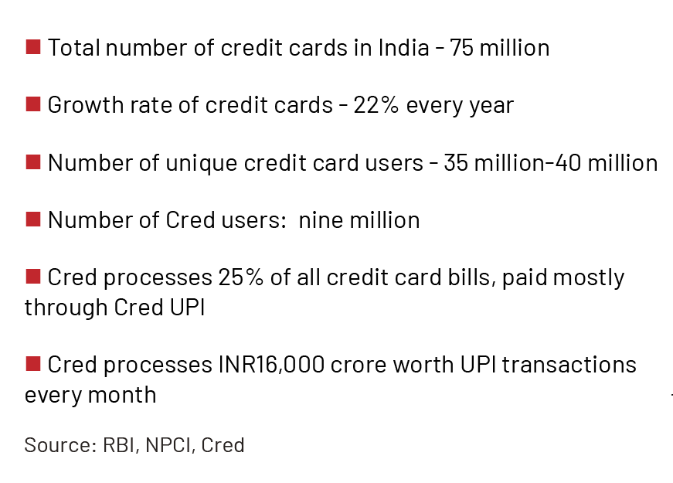
Marketplace lending
Cred Business Model Case study
The Business Model of CRED positions itself to act as a debt collection agent and as a source of data for credit rating
Cred has around 9 million customers and a quarter of the country’s credit card bills are paid through its platform. This amounts to INR15,000 crore worth of credit card bills every month.
Cred primary revenue are fees from partner for prompt repayment of credit card bill
Cred generates a credit score based on Customer KYC, before onboarding users and educates its customers about the importance of a good credit score.
This gives Cred the confidence to disburse personal loans within a few minutes without any documentation.
Source: ETPRIME, RBI, NPCI

Slide 42
Future of lending (Web3)

Slide 43
A plausible future of lending in the fintech world - Web 3
Tech trends
Web 3 adoption – Built using block chain
Source: https://www.mckinsey.com/industries/financial-services/our-insights/web3-beyond-the-hype

Slide 44




Lending on Web3 with Blockchain DAO and smart contracts
Lender registers for Lending on the Blockchain. (DAO)
Borrower applies for a membership with the DAO. Membership accepted and access to the DAO is granted.
2
3
4
5
1
6
7
Lender is paid in ‘Crypto’ or via other payment methods supported.
For external payment mechanisms, Software Oracles are used.
Blockchain
Each step of the workflow records the workflow / transaction
Borrower applies for a loan.
Borrower is presented a smart contract
On a pre-determined frequency smart contract triggers EMI debit from borrower’s account.
Borrower agrees to the smart contract, this is recorded in the blockchain.

Slide 45
Further references about Blockchain lending
https://ethglobal.com/showcase/loan-dao-p3rgr
https://www.alchemy.com/smart-contracts
https://moralis.io/dao-smart-contract-example-dao-guide/

