Slide 1

Prefetching On-time and When it Works
Sequential Prefetcher With Adaptive Distance (SPAD)
Ibrahim Burak Karsli (bkarsli@ele.uri.edu)
Mustafa Cavus (mcavus@my.uri.edu)
Resit Sendag (sendag@ele.uri.edu)
Department of Electrical, Computer, and Biomedical Engineering
University of Rhode Island
Notes:
1

Slide 2

Outline
Motivation
Sequential Prefetcher with Adaptive Distance (SPAD)
Hardware Budget
Results
Notes:
2

Slide 3
Motivation
Next-line prefetcher (offset: +1) is simple and performs quite well (score ~4.439). But
Opportunity loss due to no feedback mechanism
Timeliness: Late prefetches most important problem
Accuracy: No on/off mechanism
No adaptivity to program behavior changes
Basic idea: Add adaptive distance to next-line prefetcher
Start with +1, increment/decrement distance based on feedback
Notes:
3

Slide 4
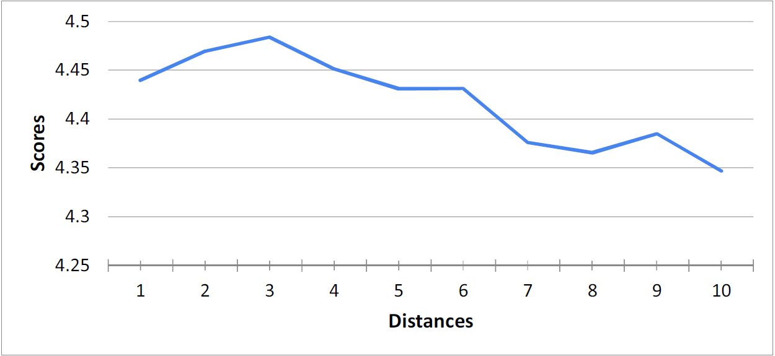
Motivation
Sequential Prefetcher Performance with FIXED distance (offset)
Distance 1 (next-line) score : 4.439
Distance 3 (best) score : 4.484
Notes:
4

Slide 5
Terminology
Interval: A period of 512 L2 demand accesses
L2miss: Number of L2 misses in an interval
Testing Queue (TQ):
FIFO Queue
Every predicted address is inserted into TQ
Also acts as a prefetch filter
tqhits: Number of L2 demand accesses found in TQ in an interval
tqmhits: Number of L2 demand access misses found in TQ in an interval
Notes:
5

Slide 6
SPAD Prefetcher Components
Notes:
6

Slide 7
SPAD Decision Engine: Distance Update Mechanism
Notes:
7

Slide 8
SPAD Adaptiveness
Comparing the results of SPAD with the results of fixed distance sequential prefetcher using best distances (BD).
BD:1
BD:1
BD:6
BD:4
BD:5
BD:3
BD:1
Notes:
8

Slide 9
SPAD Hardware & Performance
SPAD Hardware Budget
Test Queue: 4103 bits
Registers&Counters: 160 bits
Total: 4263 bits
SPAD Performance
Prefetcher | Score
Sequential +1 | 4.439
Sequential +3 (Best performing offset) | 4.483
Ampm lite | 4.511
Sandbox (+/- 16) 32 offsets | 4.578
SPAD | 4.584
Notes:
9

Slide 10
IP-Stride and SPAD
The score of SPAD is significantly better than the score of ip stride prefetcher.
However, ip stride works significantly better than SPAD for some benchmarks, such as bzip2 and soplex.
Integrating SPAD with ip stride improves SPAD performance by 5.5%.
Notes:
10

Slide 11
Submission Hardware Budget
SPAD (4263 bits)
Test Queue (4103 bits)
Registers&Counters (160 bits)
Ip Stride (67584 bits)
Global Prefetch Queue (4103 bits)
Total (75950 bits)
Notes:
11

Slide 12
Benchmarks
40 benchmarks from SPEC CPU2000, SPEC CPU2006 and Olden benchmark suites.
We used Simpoint 2.0 to generate representative 100M-instruction traces.
10m instructions for warmup
90m instructions for simulation
Notes:
12

Slide 13
Results
Notes:
13

Slide 14
Results
Prefetcher | Score
Sequential +1 | 4.439
Sequential +3 | 4.483
Ampm lite | 4.511
Sandbox | 4.578
Ip stride | 4.300
SPAD | 4.584
SPAD & IP Stride (Combined) | 4.616
Notes:
14

Slide 15
Conclusion
Adaptive distance in sequential prefetchers have significant benefits.
Our submitted version is not optimized. It can be significantly improved as we observed in our later tests.
Combining SPAD with ip stride prefetcher boosts the performance.
Notes:
15

Slide 16
Thank You
Questions?
Notes:
16

