Slide 1
PRACTICAL ASSESSMENT
Tools: Azure, Snowflake, dbt
Author: Wennan Shi
Date: 13/Feb/2026

Slide 2
Problem Understanding
Business Requirements:
  Blank
Data:
  Blank
Outcomes:
  Data marts
  BI Reporting
Constraints:
  Time limit
  Realistic trade-offs

Slide 3
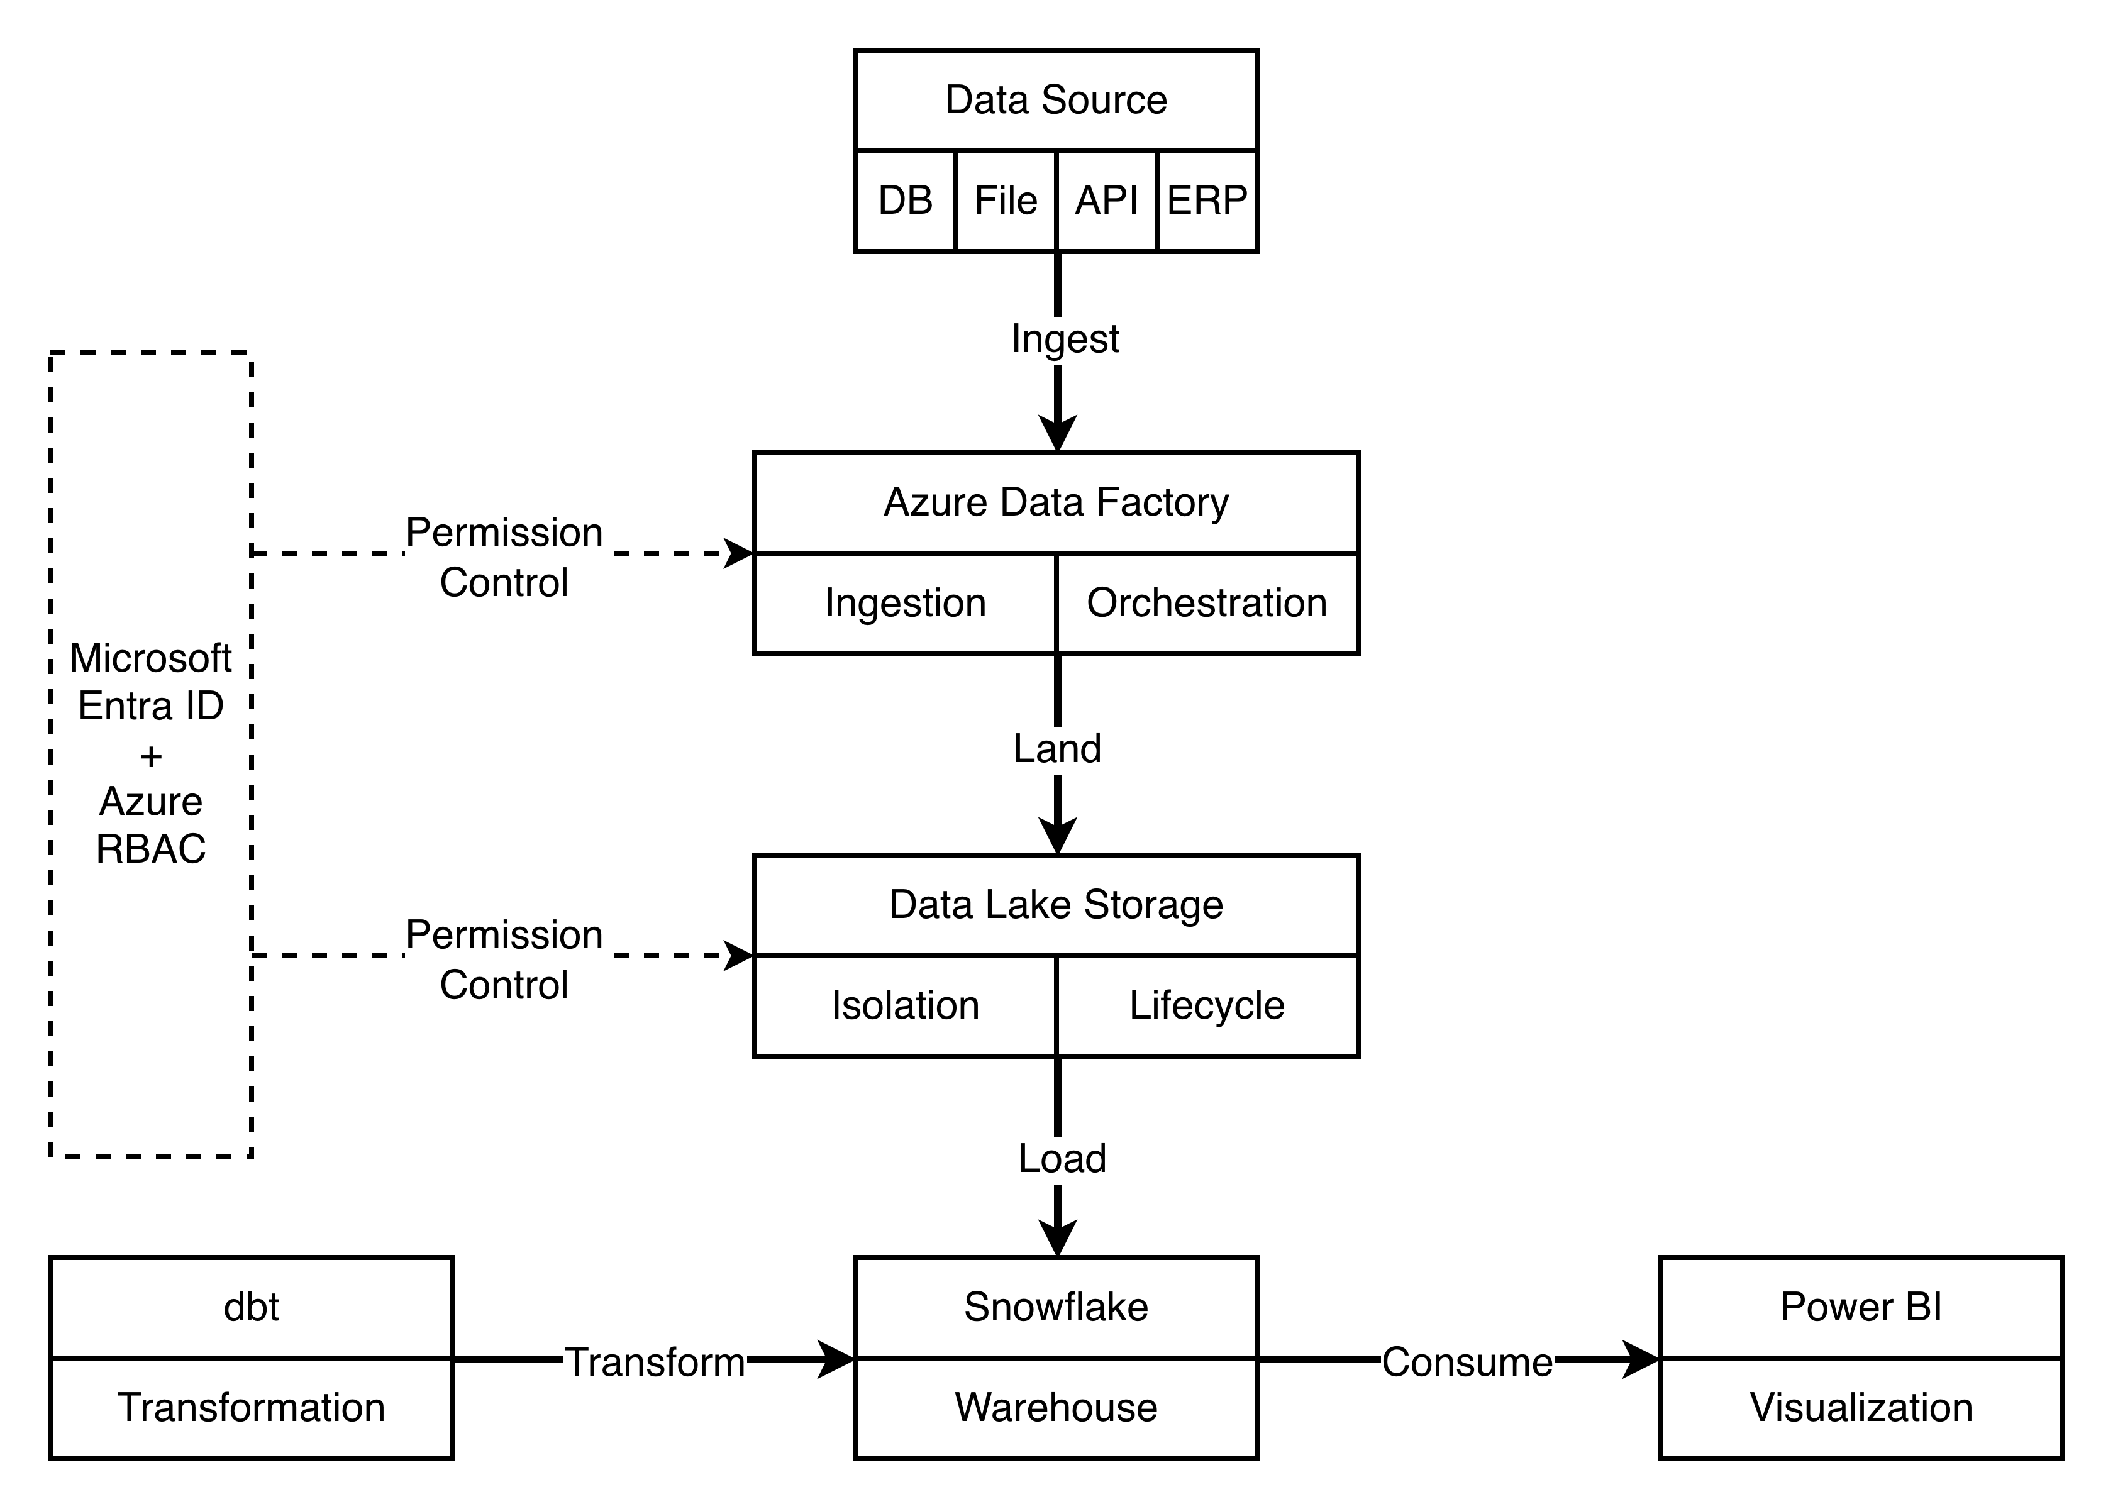
Architecture

Slide 4
Design Decisions
Approach:
  ELT
  Medallion Architecture
  Dimensional Modelling (Kimball)
Why:
  Big Data Friendly
  BI-friendly
  High Performance
  Business Clarity
Gold Layer:
  Fact tables ()
  Dimension tables ()

Slide 5
Trade-offs
Priority:
  Clarity over completeness
Simplified:
  Limited depth
  Limited orchestrated
  Limited documentation
Assumptions:
  Frequency - Daily
  Data schema - Consistent
  No slowly changing dimension

Slide 6
Data Quality
unique
not_null
duplicate
freshness
loaded_at_field

Slide 7
Validation Rules
Business Rules
  Blank
Model Rules
  relationships (PK, FK)
  accepted_values

Slide 8
Technical Implementation
Ingestion
Staging
  Cleaning
  Standardization
Intermediate
  Modelling
Marts
  Dim
  Fact
Reporting
  Power BI / Tableau

Slide 9
Improvement & Scalability
Permission Control
Reusability
Incremental Model
SCD Type 2 (dbt snapshots)
Compute & cost considerations
BI concurrency

Slide 10
Wrap-up & Q&A

