Slide 1
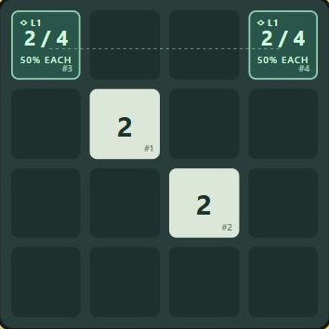
Quantum 2048
Planning with
shared fate
Exact merge forecasts powered by Qiskit
Waterloo Qiskit Fall Fest · 2026
Local simulator · Python notebook + playable game
01
Notes:
0:00–0:25. A familiar puzzle with a new planning question: what changes when two uncertain tiles share an outcome? Introduce the project without a novelty or advantage claim. AI assisted this submission. Default talk is approximately four minutes because official duration is unpublished. Sources: https://uwquantum.com/qiskit-fall-fest ; https://github.com/nirbhaykwatra/Quantum2048 .

Slide 2
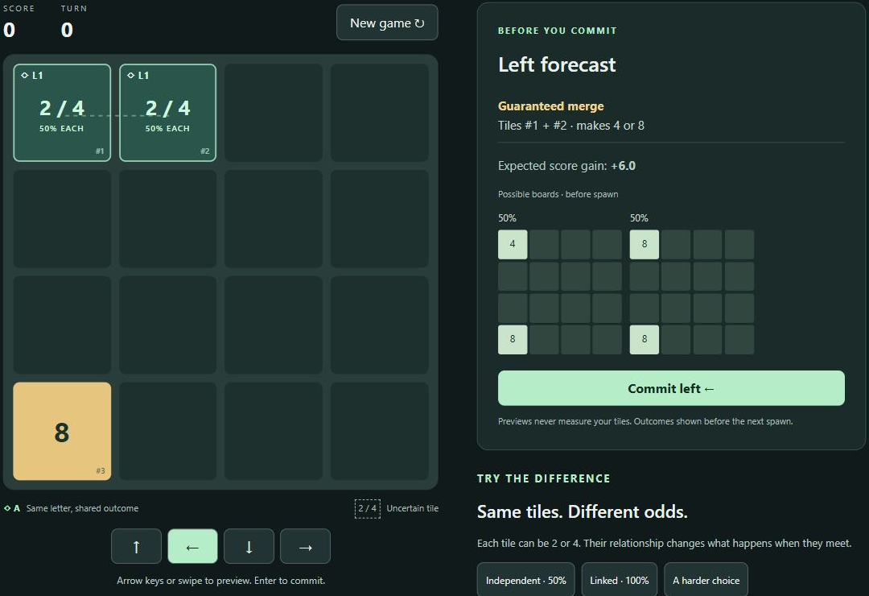
A forecast before every commitment
Choose a direction.
Read the chances.
Commit the move.
Lettered links work without color.
Outcome boards show movement and possible merges.
Measurement happens on contact.
02
Notes:
0:25–1:00. Opening instruction: Swipe to combine matching numbers. Linked tiles share their fate—use the connection to plan your merges. Select a direction with arrows, buttons, or a swipe; inspect forecast; press Enter or Commit. Screenshot is from the real local application. Demonstrate linked left forecast then commit. Possible boards exclude next spawn. Use notebook sections 2–4 if browser fails.

Slide 3
Same individual odds. Different joint outcomes.
INDEPENDENT
LINKED BELL PAIR
50%
100%
Four equally likely outcomes
22 24 42 44
Two equally likely outcomes
22 44
Expected score gain: +3
Expected score gain: +6
03
Notes:
1:00–1:35. Each tile is equally likely to become 2 or 4 in both cases. Independent basis outcomes have probability one quarter each. Matching 00 and 11 total one half. Bell basis outcomes 00 and 11 have probability one half each: guaranteed match, but uncertain result 4 or 8. Correlation can be reproduced classically. These statistics alone do not certify entanglement. Exact results from notebook section 2 and quantum2048.py.

Slide 4
The cost of keeping a pair
Merge now
Preserve the connection
An outside contact can earn points.
It also reveals the distant partner.
Move the pair toward each other.
Spend board space and extra turns.
Tradeoff fixture: left gives expected +2 and resolves the pair.
Up gives +0 and preserves uncertainty before spawning.
Balance and player appeal still require real-user evaluation.
04
Notes:
1:35–2:10. Load A harder choice. Left contacts the outside 2, with expected score +2, and resolves both partners. Up avoids the contact and preserves the two uncertain tiles, expected score zero before spawn. This is a scenario-level tradeoff, not proven strategic depth. Every fourth active turn can spawn two linked tiles, consuming two spaces. No extra score bonus. Preserving requires positioning and extra spawns. Notebook section 5.

Slide 5
One Python core for the game and notebook
Qiskit
Shared game reducer
H and H–CX preparation
Exact basis probabilities
Persistent partial measurement
Clone and enumerate for preview
Measure on committed contact
Slide and merge by the same rules
Browser and notebook import the same model.
Four unresolved qubits keep forecasts small and local.
05
Notes:
2:10–2:45. QuantumGroup prepares H or H-CX and holds Qiskit Statevector. Partial measurement returns the updated state. Forecast enumeration uses exact basis probabilities on clones and the same reducer as committed moves. No gates occur between gameplay Z measurements, so enumeration matches sequential measurement distributions. Browser is a JSON client. At most four unresolved qubits across independent one/two-qubit groups, at most sixteen basis branches. No IBM credentials or Aer needed. Sources: https://quantum.cloud.ibm.com/docs/en/api/qiskit/quantum_info .

Slide 6
Executed evidence
198 / 400
400 / 400
Independent swipes merged
49.5% sampled · 50% exact
Linked swipes merged
100% sampled · 100% exact
Interference comparison
Coherent H–H: P(0) = 1
Dephased before the second H: P(0) = 0.5
Local ideal simulator results. 10 core tests pass.
06
Notes:
2:45–3:20. Ten focused tests pass. Independent actual committed moves merged 198 out of 400 times, linked 400 out of 400. Exact analytical probabilities remain 0.5 and 1.0. Interference: H applied to engine-prepared |+> yields P(0)=1. Dephase first and H gives P(0)=0.5. This establishes coherence in the simulator demonstration, not hardware performance or entanglement certification. Notebook executes all cells from a clean kernel.

Slide 7
Contribution and honest limits
The contribution
The limits
Understandable joint outcomes
Non-measuring visual forecasts
One reproducible technical artifact
Ideal simulator, no hardware run
Classically reproducible match odds
Usability and balance unvalidated
Notebook first. Playable demo alongside it.
07
Notes:
3:20–4:00. Contribution is correlated tile strategy made legible with exact visual forecasting and a shared notebook implementation. Prior Quantum2048 exists. We copied no source/assets from it. Prepared Bell states are entangled, but Z correlations also have a classical explanation. No speedup, hardware execution, educational efficacy, or usability improvement claimed. Close with a reliable local demo. Human must verify AI/reuse policies, upload instructions, cutoff, timing, team names/registration and present live for certificate eligibility. Sources: official Waterloo page, signup page, prior repository.

Slide 8
Appendix · reliable demo and judge questions
90-second demo
Accurate short answers
Linked: guaranteed merge, commit
Independent: 50% forecast
Harder choice: compare left and up
Notebook: coherent vs dephased
Advantage? None demonstrated.
Entanglement proof? Z odds are insufficient.
Preview measurement? No.
Usability gains? Not yet measured.
Fallback: notebook sections 2–6 run without the server or browser.
08
Notes:
Optional, outside four-minute default. Demo in order: Linked > preview left > commit; Independent > preview left; A harder choice > compare left/up; notebook interference. Browser fallback: notebook sections 2–6. Restart returns normal game. Q: Is it quantum advantage? A: No, tiny states and classical simulation, no advantage demonstrated. Q: Are matching outcomes proof of entanglement? A: No, a classical correlated mixture matches Z statistics. Q: Why Qiskit? A: It computes preparation, probabilities, evolution and collapse used by game and notebook. Q: Is this first Quantum 2048? A: No. Prior MIT Unity project cited. Q: Do previews reroll? A: No. Clone enumeration leaves state and RNG unchanged. Q: Did people learn more? A: Not tested; protocol provided.

Slide 9
Appendix · sources and submission readiness
Sources
uwquantum.com/qiskit-fall-fest
uwquantum.com/fall-fest-signup
quantum.cloud.ibm.com/docs/en/api/qiskit/quantum_info
github.com/nirbhaykwatra/Quantum2048
github.com/gabrielecirulli/2048
Human actions
Confirm cutoff, upload, talk length, AI/reuse rules and session time.
Add team identity, register individually, rehearse and present.
AI assisted this work. No source or assets copied from prior games.
09
Notes:
Official requirements checked Nov 6 2026, about 03:36 EST Waterloo. Required notebook and slides, simulator compatible. Individual registration. Live presentation required for chance at physical certificate. Main site session 18:30–21:00 versus signup 17:30–20:30: unresolved conflict, not cutoff. Exact cutoff/upload, talk length, accepted slide extensions, AI and reuse rules not published on accessible pages. Do not submit externally without authorization. AI generated/revised implementation, artifacts and checks. Human review and rehearsal required.

