Slide 1

Az National Trucking Risk Analysis

Slide 2
Problem Statement
To calculate and predict risk factors for drivers based on various factors such as events, total distances travelled, average speeds and mileage.
Identify the risky drivers by analysing the dataset based on various factors like geographic location, vehicles, average mileage, gas consumption, events and risk factors.
To minimize the risks associated with each driver by analyzing their data so that we can help in the reductions of accidents being caused by large commercial trucks causing less injuries and deaths in California.
A1 | A2 | A3 | A4

Slide 3
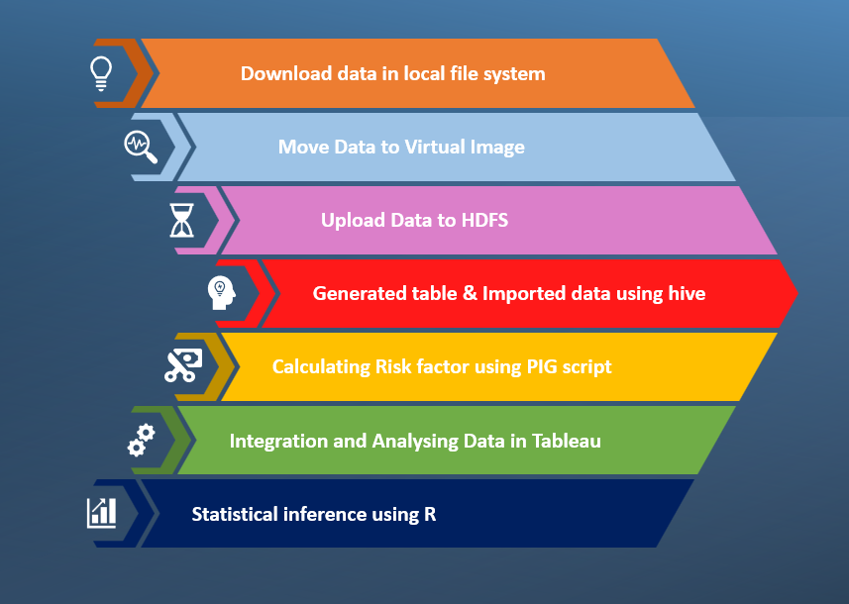
Flow of Events

Slide 4
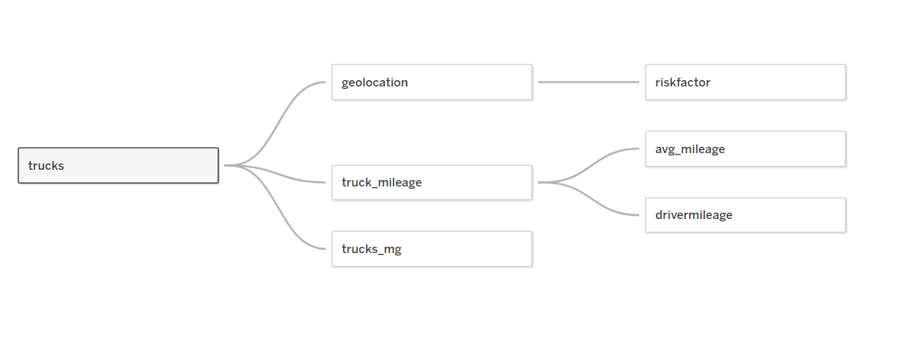
Data Exploration

Slide 5
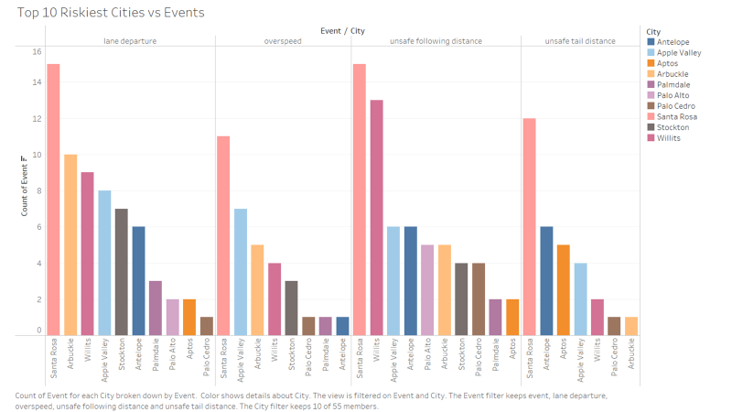
Top 10 Cities vs Events
Santa Rosa has the most number of risky events

Slide 6
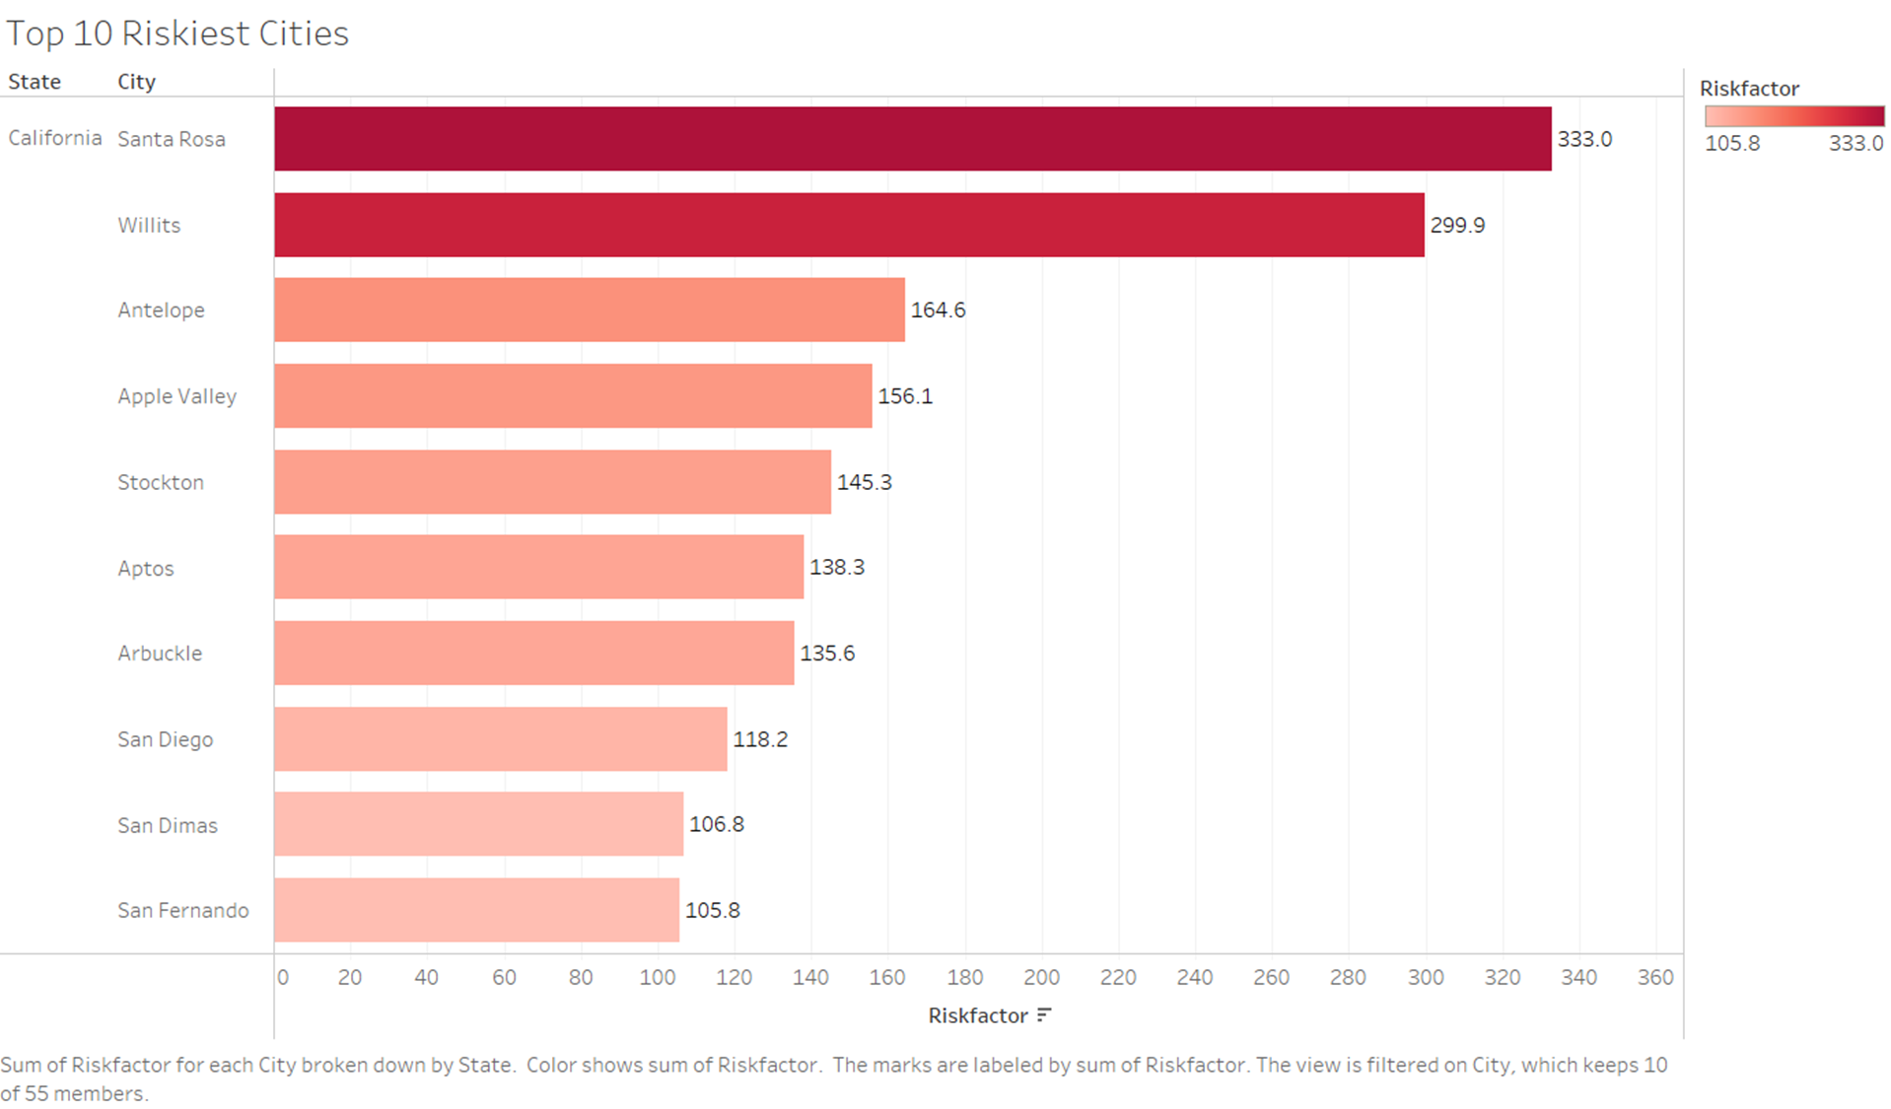
Top 10 Riskiest Cities

Slide 7
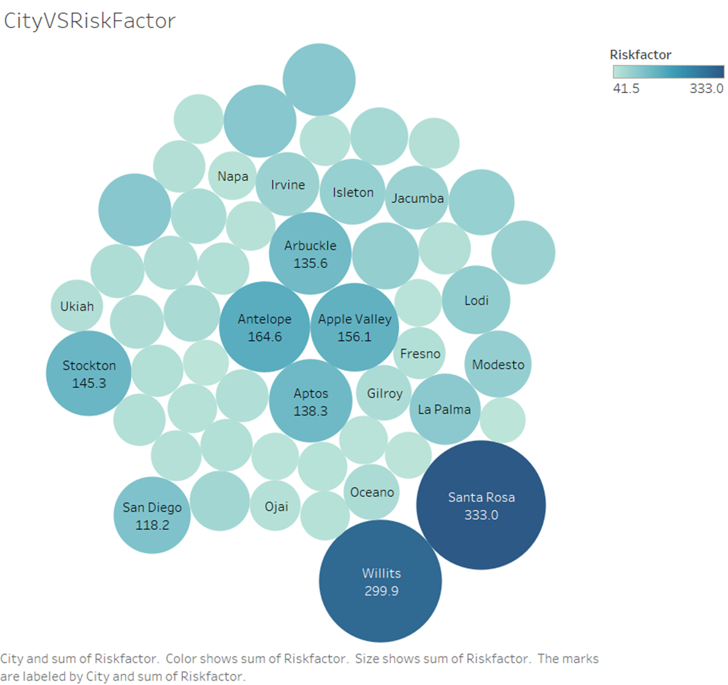
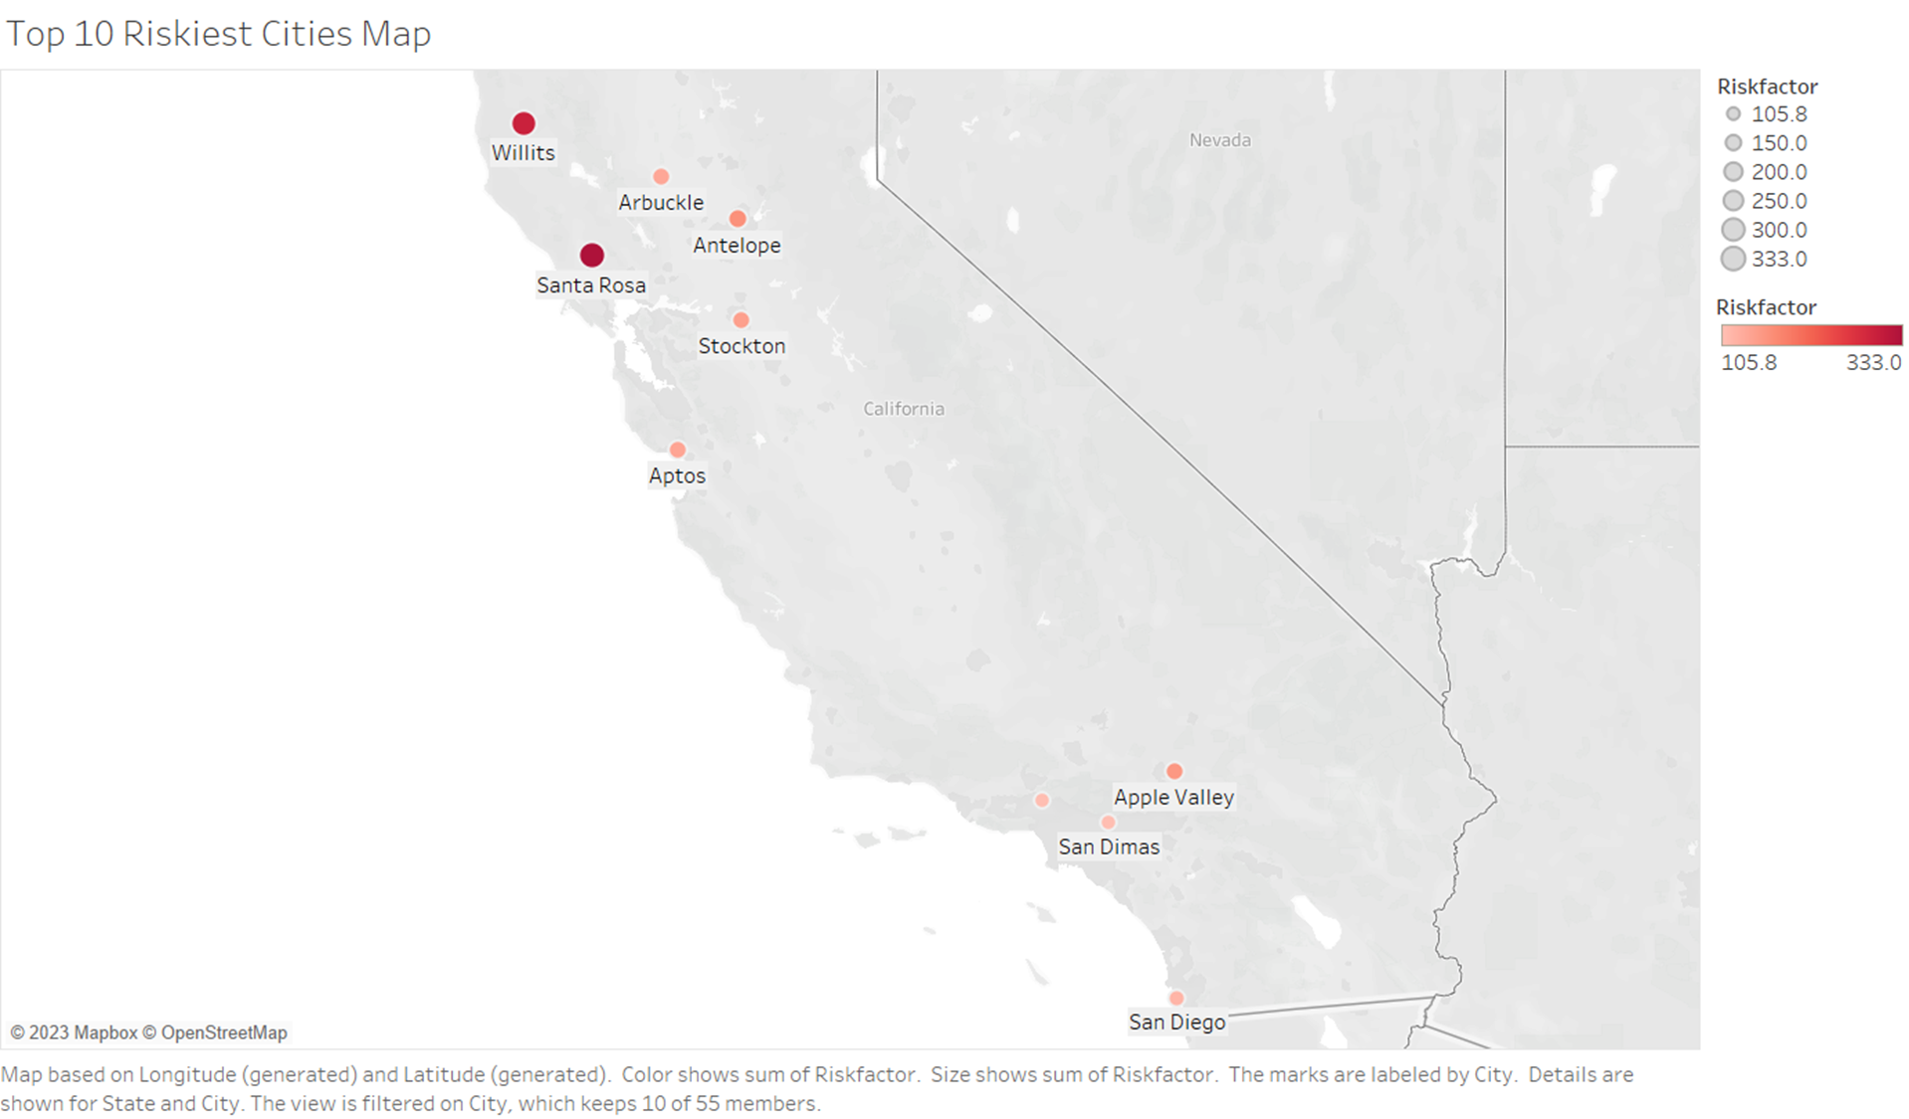
Bubble chart showing the riskiest cities
Santa Rosa and Willits are the most riskiest cities according to the risk factor value.

Slide 8
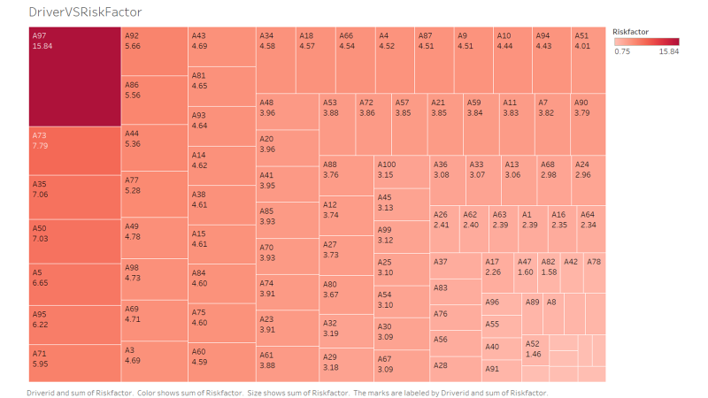
Treemap showing that Driver #A97 is the most riskiest with an extremely high value of 15.84 seems to be an outlier.

Slide 9
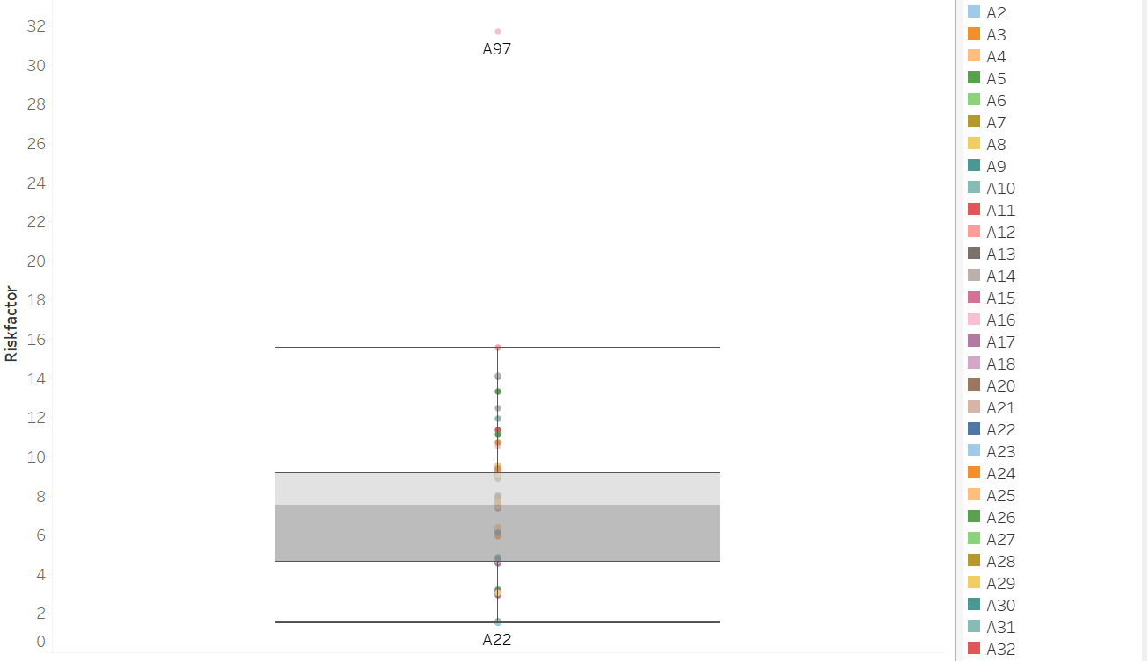
Outlier presence in Dataset??
Yes. Driver A97
How do we address
this outlier?
Remove driver A97

Slide 10
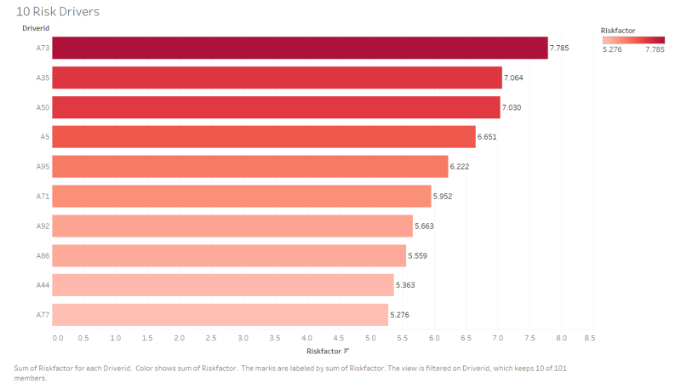
We modelled the top 10 riskiest drivers and A73 is the riskiest driver with a risk factor 7.785

Slide 11
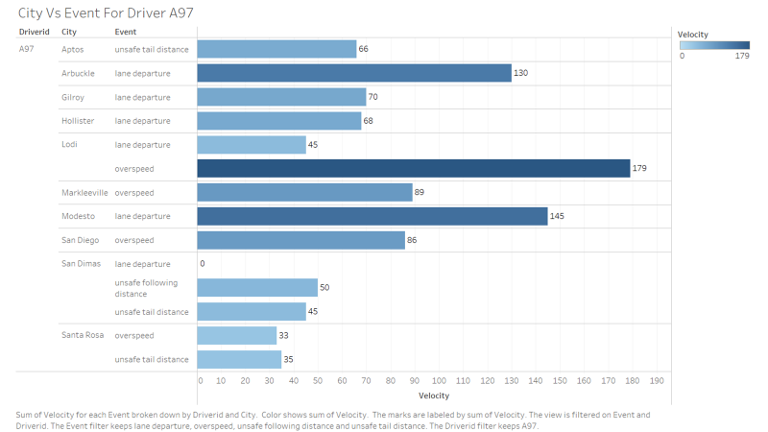
We analyzed the data for Driver A97 for the cities that he travels and his involvements in risky events
Graph showing the details for Driver A97

Slide 12
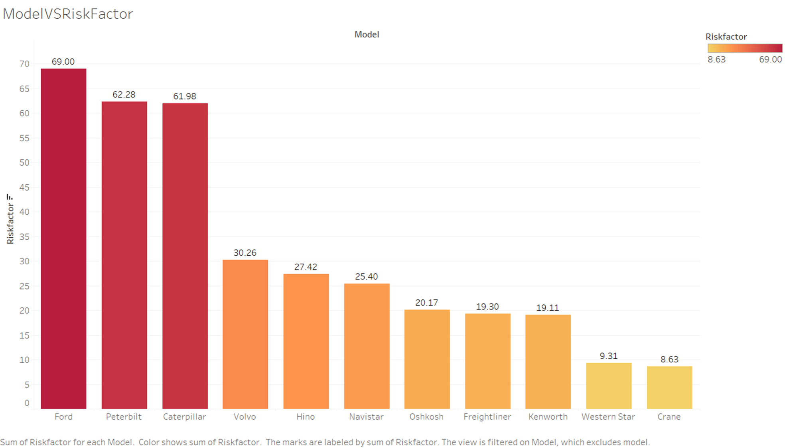
Top 10 Risky Truck Models

Slide 13
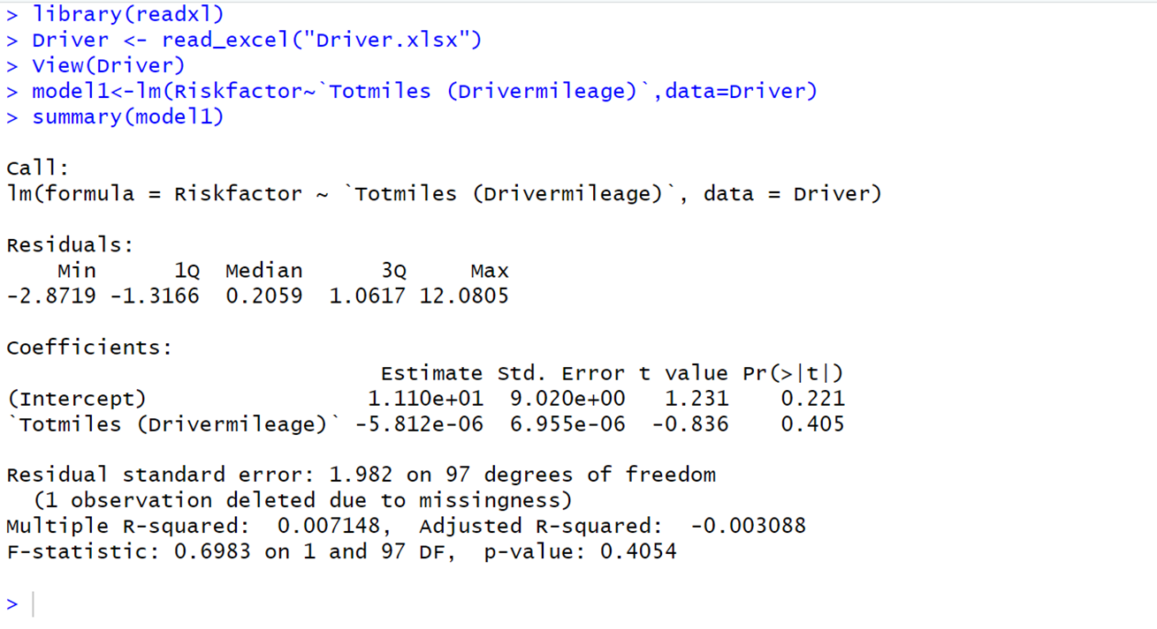
Integration with R and analysis

Slide 14
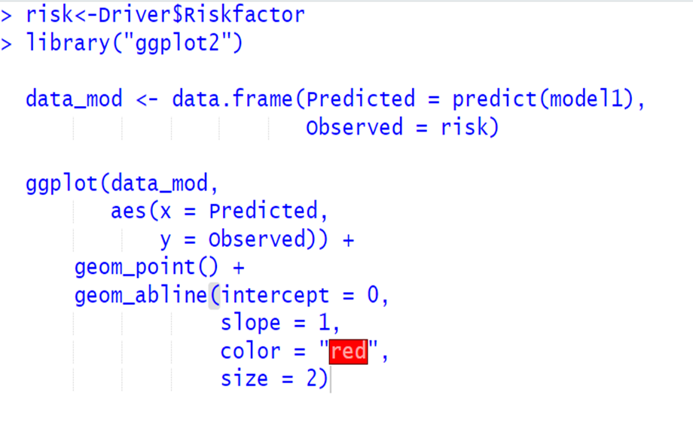
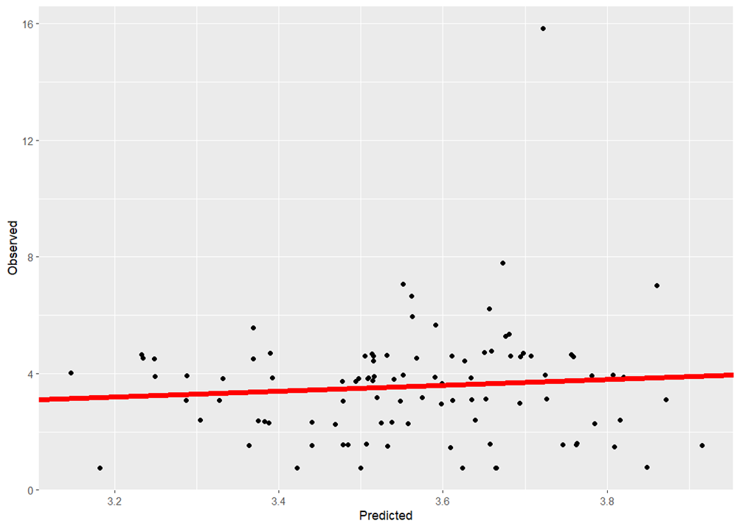
Predicted Risk Values vs Observed Risk Values

Slide 15
Conclusion
Santa Rosa has highest number of risky events and risk factor.
Model Ford has highest risk factor of 69.0
Driver A97 and A73 have highest risk factor along with number of events
From R integration it is observed that using different parameters compared to given data also had similar predicted values.

