Slide 1
Virtual Lans

Slide 2
Overview
VLAN Basics
VLAN Types
Identifying VLANs
VLAN Trunking Protocol
Routing between VLANs
Configuring VLANs

Slide 3
VLAN Basics
A VLAN is a group of network services not restricted to a physical segment or LAN switch.
Configuration or reconfiguration of VLANs is done through software.
VLANs increase overall network performance by logically grouping users and resources together.
VLANs are powerful tools for network administrators.
A group of users needing high security can be put into a VLAN so that no users outside of the VLAN can communicate with them.

Slide 4
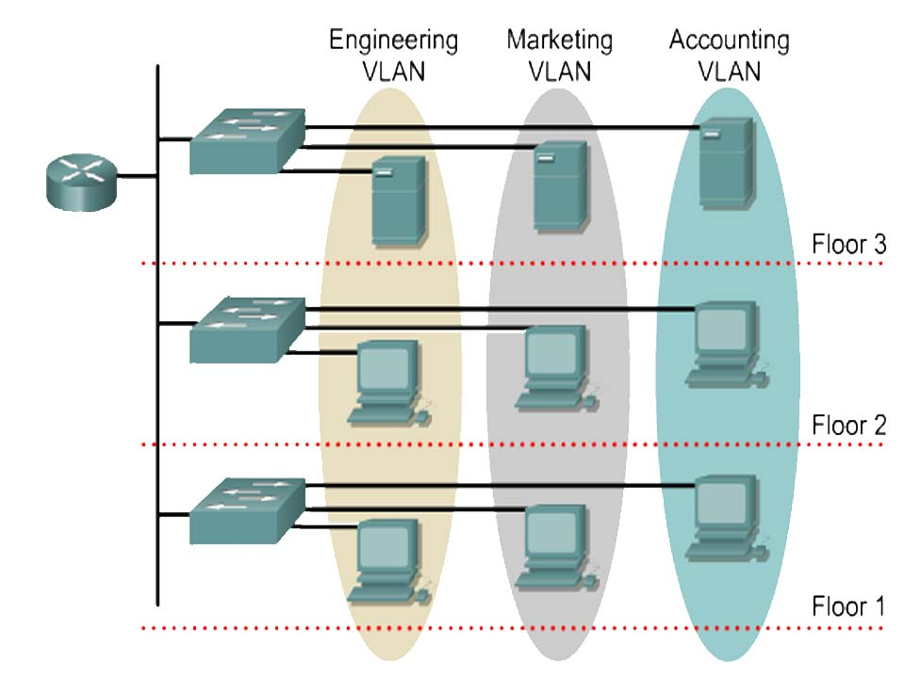
VLAN

Slide 5
VLAN Types
Static VLANs:
The switch port that you assign a VLAN association to always maintains that association until an administrator manually changes that port assignment.
Dynamic VLANs:
Are created through network management software.
CiscoWorks 2000 or CiscoWorks for Switched Internetworks is used to create Dynamic VLANs.
Allow for membership based on the MAC address of the device connected to the switch port.

Slide 6
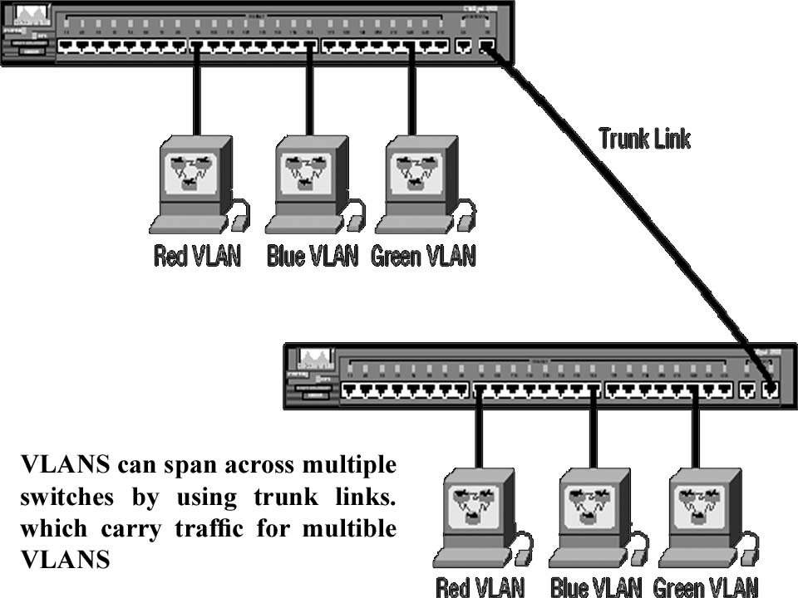
Identifying VLANs
There are two different types of links in a switched environment:
Access links: This type of link is only part of one VLAN.
Trunk links: Trunks can carry multiple VLANs and originally gained their name after system trunks that carry multiple VLANS. A trunk link is a 100- or 1000Mbps point-to-point link between two switches, between a switch and router,

Slide 7
VLAN Trunking Protocol
The basic goals of VLAN Trunking Protocol (VTP) are to manage all configured VLANs across a switched internetwork.
Here’s a list of some of the benefits VTP has to offer:
Consistent VLAN configuration across all switches in the network.
VLAN trunking over mixed networks.
Accurate tracking and monitoring of VLANs.
Dynamic reporting of added VLANs to all switches in the VTP domain.

Slide 8
VTP Modes of Operation
This is the default for all Catalyst switches. You need at least one server in your VTP domain to propagate VLAN information throughout the domain. The switch must be in server mode to be able to create, add, or delete VLANs in a VTP domain. Changing VTP information must also be done in server mode, and any change made to a switch in server mode will be advertised to the entire VTP domain. | Server
In client mode, switches receive information from VTP servers, and they also send and receive updates. Can’t make any changes. | Client
Don’t participate in the VTP domain, but they’ll still forward VTP advertisements through any configured trunk links. The purpose of Transparent mode is to allow remote switches to receive the VLAN database from a VTP Server | Transparent

Slide 9
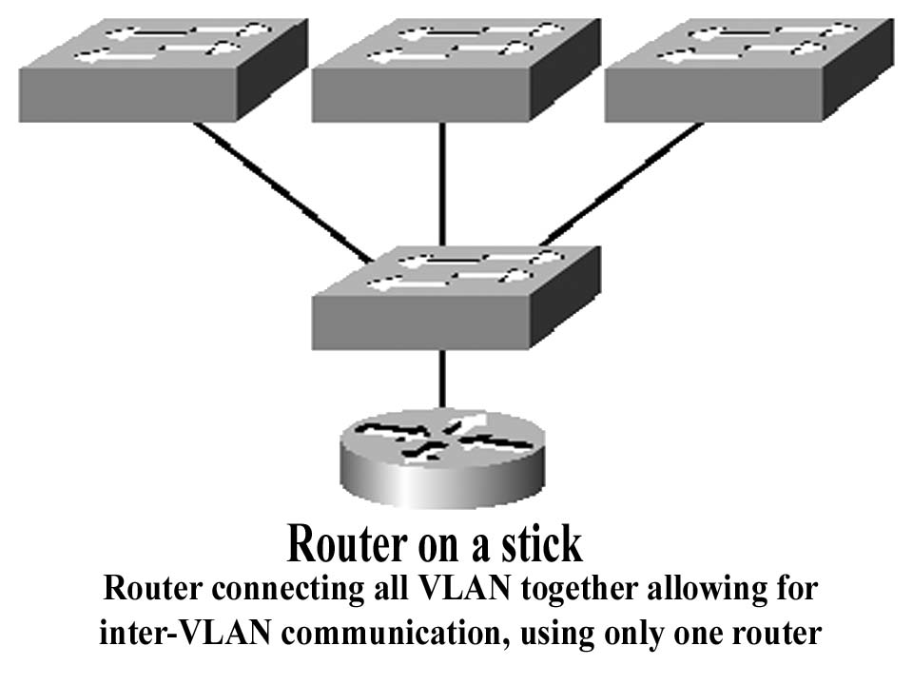
Routing between VLANs
If you want hosts or any other IP-addressable device to communicate between VLANs, a Router is absolutely necessary.
For this, you can use a router that has an interface for each VLAN.
Instead of using a router interface for each VLAN, you use one Fast Ethernet interface and run ISL or 802.1Q trunking.
This allows all VLANs to communicate through one interface. Cisco calls this a “router on a stick”.

Slide 10
Configuring VLANs
Create VLAN
1900 Switch
1900(config)#vlan 2
1900(config)#vlan 3
2950 Switch
Switch(config)#vlan 2
Switch(config-vlan)#vlan 3
You can’t change, delete, or rename VLAN 1, because it’s the default VLAN.

Slide 11
Configuring VLANs
Assigning Switch Ports to VLANs
1900 Switch
1900(config)#int e0/2
1900(config-if)#vlan-membership static 2
2950 Switch
Switch(config-if)#int f0/2
Switch(config-if)#switchport access vlan 2
If you want to verify your configuration, use this:
Switch#sh vlan

Slide 12
Configuring VLANs
Configuring Trunk Ports
1900 Switches
1900(config)#int f0/26
1900(config-if)#trunk on
2950 Switches
Switch(config)#int f0/12
Switch(config-if)#switchport mode trunk

Slide 13
Configuring VLANs
Configuring Inter-VLAN Routing
Router#config t
Router(config)#int f0/0
Router(config-if)#no ip address
Router(config-if)#no shutdown
Router(config-if)#int f0/0.1
Router(config-subif)#encaps dot1q 1 -----> VLAN 1
Router(config-subif)#ip address 192.168.10.100 255.255.255.0
Router(config-subif)#int f0/0.2
Router(config-subif)#encaps dot1q 2 -----> VLAN 2
Router(config-subif)#ip address 192.168.20.100 255.255.255.0

Slide 14
Configuring VTP
1900 Switch
1900(config)#vtp server ------> default
1900(config)#vtp domain orbits
2950 Switch
Switch(config)#vtp mode server ------> default
Switch(config)#vtp domain orbits

Slide 15
Troubleshooting VTP
Study the output from the two switches below:
SwitchB#sh vtp status VTP Version : 2 Configuration Revision : 1 Maximum VLANs supported locally : 64 Number of existing VLANs : 7 VTP Operating Mode : Server VTP Domain Name : GlobalNet VTP Pruning Mode : Disabled VTP V2 Mode : Disabled VTP Traps Generation : Disabled | SwitchA#sh vtp status VTP Version : 2 Configuration Revision : 0 Maximum VLANs supported locally : 64 Number of existing VLANs : 7 VTP Operating Mode : Server VTP Domain Name : RouterSim VTP Pruning Mode : Disabled VTP V2 Mode : Disabled VTP Traps Generation : Disabled

Slide 16
Troubleshooting VTP
Study the output from the switch below:
You are trying to create a new VLAN on Switch, but you get an error! Why? | SwitchC#sh vtp status VTP Version : 2 Configuration Revision : 1 Maximum VLANs supported locally : 64 Number of existing VLANs : 7 VTP Operating Mode : Client VTP Domain Name : Todd VTP Pruning Mode : Disabled VTP V2 Mode : Disabled VTP Traps Generation : Disabled

