Slide 1


IST 718:Distinguishing Between Malicious And Benign Traffic On IOT Devices
With guidance of Prof. Daniel Acuna
Group Members: Parth Patel, Dishank Solanki, Pawan SP

Slide 2
Problem Description & Data Description
Problem Description:
Companies are introducing new iot devices into the market every now and then without thinking much about security system. This leads to extreme acts such as identity thefts.
There is a need to create a model that can detect malicious attacks on IOT devices.
Data Description:
We have considered 4 IOT devices Danmini doorbell, Ecobee thermostat, samsung webcam and Ennio doorbell.
We took subset of 1 million data points for above mentioned devices out of 7 million data points because data was very biased.
There are 117 columns out of which 2 are for label columns.

Slide 3
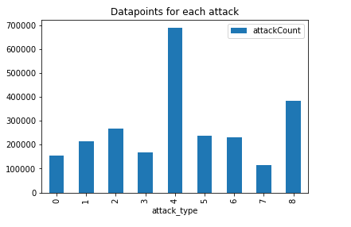
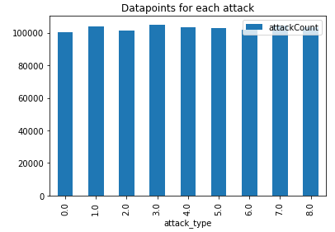
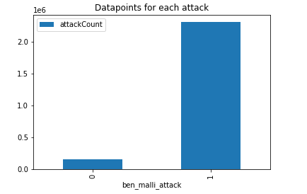
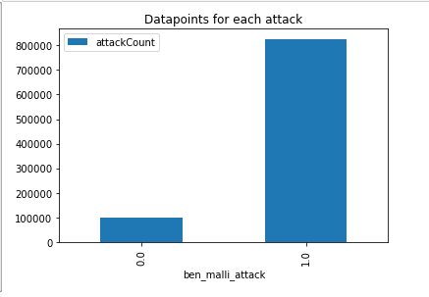
Biased Data
Unbiased Data
Data Splits
Training (0.7) | 648,019
Validation (0.2) | 185,393
Testing (0.1) | 92,790

Slide 4
Data Models
Data Models | Features | Metric
Logistic Regression to classify benign or malicious attack | All | AUC
Random Forest regression to classify benign or malicious attack | All | AUC
Random Forest regression to classify type of attacks | All | AUC
ANN to classify type of attacks | All | AUC

Slide 5
Logistic Regression To Classify Benign Or Malicious Attacks
Data Models | Parameters | Accuracy on test | Precision On test | Recall on test | F1 measure on test | AUC on validation
Logistic Reg | Regularize Parameter = 0.1 Elastic Parameter = 0.2 | 0.9988 | 0.9988 | 0.99 | 0.9989 | 0.999
Logistic Reg | Regularize Parameter = 0.2 Elastic Parameter = 0.4 | 0.8985 | 0.8979 | 0.999 | 0.9461 | 0.998
Logistic Reg | Regularize Parameter = 0.3 Elastic Parameter = 0.5 | 0.8922 | 0.892 | 1.0 | 0.943 | 0.752

Slide 6
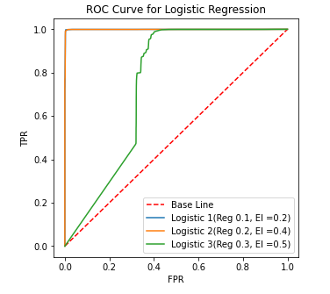
ROC Curves For Logistic Regression

Slide 7
Random Forest Regression To Classify Benign Or Malicious
Data Models | Parameters | Accuracy | Precision | Recall | F1 measure | AUC
Random Forest | Max Depth = 30, Number Of Trees = 100 | 0.8922 | 0.892 | 1.0 | 0.943 | 0.9357

Slide 8
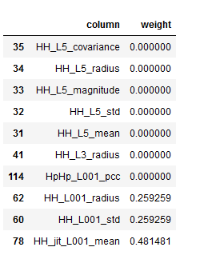
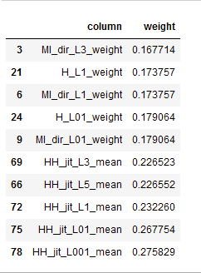
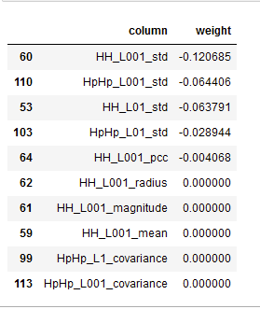
Feature Importance For Logistic Regression model 1 And Random Forest Regression
Random Forest Feature Importance
Logistic Regression Feature Importance: Positive coefficients
Logistic Regression Feature Importance:Negative coefficients

Slide 9
Random Forest Regression To Classify Type Of Attacks
Data Model | Parameters | Accuracy | AUC
Random Forest | Default Values | 0.112 | 0.02

Slide 10
Deep ANN To Classify Type Of Attack
Data Models | Parameters | Accuracy on test | AUC
Multi Layer Perceptron | Step Size 0.01 Max Iteration = 400 Layers = 3 (Hidden)+1(Output) Node Structure = 115 input => 40 nodes=> 40 nodes=> 15 nodes => 9 output nodes | 0.882 | 0.873

Slide 11

Conclusion
Deep Neural Network works well to classify types of attack.
Logistic Regression works well for binary classification of benign and malicious attack with suspected overfitting.
Validation VS Training.

Slide 12
THANKS!
Any questions?

