Slide 1
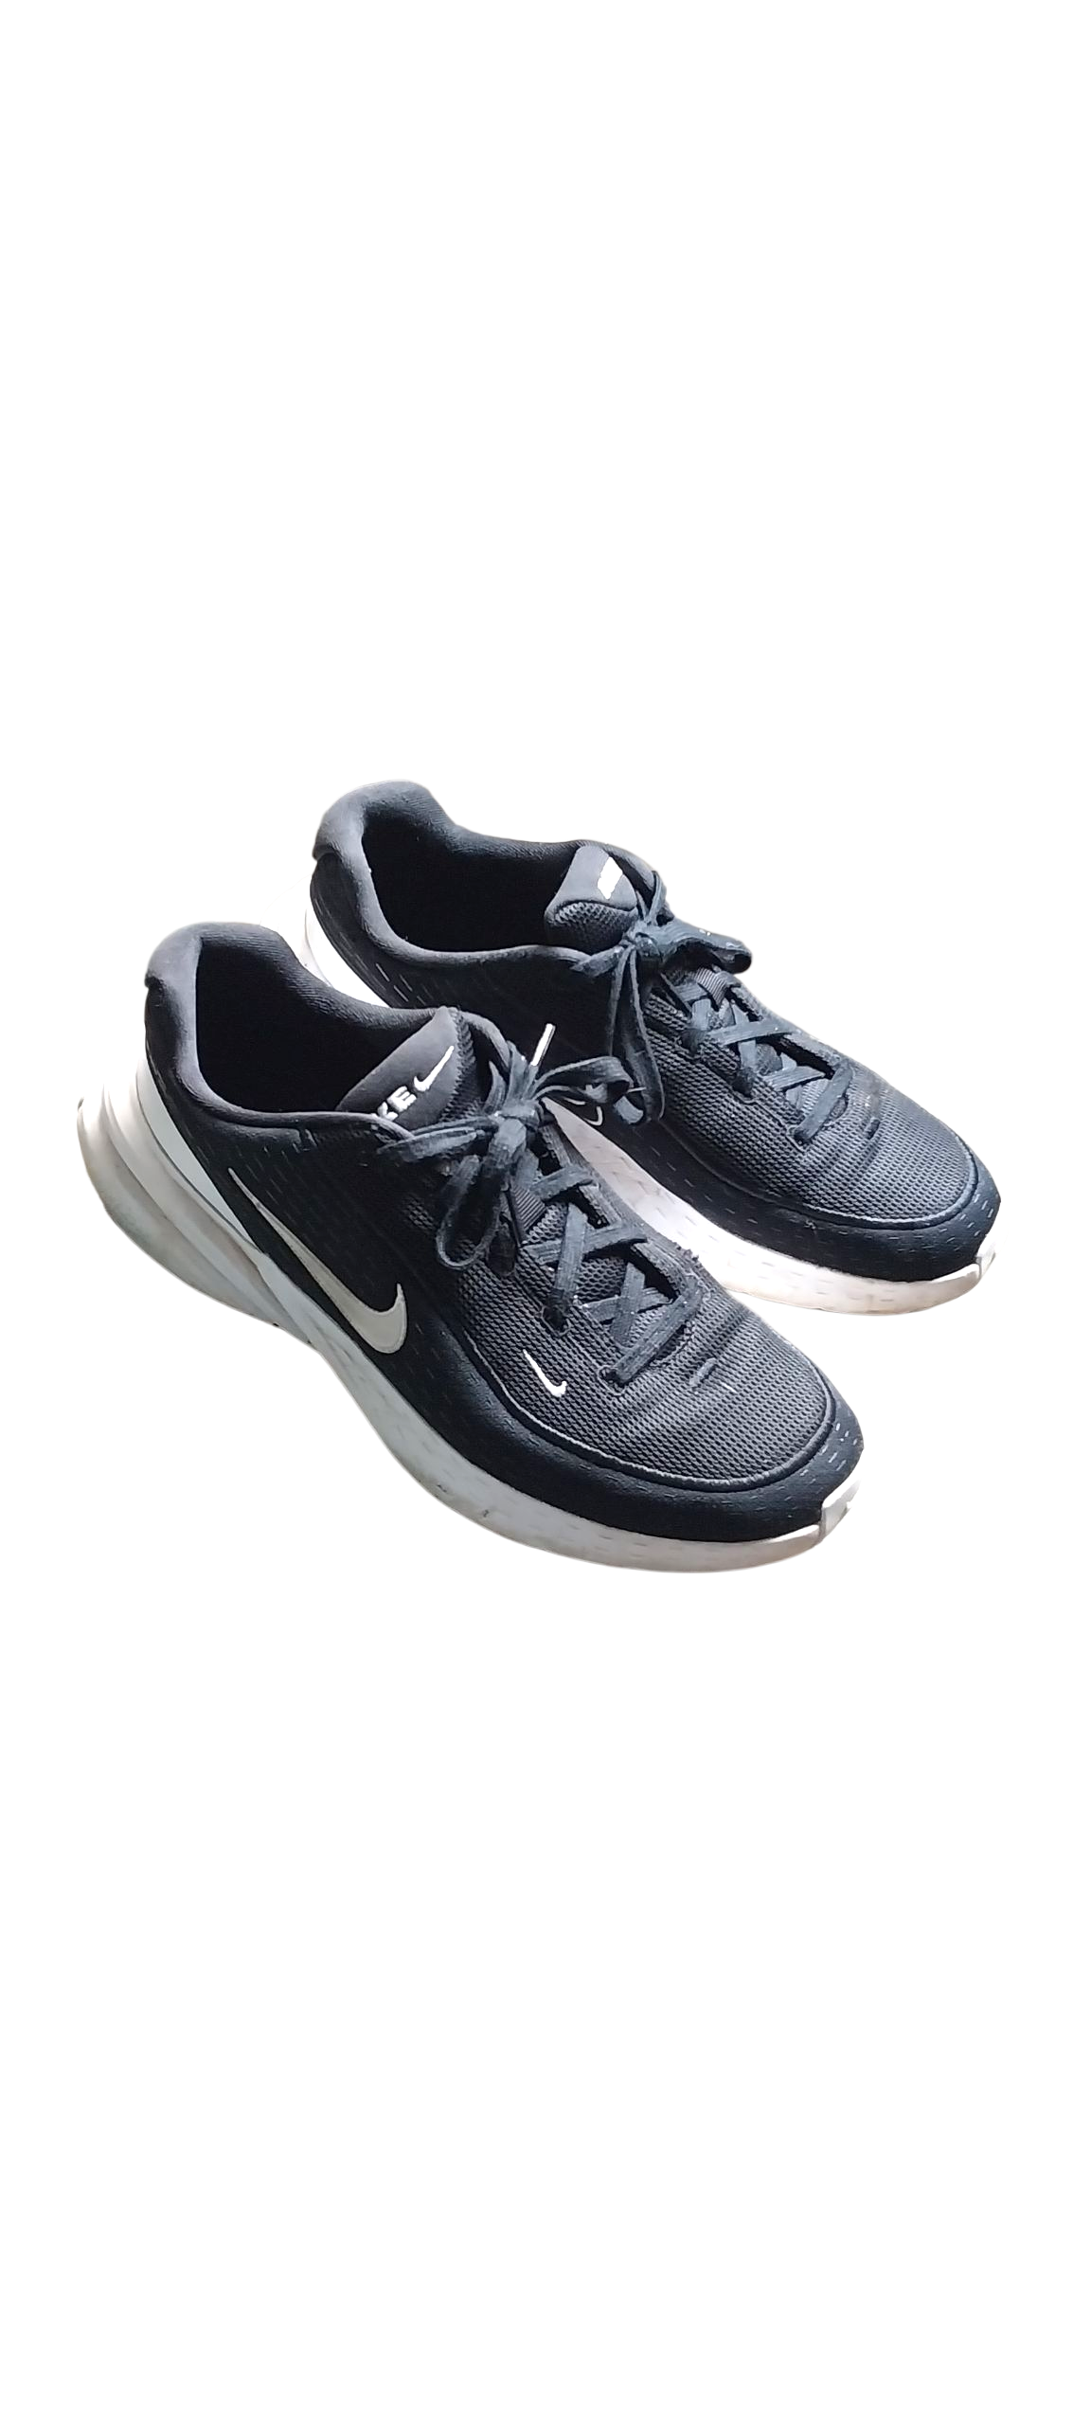
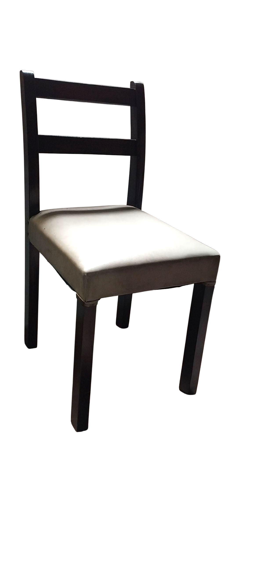
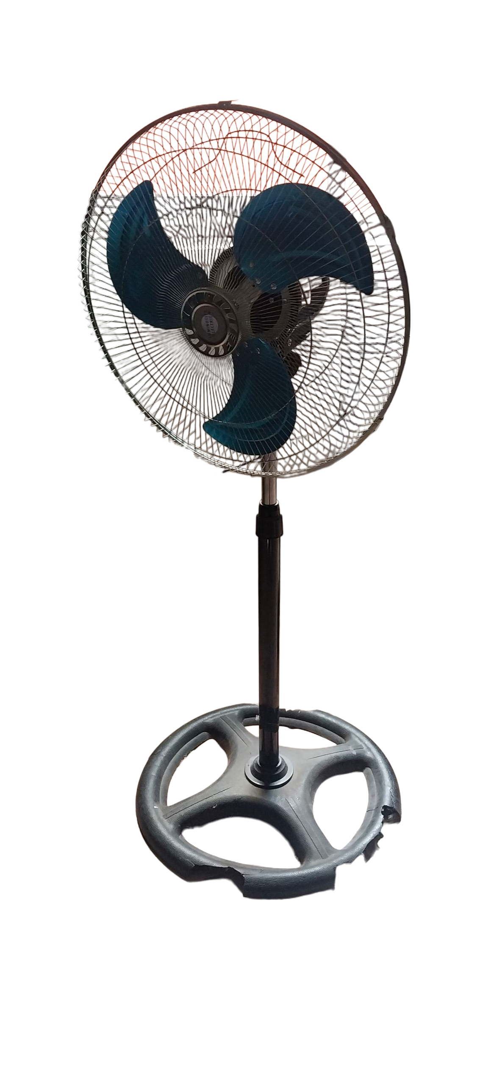
Silla de madera ZUREA
Z0003
₡10 000
Ventilador LUMINOSITY ELECTRIC
Z0001
₡15 000
Tennis NIKE Phylon Cushion Talla 12 US
Z0002
₡30 000

