Slide 1
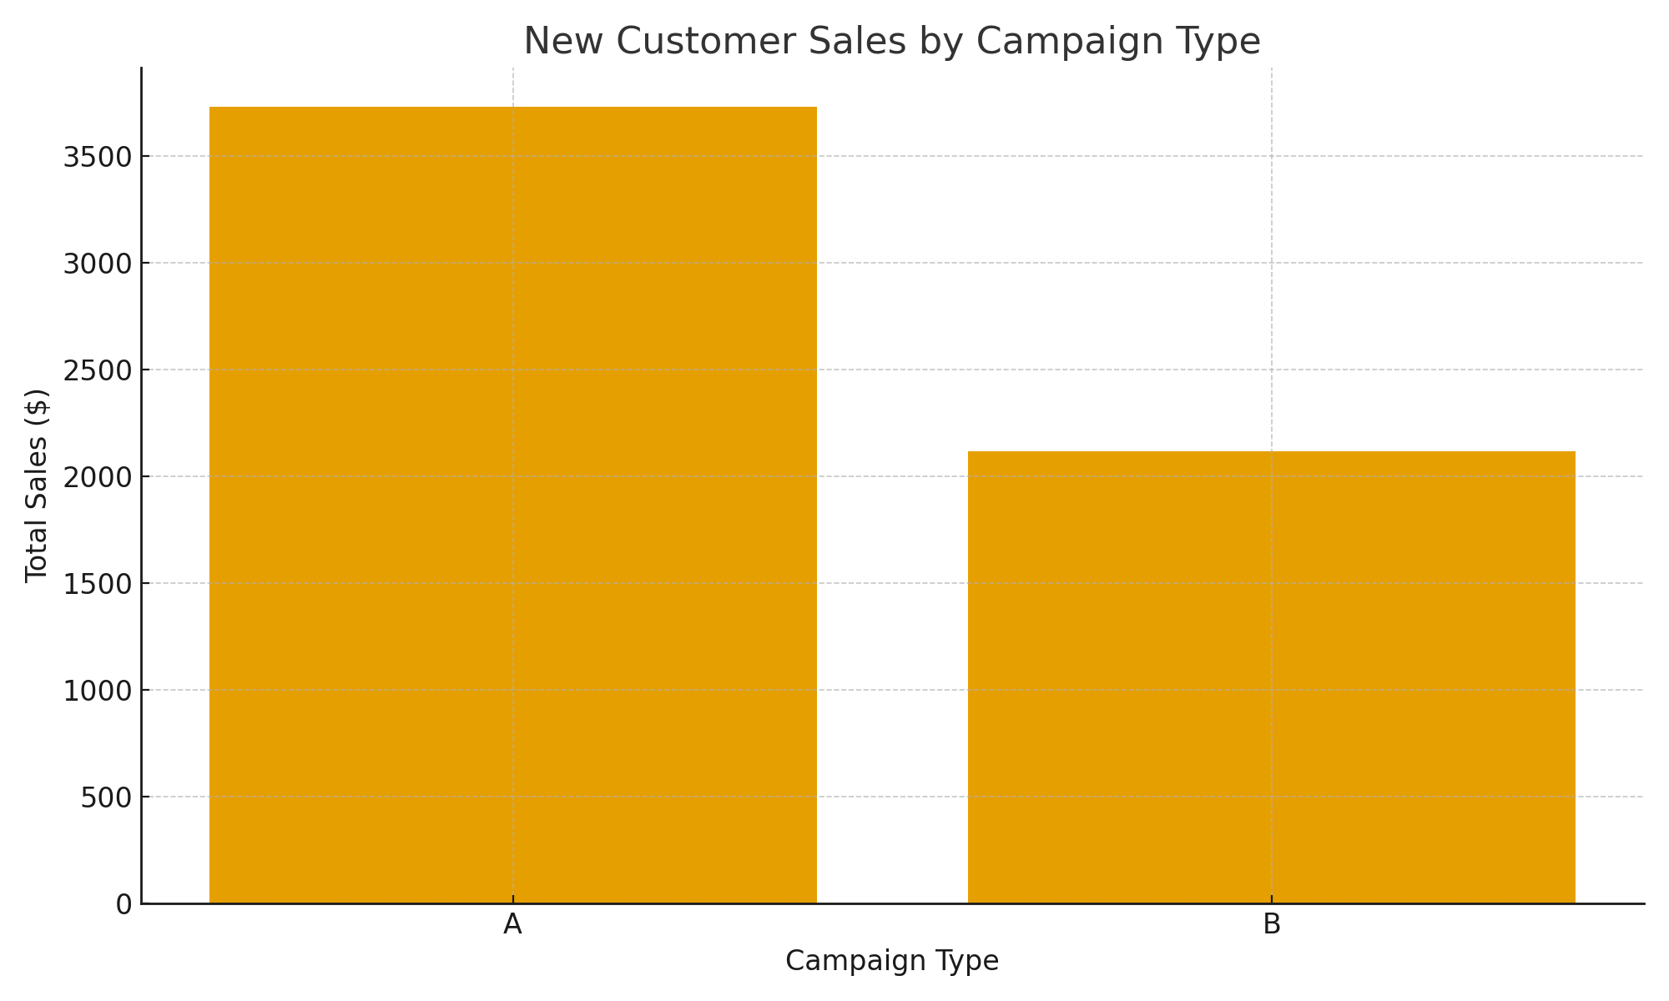
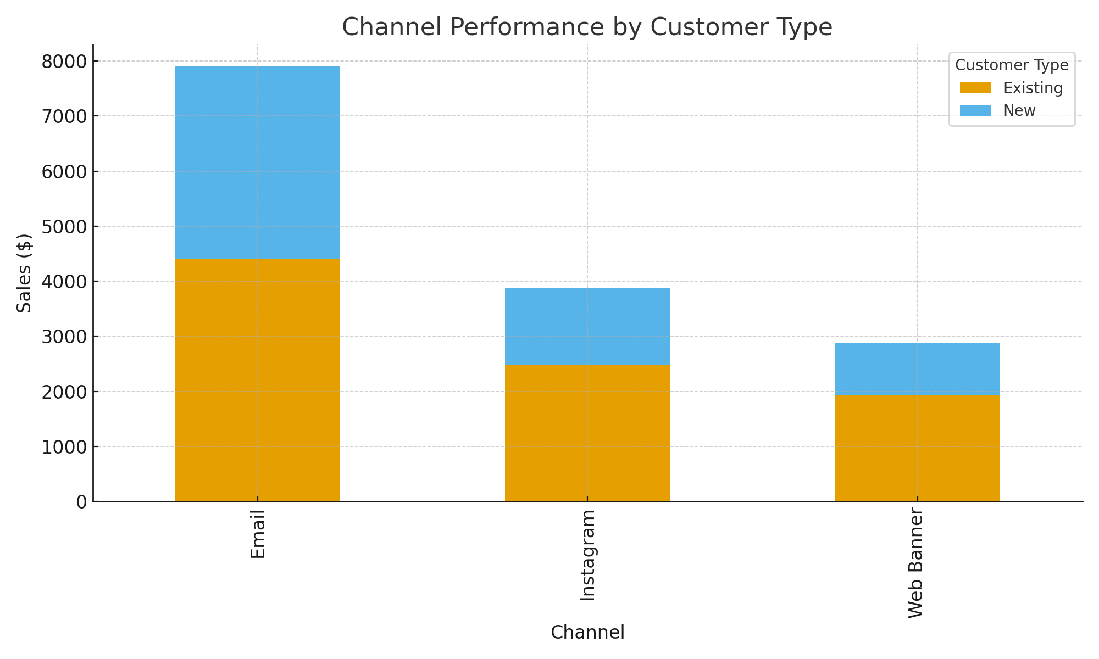
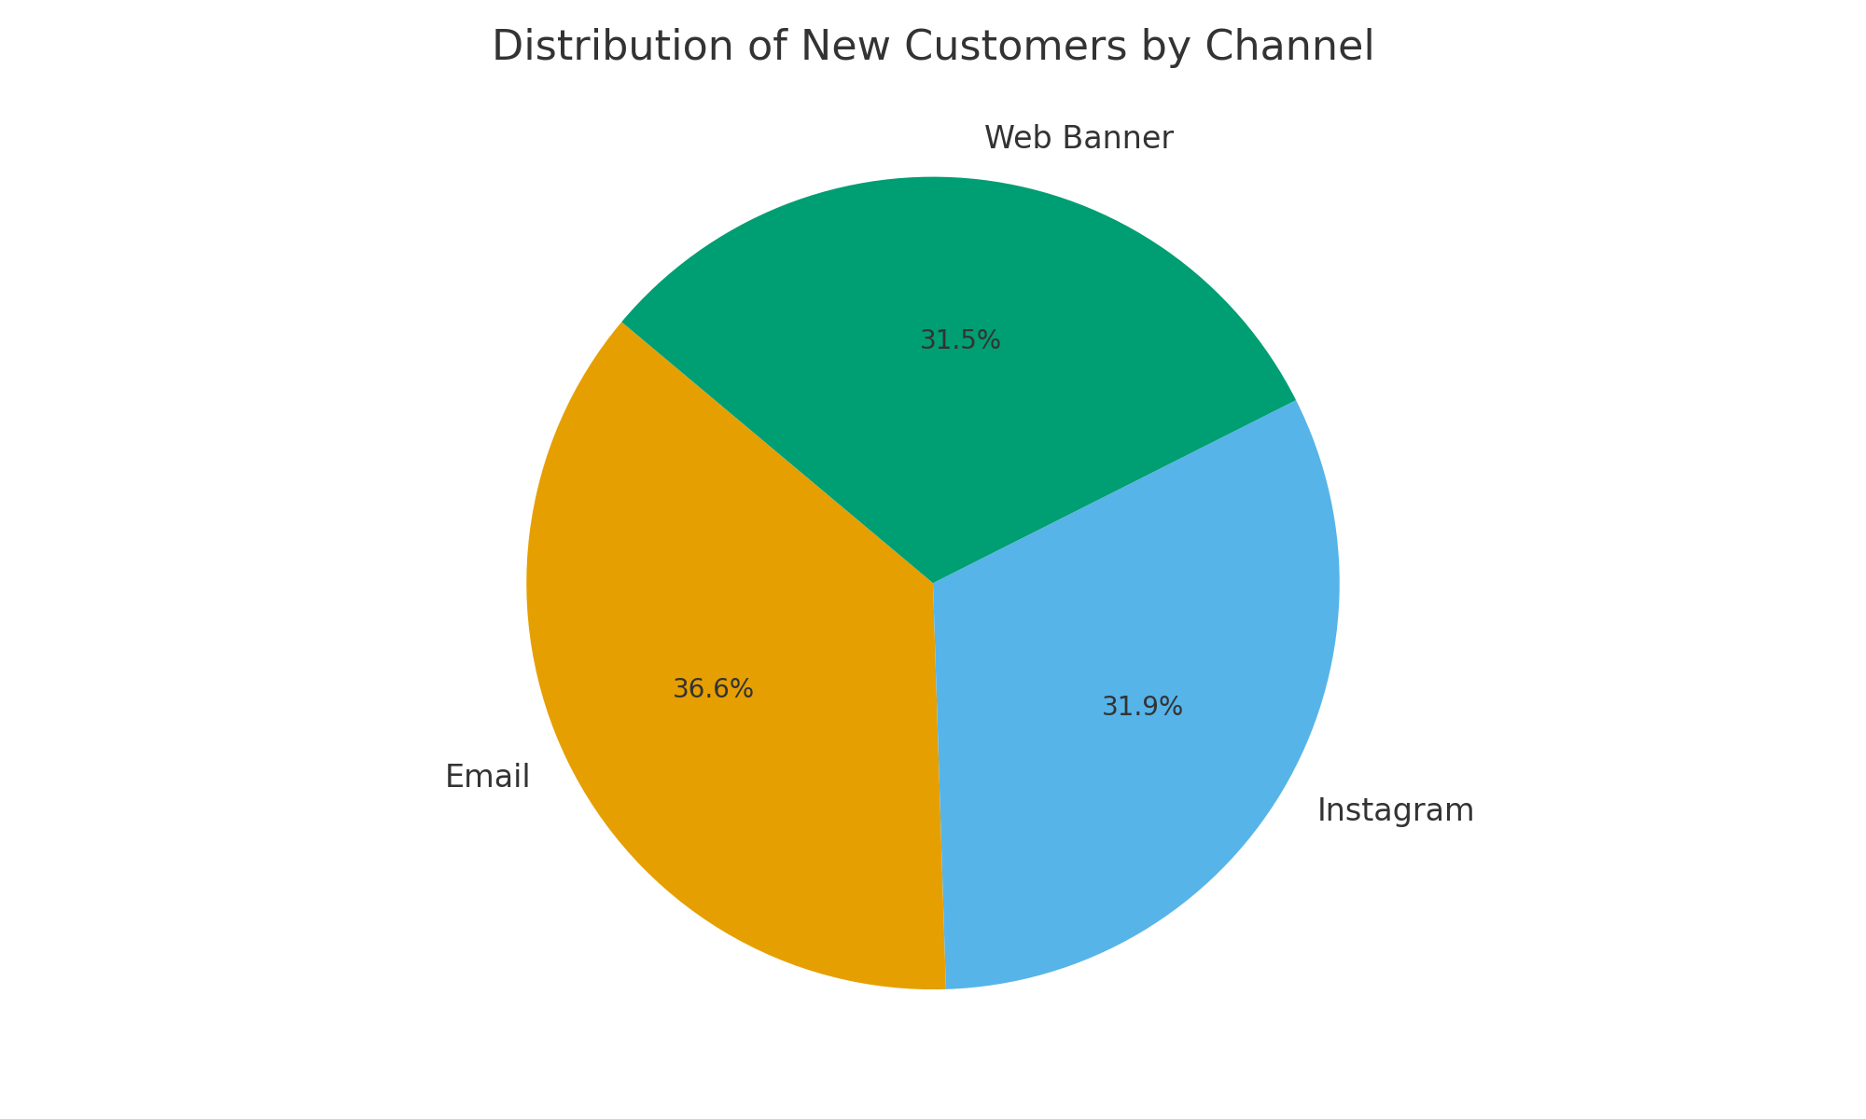
[Doubling Down on Channel + Campaign Combo]
[Clustered Column Chart]
[Stacked Bar Chart]
[Pie Chart]
Recommendation: The results show that Campaign Type A generated the highest sales among new customers, clearly outperforming Campaign Type B. Email was the strongest overall channel, driving both the highest revenue and the largest share of new customers. Instagram and Web Banner contributed moderate results, with smaller sales impact. Overall, focusing on Campaign A and enhancing Email marketing strategies could further boost new customer acquisition and revenue growth.

