Slide 1



onprint
b
Bea Carroll, Dáre Soniran, Helena Blackmore, Iwona Izdebska & Maria Lavrentyeva
Mentors: Matt Cherry & Tiarni Wilson
Notes:
We are Bea, Dáre, Helena, Iwona and Maria – and we have created bonprint.
Bonprint is an app that allows employees to create and participate in challenges to build lifestyles that reduce your carbon footprint as well as learn and support your colleagues on their journey.
This app aims to promote building lifestyles that reduce your carbon footprint and educate you on the reasons why.

Slide 2
We are committed to supporting our clients and partners in the transition to a decarbonised future, to help rebuild communities impacted by climate change and natural catastrophes, and become a more sustainable business. (Beazley, 2021)
b
onprint
Notes:
A carbon footprint is the total greenhouse gas (GHG) emissions caused directly and indirectly by an individual, organisation, event or product. It is calculated by summing the emissions resulting from every stage of a product or service’s lifetime.
With Millennials and Gen Z concerned about social impact in all aspects of their life, why not an app to help your employees at an individual level?

Slide 3
“I’m passionate about caring for this planet. I’d like to bring awareness to ways that individuals can reduce their carbon footprint without waiting for governments to change things on a policy level.” (Laura Regan, Actor)
b
onprint
Notes:
Did you know that there are so many simple things that can be done to change our carbon footprint, or at least to reduce our carbon footprint.
The University of Michigan found that:
A vegetarian diet greatly reduces an individual’s carbon footprint, but switching to less carbon intensive meats can have a major impact as well.
Switching to a cold-water clothes wash once per week can reduce household GHG emissions by over 30,000 annually
The average passenger car emits 350g of CO₂ per mile driven
https://css.umich.edu/factsheets/carbon-footprint-factsheet

Slide 4





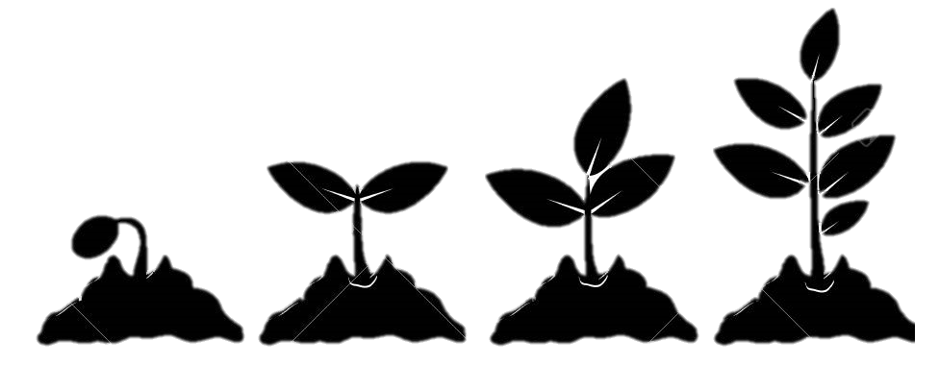
b
onprint
LEARN
CHALLENGE
SHARE
Notes:
A big way to changing behaviour would be to have a space to learn, challenge and share.
There are apps that provide the space for discussion such as Facebook and Twitter, they are already massively successful. However they are prone to misinformation and discussions about the environment can easily get lost. Apps like TikTok contain bitesize clips that you would love to apply but quickly forget.
What if there was an app that would make it simple to get your information about the climate and find challenges to change your lifestyle?
Thanks to bonprint, you can leaf your mark!

Slide 5
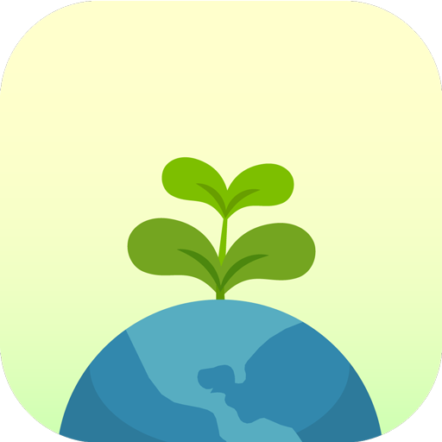
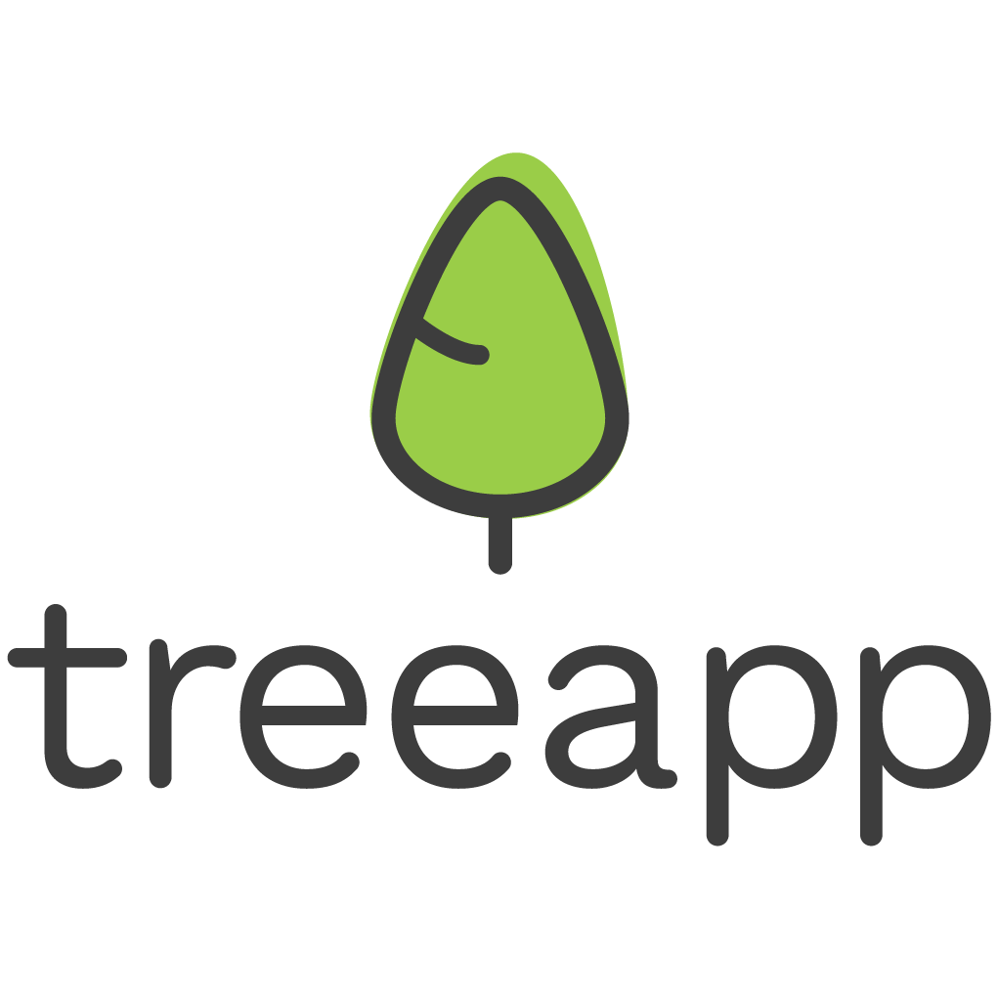






Competition
Education
Social Interaction
Personalisation
*
Notes:
There are a lot of apps that allow you to calculate your carbon footprint. Majority educate you on the importance of reducing your carbon footprint but there is seldom a social interaction and little opportunity for the personalisation of tips and content. So once you have completed the suggested changes, there is nothing keeping users from using the apps.
Why keep the fun at just the beginning? Why not share the lifestyle? Why not push for change with peers and employers?
Leave a good impression on the world with bonprint!
*With internet friends (strangers) not with direct connections.

Slide 6
bonprint
b
onprint
Empowers users to build a carbon conscious lifestyle.
Encourages people to be more carbon curious.
Enables users to interact and motivate each other.
Engages employees to petition changes at their workplace.
Notes:
Bonprint can be described as a cross between Strava and Twitter but environmentally focused.
Cutting through the green tape, our aim is empower employees to build carbon conscious lifestyles, connect with the peers and push for bigger change in their workplace.
Challenges include going vegan for a week, cycling to work, or even deleting your old emails!
Individuals or HR can create challenges among teams or departments to better engage employees with the environmental initiatives.
So while you make personal changes, you can also lobby for wider and more impactful change by pushing for better recycling options, change in canteen menu, or reduction in business flights.

Slide 7
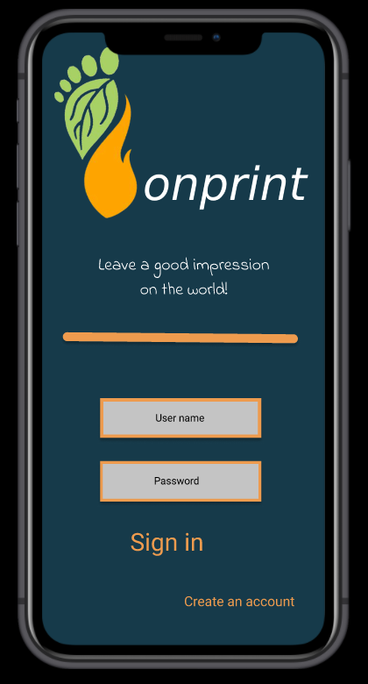

Slide 8
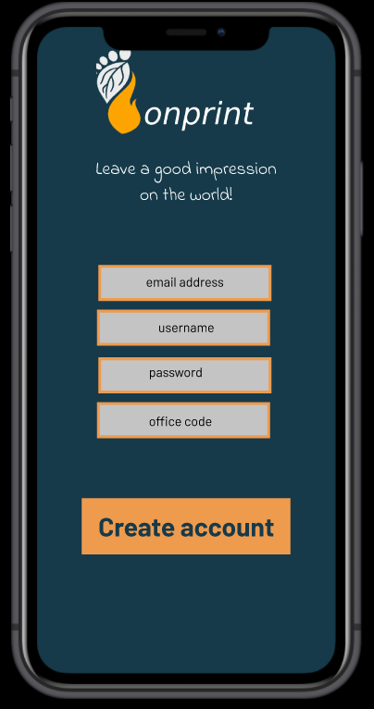

Slide 9
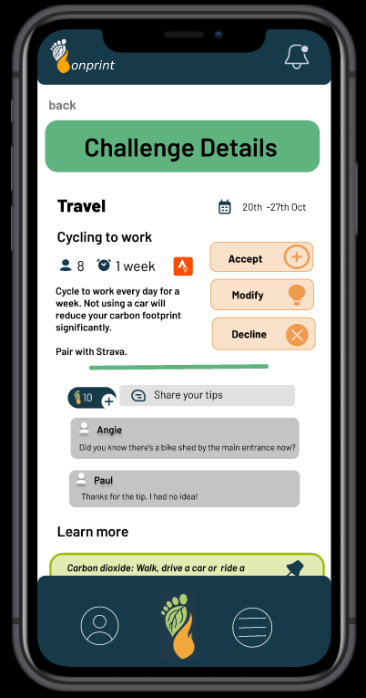

Slide 10
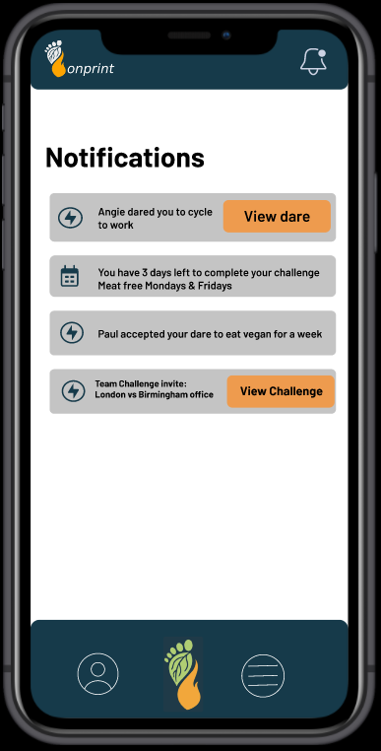

Slide 11
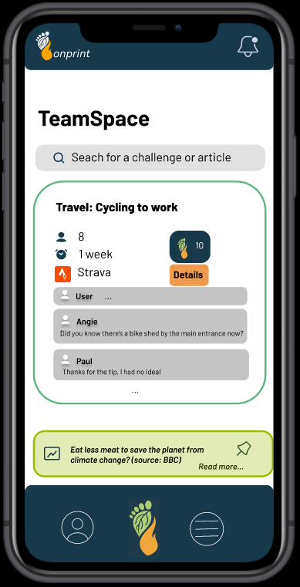

Slide 12
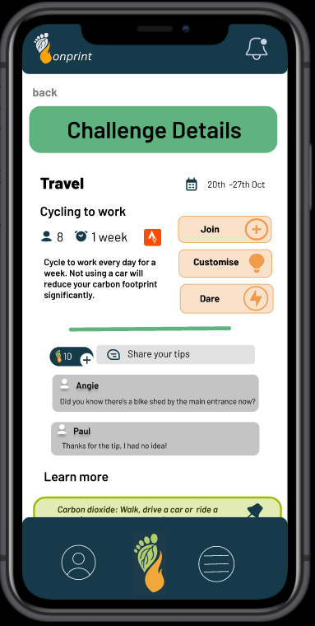

Slide 13
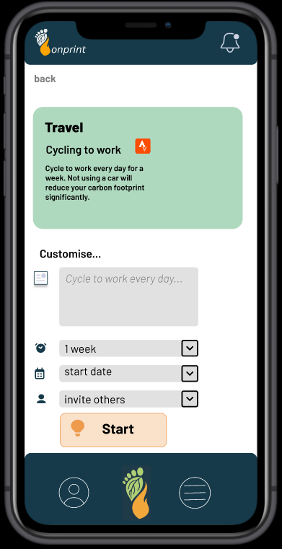

Slide 14
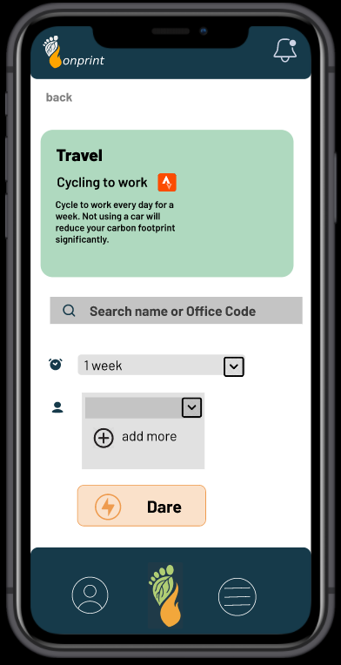

Slide 15
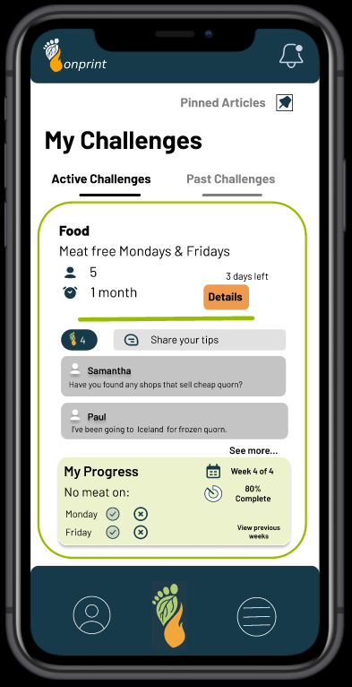

Slide 16
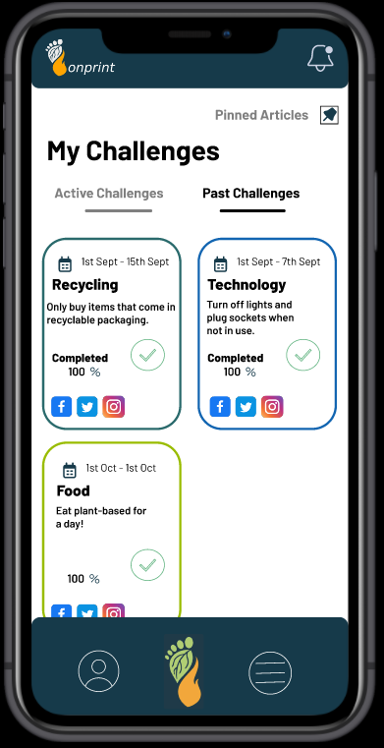

Slide 17
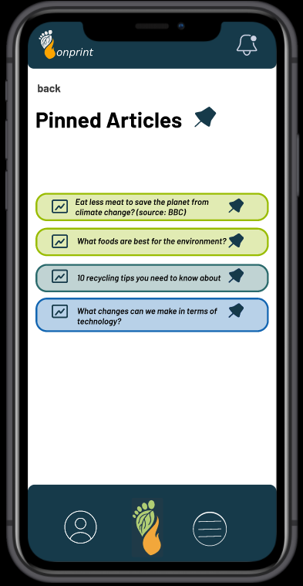

Slide 18
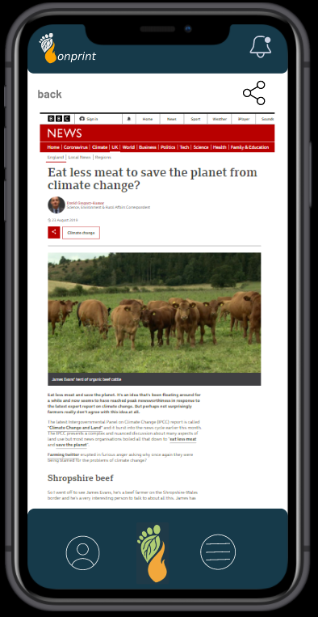

Slide 19
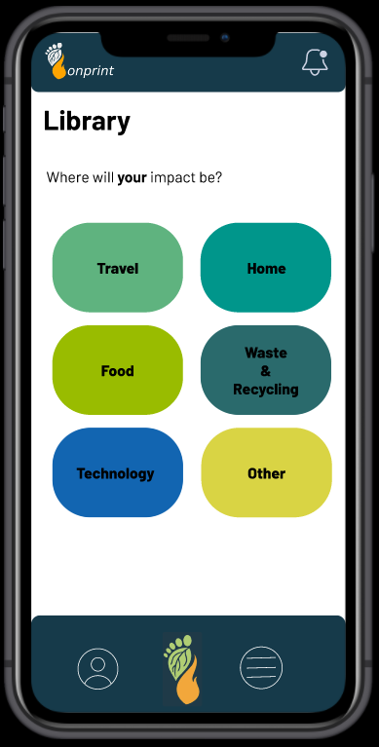

Slide 20
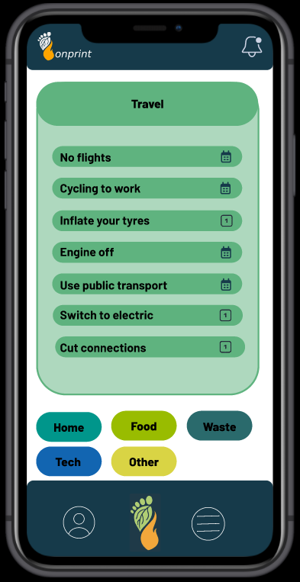

Slide 21
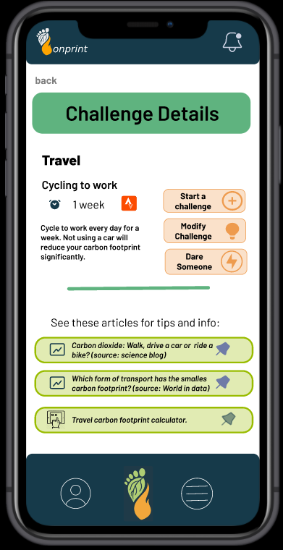

Slide 22
The App
b
onprint
Key features
Main feed of engagement with chats, news and search/browse.
Create new challenges and customisation of challenges.
Participate in group challenges or be dared to attempt a challenge!
Notifications pages for new challenges and progress report.
Profile page for the user.
Future additions
An interactive rating system to suggest changes to companies.
Corporate showcase of current and future climate-friendly activities.
Incorporate employee rewards.
Integration with other apps such as step counter or cycling routes (encouraging better health!)
Awareness raising of ethical brands.
Focus on accessible climate strategies with emerging technologies.
Notes:
In the future, we will implement a forum upvote page to lobby changes to senior management.
Once this is implemented, this app can revitalise how we enact change at a personal level to corporate level. Allowing for the voice of the small to be heard and giving power to those that want to act now against climate change and reduction of carbon footprint.
http://accessibleclimate.com/basics-of-accessible-climate-mitigation/

