Slide 1
Event-driven architecture for a 12-factor app
How the event-driven architecture fits into the “Backing services”, “Processes” and “Disposability” factors

Slide 2
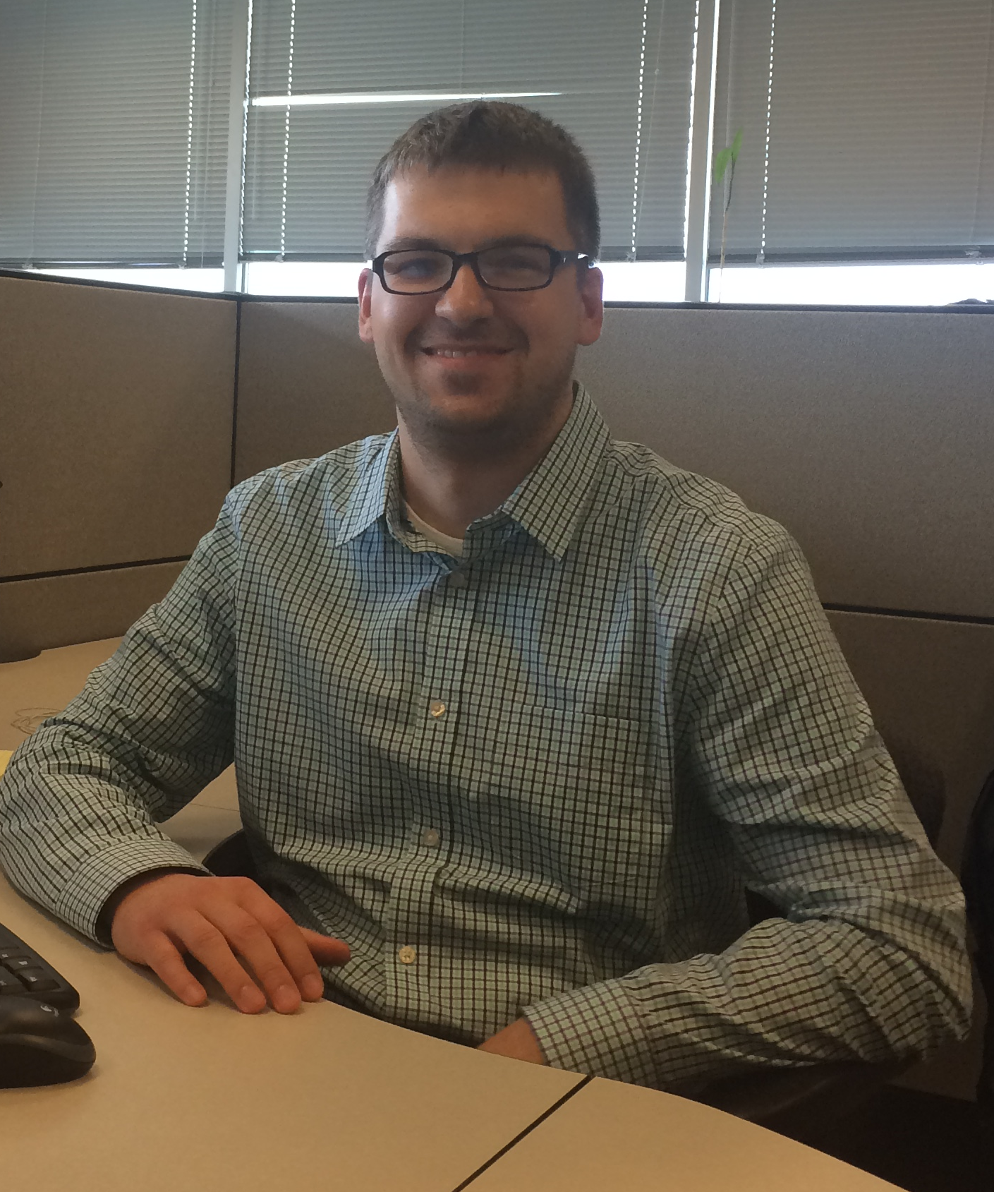
Dmitrii Sosedov Nice to meet you!
Husband
Father
Software engineer
Bookworm
LinkedIn: https://www.linkedin.com/in/dsosedov
GitHub: https://github.com/dsosedov
Web site: http://dmitrii.sosedov.org

Slide 3
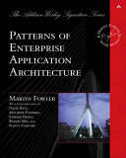
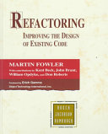
The Twelve-Factor App
Source: https://12factor.net
I. Codebase
One codebase tracked in revision control, many deploys
II. Dependencies
Explicitly declare and isolate dependencies
III. Config
Store config in the environment
IV. Backing services
Treat backing services as attached resources
V. Build, release, run
Strictly separate build and run stages
VI. Processes
Execute the app as one or more stateless processes
VII. Port binding
Export services via port binding
VIII. Concurrency
Scale out via the process model
IX. Disposability
Maximize robustness with fast startup and graceful shutdown
X. Dev/prod parity
Keep development, staging, and production as similar as possible
XI. Logs
Treat logs as event streams
XII. Admin processes
Run admin/management tasks as one-off processes

Slide 4
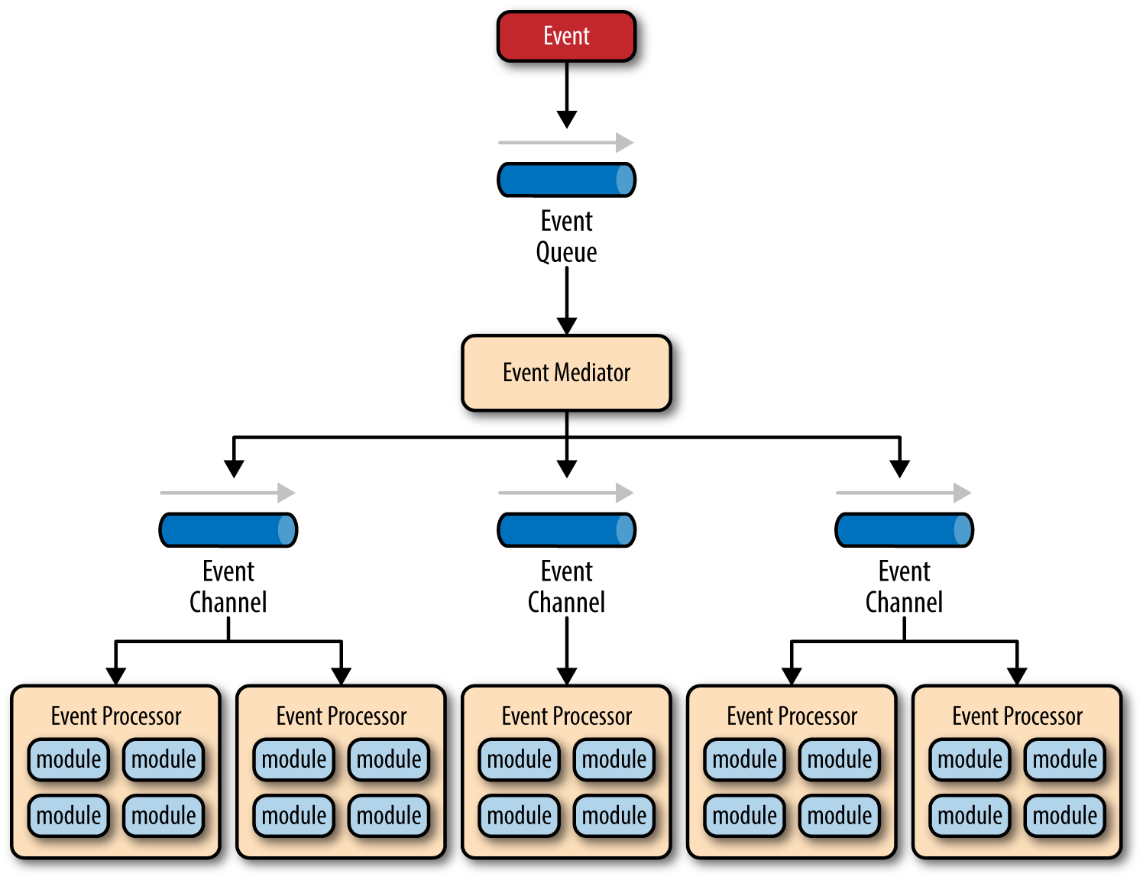
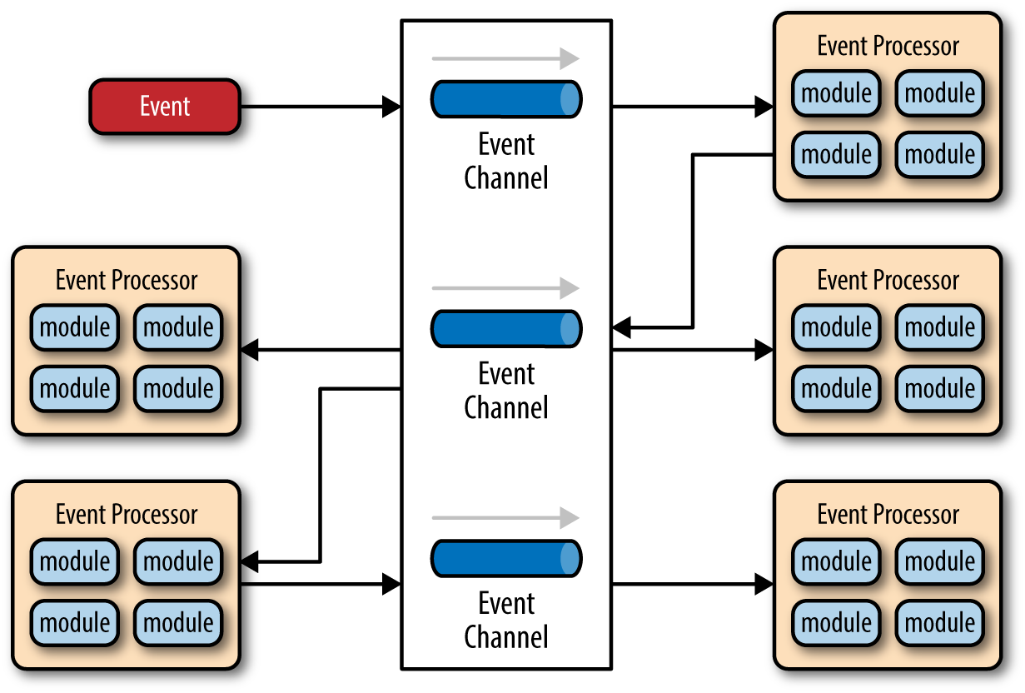
The event-driven architecture
The event-driven architecture is made up of highly decoupled, single-purpose event processing components that asynchronously receive and process events.
Mediator Topology
Broker Topology

Slide 5
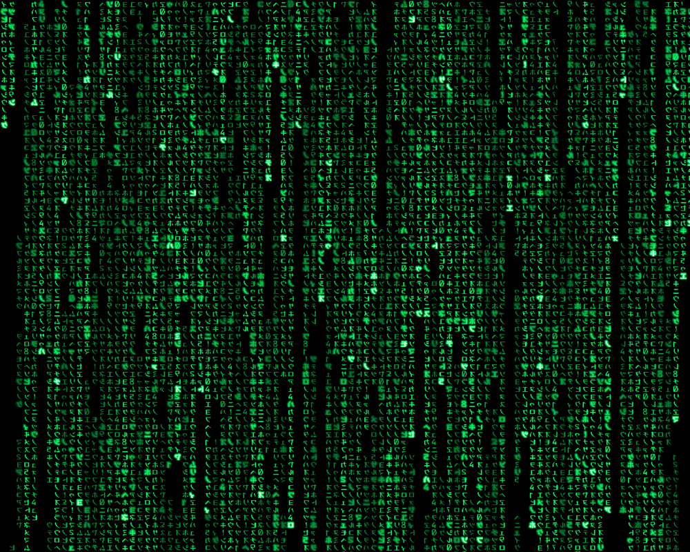
Demo! Wake up, Neo…

Slide 6
Event-driven arch meets 12-factor app
By following the distributed asynchronous architecture pattern, we turn a legacy set of services into a highly scalable and robust SaaS solution.
Sync app
Async app
Tight coupling
Some processes have multiple reasons to change
Resources cannot be detached
High chances for data to get out of sync
Stopping a resource must be planned
Loose coupling
Each process has one and only one reason to change
Resources can be detached
Low chances for data to get out of sync
A resource can stop at any given point

Slide 7

The deck and the sample app source code are available at https://github.com/dsosedov/event-driven-arch-demo

Slide 8

Questions?
Feel free to ask!

