Slide 1

James Thomas DSouza

Slide 2
Brief Synopsis
The challenge is to build a virtual wallet service. This service can be used by gaming companies to manage players account balances including virtual currencies.
The following AWS services could be leveraged to demonstrate the system:
1. Amazon API Gateway
2. AWS Lambda
3. Amazon Quantum Ledger Database (QLDB)
4. Amazon Kinesis Data Streams
5. Amazon DynamoDB

Slide 3
Problem Being Solved
At the very least, our wallet service must implement the following APIs: AddFunds, WithdrawFunds, GetFunds, GetTransactionHistory and CreateWallet
1. CreateAccount – lets user create a unique account in wallet
2. AddFunds – lets user add money to the wallet account
3. WithdrawFunds – lets user withdraw money from the wallet account
4. GetFunds – lets user know the balance in the wallet account
5. GetTransactionHistory - display the list of all transactions associated with the wallet account

Slide 4
Technology/Tool/Stack
The following AWS services could be leveraged to demonstrate the system:
1. Amazon API Gateway
2. AWS Lambda
3. Amazon Quantum Ledger Database (QLDB)
4. Amazon Kinesis Data Streams
5. Amazon DynamoDB
6. HTML / CSS / AngularJS / Postman

Slide 5
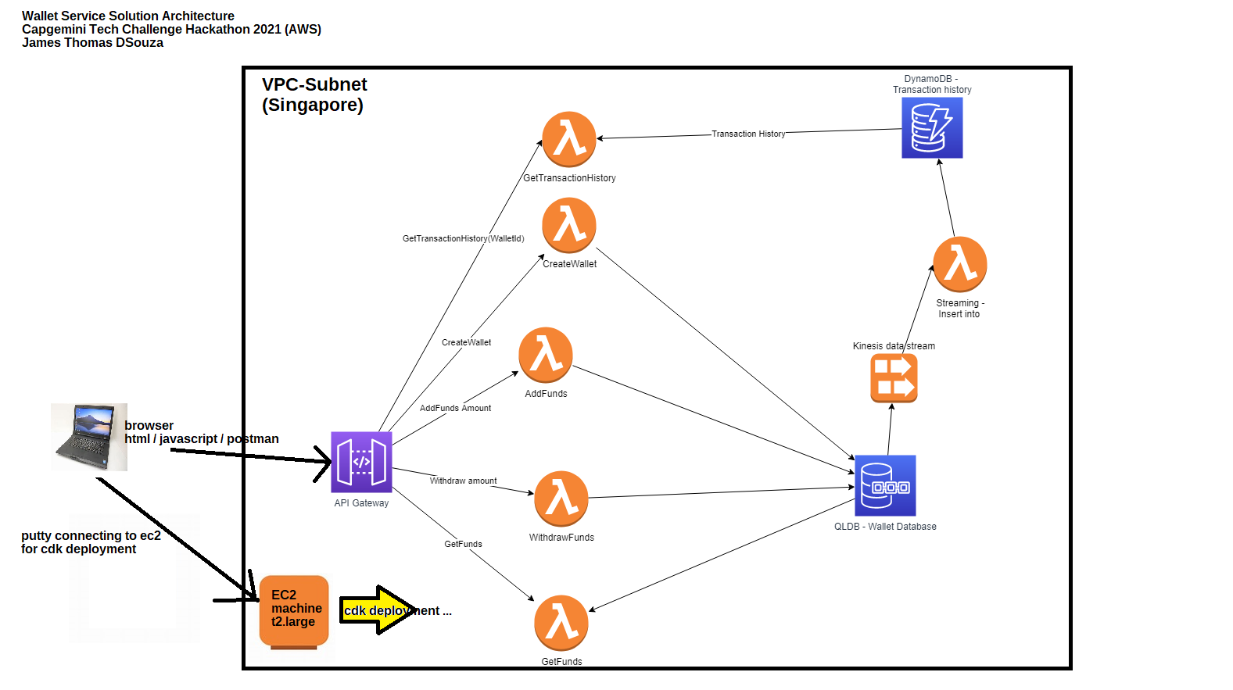
Solution Architecture

Slide 6
Prototype/ MVP Demo Video/Screenshots
The demo can be found at the following link: https://www.youtube.com/watch?v=Os56B-0cOC4

Slide 7
Challenges Faced
Initially we downloaded the CDK (Cloud Development Kit) stack on localbox, to create the wallet service architecture components on AWS cloud. But I realized that lot of softwares were required to make the CDK work
I installed GIT, Python3.8, Docker, NPM (NodeJS), AWS CDK, CDK Python Library , putty on localbox
But then once CDK started working, it was trying to upload atleast 500 MB size data which took lot of time
If there was any error post deployment, the whole process had to be repeated from local box again
This technique used 3 to 4 hours, per deployment cycle
To solve this problem, I created a EC2 Linux t2.large machine on AWS and carried out the deployment process
The deployment time was reduced drastically to less than an hour
Such change in solution gave us more productive time to test the actual architecture on AWS and resolve all pressing technical problems

Slide 8
Future enhancements
1
User registration
We can create a User registration service to control who can use the Wallet service
Account numbers can be autogenerated instead of user typing it
Admin panel
2
An Administrator user can receive and address all issues reported by the user

Slide 9
Thank You

