Slide 1
How to be the Best Student
By:
Ryan D’souza

Slide 2
Creating our Populations
Two groups
Good Students: Grades “A” or “B”
Bad Students: Grades “D” or “F”

Slide 3
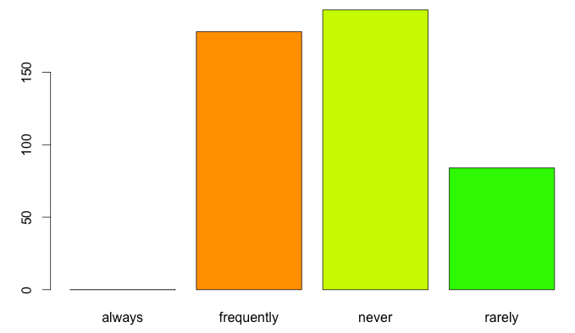
Good Students Usually Ask Questions

Slide 4
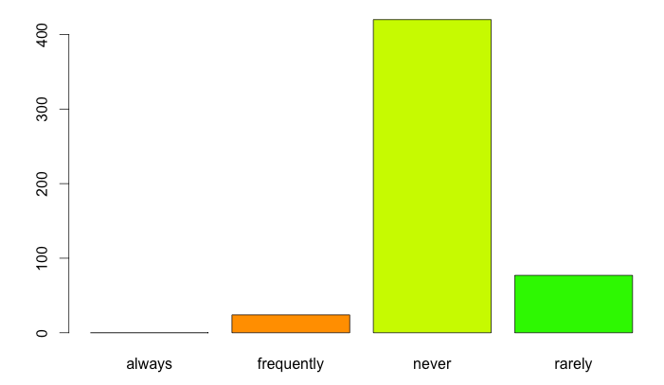
Bad Students Never Ask Questions

Slide 5
We Need To Transform Our Data
Change our categorical values into numeric ones
“Always” and “Yes”: 0
“Frequently”: 1
“Sometimes”: 2
“Rarely”: 3
“Never” or “No”: 4

Slide 6
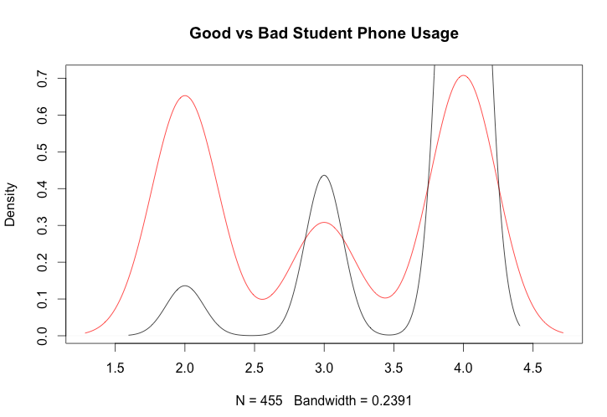
Good Students Don’t Use Phones

Slide 7
Performing a t-test reveals
Hypothesis: Good students ask more questions
Alternative Hypothesis: Good students do not ask more questions
P-value: 0.2232
We fail to reject the null hypothesis
Good students do not necessarily ask more questions

Slide 8
Another t-test
Hypothesis: Good students use their phones less in class than bad students
Alternative Hypothesis: Good students do not use their phones less in class than bad students
P-value: 2.2 X 10^-16
We reject the null hypothesis
Good students use their phones less in class than bad students

