Slide 1
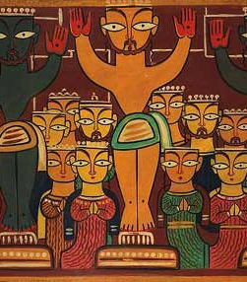
Issues and Challenges of Christians in India.
February 18, 2019

Slide 2
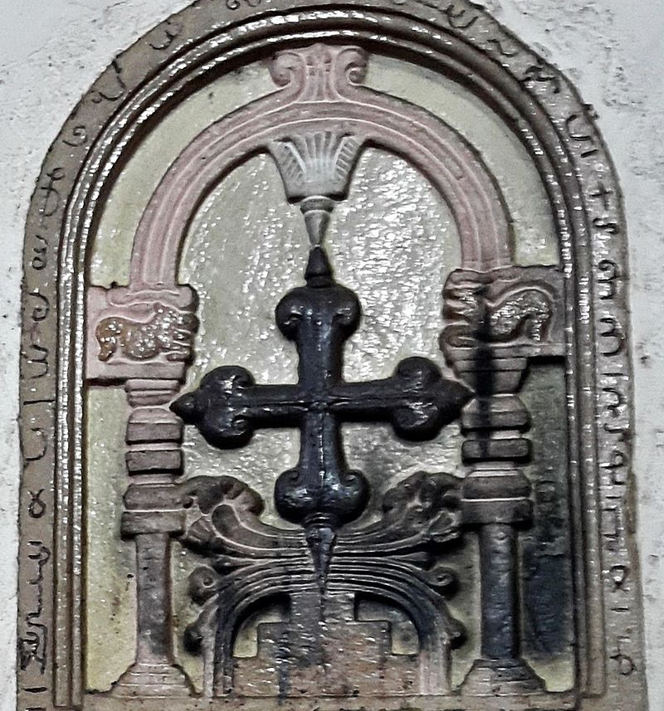
Christianity is India’s third most followed religion – Census of 2011
Approximately 2.78 crores constituting 2.3 percent of India's population
The number is on the way down, not up—from 2.6 % in 1971 to 2.34 in 1991, 2.3 % in 2001
It is traditionally believed that Christianity was introduced to India by Thomas the Apostle, who supposedly landed in Kerala in 52 AD
Exact origins of Christianity in India remain unclear - general scholarly consensus that Christianity was rooted in India by the 3rd century AD, including some communities who used Syriac liturgically
It is possible that the religion's existence extends as far back as the purported time of St. Thomas's arrival

Slide 3
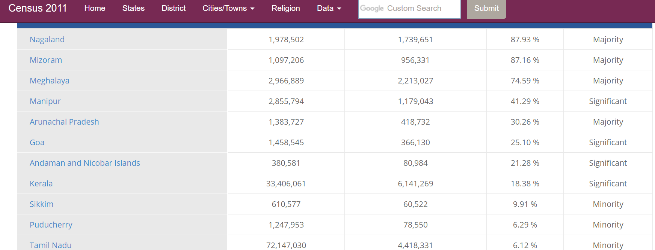
Christian Religion Census 2011

Slide 4
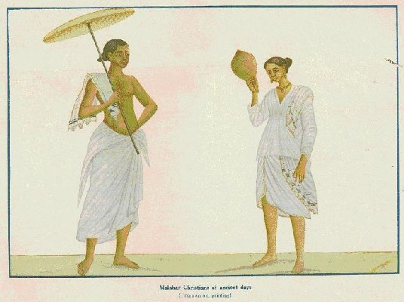
Various denominations...

Slide 5
2.96 % | 1.12 Crores

Slide 6
This is not to say that literature on Christianity as such is completely unavailable or very meagre.
However, accounts are scattered, their quality varies and they do not give us a general perspective on Christianity in India because their focus is usually more fixed and concentrated on a particular small region or a specific group.
We would get a glimpse of the many ‘Christianities’ in India!
Writing on Christianity in India suffered from enormous neglect.
It is not scholarship on Christianity alone that has faced neglect. This neglect has extended to the study of all non-Hindu communities (for want of a better term at this moment) in India.

Slide 7
What material was available often lacked richness and depth and, sometimes, analytical rigour.
This assertion of an indigeneous Aryan identity forms the root of the notion that only the Hindu Arya is indigeneous to India.
Christians, like Muslims are alien, since they cannot prove that India is either punyabhumi (sacred territory) or their pitrbhumi (land of the ancestors). This view confounds biological descent and conversion to another religion (from outside India) and bases itself on the absurd assertion of straight biological descent from the people of early times. It disregards entirely the fact that Christians or Muslims lay rightful claim to Indian ancestry.

Slide 8
The Hindutva ideologue, however, would argue that though Indian civilization has taken in and given shelter to many alien elements, these remain foreign to the land (‘descendents/sons of Babar remember?’) and are here at the sufferance (if not the mercy) of the descendants of the ancient ‘Hindus’.
Though the minorities have been given rights and safeguards against discrimination, we find that there are legal inconsistencies in the Constitution itself. There are certain Constitutional definitions and provisions that act in a discriminatory manner towards minorities.

Slide 9
Thus, while Hinduism received attention in the sociology of religion in India, this was not the case with the other communities, their religious practices and their social organization.
The tools for the analysis of these communities have not been sufficiently developed to take account of the complexity of issues relating to the practice of religion in India. View, for example, the inadequacy of the sociology of the relation between text and practice.
One of the problematics in the study of Christianity or Islam in India became that of seeing the variation between text and practice, but the text was seen here as something that was in no need of here, universal.

Slide 10
An elite and priestly understanding of the text was privileged.
All everyday practices of Christians and Muslims, therefore, that did not fit the universal textual and tradition were views as deviant.
The framework of the ideal versus the deviant dominated, the studies for a long time.
It is interesting, though perhaps not inexplicable, that interest in many minority groups in India – Muslims, Christians, Sikhs – has developed in relation to their importance vis-à-vis Hindu society, usually due to conflict.

Slide 11
Hence, studies of Muslims mostly figured in the area of politics, partition and communalism.
As we have seen, when ethnographic studies began these emphasized caste using the syncretic model to synthesize Muslims with ‘Hindu’ India and simply ignored what was specifically Islamic about them, because this was non-Indian, universal and could, anyway, be studies elsewhere.
It was not unique to the east and could not constitute the ‘essence’ of India.

Slide 12
Conversion is an issue fraught with all sorts of difficulties. For one, the assimilative model used to study Hinduism pre-empts any efforts to analyse reconversion movements or to understand the ways in which Hinduism ‘converts’ and to compare and contrast it with models of conversion from other traditions.
The idea that certain religions such as Islam and Christianity have an internal drive to convert also prevents us from understanding the historical circumstances of conversion, the various different strategies the historical circumstances of conversion, the various different strategies adopted and the ways in which religion articulates with power in certain regimes, which cannot be replicated elsewhere.

Slide 13
The Indian census collapses Christians into a single, undifferentiated category, but they belong to distinct persuasions, churches and sects.
A church is ‘an institutionalized organization of people who share common religious beliefs and practices.
A church has a stable membership and formal bureaucratic structure with trained clergy and other officials’ (D’souza 1993: 15).
A sect, on the other hand, is defined as a small group that has ‘broken away from a parent church often with a call for a return to the old ways’.

Slide 14
A third type of organization is cultic.
A cult is the most loosely organized and temporary of these religious groups: it generally forms itself around a charismatic leader who calls for a completely new and distinctive life style.

Slide 15
Catholics form the largest Christian group in India, nearly half of the total population. Another 40 per cent are Protestants, while 7 per cent are Orthodox Christians and 6 pre cent belong to indigenous sects.
What are the more clear marks of distinction between these various groups? Catholics regard the Pope as the supreme head in all religious affairs and are organized according to a well-defined hierarchy.
Protestantism includes many distinct denomination and churches.
Orthodox groups, such as the Syrian Christians, are affiliated to one of the Orthodox churches of eastern Europe or west Asia or to churches dependent on these.

Slide 16
Most Indian indigenous sects arose through separation from mother churches in the west, through separation from mother churches in the west, though some have broken away from Orthodox churches.
As we examine in the text, while the popular image of Christians as descendants of low-caste, low-status converts stretches reality, it is true that over half of all Christians are from the Untouchable castes. There are 15 to 20 per cent tribal in origin, while the upper caste Christians, largely from Kerala and the Konkan coast, constitute a quarter of the total (Tharamangalam 1996)

Slide 17
They are considerably represented in the priesthood and exercise an influence and authority far in excess of their numbers.
There would be great differences between them and, for instance, the Santal converts of eastern India.

Slide 18
Christianity is often associated in the popular imagination with British colonial rule and the process of westernization. But its appearance in India, preceded the British by several hundred years.
Indeed, one might say that Christianity in India is as old as the faith itself.
Historians agree that there was a Christian community in Kerala in the first century A.D.
Though it maintained links with Chaldea or Persia, it remained relatively isolated from western Christianity at least till the sixteenth century. Kerala Christianity was linked to west Asia, not western Europe.

Slide 19
Apart from being interesting in itself, this rich complexity described in the preceding paragraphs seriously subverts all academic (and indeed, political) efforts to unify the Christians as ‘community’, ‘minority’ and the like. It also raises a host of questions, which I would argue are best addressed in a comparative mode.

Slide 20
Most of these were Catholic communities and there were Orthodox Christians as well, as in Kerala, but the Protestants had not until they made any great efforts at conversion in this region.
Chaplains had, of course, been around, but they were there mainly to serve officers and men of the Company.
The first organized Protestant mission in the south was launched in 1706 at Tranquebar by two German Luteheran pastors, Ziengebalg and Pluetschau.
They had come to Tranquebar in order to ‘address “pagans” and “moors” with the protestant message and were the first Europeans sent to India for that express purpose’.
They succeeded, if in a small way, helped no doubt by the fact of learning and using Tamil and even translating the Bible in that language.

Slide 21
On the whole though, individual conversions were few in this entire period. By far the most intriguing effort was made in Tamil Nadu by the Jesuit Robert Nobili, who explicitly attempted to enter into dialogue with Brahmanical Hinduism. Nobili adopted the attire, diet and lifestyle of a Brahman sannyasi (renouncer). He studied Tamil and Sanskrit sacred scriptures and entered into discussions with Madurai’s priests.
His converts were high caste men who individually affirmed their belief in Christ.

Slide 22
It was only at the end of the eighteenth century, during the period of the spread and consolidation of British rule, that the north of the country witnessed a significant growth in Christian mission activity.
A few efforts predated that period and there were small groups of converts here and there
The mid-eighteenth century conversions to Catholicism in Bettiah, where the local ruler patronized the mission, is an interesting case.
In the north-eastern region, where Protestantism dominates, Christianity is largely the product of nineteenth and twentieth century conversions.

Slide 23
The British period also saw a number of individual conversions, one of the more interesting and well-known being that the Pandita Ramabai of Maharashtra.
There were others. Among them were the conversions of Narayan Vaman Tilak, Krupabai Satthianadhan, Nehemiah Gore, Madhusudan Dutt, Cornelia Sorabji, Kali Charan Chatterjee and Gopi Nath Nundi.

Slide 24
In terms of social background, there were certain similarities between these individuals drawn to the Christian faith out of deep convictions and a re-orientation of their inner selves.
They belonged in general to the urban literate higher caste groups.
Educated and discerning, some of them contributed to the making of Indian Christian theological discourses.
It would be to easy, however, to argue that all individual conversions came from among the upper castes based in cities or towns.

Slide 25
This would simplify a more complex reality. There were others, from more humble backgrounds, who were also drawn to Christianity through considerable internal negotiation. In this connection we have the interesting cases of the Isafaqirs in Uttar Pradesh and the Sabarkantha bhagats of Gujarat.

Slide 26
The sociology of conversion in India has not yet been written, through limited efforts in this direction have been made.
Not only has Christianity come to India at different points of time and from different regions of the world, it has made its impact through a variety of means and approaches.
India has been witness to Christianity as a religion of conquest (in Goa), Christianity as the religion of groups that negotiated their status through political alliances with local rules (Syrian Christianity) and Christianity brought by missionaries with only the indirect and not always unequivocal support of colonial authorities (as in parts of British India)

Slide 27
The greater stress on the use of force and disprivileges seen in Goa may be compared and contrasted with Nobili’s conscious efforts to forge linkages with Brahmanic tradition in Tamil Nadu and the contradictory position of particular missionary groups in central India, who combined a certain paternalistic attitude towards their congregations with a participation in idioms of domination characterizing the colonial cultural construction of the Other.

Slide 28
The early missionaries such as the Catholics of the sixteenth century, came with ideas of hierarchy influenced by the ‘estate’ order of their own society.
Their attitude to ‘casta’, as the Portuguese were to name it, was one of much greater tolerance.
Nineteenth century missionaries coming out of Europe (or America) in which the ideas of ‘equality’ and ‘individuality’ had come to prevail, viewed the disabilities of caste with much more horror.
With their male dominated authority structures and patri-centric notions, the different churches sometimes clashed with more equitable tribal customs.

