Slide 1
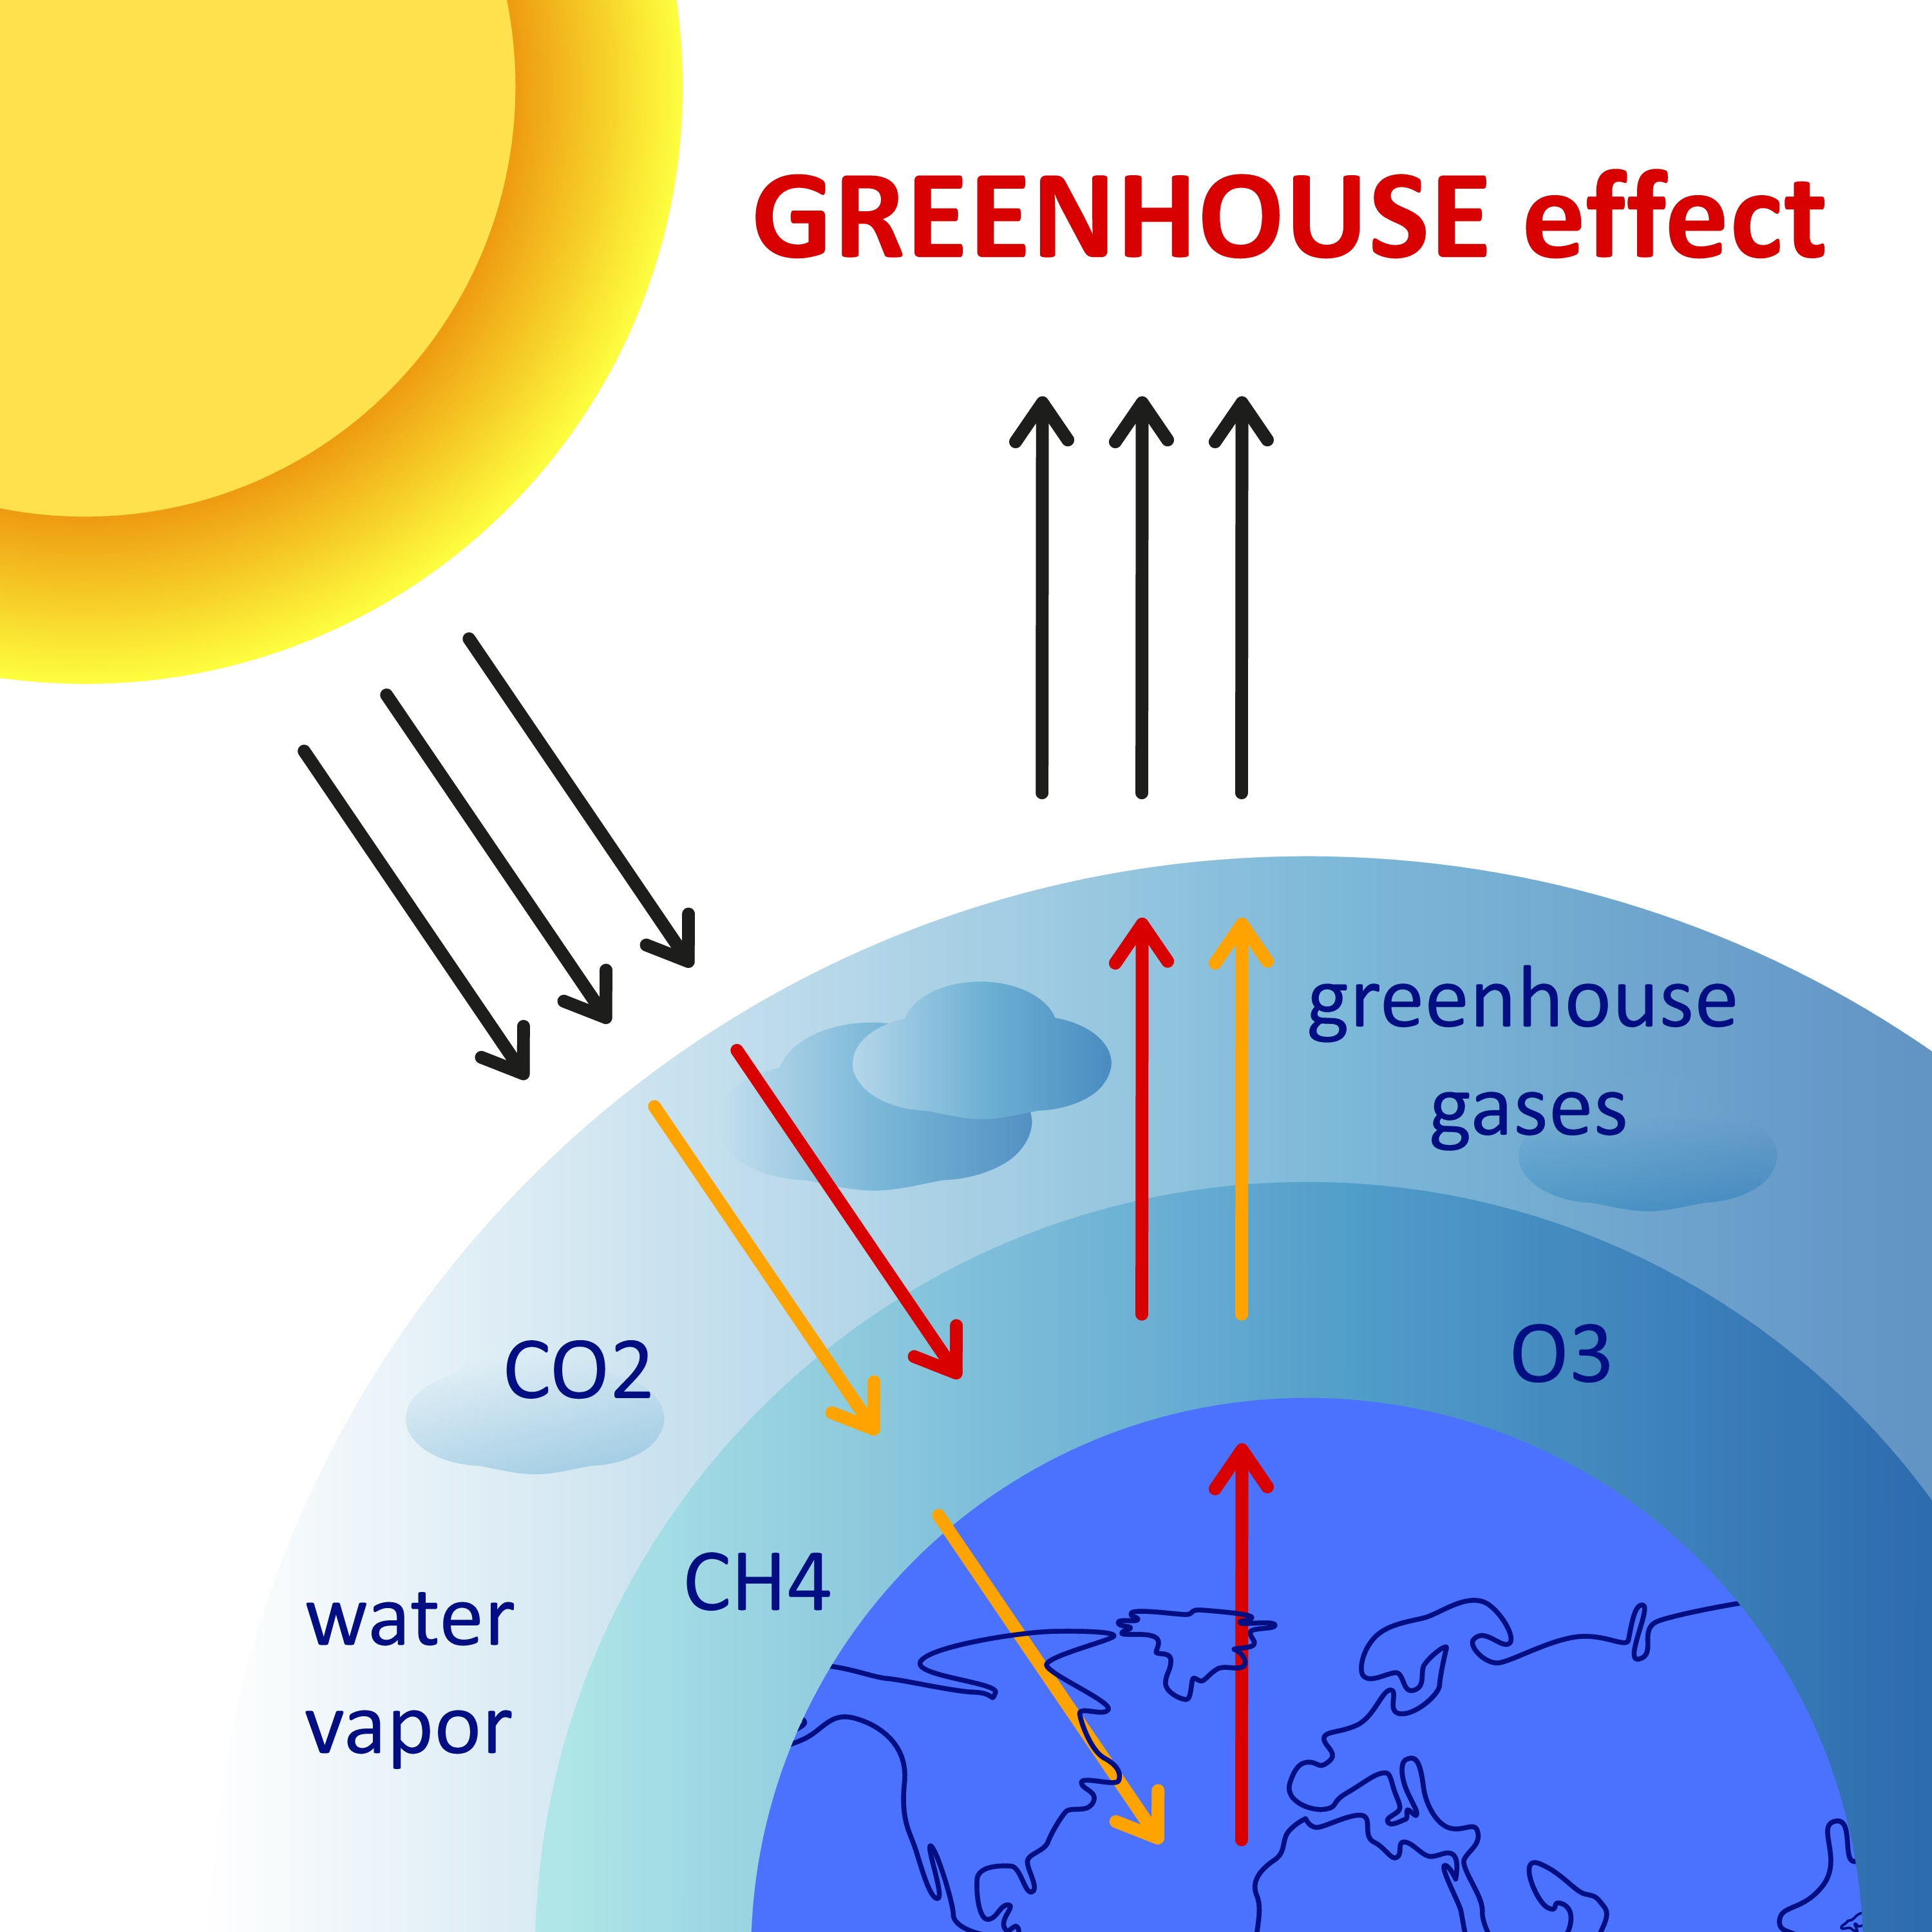
CLIMATE CHANGE ANALYSIS REPORT
How Climate Change
Affects the World
We Live In
“If you really think that the environment is less important than the economy, try holding your breath while you count your money.”
— Guy McPherson

Slide 2
OVERVIEW
A Planet Out of Balance
Climate change is a real, long-term shift in Earth's weather patterns that we are already witnessing today. Observations from ground, air, and space show clear indicators of change — rising sea levels, warming oceans, and more severe extreme weather. These shifts are primarily driven by human activities, especially the burning of fossil fuels.
CO₂
+°C
Rising atmospheric concentration
Annual temperature change
+mm
↓ %
Sea level rise per year
Declining global forest cover
Four indicators tell the story: emissions, temperature, sea level, and forests — each moving in the wrong direction.
OVERVIEW
2 / 12

Slide 3
OVERVIEW
Rising CO₂ Levels Are Driving Temperature Increases
Atmospheric CO₂ concentration and global mean temperature change move in lockstep over time.
THE KEY INSIGHT
Two curves, one cause.
The tight correlation between atmospheric CO₂ and global temperature is the clearest fingerprint of human-driven climate change.
98% likelihood that at least one of the next five years will be the warmest on record.
OVERVIEW
3 / 12

Slide 4
OVERVIEW
Three Trends Moving In The Same Direction
Sea Levels Rising
Forests Declining
Disasters Increasing
Mean sea level continues to climb consistently year after year, driven by thermal expansion and melting ice.
Global forest area as a share of total land has fallen steadily — a critical loss of natural carbon sinks.
Climate-related disasters are becoming more frequent, affecting an exceptionally large number of people.
mm change
% of land
events/yr
OVERVIEW
4 / 12

Slide 5
PART 1
Emissions &
Temperature Dynamics
How fossil fuel emissions are warming the planet

Slide 6
EMISSIONS
CO₂ Emissions Worsen Each Year
Fossil fuels account for 90% of all CO₂ emissions — the central driver of modern climate change.
ANNUAL CO₂ EMISSIONS
LEADING CAUSES OF EMISSIONS
Fossil fuels alone account for ~90% of CO₂ emissions — the single largest lever for action.
EMISSIONS & TEMPERATURE
6 / 12

Slide 7
EMISSIONS
Higher CO₂, Higher Temperatures
A clear positive relationship between atmospheric emissions and global temperature change.
THE GREENHOUSE EFFECT
In Action
Fossil fuel emissions act like a “blanket” in our atmosphere. They allow sunlight to enter — but prevent heat from escaping back into space, artificially warming the planet.
Atmospheric emissions are the primary driver of rising global temperatures.
EMISSIONS & TEMPERATURE
7 / 12

Slide 8
EMISSIONS
Wealthier Countries Produce Most of the CO₂
Cumulative responsibility is heavily concentrated — a handful of high-income economies drive the bulk of historic emissions.
UNEQUAL CONTRIBUTION
Top 10
emitters generate the majority of global CO₂ each year.
Yet climate impacts fall hardest on developing nations and rural communities that contribute least to the problem.
EMISSIONS & TEMPERATURE
8 / 12

Slide 9
FORESTS
Our Vanishing Natural Defenses
Forests are the planet's most powerful natural carbon sink — but they are shrinking, and increasingly burning.
33%
30%
80%
1.6B
of Earth's land is covered by forest
of human carbon emissions absorbed by forests
of land-based species supported by forests
people whose lives depend on forests
FROM CARBON SINK TO CARBON SOURCE
FOREST FIRES OVER TIME
When forests burn, they release stored carbon — risking a shift from absorber to emitter.
Increases in forest fires have reduced forest area and converted what was once humanity's strongest natural defense into a new source of emissions.
FORESTS
9 / 12

Slide 10
CLIMATE IMPACT
The Human Toll
Climate-related disasters have affected an exceptionally large number of people — and the burden is not evenly distributed.
TOTAL AFFECTED
CLIMATE-RELATED DISASTERS BY YEAR
4.2B+
people impacted by climate-related disasters in recent decades
Floods impact more people worldwide than any other disaster — and flash floods are expected to grow as temperatures rise.
Climate hazards are concentrated in developing countries — rural, agriculture-dependent communities are most vulnerable.
CLIMATE IMPACT
10 / 12

Slide 11
CALL TO ACTION
Adapt Now — Or Pay Later
The cost of action today is roughly one-tenth the cost of inaction tomorrow.
ACT NOW
PAY LATER
$80B
$800B
vs.
per year
per year
Invested in mitigation: reducing emissions, restoring forests, building climate resilience.
Cost of inaction: disaster response, displacement, agricultural loss, infrastructure damage.
CALL TO ACTION
11 / 12

Slide 12
CALL TO ACTION
The Path Forward
A roadmap to climate stability — three levers, applied together.
01
02
03
Reduce Emissions
Restore Forests
Build Resilience
Cut reliance on fossil fuels. They account for ~90% of CO₂ — the largest single lever for slowing warming.
Forests already absorb roughly 30% of human carbon emissions. Protecting and replanting them strengthens our natural defense.
Protect the most vulnerable communities — especially rural, agriculture-dependent populations in developing regions.
If we all do our part to reduce emissions and restore forests, we can still reduce the devastating impact of climate-related disasters.

